Slide 1
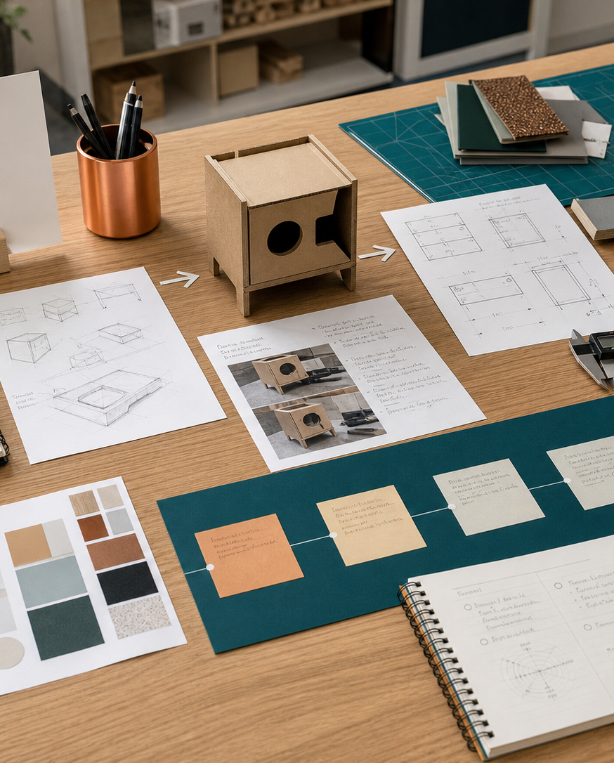
MODULE 05
Communicating research and design knowledge
Choose communication methods for purpose and audience, use command verbs accurately and complete the Research Assignment with evidence.
Research Assignment completion · P5.2 · P5.3 · P1.1 · P2.2
FORMATIVE LEARNING DECK
01
Notes:
Teaching focus: Establish the purpose of Communicating research and design knowledge.
Talking points
- Choose communication methods for purpose and audience, use command verbs accurately and complete the Research Assignment with evidence.
- Name the three learning areas without teaching them yet: Communication methods and audience; Command verbs and evidence-based responses; Research Assignment synthesis.
- Explain that this deck supports classroom learning and formative evidence. Current teacher directions and formal notices remain authoritative.
Transition: Move from the module purpose to the three-part learning map.
[Sources]
- NESA Design and Technology Stage 6 Syllabus (2013), official course authority
- Current Year 11 site source register and source-bound module data
- Visual: approved family-generated teaching asset, Year 12 D&T assets/images/course-hero.png
[/Sources]

Slide 2
YEAR 11 DESIGN & TECHNOLOGY · MODULE 05
Three ideas build one evidence pathway
APPLY + KEEP EVIDENCE
Rehearse and improve a parent-night presentation using source evidence, audience needs and command-verb accuracy.
Year 11 Preliminary · Term 1 · Weeks 9–10
02
Notes:
Teaching focus: Preview the three named ideas as a connected sequence.
Talking points
- 1. Communication methods and audience: Select and combine written, graphical, verbal, physical and digital methods for a defined audience.
- 2. Command verbs and evidence-based responses: Respond directly to identify, outline, describe, explain, compare, justify, analyse and evaluate.
- 3. Research Assignment synthesis: Combine design profession, designer, innovation, settings and impacts into a clear source-based presentation.
- Retrieval prompt: Which idea is most likely to change a real design decision in Research Assignment completion, and why?
Transition: Begin with Communication methods and audience.
[Sources]
- NESA Design and Technology Stage 6 Syllabus (2013), official course authority
- Current Year 11 site source register and source-bound module data
- Visual: current Year 11 local teaching asset assets/module-05-map.svg
[/Sources]

Slide 3

YEAR 11 DESIGN & TECHNOLOGY · MODULE 05
Communication methods and audience
Communication choices should respond to audience knowledge, purpose, context and access needs.
Annotated sketches combine visual form with information about dimensions, materials, function and decisions.
Models and prototypes communicate scale, form and interaction but may need labels or explanation to prevent misinterpretation.
LOOK FOR · KEY RELATIONSHIPS AND EVIDENCE
EVIDENCE PROMPT · A designer must explain a proposed kitchen accessory to a parent audience and a manufacturer. What is the best approach?
Year 11 Preliminary · Term 1 · Weeks 9–10
03
Notes:
Teaching focus: Select and combine written, graphical, verbal, physical and digital methods for a defined audience.
Talking points
- Communication choices should respond to audience knowledge, purpose, context and access needs.
- Annotated sketches combine visual form with information about dimensions, materials, function and decisions.
- Models and prototypes communicate scale, form and interaction but may need labels or explanation to prevent misinterpretation.
- Digital presentations should use clear hierarchy, readable graphics, source acknowledgement and restrained detail.
- Visual notice: Ask students what the scene makes visible about communication methods and audience, then connect observations to the stated principles.
- Evidence prompt: A designer must explain a proposed kitchen accessory to a parent audience and a manufacturer. What is the best approach?
Likely misconceptions
- The most visually impressive communication method is always best.
- Technical drawings are suitable for every audience without explanation.
- A model communicates every production detail automatically.
Transition: Move to Command verbs and evidence-based responses.
[Sources]
- Y11 source note: NESA communication content; current Research Assignment presentation expectations; teacher answer booklet on annotated sketches.
- Visual: approved family-generated teaching asset, Year 12 D&T assets/images/m10s01.png
[/Sources]

Slide 4
YEAR 11 DESIGN & TECHNOLOGY · MODULE 05
Command verbs and evidence-based responses
Respond directly to identify, outline, describe, explain, compare, justify, analyse and evaluate.
IDENTIFY
EXPLAIN
JUSTIFY
Identify or list requires relevant points without unnecessary explanation.
Explain requires a clear relationship, reason or cause-and-effect link.
Justify requires a defensible choice supported by evidence and context.
EVIDENCE PROMPT · A question asks students to justify the selection of plywood for a prototype. Which response is strongest?
Year 11 Preliminary · Term 1 · Weeks 9–10
04
Notes:
Teaching focus: Respond directly to identify, outline, describe, explain, compare, justify, analyse and evaluate.
Talking points
- Identify or list requires relevant points without unnecessary explanation.
- Explain requires a clear relationship, reason or cause-and-effect link.
- Justify requires a defensible choice supported by evidence and context.
- Analyse and evaluate require connected reasoning, implications and, for evaluation, a supported judgement.
- Diagram notice: Trace IDENTIFY → EXPLAIN → JUSTIFY and ask where evidence changes the next decision.
- Evidence prompt: A question asks students to justify the selection of plywood for a prototype. Which response is strongest?
Likely misconceptions
- Every command verb can be answered with a detailed description.
- Justify means state that a choice is best.
- Analyse means list positive and negative points.
Transition: Move to Research Assignment synthesis.
[Sources]
- Y11 source note: Teacher answer booklet command-verb guidance and marking reminders.
- Visual: editable native PowerPoint relationship diagram derived only from the three source-bound section principles
[/Sources]

Slide 5
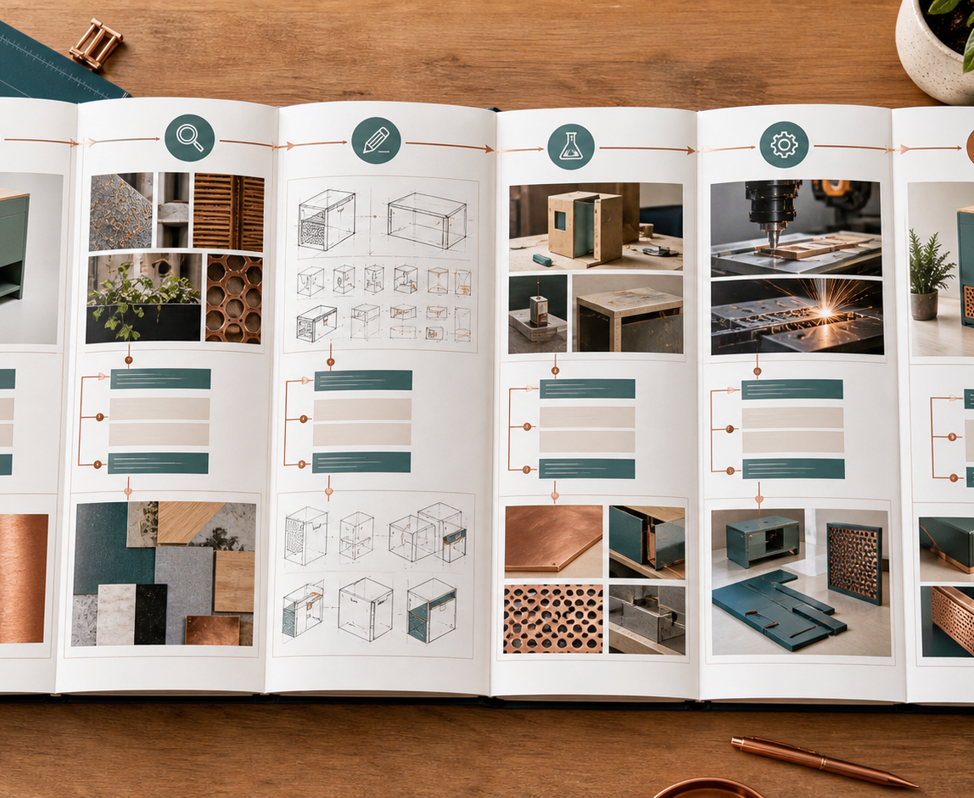
YEAR 11 DESIGN & TECHNOLOGY · MODULE 05
Research Assignment synthesis
The selected profession should be described through its purpose, work practices, tools, technologies and outputs.
The Australian designer and invention should be supported by reliable and acknowledged sources.
The presentation should identify the relevant domestic, community, industrial or commercial setting and explain why it applies.
LOOK FOR · KEY RELATIONSHIPS AND EVIDENCE
EVIDENCE PROMPT · A student has strong information but the presentation jumps between profession, invention and impacts. What should be improved?
Year 11 Preliminary · Term 1 · Weeks 9–10
05
Notes:
Teaching focus: Combine design profession, designer, innovation, settings and impacts into a clear source-based presentation.
Talking points
- The selected profession should be described through its purpose, work practices, tools, technologies and outputs.
- The Australian designer and invention should be supported by reliable and acknowledged sources.
- The presentation should identify the relevant domestic, community, industrial or commercial setting and explain why it applies.
- Impact analysis should connect evidence to individuals, society and the environment, including limitations or trade-offs where relevant.
- Visual notice: Ask students what the scene makes visible about research assignment synthesis, then connect observations to the stated principles.
- Evidence prompt: A student has strong information but the presentation jumps between profession, invention and impacts. What should be improved?
Likely misconceptions
- A design profession can be explained by listing university courses and salary estimates.
- The designer’s nationality is sufficient evidence for the Australian-designer requirement.
- The setting is determined by where the product is used rather than how design and production occur.
Transition: Move from teaching into retrieval across all three ideas.
[Sources]
- Y11 source note: Current 2026 Preliminary Research Assignment task notification.
- Visual: approved family-generated teaching asset, Year 12 D&T assets/images/m10s03.png
[/Sources]

Slide 6
YEAR 11 DESIGN & TECHNOLOGY · MODULE 05
Retrieve first; then check and improve
Answer without notes. Use one precise sentence for each check.
01
A designer must explain a proposed kitchen accessory to a parent audience and a manufacturer. What is the best approach?
A calm checking cycle
1 Recall from memory
02
A question asks students to justify the selection of plywood for a prototype. Which response is strongest?
2 Check the matching section
3 Repair the reason, not just the word
03
A student has strong information but the presentation jumps between profession, invention and impacts. What should be improved?
4 Try the question again
Year 11 Preliminary · Term 1 · Weeks 9–10
06
Notes:
Teaching focus: Use retrieval to expose and repair reasoning gaps across all three sections.
Talking points
- Give quiet recall time before inviting answers.
- Check 1: A designer must explain a proposed kitchen accessory to a parent audience and a manufacturer. What is the best approach?
- Indicative answer: Use a clear visual explanation and benefits for parents, then provide dimensioned technical information and production details for the manufacturer.
- Check 2: A question asks students to justify the selection of plywood for a prototype. Which response is strongest?
- Indicative answer: Select plywood and link its verified properties, workability, availability and cost to the prototype’s requirements and available processes.
- Check 3: A student has strong information but the presentation jumps between profession, invention and impacts. What should be improved?
- Indicative answer: Use a logical through-line: introduce the field and profession, examine the designer’s process and invention, identify its setting, then analyse impacts.
- Ask students to explain why the answer is defensible before they return to notes.
Transition: Use the retrieved ideas to construct one sustained piece of evidence.
[Sources]
- Y11 source note: NESA communication content; current Research Assignment presentation expectations; teacher answer booklet on annotated sketches.
- Y11 source note: Teacher answer booklet command-verb guidance and marking reminders.
- Y11 source note: Current 2026 Preliminary Research Assignment task notification.
[/Sources]

Slide 7
YEAR 11 DESIGN & TECHNOLOGY · MODULE 05
Construct evidence that makes reasoning visible
Rehearse and improve a parent-night presentation using source evidence, audience needs and command-verb accuracy.
READ
Identify the design question
SELECT
• Name the user, context or design issue.
• Select one relevant principle from this module.
• Explain how the evidence changes a decision.
• Check the decision against the need, criteria or source.
Choose relevant evidence
EXPLAIN
Connect evidence to the decision
CHECK
Test against the requirement
SENTENCE SUPPORT · The evidence shows … This matters because … Therefore I would …
Year 11 Preliminary · Term 1 · Weeks 9–10
07
Notes:
Teaching focus: Guide one higher-order formative response using all three module ideas.
Talking points
- Prompt: Rehearse and improve a parent-night presentation using source evidence, audience needs and command-verb accuracy.
- Read: identify the user, context and design question.
- Select: choose source-bound evidence rather than a preference.
- Explain: connect the evidence to a design consequence or decision.
- Check: test the response against the relevant need, criterion or source.
- Remind students that this is formative learning evidence, not a formal submission instruction.
Transition: Close by asking each student to retain the response and name the next useful action.
[Sources]
- Y11 source note: NESA communication content; current Research Assignment presentation expectations; teacher answer booklet on annotated sketches.
- Y11 source note: Teacher answer booklet command-verb guidance and marking reminders.
- Y11 source note: Current 2026 Preliminary Research Assignment task notification.
[/Sources]

Slide 8
YEAR 11 DESIGN & TECHNOLOGY · MODULE 05
Leave with evidence, not just notes
01
02
03
RECALL
APPLY
ACT
One idea I can now explain accurately
One design decision or evidence judgement I can justify
One next action for Research Assignment completion
Save a dated response in your module learning record or design folio. Follow teacher directions for any formal submission.
Year 11 Preliminary · Term 1 · Weeks 9–10
08
Notes:
Teaching focus: Make the exit ticket produce a concrete learning record and a manageable next action.
Talking points
- Ask students to complete all three prompts individually before discussion.
- Keep the record labelled formative learning evidence; do not imply a cloud submission or formal assessment requirement.
- Next action: connect the module evidence to Research Assignment completion.
Transition: End with each student's own next action, not a generic summary.
[Sources]
- Y11 source note: NESA communication content; current Research Assignment presentation expectations; teacher answer booklet on annotated sketches.
- Y11 source note: Teacher answer booklet command-verb guidance and marking reminders.
- Y11 source note: Current 2026 Preliminary Research Assignment task notification.
[/Sources]

