Slide 1
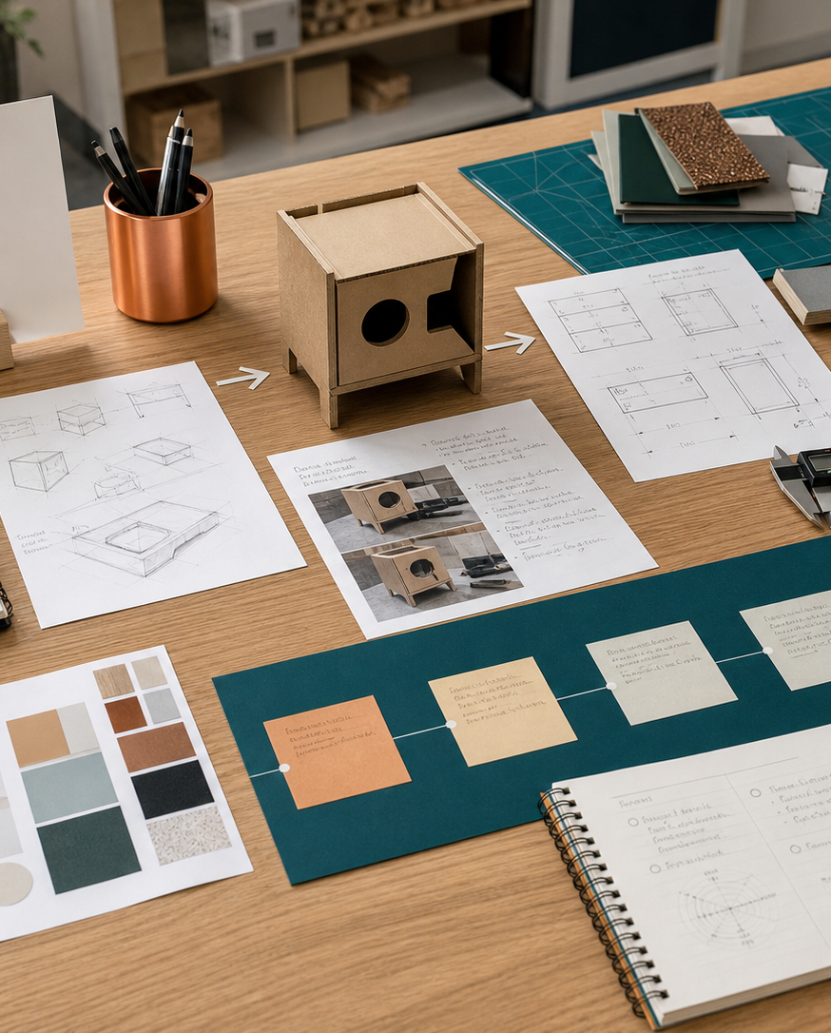
MODULE 06
Creativity and collaborative design
Generate alternatives, use cognitive organisers deliberately and collaborate through clear roles and evidence.
Kitchen Companion · P3.1 · P5.2
FORMATIVE LEARNING DECK
01
Notes:
Teaching focus: Establish the purpose of Creativity and collaborative design.
Talking points
- Generate alternatives, use cognitive organisers deliberately and collaborate through clear roles and evidence.
- Name the three learning areas without teaching them yet: Idea-generation techniques; Six Thinking Hats and collaboration; Selecting and justifying concepts.
- Explain that this deck supports classroom learning and formative evidence. Current teacher directions and formal notices remain authoritative.
Transition: Move from the module purpose to the three-part learning map.
[Sources]
- NESA Design and Technology Stage 6 Syllabus (2013), official course authority
- Current Year 11 site source register and source-bound module data
- Visual: approved family-generated teaching asset, Year 12 D&T assets/images/course-hero.png
[/Sources]

Slide 2
YEAR 11 DESIGN & TECHNOLOGY · MODULE 06
Three ideas build one evidence pathway
APPLY + KEEP EVIDENCE
Run and document a Six Thinking Hats session that produces several feasible Kitchen Companion directions.
Year 11 Preliminary · Term 2 · Weeks 11–12
02
Notes:
Teaching focus: Preview the three named ideas as a connected sequence.
Talking points
- 1. Idea-generation techniques: Use several techniques to expand, transform and organise design possibilities before selecting a concept.
- 2. Six Thinking Hats and collaboration: Use parallel-thinking roles and clear team responsibilities to improve collaborative decisions.
- 3. Selecting and justifying concepts: Compare alternatives against evidence and justify a developed design direction.
- Retrieval prompt: Which idea is most likely to change a real design decision in Kitchen Companion, and why?
Transition: Begin with Idea-generation techniques.
[Sources]
- NESA Design and Technology Stage 6 Syllabus (2013), official course authority
- Current Year 11 site source register and source-bound module data
- Visual: current Year 11 local teaching asset assets/module-06-map.svg
[/Sources]

Slide 3
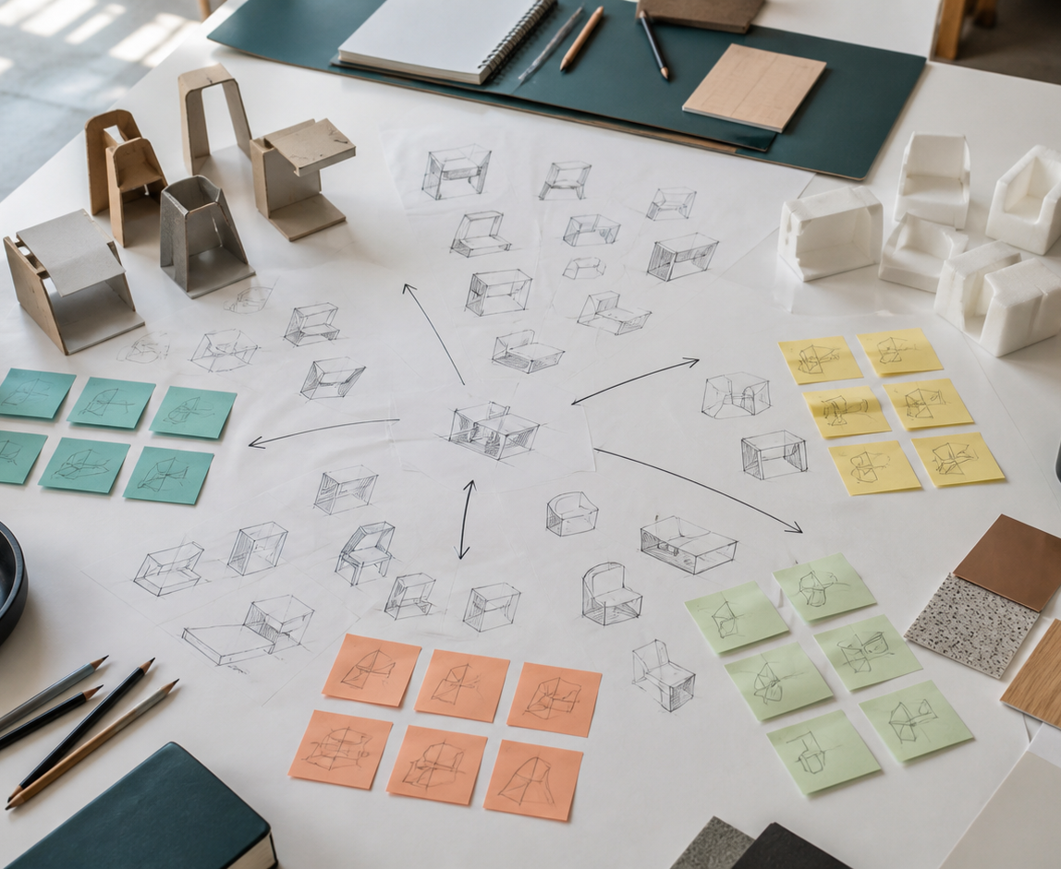
YEAR 11 DESIGN & TECHNOLOGY · MODULE 06
Idea-generation techniques
Early ideation should generate range before ideas are judged against criteria.
SCAMPER prompts a designer to substitute, combine, adapt, modify, put to another use, eliminate or rearrange features.
A morphological chart separates a problem into functions or features and recombines alternatives.
LOOK FOR · KEY RELATIONSHIPS AND EVIDENCE
EVIDENCE PROMPT · A group keeps generating variations of the same utensil holder. What is the best next action?
Year 11 Preliminary · Term 2 · Weeks 11–12
03
Notes:
Teaching focus: Use several techniques to expand, transform and organise design possibilities before selecting a concept.
Talking points
- Early ideation should generate range before ideas are judged against criteria.
- SCAMPER prompts a designer to substitute, combine, adapt, modify, put to another use, eliminate or rearrange features.
- A morphological chart separates a problem into functions or features and recombines alternatives.
- Cognitive organisers are tools for thinking; they do not replace research, testing or designer judgement.
- Visual notice: Ask students what the scene makes visible about idea-generation techniques, then connect observations to the stated principles.
- Evidence prompt: A group keeps generating variations of the same utensil holder. What is the best next action?
Likely misconceptions
- The strongest first idea should be developed immediately to save time.
- SCAMPER is a checklist used only to improve existing commercial products.
- A morphological chart ranks final concepts by cost.
Transition: Move to Six Thinking Hats and collaboration.
[Sources]
- Y11 source note: NESA creativity content; teacher answer booklet on brainstorming, mind maps and cognitive organisers.
- Visual: approved family-generated teaching asset, Year 12 D&T assets/images/m07s01.png
[/Sources]

Slide 4
YEAR 11 DESIGN & TECHNOLOGY · MODULE 06
Six Thinking Hats and collaboration
Use parallel-thinking roles and clear team responsibilities to improve collaborative decisions.
EVIDENCE
POSSIBILITIES
PROCESS
The White Hat focuses on known information, evidence gaps and facts that need verification.
The Red, Black, Yellow and Green Hats deliberately examine feelings, cautions, benefits and possibilities.
The Blue Hat manages the process, roles, sequence and decision record.
EVIDENCE PROMPT · During a Six Hats session, the group jumps between facts, objections and ideas and no decision is recorded. What should the Blue Hat do?
Year 11 Preliminary · Term 2 · Weeks 11–12
04
Notes:
Teaching focus: Use parallel-thinking roles and clear team responsibilities to improve collaborative decisions.
Talking points
- The White Hat focuses on known information, evidence gaps and facts that need verification.
- The Red, Black, Yellow and Green Hats deliberately examine feelings, cautions, benefits and possibilities.
- The Blue Hat manages the process, roles, sequence and decision record.
- A useful session records contributions and shows how the team used them to develop or select concepts.
- Diagram notice: Trace EVIDENCE → POSSIBILITIES → PROCESS and ask where evidence changes the next decision.
- Evidence prompt: During a Six Hats session, the group jumps between facts, objections and ideas and no decision is recorded. What should the Blue Hat do?
Likely misconceptions
- Each person should permanently represent the hat that matches their personality.
- The Black Hat should stop risky or difficult ideas from being considered.
- The Green Hat is used only to add decorative features.
Transition: Move to Selecting and justifying concepts.
[Sources]
- Y11 source note: Current Kitchen Companion brief and its required Six Thinking Hats collaboration.
- Visual: editable native PowerPoint relationship diagram derived only from the three source-bound section principles
[/Sources]

Slide 5

YEAR 11 DESIGN & TECHNOLOGY · MODULE 06
Selecting and justifying concepts
Criteria should come from the brief, research, users, safety, resources and intended performance.
A weighted decision matrix can organise comparison but the weighting and scores still require justification.
A concept may be modified or combined before final selection when comparison reveals strengths worth retaining.
LOOK FOR · KEY RELATIONSHIPS AND EVIDENCE
EVIDENCE PROMPT · A concept scores highly for appearance but poorly for stability and print time. What should the team do?
Year 11 Preliminary · Term 2 · Weeks 11–12
05
Notes:
Teaching focus: Compare alternatives against evidence and justify a developed design direction.
Talking points
- Criteria should come from the brief, research, users, safety, resources and intended performance.
- A weighted decision matrix can organise comparison but the weighting and scores still require justification.
- A concept may be modified or combined before final selection when comparison reveals strengths worth retaining.
- A justification connects the selected features to evidence and acknowledges important limitations or further testing.
- Visual notice: Ask students what the scene makes visible about selecting and justifying concepts, then connect observations to the stated principles.
- Evidence prompt: A concept scores highly for appearance but poorly for stability and print time. What should the team do?
Likely misconceptions
- The concept with the highest total score is automatically the correct choice.
- Criteria should be adjusted after scoring so the preferred idea wins.
- Combining ideas shows that the original concepts were weak.
Transition: Move from teaching into retrieval across all three ideas.
[Sources]
- Y11 source note: NESA creativity and design-process content; Kitchen Companion concept-selection context.
- Visual: approved family-generated teaching asset, Year 12 D&T assets/images/m07s03.png
[/Sources]

Slide 6
YEAR 11 DESIGN & TECHNOLOGY · MODULE 06
Retrieve first; then check and improve
Answer without notes. Use one precise sentence for each check.
01
A group keeps generating variations of the same utensil holder. What is the best next action?
A calm checking cycle
1 Recall from memory
02
During a Six Hats session, the group jumps between facts, objections and ideas and no decision is recorded. What should the Blue Hat do?
2 Check the matching section
3 Repair the reason, not just the word
03
A concept scores highly for appearance but poorly for stability and print time. What should the team do?
4 Try the question again
Year 11 Preliminary · Term 2 · Weeks 11–12
06
Notes:
Teaching focus: Use retrieval to expose and repair reasoning gaps across all three sections.
Talking points
- Give quiet recall time before inviting answers.
- Check 1: A group keeps generating variations of the same utensil holder. What is the best next action?
- Indicative answer: Change the thinking method: separate functions in a morphological chart or use SCAMPER to transform assumptions about storage, access and assembly.
- Check 2: During a Six Hats session, the group jumps between facts, objections and ideas and no decision is recorded. What should the Blue Hat do?
- Indicative answer: Set the sequence, clarify the question, allocate time, summarise evidence and record the agreed next test or decision.
- Check 3: A concept scores highly for appearance but poorly for stability and print time. What should the team do?
- Indicative answer: Review the weighting and evidence, modify or combine concepts, and select only after critical requirements such as function and safety are addressed.
- Ask students to explain why the answer is defensible before they return to notes.
Transition: Use the retrieved ideas to construct one sustained piece of evidence.
[Sources]
- Y11 source note: NESA creativity content; teacher answer booklet on brainstorming, mind maps and cognitive organisers.
- Y11 source note: Current Kitchen Companion brief and its required Six Thinking Hats collaboration.
- Y11 source note: NESA creativity and design-process content; Kitchen Companion concept-selection context.
[/Sources]

Slide 7
YEAR 11 DESIGN & TECHNOLOGY · MODULE 06
Construct evidence that makes reasoning visible
Run and document a Six Thinking Hats session that produces several feasible Kitchen Companion directions.
READ
Identify the design question
SELECT
• Name the user, context or design issue.
• Select one relevant principle from this module.
• Explain how the evidence changes a decision.
• Check the decision against the need, criteria or source.
Choose relevant evidence
EXPLAIN
Connect evidence to the decision
CHECK
Test against the requirement
SENTENCE SUPPORT · The evidence shows … This matters because … Therefore I would …
Year 11 Preliminary · Term 2 · Weeks 11–12
07
Notes:
Teaching focus: Guide one higher-order formative response using all three module ideas.
Talking points
- Prompt: Run and document a Six Thinking Hats session that produces several feasible Kitchen Companion directions.
- Read: identify the user, context and design question.
- Select: choose source-bound evidence rather than a preference.
- Explain: connect the evidence to a design consequence or decision.
- Check: test the response against the relevant need, criterion or source.
- Remind students that this is formative learning evidence, not a formal submission instruction.
Transition: Close by asking each student to retain the response and name the next useful action.
[Sources]
- Y11 source note: NESA creativity content; teacher answer booklet on brainstorming, mind maps and cognitive organisers.
- Y11 source note: Current Kitchen Companion brief and its required Six Thinking Hats collaboration.
- Y11 source note: NESA creativity and design-process content; Kitchen Companion concept-selection context.
[/Sources]

Slide 8
YEAR 11 DESIGN & TECHNOLOGY · MODULE 06
Leave with evidence, not just notes
01
02
03
RECALL
APPLY
ACT
One idea I can now explain accurately
One design decision or evidence judgement I can justify
One next action for Kitchen Companion
Save a dated response in your module learning record or design folio. Follow teacher directions for any formal submission.
Year 11 Preliminary · Term 2 · Weeks 11–12
08
Notes:
Teaching focus: Make the exit ticket produce a concrete learning record and a manageable next action.
Talking points
- Ask students to complete all three prompts individually before discussion.
- Keep the record labelled formative learning evidence; do not imply a cloud submission or formal assessment requirement.
- Next action: connect the module evidence to Kitchen Companion.
Transition: End with each student's own next action, not a generic summary.
[Sources]
- Y11 source note: NESA creativity content; teacher answer booklet on brainstorming, mind maps and cognitive organisers.
- Y11 source note: Current Kitchen Companion brief and its required Six Thinking Hats collaboration.
- Y11 source note: NESA creativity and design-process content; Kitchen Companion concept-selection context.
[/Sources]

