Slide 1
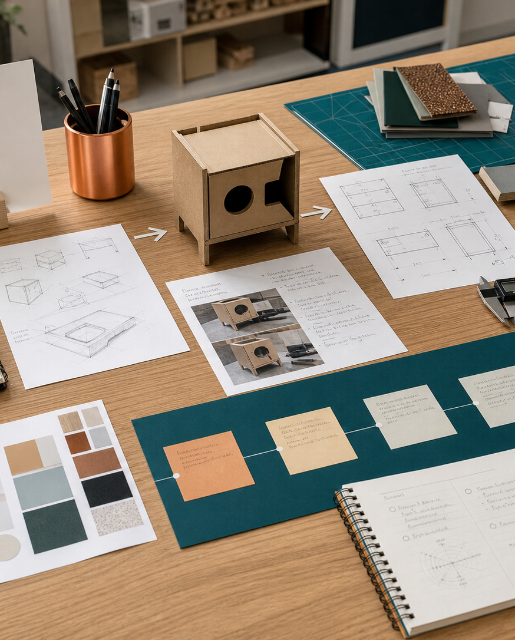
MODULE 07
Briefs, users and criteria
Translate evidence about users and contexts into a clear brief, practical boundaries and criteria that guide testing.
Kitchen Companion · P4.1 · P4.3 · P5.3
FORMATIVE LEARNING DECK
01
Notes:
Teaching focus: Establish the purpose of Briefs, users and criteria.
Talking points
- Translate evidence about users and contexts into a clear brief, practical boundaries and criteria that guide testing.
- Name the three learning areas without teaching them yet: Design situation, brief and constraints; Target market, equity and accessibility; Criteria to evaluate success.
- Explain that this deck supports classroom learning and formative evidence. Current teacher directions and formal notices remain authoritative.
Transition: Move from the module purpose to the three-part learning map.
[Sources]
- NESA Design and Technology Stage 6 Syllabus (2013), official course authority
- Current Year 11 site source register and source-bound module data
- Visual: approved family-generated teaching asset, Year 12 D&T assets/images/course-hero.png
[/Sources]

Slide 2
YEAR 11 DESIGN & TECHNOLOGY · MODULE 07
Three ideas build one evidence pathway
APPLY + KEEP EVIDENCE
Build a user-needs, constraints and criteria matrix for the Kitchen Companion design.
Year 11 Preliminary · Term 2 · Weeks 13–14
02
Notes:
Teaching focus: Preview the three named ideas as a connected sequence.
Talking points
- 1. Design situation, brief and constraints: Write a design brief that gives direction without prescribing the final solution.
- 2. Target market, equity and accessibility: Define users through relevant needs and design inclusively without relying on stereotypes.
- 3. Criteria to evaluate success: Develop measurable criteria and use them throughout design development and final evaluation.
- Retrieval prompt: Which idea is most likely to change a real design decision in Kitchen Companion, and why?
Transition: Begin with Design situation, brief and constraints.
[Sources]
- NESA Design and Technology Stage 6 Syllabus (2013), official course authority
- Current Year 11 site source register and source-bound module data
- Visual: current Year 11 local teaching asset assets/module-07-map.svg
[/Sources]

Slide 3
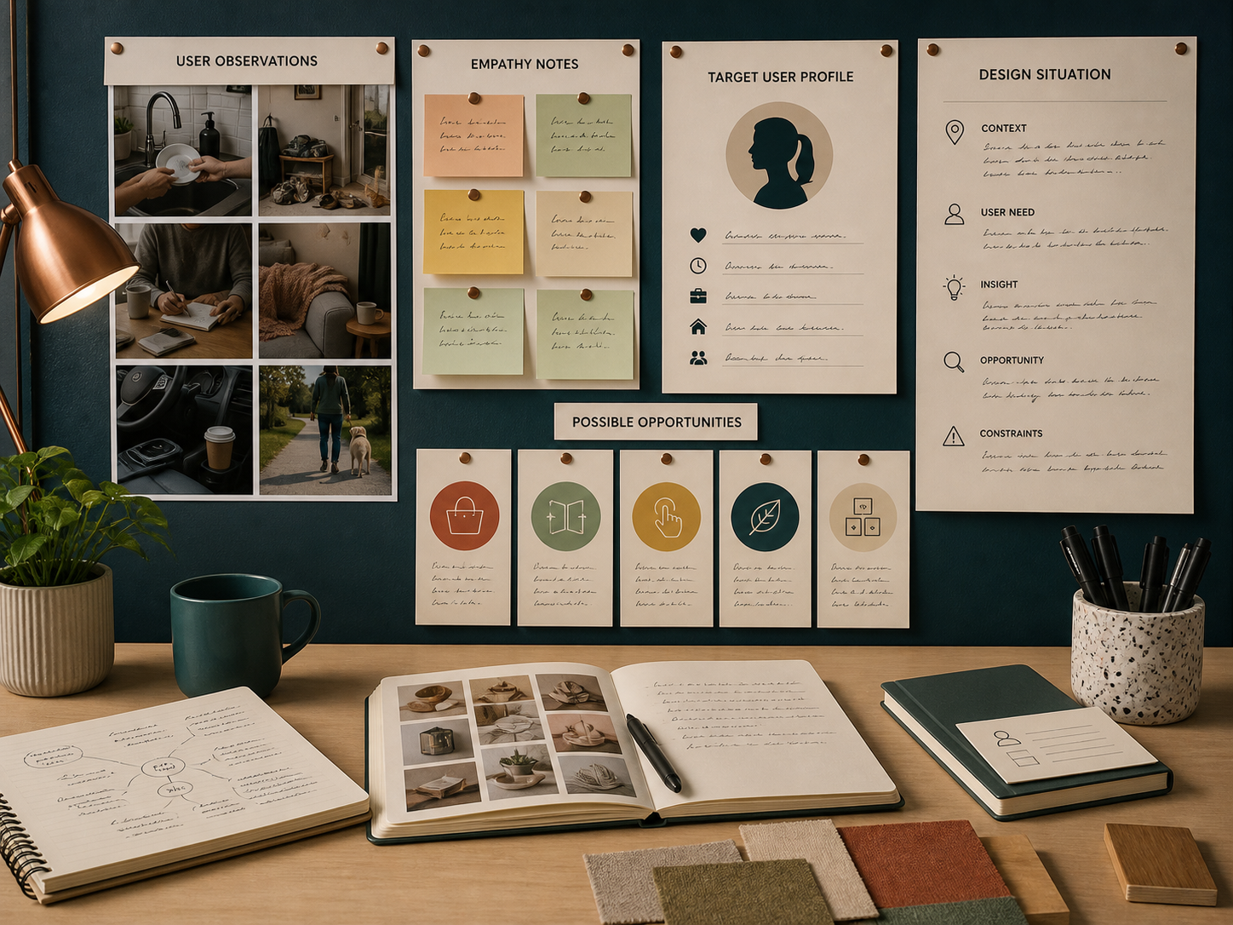
YEAR 11 DESIGN & TECHNOLOGY · MODULE 07
Design situation, brief and constraints
A useful design situation explains the context, affected users and reason a response is needed.
A useful brief identifies the intended user, need, purpose and important boundaries while leaving room for design development.
Constraints should be recorded early because they influence feasible research, ideas, materials and processes.
LOOK FOR · KEY RELATIONSHIPS AND EVIDENCE
EVIDENCE PROMPT · Which revision most improves the brief “Design a kitchen gadget”?
Year 11 Preliminary · Term 2 · Weeks 13–14
03
Notes:
Teaching focus: Write a design brief that gives direction without prescribing the final solution.
Talking points
- A useful design situation explains the context, affected users and reason a response is needed.
- A useful brief identifies the intended user, need, purpose and important boundaries while leaving room for design development.
- Constraints should be recorded early because they influence feasible research, ideas, materials and processes.
- A brief can be refined when research reveals that the original need or boundaries were inaccurate.
- Visual notice: Ask students what the scene makes visible about design situation, brief and constraints, then connect observations to the stated principles.
- Evidence prompt: Which revision most improves the brief “Design a kitchen gadget”?
Likely misconceptions
- A design brief should describe the final product in enough detail to prevent alternatives.
- Constraints are problems that good designers can ignore through creativity.
- A broad brief such as “design something useful” encourages better innovation.
Transition: Move to Target market, equity and accessibility.
[Sources]
- Y11 source note: NESA design-process content; Kitchen Companion and teacher answer booklet brief guidance.
- Visual: approved family-generated teaching asset, Year 12 D&T assets/images/m04s01.png
[/Sources]

Slide 4
YEAR 11 DESIGN & TECHNOLOGY · MODULE 07
Target market, equity and accessibility
Define users through relevant needs and design inclusively without relying on stereotypes.
ABILITY
ACCESS
EQUITY
User profiles should include relevant abilities, tasks, environment, preferences and access requirements rather than assumptions based on age or identity alone.
Inclusive design considers variation in strength, reach, vision, dexterity, cognition, language and resources where relevant.
Equity may require different support or features so users can achieve fair access rather than identical treatment.
EVIDENCE PROMPT · A kitchen accessory is intended for users with reduced grip strength. Which decision is most defensible?
Year 11 Preliminary · Term 2 · Weeks 13–14
04
Notes:
Teaching focus: Define users through relevant needs and design inclusively without relying on stereotypes.
Talking points
- User profiles should include relevant abilities, tasks, environment, preferences and access requirements rather than assumptions based on age or identity alone.
- Inclusive design considers variation in strength, reach, vision, dexterity, cognition, language and resources where relevant.
- Equity may require different support or features so users can achieve fair access rather than identical treatment.
- Direct participation by intended users can reveal barriers that designers and proxy users overlook.
- Diagram notice: Trace ABILITY → ACCESS → EQUITY and ask where evidence changes the next decision.
- Evidence prompt: A kitchen accessory is intended for users with reduced grip strength. Which decision is most defensible?
Likely misconceptions
- A target market is defined mainly by age and gender.
- Inclusive design requires one solution to work perfectly for every person.
- Equity means giving all users exactly the same experience.
Transition: Move to Criteria to evaluate success.
[Sources]
- Y11 source note: Teacher answer booklet on equity and ergonomics; NESA user and impact content.
- Visual: editable native PowerPoint relationship diagram derived only from the three source-bound section principles
[/Sources]

Slide 5
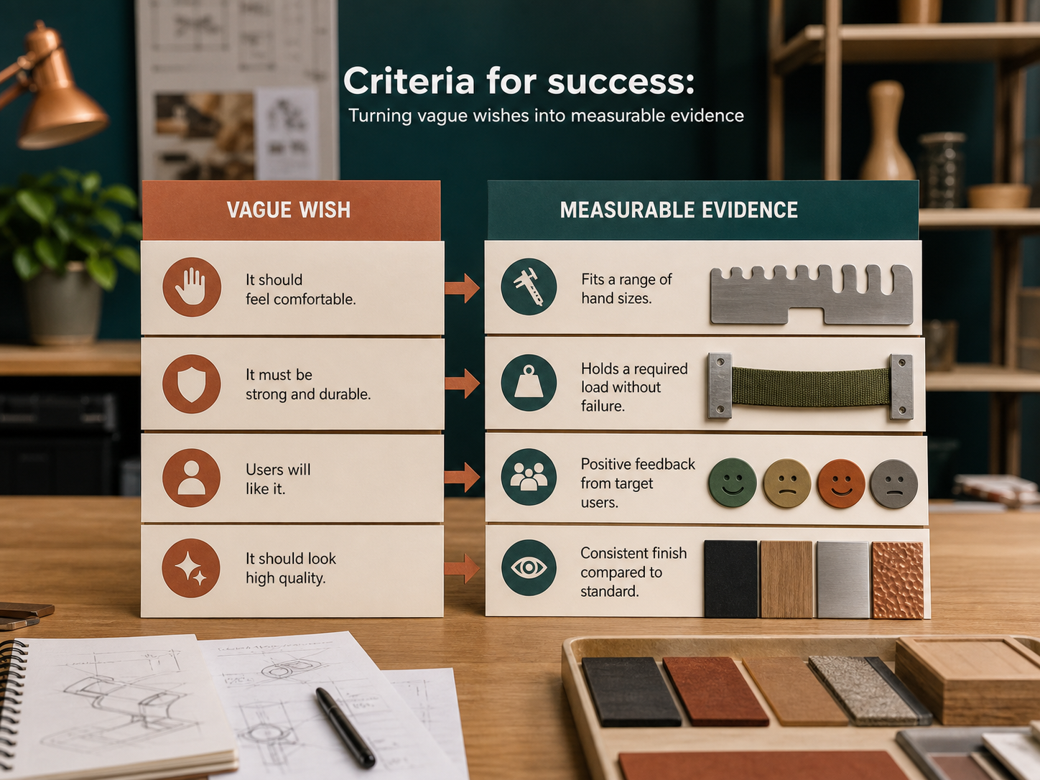
YEAR 11 DESIGN & TECHNOLOGY · MODULE 07
Criteria to evaluate success
Each criterion should state what successful performance looks like for the intended user and context.
A testing method should be planned with the criterion so evidence can be collected later.
Criteria may cover function, ergonomics, aesthetics, safety, durability, quality, size, cost and environmental performance.
LOOK FOR · KEY RELATIONSHIPS AND EVIDENCE
EVIDENCE PROMPT · Which criterion is strongest for a 3D-printed sliding component?
Year 11 Preliminary · Term 2 · Weeks 13–14
05
Notes:
Teaching focus: Develop measurable criteria and use them throughout design development and final evaluation.
Talking points
- Each criterion should state what successful performance looks like for the intended user and context.
- A testing method should be planned with the criterion so evidence can be collected later.
- Criteria may cover function, ergonomics, aesthetics, safety, durability, quality, size, cost and environmental performance.
- Criteria should be reviewed when research changes the understanding of the need, but not altered merely to make the final design appear successful.
- Visual notice: Ask students what the scene makes visible about criteria to evaluate success, then connect observations to the stated principles.
- Evidence prompt: Which criterion is strongest for a 3D-printed sliding component?
Likely misconceptions
- A criterion such as “looks good” is adequate because aesthetics is subjective.
- Testing methods should be chosen after the product is completed.
- More criteria always create a more rigorous evaluation.
Transition: Move from teaching into retrieval across all three ideas.
[Sources]
- Y11 source note: Teacher answer booklet on criteria versus constraints and continual evaluation; current project folio requirements.
- Visual: approved family-generated teaching asset, Year 12 D&T assets/images/m04s03.png
[/Sources]

Slide 6
YEAR 11 DESIGN & TECHNOLOGY · MODULE 07
Retrieve first; then check and improve
Answer without notes. Use one precise sentence for each check.
01
Which revision most improves the brief “Design a kitchen gadget”?
A calm checking cycle
1 Recall from memory
02
A kitchen accessory is intended for users with reduced grip strength. Which decision is most defensible?
2 Check the matching section
3 Repair the reason, not just the word
03
Which criterion is strongest for a 3D-printed sliding component?
4 Try the question again
Year 11 Preliminary · Term 2 · Weeks 13–14
06
Notes:
Teaching focus: Use retrieval to expose and repair reasoning gaps across all three sections.
Talking points
- Give quiet recall time before inviting answers.
- Check 1: Which revision most improves the brief “Design a kitchen gadget”?
- Indicative answer: Design a compact, 3D-printed kitchen accessory for a clearly identified user that addresses a researched problem and can be assembled without glue or screws.
- Check 2: A kitchen accessory is intended for users with reduced grip strength. Which decision is most defensible?
- Indicative answer: Research grip, reach and operating-force needs with intended users and test alternative forms under realistic tasks.
- Check 3: Which criterion is strongest for a 3D-printed sliding component?
- Indicative answer: The slider must move through its full travel ten times without binding or separating when tested after the authorised print and finishing process.
- Ask students to explain why the answer is defensible before they return to notes.
Transition: Use the retrieved ideas to construct one sustained piece of evidence.
[Sources]
- Y11 source note: NESA design-process content; Kitchen Companion and teacher answer booklet brief guidance.
- Y11 source note: Teacher answer booklet on equity and ergonomics; NESA user and impact content.
- Y11 source note: Teacher answer booklet on criteria versus constraints and continual evaluation; current project folio requirements.
[/Sources]

Slide 7
YEAR 11 DESIGN & TECHNOLOGY · MODULE 07
Construct evidence that makes reasoning visible
Build a user-needs, constraints and criteria matrix for the Kitchen Companion design.
READ
Identify the design question
SELECT
• Name the user, context or design issue.
• Select one relevant principle from this module.
• Explain how the evidence changes a decision.
• Check the decision against the need, criteria or source.
Choose relevant evidence
EXPLAIN
Connect evidence to the decision
CHECK
Test against the requirement
SENTENCE SUPPORT · The evidence shows … This matters because … Therefore I would …
Year 11 Preliminary · Term 2 · Weeks 13–14
07
Notes:
Teaching focus: Guide one higher-order formative response using all three module ideas.
Talking points
- Prompt: Build a user-needs, constraints and criteria matrix for the Kitchen Companion design.
- Read: identify the user, context and design question.
- Select: choose source-bound evidence rather than a preference.
- Explain: connect the evidence to a design consequence or decision.
- Check: test the response against the relevant need, criterion or source.
- Remind students that this is formative learning evidence, not a formal submission instruction.
Transition: Close by asking each student to retain the response and name the next useful action.
[Sources]
- Y11 source note: NESA design-process content; Kitchen Companion and teacher answer booklet brief guidance.
- Y11 source note: Teacher answer booklet on equity and ergonomics; NESA user and impact content.
- Y11 source note: Teacher answer booklet on criteria versus constraints and continual evaluation; current project folio requirements.
[/Sources]

Slide 8
YEAR 11 DESIGN & TECHNOLOGY · MODULE 07
Leave with evidence, not just notes
01
02
03
RECALL
APPLY
ACT
One idea I can now explain accurately
One design decision or evidence judgement I can justify
One next action for Kitchen Companion
Save a dated response in your module learning record or design folio. Follow teacher directions for any formal submission.
Year 11 Preliminary · Term 2 · Weeks 13–14
08
Notes:
Teaching focus: Make the exit ticket produce a concrete learning record and a manageable next action.
Talking points
- Ask students to complete all three prompts individually before discussion.
- Keep the record labelled formative learning evidence; do not imply a cloud submission or formal assessment requirement.
- Next action: connect the module evidence to Kitchen Companion.
Transition: End with each student's own next action, not a generic summary.
[Sources]
- Y11 source note: NESA design-process content; Kitchen Companion and teacher answer booklet brief guidance.
- Y11 source note: Teacher answer booklet on equity and ergonomics; NESA user and impact content.
- Y11 source note: Teacher answer booklet on criteria versus constraints and continual evaluation; current project folio requirements.
[/Sources]

