Slide 1
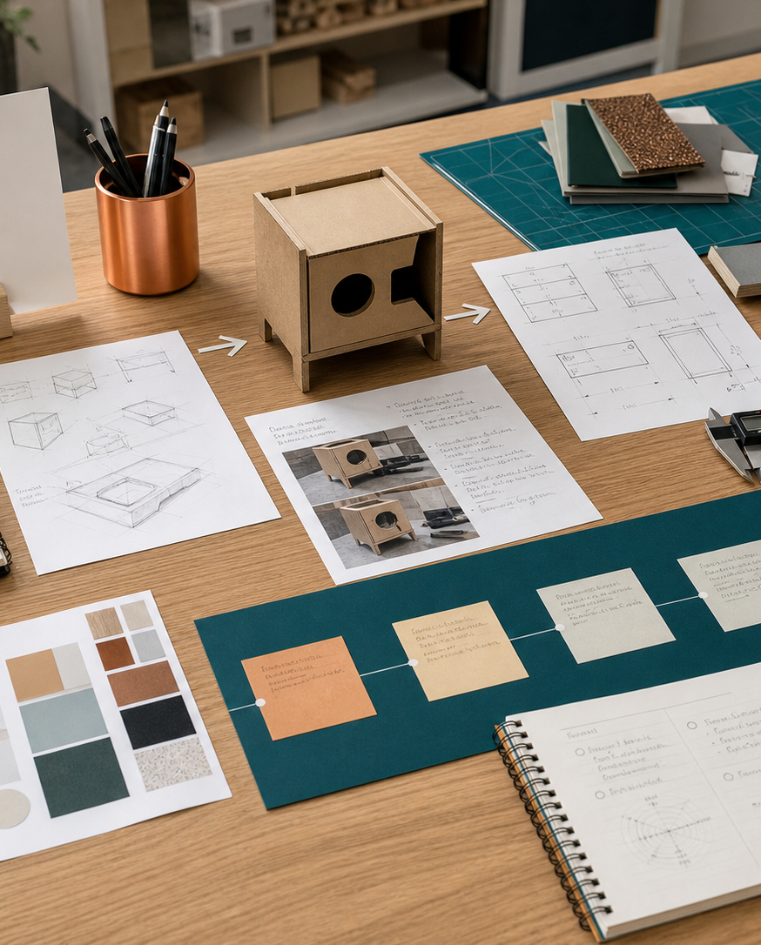
MODULE 08
Graphical and design communication
Use freehand, pictorial, orthogonal and digital communication to develop and explain ideas.
Kitchen Companion / Camping launch · P5.2 · P6.2
FORMATIVE LEARNING DECK
01
Notes:
Teaching focus: Establish the purpose of Graphical and design communication.
Talking points
- Use freehand, pictorial, orthogonal and digital communication to develop and explain ideas.
- Name the three learning areas without teaching them yet: Freehand sketching and annotation; Isometric, oblique and orthogonal drawing; Models, presentations and folio communication.
- Explain that this deck supports classroom learning and formative evidence. Current teacher directions and formal notices remain authoritative.
Transition: Move from the module purpose to the three-part learning map.
[Sources]
- NESA Design and Technology Stage 6 Syllabus (2013), official course authority
- Current Year 11 site source register and source-bound module data
- Visual: approved family-generated teaching asset, Year 12 D&T assets/images/course-hero.png
[/Sources]

Slide 2
YEAR 11 DESIGN & TECHNOLOGY · MODULE 08
Three ideas build one evidence pathway
APPLY + KEEP EVIDENCE
Produce an annotated concept sheet containing a freehand idea, a pictorial view and essential working information.
Year 11 Preliminary · Term 2 · Weeks 15–16
02
Notes:
Teaching focus: Preview the three named ideas as a connected sequence.
Talking points
- 1. Freehand sketching and annotation: Use quick, proportionate sketches to think, compare and communicate design ideas.
- 2. Isometric, oblique and orthogonal drawing: Select a drawing system that communicates form or manufacture accurately.
- 3. Models, presentations and folio communication: Use physical and digital communication to explain development, not merely display outcomes.
- Retrieval prompt: Which idea is most likely to change a real design decision in Kitchen Companion / Camping launch, and why?
Transition: Begin with Freehand sketching and annotation.
[Sources]
- NESA Design and Technology Stage 6 Syllabus (2013), official course authority
- Current Year 11 site source register and source-bound module data
- Visual: current Year 11 local teaching asset assets/module-08-map.svg
[/Sources]

Slide 3
YEAR 11 DESIGN & TECHNOLOGY · MODULE 08
Freehand sketching and annotation
Use quick, proportionate sketches to think, compare and communicate design ideas.
PROPORTION
VIEWS
ANNOTATION
Construction lines, simple forms and proportion help a designer build clear sketches without over-rendering.
Multiple views and detail sketches can expose issues hidden in a single attractive perspective.
Annotations should identify materials, dimensions, functions, joins, movement and reasons for decisions where relevant.
EVIDENCE PROMPT · A student has one polished concept image but cannot explain assembly or movement. What is the best next action?
Year 11 Preliminary · Term 2 · Weeks 15–16
03
Notes:
Teaching focus: Use quick, proportionate sketches to think, compare and communicate design ideas.
Talking points
- Construction lines, simple forms and proportion help a designer build clear sketches without over-rendering.
- Multiple views and detail sketches can expose issues hidden in a single attractive perspective.
- Annotations should identify materials, dimensions, functions, joins, movement and reasons for decisions where relevant.
- Sketch quality is judged by how effectively it develops or communicates an idea, not by artistic realism alone.
- Diagram notice: Trace PROPORTION → VIEWS → ANNOTATION and ask where evidence changes the next decision.
- Evidence prompt: A student has one polished concept image but cannot explain assembly or movement. What is the best next action?
Likely misconceptions
- Early sketches should be polished before more ideas are generated.
- One perspective view is enough to resolve a product.
- Annotations should describe only visible features.
Transition: Move to Isometric, oblique and orthogonal drawing.
[Sources]
- Y11 source note: Authorised sketching folder and teacher answer booklet on annotated sketches.
- Visual: editable native PowerPoint relationship diagram derived only from the three source-bound section principles
[/Sources]

Slide 4
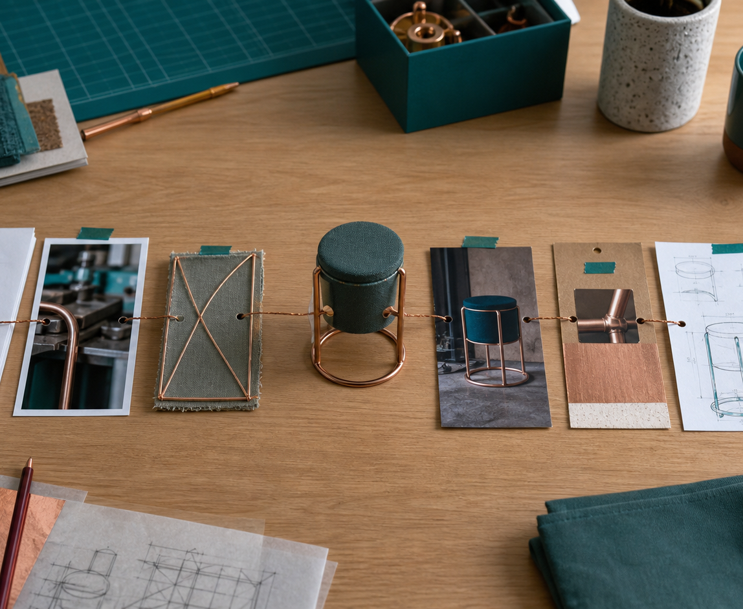
YEAR 11 DESIGN & TECHNOLOGY · MODULE 08
Isometric, oblique and orthogonal drawing
Isometric drawing is useful for communicating overall form and relationships between features.
Oblique drawing can make a complex front face easy to construct while showing depth.
Orthogonal drawings use multiple aligned views because no single view normally communicates every feature.
EVIDENCE PROMPT · A manufacturer needs exact hole positions and overall size for a component. Which communication is strongest?
LOOK FOR · KEY RELATIONSHIPS AND EVIDENCE
Year 11 Preliminary · Term 2 · Weeks 15–16
04
Notes:
Teaching focus: Select a drawing system that communicates form or manufacture accurately.
Talking points
- Isometric drawing is useful for communicating overall form and relationships between features.
- Oblique drawing can make a complex front face easy to construct while showing depth.
- Orthogonal drawings use multiple aligned views because no single view normally communicates every feature.
- Dimensions, line types, scale and view selection should provide necessary production information without duplication.
- Visual notice: Ask students what the scene makes visible about isometric, oblique and orthogonal drawing, then connect observations to the stated principles.
- Evidence prompt: A manufacturer needs exact hole positions and overall size for a component. Which communication is strongest?
Likely misconceptions
- Isometric drawings show perspective by making distant edges smaller.
- Oblique receding lines are always drawn at their full depth.
- Orthogonal projection is simply three unrelated drawings of the object.
Transition: Move to Models, presentations and folio communication.
[Sources]
- Y11 source note: Authorised Isometric and Oblique Technical Drawing PDF and Isometric Drawing Guide video in the course Drive.
- Visual: approved family-generated teaching asset, Year 12 D&T assets/images/m10s02.png
[/Sources]

Slide 5

YEAR 11 DESIGN & TECHNOLOGY · MODULE 08
Models, presentations and folio communication
Low-fidelity models can test form, size, layout and interaction before detailed resources are committed.
Digital models can be revised, measured, shared and linked to manufacturing processes, but they still require verification.
A presentation should select evidence for the audience rather than reproducing the entire folio.
LOOK FOR · KEY RELATIONSHIPS AND EVIDENCE
EVIDENCE PROMPT · A cardboard model shows that a handle blocks access to a control. What is the best folio record?
Year 11 Preliminary · Term 2 · Weeks 15–16
05
Notes:
Teaching focus: Use physical and digital communication to explain development, not merely display outcomes.
Talking points
- Low-fidelity models can test form, size, layout and interaction before detailed resources are committed.
- Digital models can be revised, measured, shared and linked to manufacturing processes, but they still require verification.
- A presentation should select evidence for the audience rather than reproducing the entire folio.
- Folio pages should label evidence and explain what it showed, what changed and why.
- Visual notice: Ask students what the scene makes visible about models, presentations and folio communication, then connect observations to the stated principles.
- Evidence prompt: A cardboard model shows that a handle blocks access to a control. What is the best folio record?
Likely misconceptions
- A model is useful only when it resembles the final product closely.
- A CAD model proves that a product can be manufactured successfully.
- A presentation is strongest when it includes every project image.
Transition: Move from teaching into retrieval across all three ideas.
[Sources]
- Y11 source note: NESA communication and computer-based technology content; current project folio requirements.
- Visual: approved family-generated teaching asset, Year 12 D&T assets/images/m12s01.png
[/Sources]

Slide 6
YEAR 11 DESIGN & TECHNOLOGY · MODULE 08
Retrieve first; then check and improve
Answer without notes. Use one precise sentence for each check.
01
A student has one polished concept image but cannot explain assembly or movement. What is the best next action?
A calm checking cycle
1 Recall from memory
02
A manufacturer needs exact hole positions and overall size for a component. Which communication is strongest?
2 Check the matching section
3 Repair the reason, not just the word
03
A cardboard model shows that a handle blocks access to a control. What is the best folio record?
4 Try the question again
Year 11 Preliminary · Term 2 · Weeks 15–16
06
Notes:
Teaching focus: Use retrieval to expose and repair reasoning gaps across all three sections.
Talking points
- Give quiet recall time before inviting answers.
- Check 1: A student has one polished concept image but cannot explain assembly or movement. What is the best next action?
- Indicative answer: Add quick alternative views, an exploded or detail sketch and annotations showing components, joins, movement and design reasoning.
- Check 2: A manufacturer needs exact hole positions and overall size for a component. Which communication is strongest?
- Indicative answer: A clear orthogonal drawing with appropriate views, line types, scale and non-duplicated dimensions.
- Check 3: A cardboard model shows that a handle blocks access to a control. What is the best folio record?
- Indicative answer: Include the model evidence, explain the observed conflict, show the revised idea and identify the next test.
- Ask students to explain why the answer is defensible before they return to notes.
Transition: Use the retrieved ideas to construct one sustained piece of evidence.
[Sources]
- Y11 source note: Authorised sketching folder and teacher answer booklet on annotated sketches.
- Y11 source note: Authorised Isometric and Oblique Technical Drawing PDF and Isometric Drawing Guide video in the course Drive.
- Y11 source note: NESA communication and computer-based technology content; current project folio requirements.
[/Sources]

Slide 7
YEAR 11 DESIGN & TECHNOLOGY · MODULE 08
Construct evidence that makes reasoning visible
Produce an annotated concept sheet containing a freehand idea, a pictorial view and essential working information.
READ
Identify the design question
SELECT
• Name the user, context or design issue.
• Select one relevant principle from this module.
• Explain how the evidence changes a decision.
• Check the decision against the need, criteria or source.
Choose relevant evidence
EXPLAIN
Connect evidence to the decision
CHECK
Test against the requirement
SENTENCE SUPPORT · The evidence shows … This matters because … Therefore I would …
Year 11 Preliminary · Term 2 · Weeks 15–16
07
Notes:
Teaching focus: Guide one higher-order formative response using all three module ideas.
Talking points
- Prompt: Produce an annotated concept sheet containing a freehand idea, a pictorial view and essential working information.
- Read: identify the user, context and design question.
- Select: choose source-bound evidence rather than a preference.
- Explain: connect the evidence to a design consequence or decision.
- Check: test the response against the relevant need, criterion or source.
- Remind students that this is formative learning evidence, not a formal submission instruction.
Transition: Close by asking each student to retain the response and name the next useful action.
[Sources]
- Y11 source note: Authorised sketching folder and teacher answer booklet on annotated sketches.
- Y11 source note: Authorised Isometric and Oblique Technical Drawing PDF and Isometric Drawing Guide video in the course Drive.
- Y11 source note: NESA communication and computer-based technology content; current project folio requirements.
[/Sources]

Slide 8
YEAR 11 DESIGN & TECHNOLOGY · MODULE 08
Leave with evidence, not just notes
01
02
03
RECALL
APPLY
ACT
One idea I can now explain accurately
One design decision or evidence judgement I can justify
One next action for Kitchen Companion / Camping launch
Save a dated response in your module learning record or design folio. Follow teacher directions for any formal submission.
Year 11 Preliminary · Term 2 · Weeks 15–16
08
Notes:
Teaching focus: Make the exit ticket produce a concrete learning record and a manageable next action.
Talking points
- Ask students to complete all three prompts individually before discussion.
- Keep the record labelled formative learning evidence; do not imply a cloud submission or formal assessment requirement.
- Next action: connect the module evidence to Kitchen Companion / Camping launch.
Transition: End with each student's own next action, not a generic summary.
[Sources]
- Y11 source note: Authorised sketching folder and teacher answer booklet on annotated sketches.
- Y11 source note: Authorised Isometric and Oblique Technical Drawing PDF and Isometric Drawing Guide video in the course Drive.
- Y11 source note: NESA communication and computer-based technology content; current project folio requirements.
[/Sources]

