Slide 1
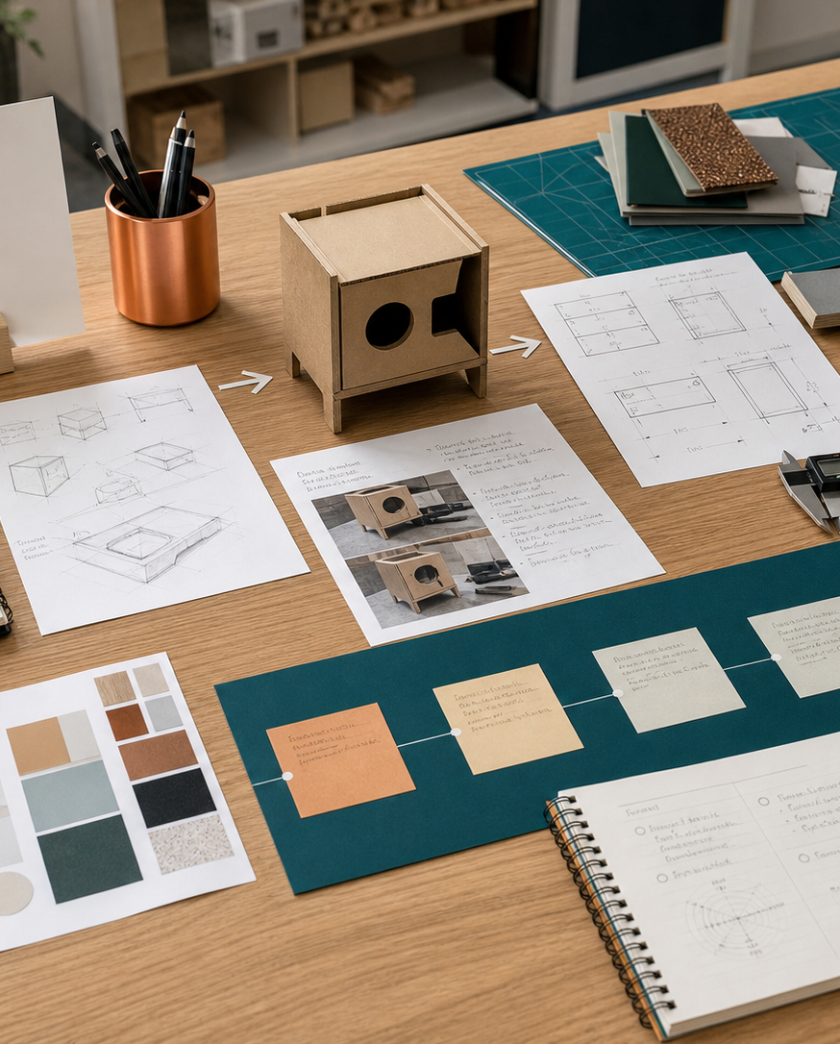
MODULE 09
CAD and rapid prototyping
Build controlled digital models, transfer information to production and use rapid prototypes to test assumptions.
Kitchen Companion · P6.2 · P4.1 · P4.2
FORMATIVE LEARNING DECK
01
Notes:
Teaching focus: Establish the purpose of CAD and rapid prototyping.
Talking points
- Build controlled digital models, transfer information to production and use rapid prototypes to test assumptions.
- Name the three learning areas without teaching them yet: CAD modelling and design intent; Rapid prototyping and 3D printing; Tolerance, fit and the Kitchen Companion.
- Explain that this deck supports classroom learning and formative evidence. Current teacher directions and formal notices remain authoritative.
Transition: Move from the module purpose to the three-part learning map.
[Sources]
- NESA Design and Technology Stage 6 Syllabus (2013), official course authority
- Current Year 11 site source register and source-bound module data
- Visual: approved family-generated teaching asset, Year 12 D&T assets/images/course-hero.png
[/Sources]

Slide 2
YEAR 11 DESIGN & TECHNOLOGY · MODULE 09
Three ideas build one evidence pathway
APPLY + KEEP EVIDENCE
Create and document a 0.2 mm tolerance test before committing the Kitchen Companion final print.
Year 11 Preliminary · Term 2 · Weeks 17–18
02
Notes:
Teaching focus: Preview the three named ideas as a connected sequence.
Talking points
- 1. CAD modelling and design intent: Create editable CAD models whose features, dimensions and relationships reflect design decisions.
- 2. Rapid prototyping and 3D printing: Use rapid prototypes to test form, fit, function and manufacture before final production.
- 3. Tolerance, fit and the Kitchen Companion: Plan and test clearances so moving or mating 3D-printed parts work reliably.
- Retrieval prompt: Which idea is most likely to change a real design decision in Kitchen Companion, and why?
Transition: Begin with CAD modelling and design intent.
[Sources]
- NESA Design and Technology Stage 6 Syllabus (2013), official course authority
- Current Year 11 site source register and source-bound module data
- Visual: current Year 11 local teaching asset assets/module-09-map.svg
[/Sources]

Slide 3
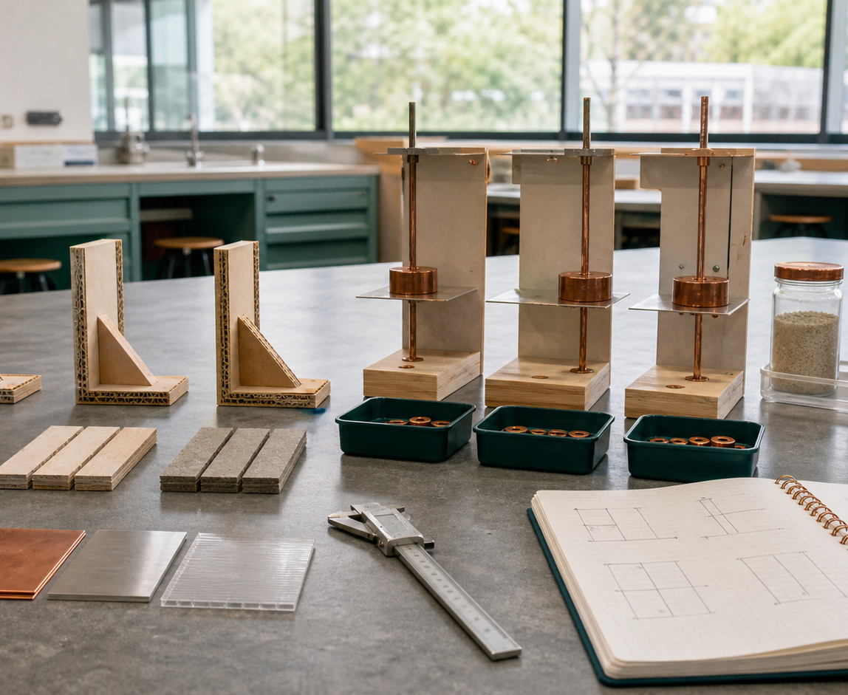
YEAR 11 DESIGN & TECHNOLOGY · MODULE 09
CAD modelling and design intent
Sketch constraints and dimensions should control important geometry rather than merely make the sketch appear complete.
Feature order affects how easily a model can be understood, edited and repaired.
Named parts, versions and meaningful comments reduce confusion in collaborative or iterative work.
LOOK FOR · KEY RELATIONSHIPS AND EVIDENCE
EVIDENCE PROMPT · A team changes one width and several holes move incorrectly. What is the best response?
Year 11 Preliminary · Term 2 · Weeks 17–18
03
Notes:
Teaching focus: Create editable CAD models whose features, dimensions and relationships reflect design decisions.
Talking points
- Sketch constraints and dimensions should control important geometry rather than merely make the sketch appear complete.
- Feature order affects how easily a model can be understood, edited and repaired.
- Named parts, versions and meaningful comments reduce confusion in collaborative or iterative work.
- CAD accuracy must be checked against the brief, material, manufacturing process and physical tests.
- Visual notice: Ask students what the scene makes visible about cad modelling and design intent, then connect observations to the stated principles.
- Evidence prompt: A team changes one width and several holes move incorrectly. What is the best response?
Likely misconceptions
- A fully constrained sketch is correct regardless of how the constraints were applied.
- Feature history is only a record and has little effect on editing.
- The newest file is always the correct version.
Transition: Move to Rapid prototyping and 3D printing.
[Sources]
- Y11 source note: NESA computer-based technology content; CAD competency resources in the authorised Drive.
- Visual: approved family-generated teaching asset, Year 12 D&T assets/images/m08s01.png
[/Sources]

Slide 4
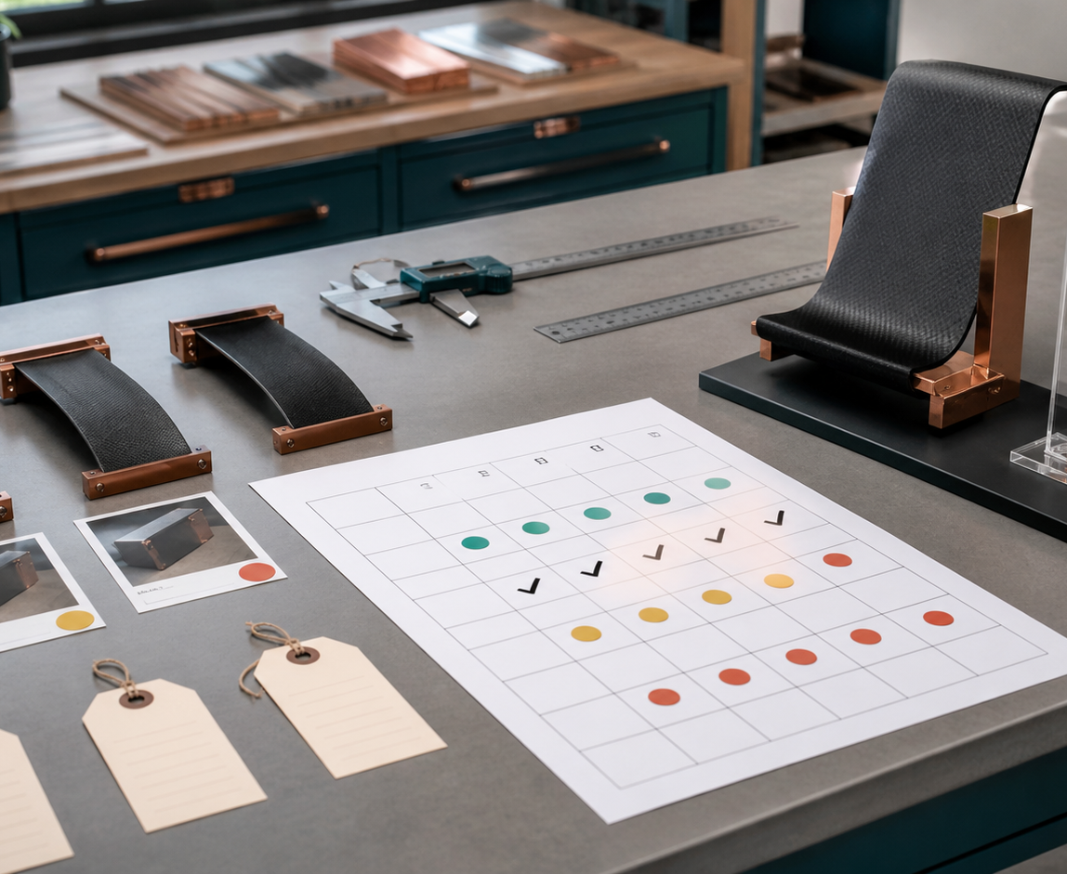
YEAR 11 DESIGN & TECHNOLOGY · MODULE 09
Rapid prototyping and 3D printing
A prototype should answer a defined design question rather than simply demonstrate that a file can be printed.
Print orientation can affect surface quality, strength, support and accuracy.
Small test pieces often provide faster and cheaper evidence than printing a complete design.
EVIDENCE PROMPT · A hinged feature is uncertain and the full print will take eight hours. What is the best strategy?
LOOK FOR · KEY RELATIONSHIPS AND EVIDENCE
Year 11 Preliminary · Term 2 · Weeks 17–18
04
Notes:
Teaching focus: Use rapid prototypes to test form, fit, function and manufacture before final production.
Talking points
- A prototype should answer a defined design question rather than simply demonstrate that a file can be printed.
- Print orientation can affect surface quality, strength, support and accuracy.
- Small test pieces often provide faster and cheaper evidence than printing a complete design.
- The result should be measured and observed, then used to modify the digital model or production plan.
- Visual notice: Ask students what the scene makes visible about rapid prototyping and 3d printing, then connect observations to the stated principles.
- Evidence prompt: A hinged feature is uncertain and the full print will take eight hours. What is the best strategy?
Likely misconceptions
- The final-size product should be printed first so all features are tested together.
- A successful print proves the design is successful.
- Orientation affects appearance but not performance or resource use.
Transition: Move to Tolerance, fit and the Kitchen Companion.
[Sources]
- Y11 source note: Current Kitchen Companion brief and teacher answer booklet on rapid prototyping/3D printing.
- Visual: approved family-generated teaching asset, Year 12 D&T assets/images/m08s02.png
[/Sources]

Slide 5
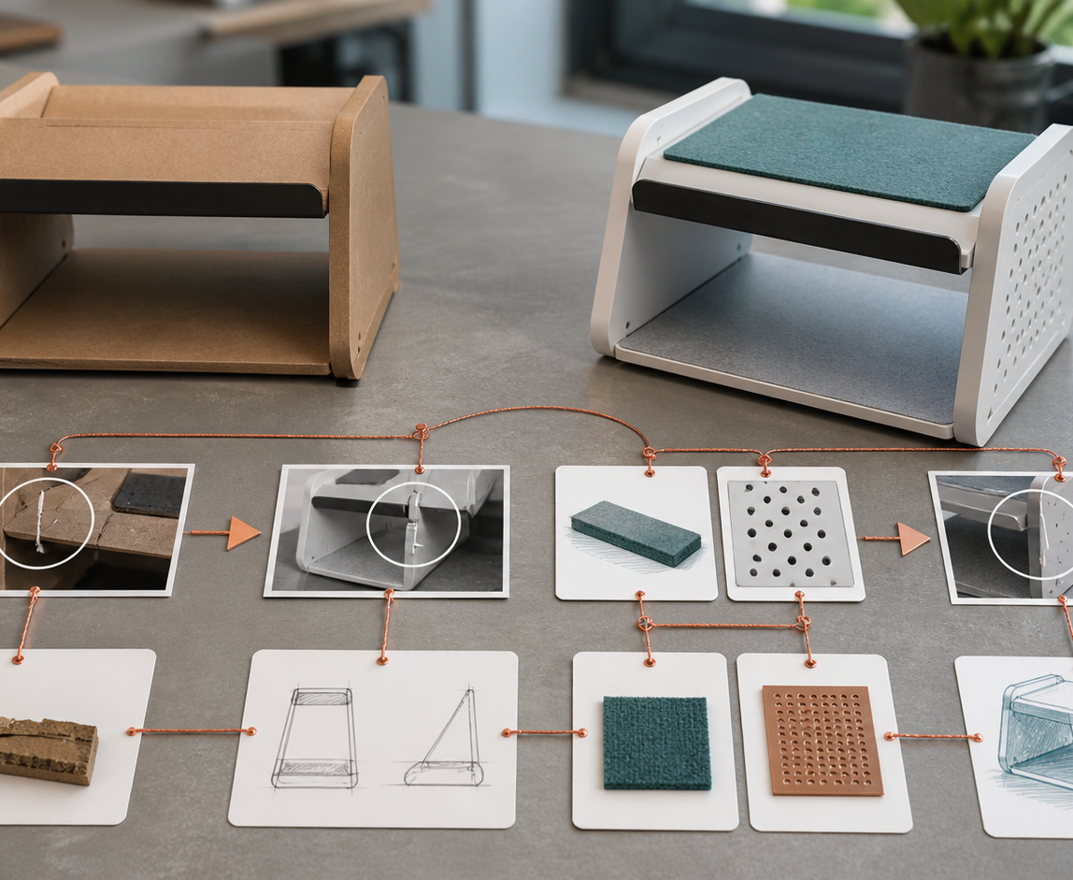
YEAR 11 DESIGN & TECHNOLOGY · MODULE 09
Tolerance, fit and the Kitchen Companion
Nominal CAD dimensions are not identical to the dimensions a printer will produce.
Clearance tests should use representative geometry, settings and orientation where possible.
A tolerance test should measure fit, movement, retention and repeatability rather than rely only on visual inspection.
LOOK FOR · KEY RELATIONSHIPS AND EVIDENCE
EVIDENCE PROMPT · A 0.2 mm sliding test binds in one orientation but works in another. What should the team do?
Year 11 Preliminary · Term 2 · Weeks 17–18
05
Notes:
Teaching focus: Plan and test clearances so moving or mating 3D-printed parts work reliably.
Talking points
- Nominal CAD dimensions are not identical to the dimensions a printer will produce.
- Clearance tests should use representative geometry, settings and orientation where possible.
- A tolerance test should measure fit, movement, retention and repeatability rather than rely only on visual inspection.
- The team should record the approved setting and model change so every part uses the same evidence-based decision.
- Visual notice: Ask students what the scene makes visible about tolerance, fit and the kitchen companion, then connect observations to the stated principles.
- Evidence prompt: A 0.2 mm sliding test binds in one orientation but works in another. What should the team do?
Likely misconceptions
- A 0.2 mm clearance will work identically on every printer and feature.
- If two parts fit once, the tolerance has been validated.
- Sanding parts until they move is equivalent to designing the correct clearance.
Transition: Move from teaching into retrieval across all three ideas.
[Sources]
- Y11 source note: Current Kitchen Companion brief: 100% 3D printed, no glue or screws, and 0.2 mm moving-part tolerance testing.
- Visual: approved family-generated teaching asset, Year 12 D&T assets/images/m08s03.png
[/Sources]

Slide 6
YEAR 11 DESIGN & TECHNOLOGY · MODULE 09
Retrieve first; then check and improve
Answer without notes. Use one precise sentence for each check.
01
A team changes one width and several holes move incorrectly. What is the best response?
A calm checking cycle
1 Recall from memory
02
A hinged feature is uncertain and the full print will take eight hours. What is the best strategy?
2 Check the matching section
3 Repair the reason, not just the word
03
A 0.2 mm sliding test binds in one orientation but works in another. What should the team do?
4 Try the question again
Year 11 Preliminary · Term 2 · Weeks 17–18
06
Notes:
Teaching focus: Use retrieval to expose and repair reasoning gaps across all three sections.
Talking points
- Give quiet recall time before inviting answers.
- Check 1: A team changes one width and several holes move incorrectly. What is the best response?
- Indicative answer: Inspect the sketch references and feature order, rebuild the relationships around design intent, then verify dependent dimensions.
- Check 2: A hinged feature is uncertain and the full print will take eight hours. What is the best strategy?
- Indicative answer: Print a small representative hinge test using the intended orientation and settings, measure performance and update the model before the full print.
- Check 3: A 0.2 mm sliding test binds in one orientation but works in another. What should the team do?
- Indicative answer: Record the result, investigate orientation and process effects, adjust the test systematically and justify the final clearance used.
- Ask students to explain why the answer is defensible before they return to notes.
Transition: Use the retrieved ideas to construct one sustained piece of evidence.
[Sources]
- Y11 source note: NESA computer-based technology content; CAD competency resources in the authorised Drive.
- Y11 source note: Current Kitchen Companion brief and teacher answer booklet on rapid prototyping/3D printing.
- Y11 source note: Current Kitchen Companion brief: 100% 3D printed, no glue or screws, and 0.2 mm moving-part tolerance testing.
[/Sources]

Slide 7
YEAR 11 DESIGN & TECHNOLOGY · MODULE 09
Construct evidence that makes reasoning visible
Create and document a 0.2 mm tolerance test before committing the Kitchen Companion final print.
READ
Identify the design question
SELECT
• Name the user, context or design issue.
• Select one relevant principle from this module.
• Explain how the evidence changes a decision.
• Check the decision against the need, criteria or source.
Choose relevant evidence
EXPLAIN
Connect evidence to the decision
CHECK
Test against the requirement
SENTENCE SUPPORT · The evidence shows … This matters because … Therefore I would …
Year 11 Preliminary · Term 2 · Weeks 17–18
07
Notes:
Teaching focus: Guide one higher-order formative response using all three module ideas.
Talking points
- Prompt: Create and document a 0.2 mm tolerance test before committing the Kitchen Companion final print.
- Read: identify the user, context and design question.
- Select: choose source-bound evidence rather than a preference.
- Explain: connect the evidence to a design consequence or decision.
- Check: test the response against the relevant need, criterion or source.
- Remind students that this is formative learning evidence, not a formal submission instruction.
Transition: Close by asking each student to retain the response and name the next useful action.
[Sources]
- Y11 source note: NESA computer-based technology content; CAD competency resources in the authorised Drive.
- Y11 source note: Current Kitchen Companion brief and teacher answer booklet on rapid prototyping/3D printing.
- Y11 source note: Current Kitchen Companion brief: 100% 3D printed, no glue or screws, and 0.2 mm moving-part tolerance testing.
[/Sources]

Slide 8
YEAR 11 DESIGN & TECHNOLOGY · MODULE 09
Leave with evidence, not just notes
01
02
03
RECALL
APPLY
ACT
One idea I can now explain accurately
One design decision or evidence judgement I can justify
One next action for Kitchen Companion
Save a dated response in your module learning record or design folio. Follow teacher directions for any formal submission.
Year 11 Preliminary · Term 2 · Weeks 17–18
08
Notes:
Teaching focus: Make the exit ticket produce a concrete learning record and a manageable next action.
Talking points
- Ask students to complete all three prompts individually before discussion.
- Keep the record labelled formative learning evidence; do not imply a cloud submission or formal assessment requirement.
- Next action: connect the module evidence to Kitchen Companion.
Transition: End with each student's own next action, not a generic summary.
[Sources]
- Y11 source note: NESA computer-based technology content; CAD competency resources in the authorised Drive.
- Y11 source note: Current Kitchen Companion brief and teacher answer booklet on rapid prototyping/3D printing.
- Y11 source note: Current Kitchen Companion brief: 100% 3D printed, no glue or screws, and 0.2 mm moving-part tolerance testing.
[/Sources]

