Slide 1
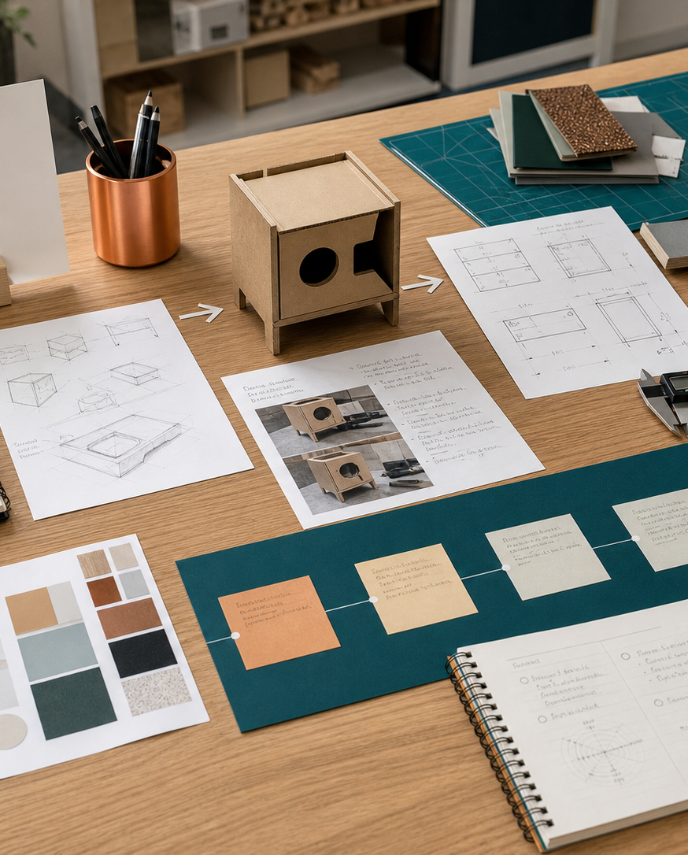
MODULE 10
Testing, materials and evaluation
Select resources through evidence, plan fair tests and use evaluation to refine prototypes before final production.
Kitchen Companion completion / Camping launch · P4.2 · P4.3 · P6.1
FORMATIVE LEARNING DECK
01
Notes:
Teaching focus: Establish the purpose of Testing, materials and evaluation.
Talking points
- Select resources through evidence, plan fair tests and use evaluation to refine prototypes before final production.
- Name the three learning areas without teaching them yet: Material selection and evidence; Manufacturing processes and scale; Prototype testing and continual evaluation.
- Explain that this deck supports classroom learning and formative evidence. Current teacher directions and formal notices remain authoritative.
Transition: Move from the module purpose to the three-part learning map.
[Sources]
- NESA Design and Technology Stage 6 Syllabus (2013), official course authority
- Current Year 11 site source register and source-bound module data
- Visual: approved family-generated teaching asset, Year 12 D&T assets/images/course-hero.png
[/Sources]

Slide 2
YEAR 11 DESIGN & TECHNOLOGY · MODULE 10
Three ideas build one evidence pathway
APPLY + KEEP EVIDENCE
Complete one controlled material or feature test and document the decision it changes.
Year 11 Preliminary · Term 2 · Weeks 19–20
02
Notes:
Teaching focus: Preview the three named ideas as a connected sequence.
Talking points
- 1. Material selection and evidence: Justify materials using properties, processing, context, cost, safety and whole-of-life evidence.
- 2. Manufacturing processes and scale: Select manufacturing processes that suit material, geometry, volume, quality and available resources.
- 3. Prototype testing and continual evaluation: Design fair tests, interpret feedback and make evidence-based modifications.
- Retrieval prompt: Which idea is most likely to change a real design decision in Kitchen Companion completion / Camping launch, and why?
Transition: Begin with Material selection and evidence.
[Sources]
- NESA Design and Technology Stage 6 Syllabus (2013), official course authority
- Current Year 11 site source register and source-bound module data
- Visual: current Year 11 local teaching asset assets/module-10-map.svg
[/Sources]

Slide 3
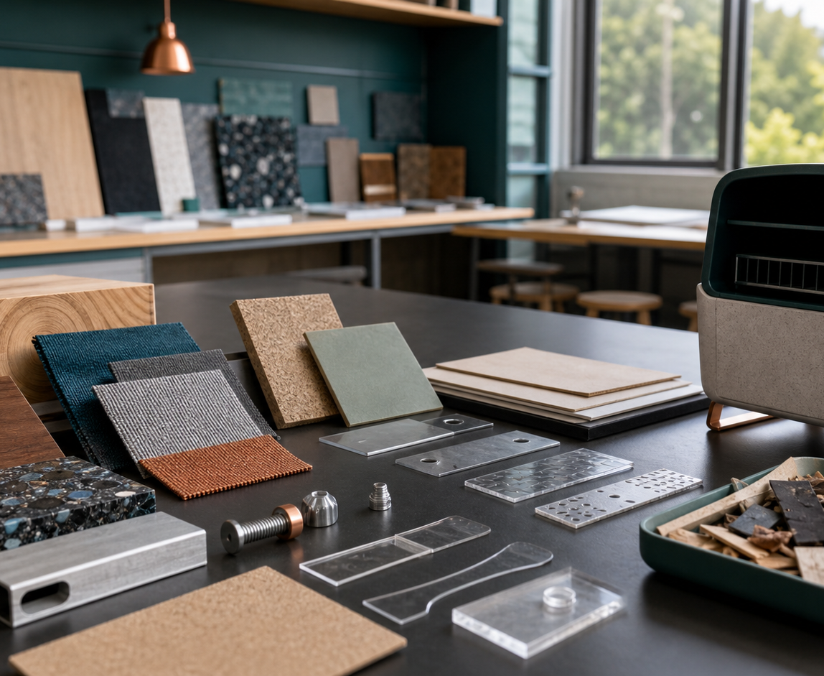
YEAR 11 DESIGN & TECHNOLOGY · MODULE 10
Material selection and evidence
Required properties should be derived from the user, load, environment, expected life, appearance and maintenance needs.
Supplier information is useful but should be checked against the actual form, process and use condition.
Testing can verify strength, stiffness, wear, fit, finish, weather response or workability where these are critical.
LOOK FOR · KEY RELATIONSHIPS AND EVIDENCE
EVIDENCE PROMPT · A camping product needs low mass, weather resistance and safe school manufacture. What is the best approach?
Year 11 Preliminary · Term 2 · Weeks 19–20
03
Notes:
Teaching focus: Justify materials using properties, processing, context, cost, safety and whole-of-life evidence.
Talking points
- Required properties should be derived from the user, load, environment, expected life, appearance and maintenance needs.
- Supplier information is useful but should be checked against the actual form, process and use condition.
- Testing can verify strength, stiffness, wear, fit, finish, weather response or workability where these are critical.
- A justified selection explains why the material is more appropriate than feasible alternatives, including limitations.
- Visual notice: Ask students what the scene makes visible about material selection and evidence, then connect observations to the stated principles.
- Evidence prompt: A camping product needs low mass, weather resistance and safe school manufacture. What is the best approach?
Likely misconceptions
- A familiar material is appropriate because the student already knows how to use it.
- Material data applies equally to every thickness, direction and manufacturing process.
- Testing is unnecessary when the supplier describes the material as durable.
Transition: Move to Manufacturing processes and scale.
[Sources]
- Y11 source note: Teacher answer booklet on material criteria, testing and research; current project contexts.
- Visual: approved family-generated teaching asset, Year 12 D&T assets/images/m09s01.png
[/Sources]

Slide 4
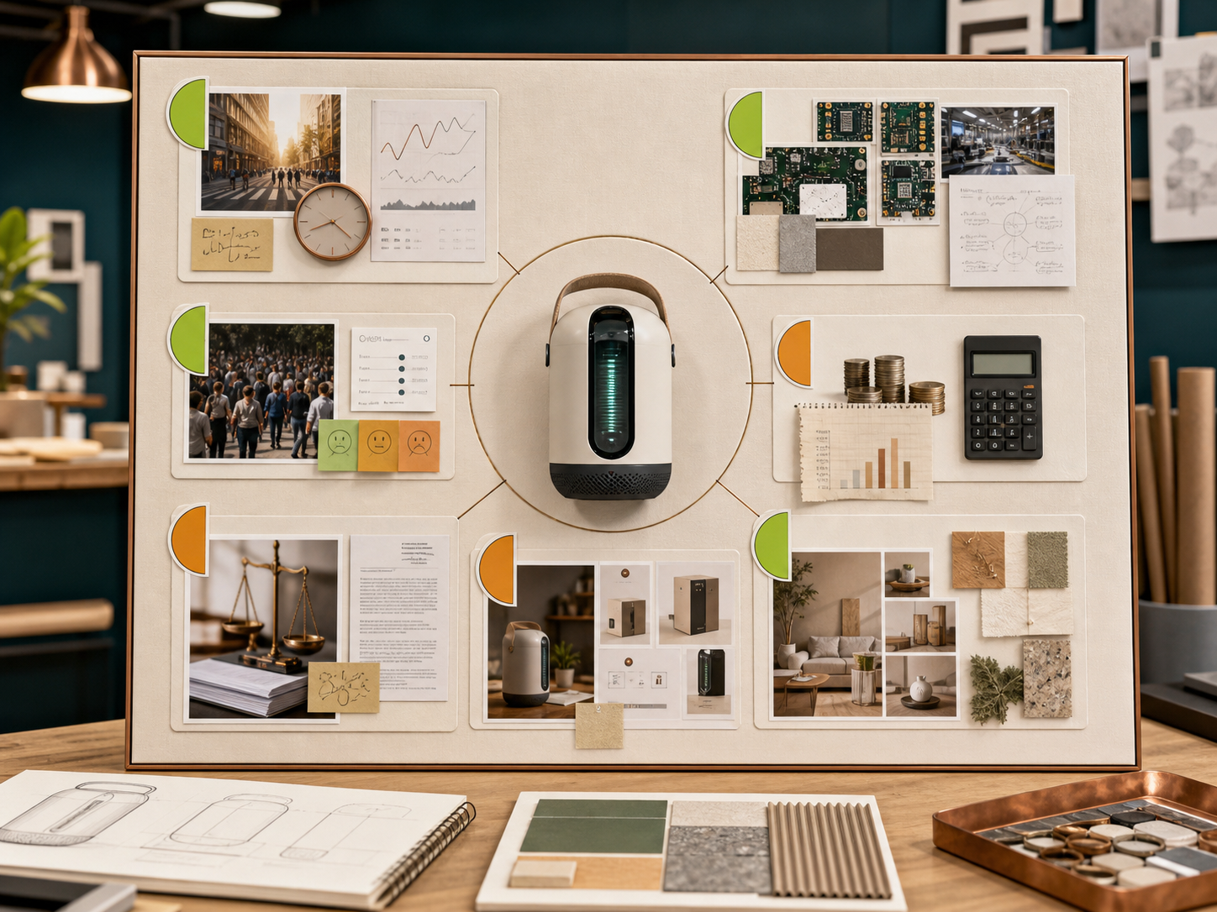
YEAR 11 DESIGN & TECHNOLOGY · MODULE 10
Manufacturing processes and scale
The required geometry and material behaviour narrow the feasible manufacturing processes.
One-off production supports customisation but usually has higher unit labour and less specialised tooling.
Batch and mass production use standardisation, jigs, tooling or automation to improve consistency and output.
EVIDENCE PROMPT · A design requires twelve identical holes in a small batch of plywood components. Which approach is most defensible?
LOOK FOR · KEY RELATIONSHIPS AND EVIDENCE
Year 11 Preliminary · Term 2 · Weeks 19–20
04
Notes:
Teaching focus: Select manufacturing processes that suit material, geometry, volume, quality and available resources.
Talking points
- The required geometry and material behaviour narrow the feasible manufacturing processes.
- One-off production supports customisation but usually has higher unit labour and less specialised tooling.
- Batch and mass production use standardisation, jigs, tooling or automation to improve consistency and output.
- Process selection should include quality checkpoints and a realistic plan for errors, maintenance and waste.
- Visual notice: Ask students what the scene makes visible about manufacturing processes and scale, then connect observations to the stated principles.
- Evidence prompt: A design requires twelve identical holes in a small batch of plywood components. Which approach is most defensible?
Likely misconceptions
- The fastest process is normally the most efficient.
- Mass-production methods are appropriate whenever a component repeats.
- Manual production cannot achieve consistent quality.
Transition: Move to Prototype testing and continual evaluation.
[Sources]
- Y11 source note: NESA manufacturing content; teacher answer booklet on one-off/mass production and process change.
- Visual: approved family-generated teaching asset, Year 12 D&T assets/images/m02s02.png
[/Sources]

Slide 5
YEAR 11 DESIGN & TECHNOLOGY · MODULE 10
Prototype testing and continual evaluation
Design fair tests, interpret feedback and make evidence-based modifications.
TEST
COMPARE
CHANGE
Each test should identify the criterion, method, conditions, measurement or observation and decision rule.
A fair comparison changes one important variable at a time or records other differences clearly.
User feedback should involve representative users and focused tasks rather than general liking.
EVIDENCE PROMPT · Two handle prototypes are made from different materials and tested by different users doing different tasks. What is the problem?
Year 11 Preliminary · Term 2 · Weeks 19–20
05
Notes:
Teaching focus: Design fair tests, interpret feedback and make evidence-based modifications.
Talking points
- Each test should identify the criterion, method, conditions, measurement or observation and decision rule.
- A fair comparison changes one important variable at a time or records other differences clearly.
- User feedback should involve representative users and focused tasks rather than general liking.
- Evaluation explains what the evidence means, what changed and what uncertainty remains.
- Diagram notice: Trace TEST → COMPARE → CHANGE and ask where evidence changes the next decision.
- Evidence prompt: Two handle prototypes are made from different materials and tested by different users doing different tasks. What is the problem?
Likely misconceptions
- A prototype is successful when it resembles the final product.
- More participants automatically make a test valid.
- General comments such as “looks good” provide sufficient user evaluation.
Transition: Move from teaching into retrieval across all three ideas.
[Sources]
- Y11 source note: Teacher answer booklet on prototype uses, fair testing, feedback and continual evaluation.
- Visual: editable native PowerPoint relationship diagram derived only from the three source-bound section principles
[/Sources]

Slide 6
YEAR 11 DESIGN & TECHNOLOGY · MODULE 10
Retrieve first; then check and improve
Answer without notes. Use one precise sentence for each check.
01
A camping product needs low mass, weather resistance and safe school manufacture. What is the best approach?
A calm checking cycle
1 Recall from memory
02
A design requires twelve identical holes in a small batch of plywood components. Which approach is most defensible?
2 Check the matching section
3 Repair the reason, not just the word
03
Two handle prototypes are made from different materials and tested by different users doing different tasks. What is the problem?
4 Try the question again
Year 11 Preliminary · Term 2 · Weeks 19–20
06
Notes:
Teaching focus: Use retrieval to expose and repair reasoning gaps across all three sections.
Talking points
- Give quiet recall time before inviting answers.
- Check 1: A camping product needs low mass, weather resistance and safe school manufacture. What is the best approach?
- Indicative answer: Compare feasible materials against all three requirements, verify critical properties and consider joining, finish, cost, availability and end-of-life.
- Check 2: A design requires twelve identical holes in a small batch of plywood components. Which approach is most defensible?
- Indicative answer: Compare a drilling jig, CNC process and manual layout against accuracy, setup time, safety, equipment and batch size.
- Check 3: Two handle prototypes are made from different materials and tested by different users doing different tasks. What is the problem?
- Indicative answer: Too many variables changed, so the result cannot show whether shape or material caused the difference; redesign the comparison.
- Ask students to explain why the answer is defensible before they return to notes.
Transition: Use the retrieved ideas to construct one sustained piece of evidence.
[Sources]
- Y11 source note: Teacher answer booklet on material criteria, testing and research; current project contexts.
- Y11 source note: NESA manufacturing content; teacher answer booklet on one-off/mass production and process change.
- Y11 source note: Teacher answer booklet on prototype uses, fair testing, feedback and continual evaluation.
[/Sources]

Slide 7
YEAR 11 DESIGN & TECHNOLOGY · MODULE 10
Construct evidence that makes reasoning visible
Complete one controlled material or feature test and document the decision it changes.
READ
Identify the design question
SELECT
• Name the user, context or design issue.
• Select one relevant principle from this module.
• Explain how the evidence changes a decision.
• Check the decision against the need, criteria or source.
Choose relevant evidence
EXPLAIN
Connect evidence to the decision
CHECK
Test against the requirement
SENTENCE SUPPORT · The evidence shows … This matters because … Therefore I would …
Year 11 Preliminary · Term 2 · Weeks 19–20
07
Notes:
Teaching focus: Guide one higher-order formative response using all three module ideas.
Talking points
- Prompt: Complete one controlled material or feature test and document the decision it changes.
- Read: identify the user, context and design question.
- Select: choose source-bound evidence rather than a preference.
- Explain: connect the evidence to a design consequence or decision.
- Check: test the response against the relevant need, criterion or source.
- Remind students that this is formative learning evidence, not a formal submission instruction.
Transition: Close by asking each student to retain the response and name the next useful action.
[Sources]
- Y11 source note: Teacher answer booklet on material criteria, testing and research; current project contexts.
- Y11 source note: NESA manufacturing content; teacher answer booklet on one-off/mass production and process change.
- Y11 source note: Teacher answer booklet on prototype uses, fair testing, feedback and continual evaluation.
[/Sources]

Slide 8
YEAR 11 DESIGN & TECHNOLOGY · MODULE 10
Leave with evidence, not just notes
01
02
03
RECALL
APPLY
ACT
One idea I can now explain accurately
One design decision or evidence judgement I can justify
One next action for Kitchen Companion completion / Camping launch
Save a dated response in your module learning record or design folio. Follow teacher directions for any formal submission.
Year 11 Preliminary · Term 2 · Weeks 19–20
08
Notes:
Teaching focus: Make the exit ticket produce a concrete learning record and a manageable next action.
Talking points
- Ask students to complete all three prompts individually before discussion.
- Keep the record labelled formative learning evidence; do not imply a cloud submission or formal assessment requirement.
- Next action: connect the module evidence to Kitchen Companion completion / Camping launch.
Transition: End with each student's own next action, not a generic summary.
[Sources]
- Y11 source note: Teacher answer booklet on material criteria, testing and research; current project contexts.
- Y11 source note: NESA manufacturing content; teacher answer booklet on one-off/mass production and process change.
- Y11 source note: Teacher answer booklet on prototype uses, fair testing, feedback and continual evaluation.
[/Sources]

