Slide 1
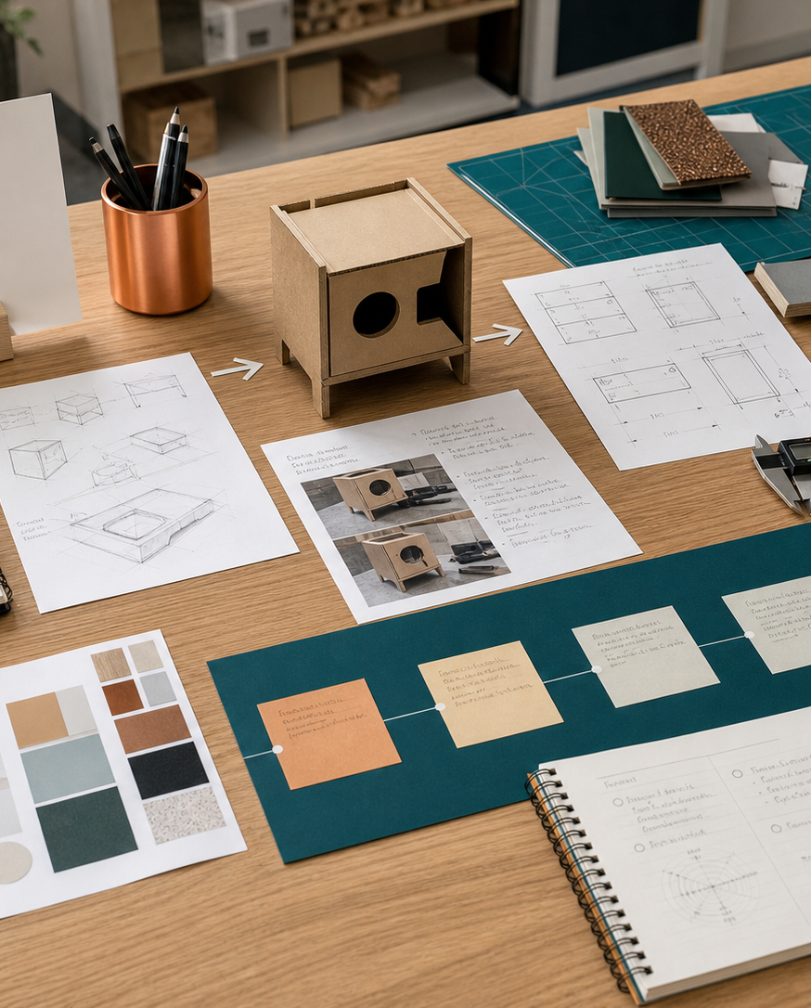
MODULE 11
Camping design project
Identify a genuine camping need and convert evidence, constraints and project criteria into a feasible compact product direction.
Camping Environment - need and proposal · P1.1 · P4.1 · P5.3
FORMATIVE LEARNING DECK
01
Notes:
Teaching focus: Establish the purpose of Camping design project.
Talking points
- Identify a genuine camping need and convert evidence, constraints and project criteria into a feasible compact product direction.
- Name the three learning areas without teaching them yet: Identifying a genuine camping need; From situation to design brief; Camping proposal and degree of difference.
- Explain that this deck supports classroom learning and formative evidence. Current teacher directions and formal notices remain authoritative.
Transition: Move from the module purpose to the three-part learning map.
[Sources]
- NESA Design and Technology Stage 6 Syllabus (2013), official course authority
- Current Year 11 site source register and source-bound module data
- Visual: approved family-generated teaching asset, Year 12 D&T assets/images/course-hero.png
[/Sources]

Slide 2
YEAR 11 DESIGN & TECHNOLOGY · MODULE 11
Three ideas build one evidence pathway
APPLY + KEEP EVIDENCE
Investigate a camping problem, define a target market and develop a justified proposal using current task requirements.
Year 11 Preliminary · Term 3 · Weeks 1–2
02
Notes:
Teaching focus: Preview the three named ideas as a connected sequence.
Talking points
- 1. Identifying a genuine camping need: Distinguish an evidenced need from a preselected product idea or personal preference.
- 2. From situation to design brief: Write a purposeful design brief that directs development without locking in a premature solution.
- 3. Camping proposal and degree of difference: Develop and justify a project proposal that is feasible, distinctive and linked to the evidence.
- Retrieval prompt: Which idea is most likely to change a real design decision in Camping Environment - need and proposal, and why?
Transition: Begin with Identifying a genuine camping need.
[Sources]
- NESA Design and Technology Stage 6 Syllabus (2013), official course authority
- Current Year 11 site source register and source-bound module data
- Visual: current Year 11 local teaching asset assets/module-11-map.svg
[/Sources]

Slide 3
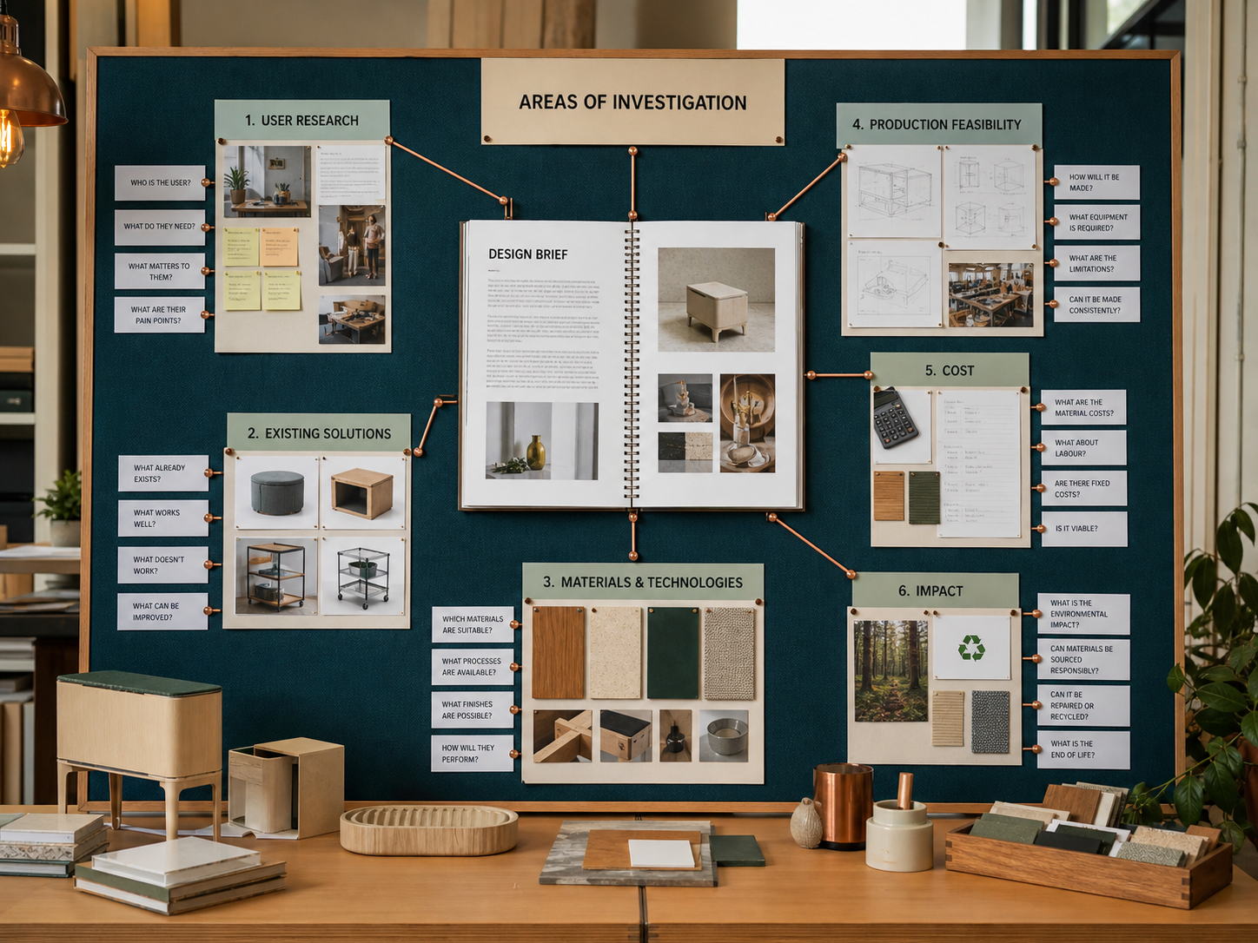
YEAR 11 DESIGN & TECHNOLOGY · MODULE 11
Identifying a genuine camping need
A need statement describes the user, context, difficulty and consequence before proposing a solution.
Observation, interviews, questionnaires and existing-product analysis can reveal different parts of the camping problem.
A target market should be specific enough to guide decisions without relying on stereotypes.
LOOK FOR · KEY RELATIONSHIPS AND EVIDENCE
EVIDENCE PROMPT · A student wants to make a folding camp shelf because it looks interesting. What should happen before the brief is finalised?
Year 11 Preliminary · Term 3 · Weeks 1–2
03
Notes:
Teaching focus: Distinguish an evidenced need from a preselected product idea or personal preference.
Talking points
- A need statement describes the user, context, difficulty and consequence before proposing a solution.
- Observation, interviews, questionnaires and existing-product analysis can reveal different parts of the camping problem.
- A target market should be specific enough to guide decisions without relying on stereotypes.
- The final need should be significant, feasible and supported by more than one piece of evidence.
- Visual notice: Ask students what the scene makes visible about identifying a genuine camping need, then connect observations to the stated principles.
- Evidence prompt: A student wants to make a folding camp shelf because it looks interesting. What should happen before the brief is finalised?
Likely misconceptions
- A common camping activity automatically proves there is a design need.
- A target market is defined mainly by age and gender.
- The product idea should be selected before research so the investigation stays focused.
Transition: Move to From situation to design brief.
[Sources]
- Y11 source note: Current 2026 Camping Environment task; NESA project analysis and research content.
- Visual: approved family-generated teaching asset, Year 12 D&T assets/images/m04s02.png
[/Sources]

Slide 4
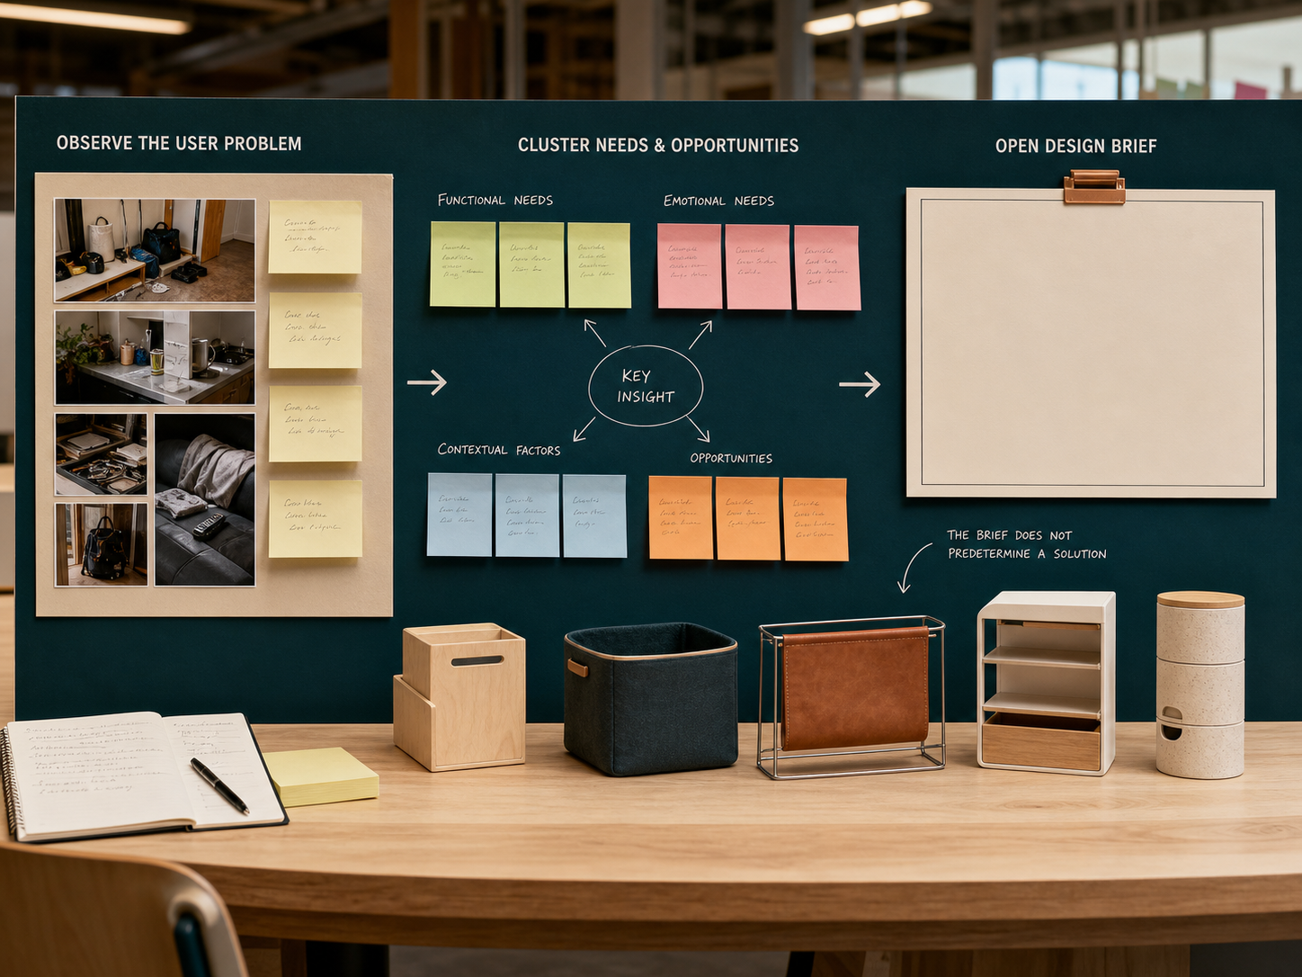
YEAR 11 DESIGN & TECHNOLOGY · MODULE 11
From situation to design brief
A design situation describes the context, people and problem that create the opportunity.
A design brief identifies the intended user and purpose while leaving room for alternative concepts.
Constraints set non-negotiable boundaries such as time, cost, available equipment or size.
EVIDENCE PROMPT · Which revision most improves the weak brief “Design a useful item for campers”?
LOOK FOR · KEY RELATIONSHIPS AND EVIDENCE
Year 11 Preliminary · Term 3 · Weeks 1–2
04
Notes:
Teaching focus: Write a purposeful design brief that directs development without locking in a premature solution.
Talking points
- A design situation describes the context, people and problem that create the opportunity.
- A design brief identifies the intended user and purpose while leaving room for alternative concepts.
- Constraints set non-negotiable boundaries such as time, cost, available equipment or size.
- Criteria translate research and task requirements into standards that can later be tested.
- Visual notice: Ask students what the scene makes visible about from situation to design brief, then connect observations to the stated principles.
- Evidence prompt: Which revision most improves the weak brief “Design a useful item for campers”?
Likely misconceptions
- The situation and brief should contain the same information in different words.
- A strong brief names the exact materials and construction method before testing.
- Constraints are optional goals that can be ignored if the final product looks successful.
Transition: Move to Camping proposal and degree of difference.
[Sources]
- Y11 source note: Current 2026 Camping Environment task and teacher answer booklet on briefs, criteria and constraints.
- Visual: approved family-generated teaching asset, Year 12 D&T assets/images/m01s03.png
[/Sources]

Slide 5
YEAR 11 DESIGN & TECHNOLOGY · MODULE 11
Camping proposal and degree of difference
Develop and justify a project proposal that is feasible, distinctive and linked to the evidence.
NEED
FEASIBILITY
EVIDENCE
A proposal connects the need, target market, design direction, likely resources and intended evidence.
Degree of difference may come from function, usability, portability, repair, materials, manufacture, access or another justified improvement.
Feasibility should be checked against time, cost, size, skills, equipment, safety and access to materials.
EVIDENCE PROMPT · An idea adds a powered mechanism to a compact organiser, but users mainly need simple one-handed access. What is the best response?
Year 11 Preliminary · Term 3 · Weeks 1–2
05
Notes:
Teaching focus: Develop and justify a project proposal that is feasible, distinctive and linked to the evidence.
Talking points
- A proposal connects the need, target market, design direction, likely resources and intended evidence.
- Degree of difference may come from function, usability, portability, repair, materials, manufacture, access or another justified improvement.
- Feasibility should be checked against time, cost, size, skills, equipment, safety and access to materials.
- A proposal remains provisional and may change when concept testing produces stronger evidence.
- Diagram notice: Trace NEED → FEASIBILITY → EVIDENCE and ask where evidence changes the next decision.
- Evidence prompt: An idea adds a powered mechanism to a compact organiser, but users mainly need simple one-handed access. What is the best response?
Likely misconceptions
- Degree of difference means the product must never have existed before.
- A more complex feature always makes a product more innovative.
- Feasibility is confirmed when the required materials are inexpensive.
Transition: Move from teaching into retrieval across all three ideas.
[Sources]
- Y11 source note: Current Camping Environment folio requirements; NESA project analysis and creative development content.
- Visual: editable native PowerPoint relationship diagram derived only from the three source-bound section principles
[/Sources]

Slide 6
YEAR 11 DESIGN & TECHNOLOGY · MODULE 11
Retrieve first; then check and improve
Answer without notes. Use one precise sentence for each check.
01
A student wants to make a folding camp shelf because it looks interesting. What should happen before the brief is finalised?
A calm checking cycle
1 Recall from memory
02
Which revision most improves the weak brief “Design a useful item for campers”?
2 Check the matching section
3 Repair the reason, not just the word
03
An idea adds a powered mechanism to a compact organiser, but users mainly need simple one-handed access. What is the best response?
4 Try the question again
Year 11 Preliminary · Term 3 · Weeks 1–2
06
Notes:
Teaching focus: Use retrieval to expose and repair reasoning gaps across all three sections.
Talking points
- Give quiet recall time before inviting answers.
- Check 1: A student wants to make a folding camp shelf because it looks interesting. What should happen before the brief is finalised?
- Indicative answer: Investigate who has the storage problem, where it occurs, what existing solutions fail to do and whether the problem is feasible within the task constraints.
- Check 2: Which revision most improves the weak brief “Design a useful item for campers”?
- Indicative answer: Design and produce a compact, practical and marketable solution for a defined camping user that addresses an evidenced need within the current project constraints.
- Check 3: An idea adds a powered mechanism to a compact organiser, but users mainly need simple one-handed access. What is the best response?
- Indicative answer: Compare the powered and non-powered concepts against user evidence, reliability, cost, size, safety and the value each adds before selecting a direction.
- Ask students to explain why the answer is defensible before they return to notes.
Transition: Use the retrieved ideas to construct one sustained piece of evidence.
[Sources]
- Y11 source note: Current 2026 Camping Environment task; NESA project analysis and research content.
- Y11 source note: Current 2026 Camping Environment task and teacher answer booklet on briefs, criteria and constraints.
- Y11 source note: Current Camping Environment folio requirements; NESA project analysis and creative development content.
[/Sources]

Slide 7
YEAR 11 DESIGN & TECHNOLOGY · MODULE 11
Construct evidence that makes reasoning visible
Investigate a camping problem, define a target market and develop a justified proposal using current task requirements.
READ
Identify the design question
SELECT
• Name the user, context or design issue.
• Select one relevant principle from this module.
• Explain how the evidence changes a decision.
• Check the decision against the need, criteria or source.
Choose relevant evidence
EXPLAIN
Connect evidence to the decision
CHECK
Test against the requirement
SENTENCE SUPPORT · The evidence shows … This matters because … Therefore I would …
Year 11 Preliminary · Term 3 · Weeks 1–2
07
Notes:
Teaching focus: Guide one higher-order formative response using all three module ideas.
Talking points
- Prompt: Investigate a camping problem, define a target market and develop a justified proposal using current task requirements.
- Read: identify the user, context and design question.
- Select: choose source-bound evidence rather than a preference.
- Explain: connect the evidence to a design consequence or decision.
- Check: test the response against the relevant need, criterion or source.
- Remind students that this is formative learning evidence, not a formal submission instruction.
Transition: Close by asking each student to retain the response and name the next useful action.
[Sources]
- Y11 source note: Current 2026 Camping Environment task; NESA project analysis and research content.
- Y11 source note: Current 2026 Camping Environment task and teacher answer booklet on briefs, criteria and constraints.
- Y11 source note: Current Camping Environment folio requirements; NESA project analysis and creative development content.
[/Sources]

Slide 8
YEAR 11 DESIGN & TECHNOLOGY · MODULE 11
Leave with evidence, not just notes
01
02
03
RECALL
APPLY
ACT
One idea I can now explain accurately
One design decision or evidence judgement I can justify
One next action for Camping Environment - need and proposal
Save a dated response in your module learning record or design folio. Follow teacher directions for any formal submission.
Year 11 Preliminary · Term 3 · Weeks 1–2
08
Notes:
Teaching focus: Make the exit ticket produce a concrete learning record and a manageable next action.
Talking points
- Ask students to complete all three prompts individually before discussion.
- Keep the record labelled formative learning evidence; do not imply a cloud submission or formal assessment requirement.
- Next action: connect the module evidence to Camping Environment - need and proposal.
Transition: End with each student's own next action, not a generic summary.
[Sources]
- Y11 source note: Current 2026 Camping Environment task; NESA project analysis and research content.
- Y11 source note: Current 2026 Camping Environment task and teacher answer booklet on briefs, criteria and constraints.
- Y11 source note: Current Camping Environment folio requirements; NESA project analysis and creative development content.
[/Sources]

