Slide 1

MODULE 12
Project management and safe production
Use action, time, finance, resource and WHS planning as active decision tools during project development and production.
Camping Environment - management and production readiness · P4.2 · P5.1
FORMATIVE LEARNING DECK
01
Notes:
Teaching focus: Establish the purpose of Project management and safe production.
Talking points
- Use action, time, finance, resource and WHS planning as active decision tools during project development and production.
- Name the three learning areas without teaching them yet: Action plans, time plans and milestones; Finance and resource management; WHS, risk controls and production readiness.
- Explain that this deck supports classroom learning and formative evidence. Current teacher directions and formal notices remain authoritative.
Transition: Move from the module purpose to the three-part learning map.
[Sources]
- NESA Design and Technology Stage 6 Syllabus (2013), official course authority
- Current Year 11 site source register and source-bound module data
- Visual: approved family-generated teaching asset, Year 12 D&T assets/images/course-hero.png
[/Sources]

Slide 2
YEAR 11 DESIGN & TECHNOLOGY · MODULE 12
Three ideas build one evidence pathway
APPLY + KEEP EVIDENCE
Construct an integrated action, time, finance, resource and risk plan for the camping project, then update it after a simulated disruption.
Year 11 Preliminary · Term 3 · Weeks 3–4
02
Notes:
Teaching focus: Preview the three named ideas as a connected sequence.
Talking points
- 1. Action plans, time plans and milestones: Build a realistic project plan that exposes dependencies, checkpoints and recovery options.
- 2. Finance and resource management: Estimate, monitor and justify project costs and resource use rather than treating a budget as a final receipt list.
- 3. WHS, risk controls and production readiness: Plan safe production by identifying hazards and selecting effective controls before work begins.
- Retrieval prompt: Which idea is most likely to change a real design decision in Camping Environment - management and production readiness, and why?
Transition: Begin with Action plans, time plans and milestones.
[Sources]
- NESA Design and Technology Stage 6 Syllabus (2013), official course authority
- Current Year 11 site source register and source-bound module data
- Visual: current Year 11 local teaching asset assets/module-12-map.svg
[/Sources]

Slide 3
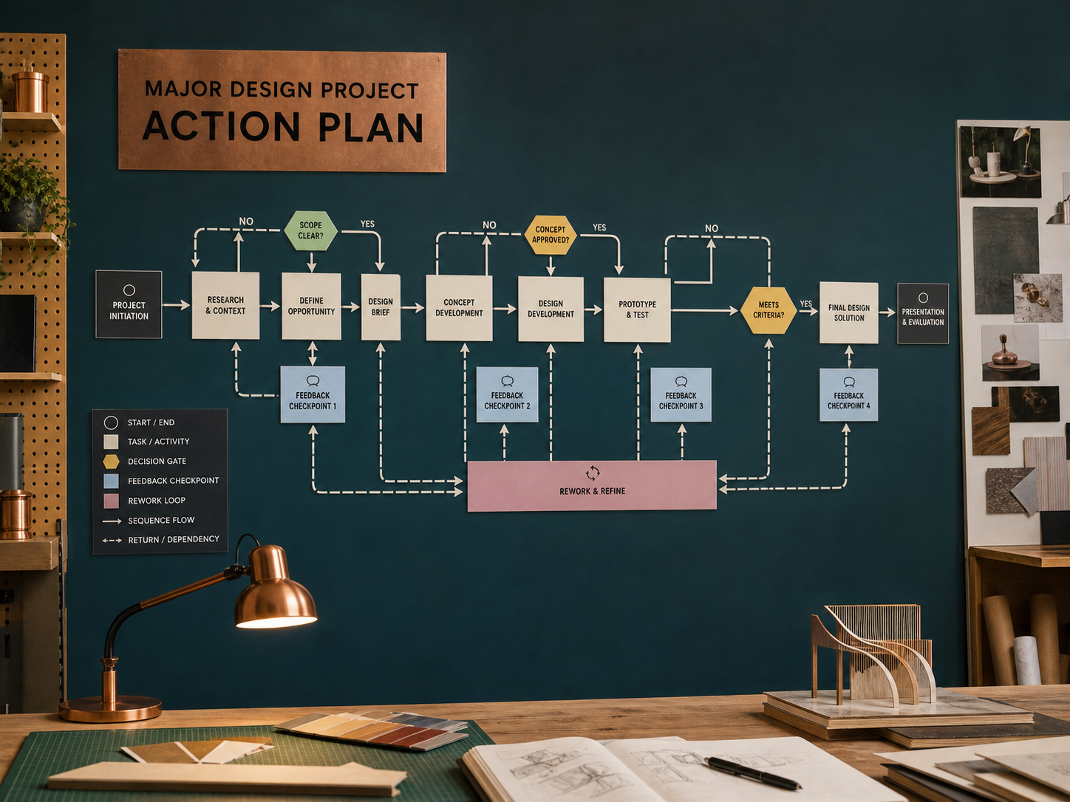
YEAR 11 DESIGN & TECHNOLOGY · MODULE 12
Action plans, time plans and milestones
Tasks should be broken into observable actions rather than broad labels such as “work on project”.
Dependencies identify work that cannot begin until an earlier decision, material or process is complete.
Milestones mark important decisions or completed stages; quality checkpoints verify requirements before work continues.
LOOK FOR · KEY RELATIONSHIPS AND EVIDENCE
EVIDENCE PROMPT · A critical material will arrive one week late. Which response demonstrates effective project management?
Year 11 Preliminary · Term 3 · Weeks 3–4
03
Notes:
Teaching focus: Build a realistic project plan that exposes dependencies, checkpoints and recovery options.
Talking points
- Tasks should be broken into observable actions rather than broad labels such as “work on project”.
- Dependencies identify work that cannot begin until an earlier decision, material or process is complete.
- Milestones mark important decisions or completed stages; quality checkpoints verify requirements before work continues.
- Actual progress should be recorded and the plan updated when evidence, delays or resource changes occur.
- Visual notice: Ask students what the scene makes visible about action plans, time plans and milestones, then connect observations to the stated principles.
- Evidence prompt: A critical material will arrive one week late. Which response demonstrates effective project management?
Likely misconceptions
- A detailed plan guarantees the project will finish on time.
- Every task should be scheduled for the same length to keep the chart simple.
- Updating a plan hides poor time management.
Transition: Move to Finance and resource management.
[Sources]
- Y11 source note: Current Camping Environment action-plan requirement; teacher answer booklet on Gantt charts and project management.
- Visual: approved family-generated teaching asset, Year 12 D&T assets/images/m06s01.png
[/Sources]

Slide 4
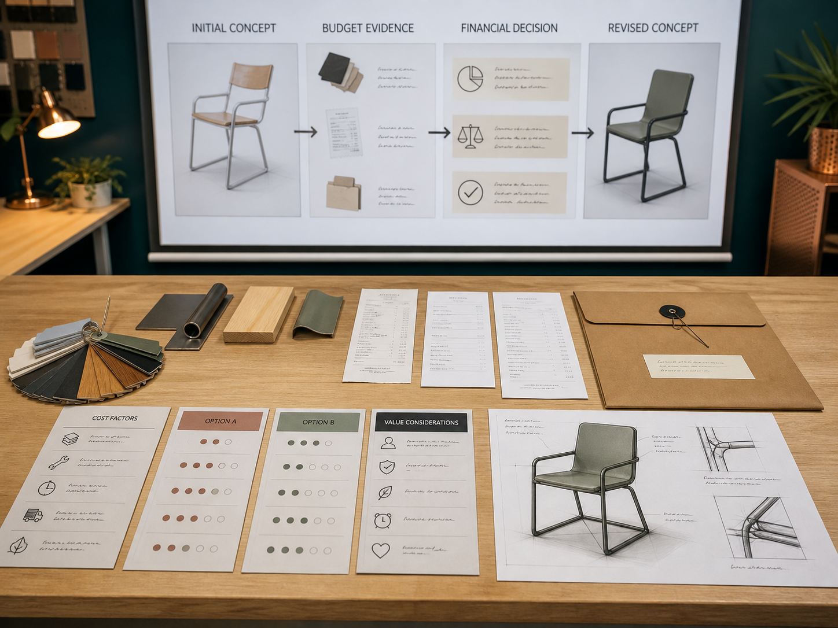
YEAR 11 DESIGN & TECHNOLOGY · MODULE 12
Finance and resource management
Estimated quantities and unit costs should be based on the intended design and updated as it changes.
A contingency allows for reasonable uncertainty but does not replace accurate estimating.
Material yield and stock dimensions can affect cost more than the nominal price of a small component.
EVIDENCE PROMPT · A material is cheap per metre but must be bought in a large minimum quantity. What should the designer do?
LOOK FOR · KEY RELATIONSHIPS AND EVIDENCE
Year 11 Preliminary · Term 3 · Weeks 3–4
04
Notes:
Teaching focus: Estimate, monitor and justify project costs and resource use rather than treating a budget as a final receipt list.
Talking points
- Estimated quantities and unit costs should be based on the intended design and updated as it changes.
- A contingency allows for reasonable uncertainty but does not replace accurate estimating.
- Material yield and stock dimensions can affect cost more than the nominal price of a small component.
- Resource selection should balance function, quality, safety, sustainability, availability and cost.
- Visual notice: Ask students what the scene makes visible about finance and resource management, then connect observations to the stated principles.
- Evidence prompt: A material is cheap per metre but must be bought in a large minimum quantity. What should the designer do?
Likely misconceptions
- The finance plan is accurate when receipts total less than the budget.
- School-supplied materials have no project cost and need not be recorded.
- The lowest purchase price produces the lowest whole-project cost.
Transition: Move to WHS, risk controls and production readiness.
[Sources]
- Y11 source note: Current Camping Environment A$30 construction constraint; teacher answer booklet finance-plan content.
- Visual: approved family-generated teaching asset, Year 12 D&T assets/images/m06s03.png
[/Sources]

Slide 5
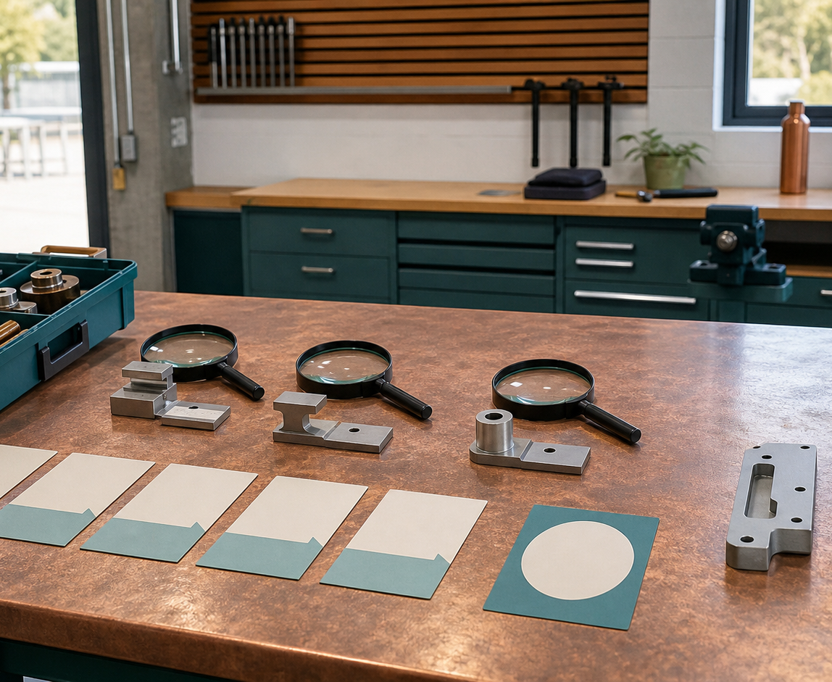
YEAR 11 DESIGN & TECHNOLOGY · MODULE 12
WHS, risk controls and production readiness
Eliminating or substituting a hazard is generally more effective than relying only on PPE.
Engineering controls such as guards, extraction and secure work holding reduce exposure through the work setup.
Administrative controls include training, safe operating procedures, supervision, signage and planned sequencing.
LOOK FOR · KEY RELATIONSHIPS AND EVIDENCE
EVIDENCE PROMPT · A dusty process can be replaced with a lower-dust method that still meets the design criteria. Which control is strongest?
Year 11 Preliminary · Term 3 · Weeks 3–4
05
Notes:
Teaching focus: Plan safe production by identifying hazards and selecting effective controls before work begins.
Talking points
- Eliminating or substituting a hazard is generally more effective than relying only on PPE.
- Engineering controls such as guards, extraction and secure work holding reduce exposure through the work setup.
- Administrative controls include training, safe operating procedures, supervision, signage and planned sequencing.
- Production should not begin until required induction, teacher approval, equipment checks and controls are in place.
- Visual notice: Ask students what the scene makes visible about whs, risk controls and production readiness, then connect observations to the stated principles.
- Evidence prompt: A dusty process can be replaced with a lower-dust method that still meets the design criteria. Which control is strongest?
Likely misconceptions
- A risk is controlled when everyone knows the hazard exists.
- PPE is the most reliable control because it stays with the worker.
- A process demonstrated by an experienced student needs no further approval.
Transition: Move from teaching into retrieval across all three ideas.
[Sources]
- Y11 source note: NESA WHS content; teacher answer booklet on PPE and wider controls; current school procedures remain authoritative.
- Visual: approved family-generated teaching asset, Year 12 D&T assets/images/m09s02.png
[/Sources]

Slide 6
YEAR 11 DESIGN & TECHNOLOGY · MODULE 12
Retrieve first; then check and improve
Answer without notes. Use one precise sentence for each check.
01
A critical material will arrive one week late. Which response demonstrates effective project management?
A calm checking cycle
1 Recall from memory
02
A material is cheap per metre but must be bought in a large minimum quantity. What should the designer do?
2 Check the matching section
3 Repair the reason, not just the word
03
A dusty process can be replaced with a lower-dust method that still meets the design criteria. Which control is strongest?
4 Try the question again
Year 11 Preliminary · Term 3 · Weeks 3–4
06
Notes:
Teaching focus: Use retrieval to expose and repair reasoning gaps across all three sections.
Talking points
- Give quiet recall time before inviting answers.
- Check 1: A critical material will arrive one week late. Which response demonstrates effective project management?
- Indicative answer: Update the plan, identify dependent tasks, bring forward independent research or prototype work and record the effect on milestones.
- Check 2: A material is cheap per metre but must be bought in a large minimum quantity. What should the designer do?
- Indicative answer: Calculate the actual purchase and usable yield, compare alternatives and document how the choice affects budget, waste and performance.
- Check 3: A dusty process can be replaced with a lower-dust method that still meets the design criteria. Which control is strongest?
- Indicative answer: Substitute the lower-dust method, then add any required extraction, procedure and PPE controls for the remaining risk.
- Ask students to explain why the answer is defensible before they return to notes.
Transition: Use the retrieved ideas to construct one sustained piece of evidence.
[Sources]
- Y11 source note: Current Camping Environment action-plan requirement; teacher answer booklet on Gantt charts and project management.
- Y11 source note: Current Camping Environment A$30 construction constraint; teacher answer booklet finance-plan content.
- Y11 source note: NESA WHS content; teacher answer booklet on PPE and wider controls; current school procedures remain authoritative.
[/Sources]

Slide 7
YEAR 11 DESIGN & TECHNOLOGY · MODULE 12
Construct evidence that makes reasoning visible
Construct an integrated action, time, finance, resource and risk plan for the camping project, then update it after a simulated disruption.
READ
Identify the design question
SELECT
• Name the user, context or design issue.
• Select one relevant principle from this module.
• Explain how the evidence changes a decision.
• Check the decision against the need, criteria or source.
Choose relevant evidence
EXPLAIN
Connect evidence to the decision
CHECK
Test against the requirement
SENTENCE SUPPORT · The evidence shows … This matters because … Therefore I would …
Year 11 Preliminary · Term 3 · Weeks 3–4
07
Notes:
Teaching focus: Guide one higher-order formative response using all three module ideas.
Talking points
- Prompt: Construct an integrated action, time, finance, resource and risk plan for the camping project, then update it after a simulated disruption.
- Read: identify the user, context and design question.
- Select: choose source-bound evidence rather than a preference.
- Explain: connect the evidence to a design consequence or decision.
- Check: test the response against the relevant need, criterion or source.
- Remind students that this is formative learning evidence, not a formal submission instruction.
Transition: Close by asking each student to retain the response and name the next useful action.
[Sources]
- Y11 source note: Current Camping Environment action-plan requirement; teacher answer booklet on Gantt charts and project management.
- Y11 source note: Current Camping Environment A$30 construction constraint; teacher answer booklet finance-plan content.
- Y11 source note: NESA WHS content; teacher answer booklet on PPE and wider controls; current school procedures remain authoritative.
[/Sources]

Slide 8
YEAR 11 DESIGN & TECHNOLOGY · MODULE 12
Leave with evidence, not just notes
01
02
03
RECALL
APPLY
ACT
One idea I can now explain accurately
One design decision or evidence judgement I can justify
One next action for Camping Environment - management and production readiness
Save a dated response in your module learning record or design folio. Follow teacher directions for any formal submission.
Year 11 Preliminary · Term 3 · Weeks 3–4
08
Notes:
Teaching focus: Make the exit ticket produce a concrete learning record and a manageable next action.
Talking points
- Ask students to complete all three prompts individually before discussion.
- Keep the record labelled formative learning evidence; do not imply a cloud submission or formal assessment requirement.
- Next action: connect the module evidence to Camping Environment - management and production readiness.
Transition: End with each student's own next action, not a generic summary.
[Sources]
- Y11 source note: Current Camping Environment action-plan requirement; teacher answer booklet on Gantt charts and project management.
- Y11 source note: Current Camping Environment A$30 construction constraint; teacher answer booklet finance-plan content.
- Y11 source note: NESA WHS content; teacher answer booklet on PPE and wider controls; current school procedures remain authoritative.
[/Sources]

