Slide 1
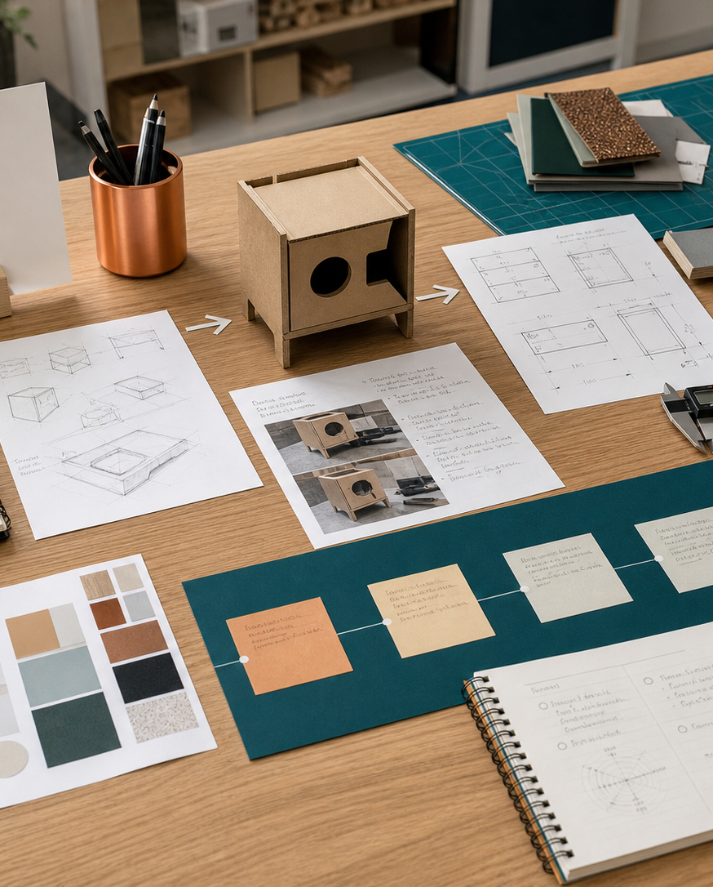
MODULE 13
Manufacturing, quality and production evidence
Plan and document a controlled production sequence that links workshop decisions to industrial and commercial practice.
Camping Environment - production and quality · P4.2 · P6.1
FORMATIVE LEARNING DECK
01
Notes:
Teaching focus: Establish the purpose of Manufacturing, quality and production evidence.
Talking points
- Plan and document a controlled production sequence that links workshop decisions to industrial and commercial practice.
- Name the three learning areas without teaching them yet: Production sequence and quality assurance; Industrial and commercial production links; Recording practical skills and production decisions.
- Explain that this deck supports classroom learning and formative evidence. Current teacher directions and formal notices remain authoritative.
Transition: Move from the module purpose to the three-part learning map.
[Sources]
- NESA Design and Technology Stage 6 Syllabus (2013), official course authority
- Current Year 11 site source register and source-bound module data
- Visual: approved family-generated teaching asset, Year 12 D&T assets/images/course-hero.png
[/Sources]

Slide 2
YEAR 11 DESIGN & TECHNOLOGY · MODULE 13
Three ideas build one evidence pathway
APPLY + KEEP EVIDENCE
Develop a production plan with process trials, quality checkpoints, evidence captions and an industrial/commercial comparison.
Year 11 Preliminary · Term 3 · Weeks 5–6
02
Notes:
Teaching focus: Preview the three named ideas as a connected sequence.
Talking points
- 1. Production sequence and quality assurance: Create a production sequence that controls accuracy, fit, finish and rework before errors compound.
- 2. Industrial and commercial production links: Relate school project methods to comparable industrial or commercial processes without pretending they are identical.
- 3. Recording practical skills and production decisions: Create concise folio evidence that demonstrates process, judgement and safe practical skill.
- Retrieval prompt: Which idea is most likely to change a real design decision in Camping Environment - production and quality, and why?
Transition: Begin with Production sequence and quality assurance.
[Sources]
- NESA Design and Technology Stage 6 Syllabus (2013), official course authority
- Current Year 11 site source register and source-bound module data
- Visual: current Year 11 local teaching asset assets/module-13-map.svg
[/Sources]

Slide 3
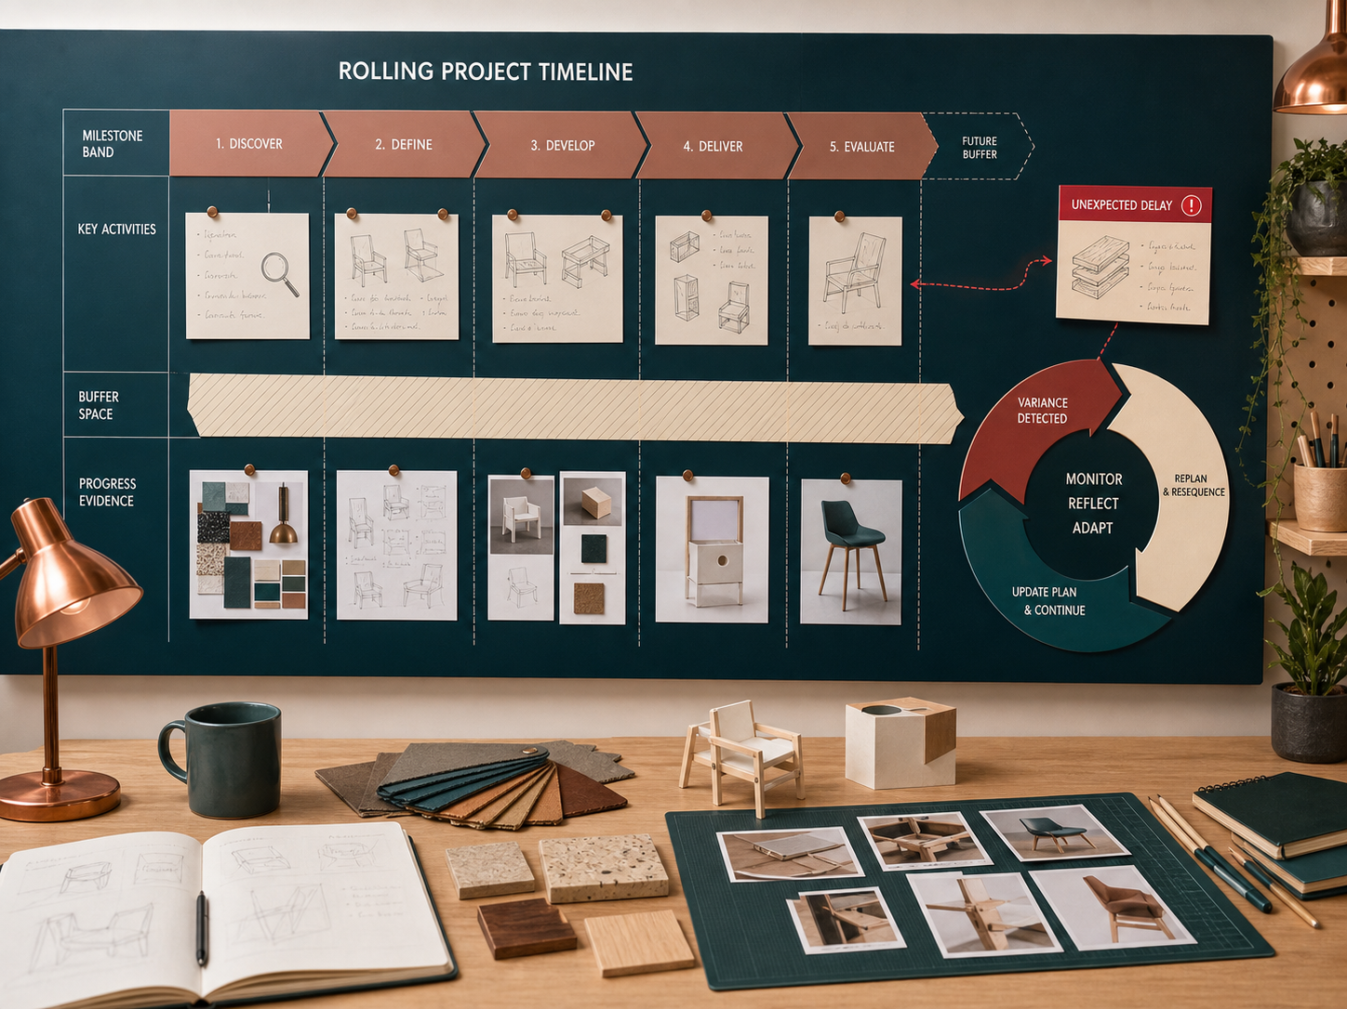
YEAR 11 DESIGN & TECHNOLOGY · MODULE 13
Production sequence and quality assurance
Critical dimensions and reference surfaces should be identified before components are processed.
Quality checkpoints should occur before errors become hidden or expensive to correct.
Jigs, templates, gauges and documented settings can improve repeatability.
LOOK FOR · KEY RELATIONSHIPS AND EVIDENCE
EVIDENCE PROMPT · A joint becomes inaccessible after assembly. When should its fit and strength be checked?
Year 11 Preliminary · Term 3 · Weeks 5–6
03
Notes:
Teaching focus: Create a production sequence that controls accuracy, fit, finish and rework before errors compound.
Talking points
- Critical dimensions and reference surfaces should be identified before components are processed.
- Quality checkpoints should occur before errors become hidden or expensive to correct.
- Jigs, templates, gauges and documented settings can improve repeatability.
- A production plan should include safe setup, process, inspection, correction and evidence capture.
- Visual notice: Ask students what the scene makes visible about production sequence and quality assurance, then connect observations to the stated principles.
- Evidence prompt: A joint becomes inaccessible after assembly. When should its fit and strength be checked?
Likely misconceptions
- Quality assurance and quality control mean the same thing.
- A final inspection can compensate for missing earlier checkpoints.
- A highly skilled worker does not need jigs or gauges.
Transition: Move to Industrial and commercial production links.
[Sources]
- Y11 source note: NESA manufacturing and production content; teacher answer booklet on quality and process selection.
- Visual: approved family-generated teaching asset, Year 12 D&T assets/images/m06s02.png
[/Sources]

Slide 4

YEAR 11 DESIGN & TECHNOLOGY · MODULE 13
Industrial and commercial production links
School prototyping and commercial production may use similar design logic but different equipment, volume and accountability.
Industrial settings often divide work among specialist roles and formalise specifications, traceability and quality checks.
Commercial decisions include demand, lead time, unit cost, reliability, compliance, distribution and after-sales responsibility.
EVIDENCE PROMPT · A student laser-cuts one component, while a manufacturer cuts thousands. What is the strongest comparison?
LOOK FOR · KEY RELATIONSHIPS AND EVIDENCE
Year 11 Preliminary · Term 3 · Weeks 5–6
04
Notes:
Teaching focus: Relate school project methods to comparable industrial or commercial processes without pretending they are identical.
Talking points
- School prototyping and commercial production may use similar design logic but different equipment, volume and accountability.
- Industrial settings often divide work among specialist roles and formalise specifications, traceability and quality checks.
- Commercial decisions include demand, lead time, unit cost, reliability, compliance, distribution and after-sales responsibility.
- A useful comparison explains what could transfer to the school project and what cannot be assumed.
- Visual notice: Ask students what the scene makes visible about industrial and commercial production links, then connect observations to the stated principles.
- Evidence prompt: A student laser-cuts one component, while a manufacturer cuts thousands. What is the strongest comparison?
Likely misconceptions
- Using a digital machine makes a school process industrial.
- Commercial production focuses on profit instead of quality or user needs.
- Industrial processes always create less waste than one-off production.
Transition: Move to Recording practical skills and production decisions.
[Sources]
- Y11 source note: NESA course requirement to relate school projects to industrial and commercial settings; teacher answer booklet.
- Visual: approved family-generated teaching asset, Year 12 D&T assets/images/m03s02.png
[/Sources]

Slide 5
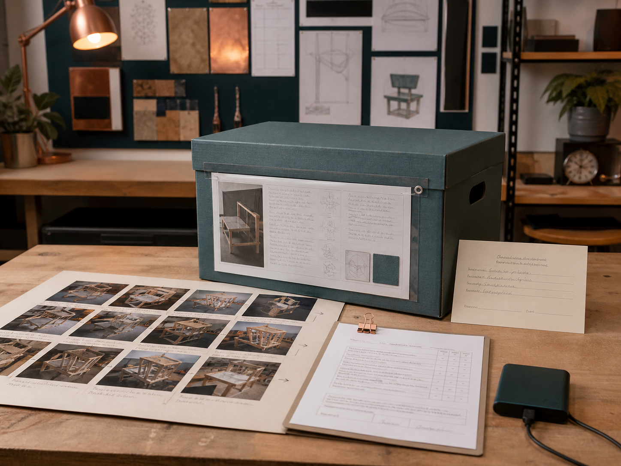
YEAR 11 DESIGN & TECHNOLOGY · MODULE 13
Recording practical skills and production decisions
A strong caption identifies the operation, relevant requirement, observation and next decision.
Evidence should be captured at critical stages rather than recreated after completion.
Practical skill is shown through control, accuracy, safe setup, appropriate technique and response to problems.
LOOK FOR · KEY RELATIONSHIPS AND EVIDENCE
EVIDENCE PROMPT · A photograph shows a component clamped during drilling. Which caption is strongest?
Year 11 Preliminary · Term 3 · Weeks 5–6
05
Notes:
Teaching focus: Create concise folio evidence that demonstrates process, judgement and safe practical skill.
Talking points
- A strong caption identifies the operation, relevant requirement, observation and next decision.
- Evidence should be captured at critical stages rather than recreated after completion.
- Practical skill is shown through control, accuracy, safe setup, appropriate technique and response to problems.
- The folio should select representative evidence rather than include every photograph taken.
- Visual notice: Ask students what the scene makes visible about recording practical skills and production decisions, then connect observations to the stated principles.
- Evidence prompt: A photograph shows a component clamped during drilling. Which caption is strongest?
Likely misconceptions
- More photographs always provide stronger evidence.
- A caption should describe only what can already be seen.
- Practical skill is demonstrated by naming the tool correctly.
Transition: Move from teaching into retrieval across all three ideas.
[Sources]
- Y11 source note: Current Camping Environment work-in-progress requirement; teacher answer booklet on communication and evaluation evidence.
- Visual: approved family-generated teaching asset, Year 12 D&T assets/images/m01s02.png
[/Sources]

Slide 6
YEAR 11 DESIGN & TECHNOLOGY · MODULE 13
Retrieve first; then check and improve
Answer without notes. Use one precise sentence for each check.
01
A joint becomes inaccessible after assembly. When should its fit and strength be checked?
A calm checking cycle
1 Recall from memory
02
A student laser-cuts one component, while a manufacturer cuts thousands. What is the strongest comparison?
2 Check the matching section
3 Repair the reason, not just the word
03
A photograph shows a component clamped during drilling. Which caption is strongest?
4 Try the question again
Year 11 Preliminary · Term 3 · Weeks 5–6
06
Notes:
Teaching focus: Use retrieval to expose and repair reasoning gaps across all three sections.
Talking points
- Give quiet recall time before inviting answers.
- Check 1: A joint becomes inaccessible after assembly. When should its fit and strength be checked?
- Indicative answer: Before final assembly, using defined acceptance criteria and recording any correction before the joint is concealed.
- Check 2: A student laser-cuts one component, while a manufacturer cuts thousands. What is the strongest comparison?
- Indicative answer: Compare file preparation and cutting purpose, then explain differences in nesting, automation, quality assurance, maintenance, throughput and unit cost.
- Check 3: A photograph shows a component clamped during drilling. Which caption is strongest?
- Indicative answer: The component was secured against a drilling jig to control hole position and prevent movement; the first hole measured within tolerance, so the setup was retained for the batch.
- Ask students to explain why the answer is defensible before they return to notes.
Transition: Use the retrieved ideas to construct one sustained piece of evidence.
[Sources]
- Y11 source note: NESA manufacturing and production content; teacher answer booklet on quality and process selection.
- Y11 source note: NESA course requirement to relate school projects to industrial and commercial settings; teacher answer booklet.
- Y11 source note: Current Camping Environment work-in-progress requirement; teacher answer booklet on communication and evaluation evidence.
[/Sources]

Slide 7
YEAR 11 DESIGN & TECHNOLOGY · MODULE 13
Construct evidence that makes reasoning visible
Develop a production plan with process trials, quality checkpoints, evidence captions and an industrial/commercial comparison.
READ
Identify the design question
SELECT
• Name the user, context or design issue.
• Select one relevant principle from this module.
• Explain how the evidence changes a decision.
• Check the decision against the need, criteria or source.
Choose relevant evidence
EXPLAIN
Connect evidence to the decision
CHECK
Test against the requirement
SENTENCE SUPPORT · The evidence shows … This matters because … Therefore I would …
Year 11 Preliminary · Term 3 · Weeks 5–6
07
Notes:
Teaching focus: Guide one higher-order formative response using all three module ideas.
Talking points
- Prompt: Develop a production plan with process trials, quality checkpoints, evidence captions and an industrial/commercial comparison.
- Read: identify the user, context and design question.
- Select: choose source-bound evidence rather than a preference.
- Explain: connect the evidence to a design consequence or decision.
- Check: test the response against the relevant need, criterion or source.
- Remind students that this is formative learning evidence, not a formal submission instruction.
Transition: Close by asking each student to retain the response and name the next useful action.
[Sources]
- Y11 source note: NESA manufacturing and production content; teacher answer booklet on quality and process selection.
- Y11 source note: NESA course requirement to relate school projects to industrial and commercial settings; teacher answer booklet.
- Y11 source note: Current Camping Environment work-in-progress requirement; teacher answer booklet on communication and evaluation evidence.
[/Sources]

Slide 8
YEAR 11 DESIGN & TECHNOLOGY · MODULE 13
Leave with evidence, not just notes
01
02
03
RECALL
APPLY
ACT
One idea I can now explain accurately
One design decision or evidence judgement I can justify
One next action for Camping Environment - production and quality
Save a dated response in your module learning record or design folio. Follow teacher directions for any formal submission.
Year 11 Preliminary · Term 3 · Weeks 5–6
08
Notes:
Teaching focus: Make the exit ticket produce a concrete learning record and a manageable next action.
Talking points
- Ask students to complete all three prompts individually before discussion.
- Keep the record labelled formative learning evidence; do not imply a cloud submission or formal assessment requirement.
- Next action: connect the module evidence to Camping Environment - production and quality.
Transition: End with each student's own next action, not a generic summary.
[Sources]
- Y11 source note: NESA manufacturing and production content; teacher answer booklet on quality and process selection.
- Y11 source note: NESA course requirement to relate school projects to industrial and commercial settings; teacher answer booklet.
- Y11 source note: Current Camping Environment work-in-progress requirement; teacher answer booklet on communication and evaluation evidence.
[/Sources]

