Slide 1

MODULE 14
Marketing, sustainability and final evaluation
Evaluate the completed solution and communicate a credible market position using evidence rather than unsupported claims.
Camping Environment - evaluation and communication · P2.2 · P4.3 · P5.2
FORMATIVE LEARNING DECK
01
Notes:
Teaching focus: Establish the purpose of Marketing, sustainability and final evaluation.
Talking points
- Evaluate the completed solution and communicate a credible market position using evidence rather than unsupported claims.
- Name the three learning areas without teaching them yet: Ongoing and final evaluation; Marketing and commercial viability; Life-cycle thinking and responsible design claims.
- Explain that this deck supports classroom learning and formative evidence. Current teacher directions and formal notices remain authoritative.
Transition: Move from the module purpose to the three-part learning map.
[Sources]
- NESA Design and Technology Stage 6 Syllabus (2013), official course authority
- Current Year 11 site source register and source-bound module data
- Visual: approved family-generated teaching asset, Year 12 D&T assets/images/course-hero.png
[/Sources]

Slide 2
YEAR 11 DESIGN & TECHNOLOGY · MODULE 14
Three ideas build one evidence pathway
APPLY + KEEP EVIDENCE
Complete a criteria-based evaluation, life-cycle review and qualified marketing proposal for the camping product.
Year 11 Preliminary · Term 3 · Weeks 7–8
02
Notes:
Teaching focus: Preview the three named ideas as a connected sequence.
Talking points
- 1. Ongoing and final evaluation: Use criteria-linked evidence to make balanced judgements about process and product success.
- 2. Marketing and commercial viability: Explain how product, price, place and promotion interact for a defined target market.
- 3. Life-cycle thinking and responsible design claims: Evaluate environmental and social impacts across a product life cycle and qualify sustainability claims.
- Retrieval prompt: Which idea is most likely to change a real design decision in Camping Environment - evaluation and communication, and why?
Transition: Begin with Ongoing and final evaluation.
[Sources]
- NESA Design and Technology Stage 6 Syllabus (2013), official course authority
- Current Year 11 site source register and source-bound module data
- Visual: current Year 11 local teaching asset assets/module-14-map.svg
[/Sources]

Slide 3
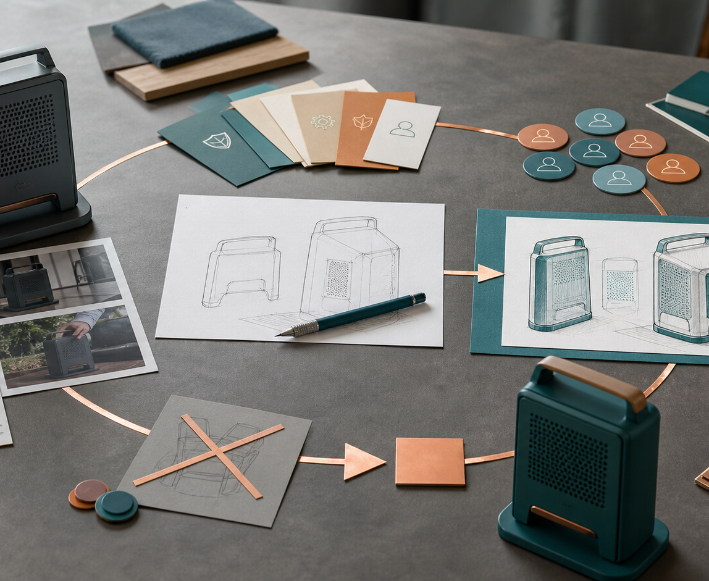
YEAR 11 DESIGN & TECHNOLOGY · MODULE 14
Ongoing and final evaluation
Each conclusion should refer to the relevant criterion, test or user evidence.
A balanced judgement distinguishes confirmed success, partial success, failure and unresolved uncertainty.
Process evaluation considers research, planning, communication, resources, production and continual decision-making.
LOOK FOR · KEY RELATIONSHIPS AND EVIDENCE
EVIDENCE PROMPT · A compactness criterion was met, but user testing found the product awkward to set up. What is the strongest evaluation?
Year 11 Preliminary · Term 3 · Weeks 7–8
03
Notes:
Teaching focus: Use criteria-linked evidence to make balanced judgements about process and product success.
Talking points
- Each conclusion should refer to the relevant criterion, test or user evidence.
- A balanced judgement distinguishes confirmed success, partial success, failure and unresolved uncertainty.
- Process evaluation considers research, planning, communication, resources, production and continual decision-making.
- Recommended improvements should address a demonstrated limitation and explain the likely benefit.
- Visual notice: Ask students what the scene makes visible about ongoing and final evaluation, then connect observations to the stated principles.
- Evidence prompt: A compactness criterion was met, but user testing found the product awkward to set up. What is the strongest evaluation?
Likely misconceptions
- Every criterion should be described as met if the product was completed.
- Final evaluation is stronger when it contains only numerical results.
- A product limitation proves the whole project was unsuccessful.
Transition: Move to Marketing and commercial viability.
[Sources]
- Y11 source note: Current Camping Environment evaluation requirements; teacher answer booklet on continual and final evaluation.
- Visual: approved family-generated teaching asset, Year 12 D&T assets/images/m11s01.png
[/Sources]

Slide 4
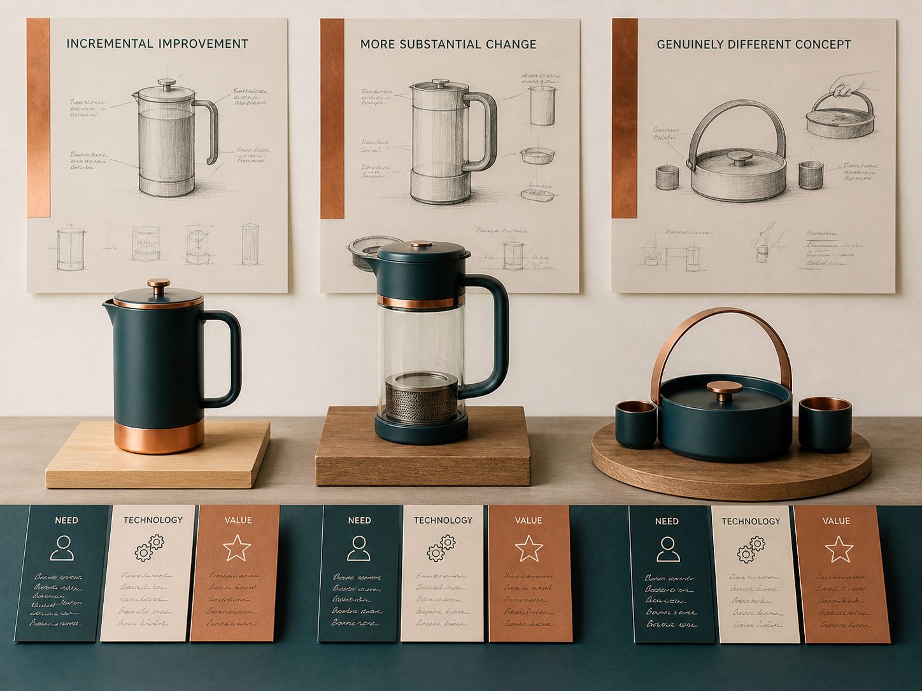
YEAR 11 DESIGN & TECHNOLOGY · MODULE 14
Marketing and commercial viability
The product decision includes features, quality, appearance, packaging, service and the need being addressed.
Price must consider cost, perceived value, target-market affordability and the margin required across the supply chain.
Place describes how and where the product reaches the user, which can affect packaging, stock, delivery and price.
EVIDENCE PROMPT · The product is intended for lightweight backpackers but requires bulky retail packaging. What should be reconsidered?
LOOK FOR · KEY RELATIONSHIPS AND EVIDENCE
Year 11 Preliminary · Term 3 · Weeks 7–8
04
Notes:
Teaching focus: Explain how product, price, place and promotion interact for a defined target market.
Talking points
- The product decision includes features, quality, appearance, packaging, service and the need being addressed.
- Price must consider cost, perceived value, target-market affordability and the margin required across the supply chain.
- Place describes how and where the product reaches the user, which can affect packaging, stock, delivery and price.
- Promotion should communicate supportable benefits to the target market through suitable channels and messages.
- Visual notice: Ask students what the scene makes visible about marketing and commercial viability, then connect observations to the stated principles.
- Evidence prompt: The product is intended for lightweight backpackers but requires bulky retail packaging. What should be reconsidered?
Likely misconceptions
- A low price is the safest strategy for a new product.
- Place means the physical location shown in an advertisement.
- Promotion creates a target market even when no need has been demonstrated.
Transition: Move to Life-cycle thinking and responsible design claims.
[Sources]
- Y11 source note: Current Camping Environment marketing requirement; teacher answer booklet on RRP and commercial success; Drive marketing resources.
- Visual: approved family-generated teaching asset, Year 12 D&T assets/images/m02s01.png
[/Sources]

Slide 5
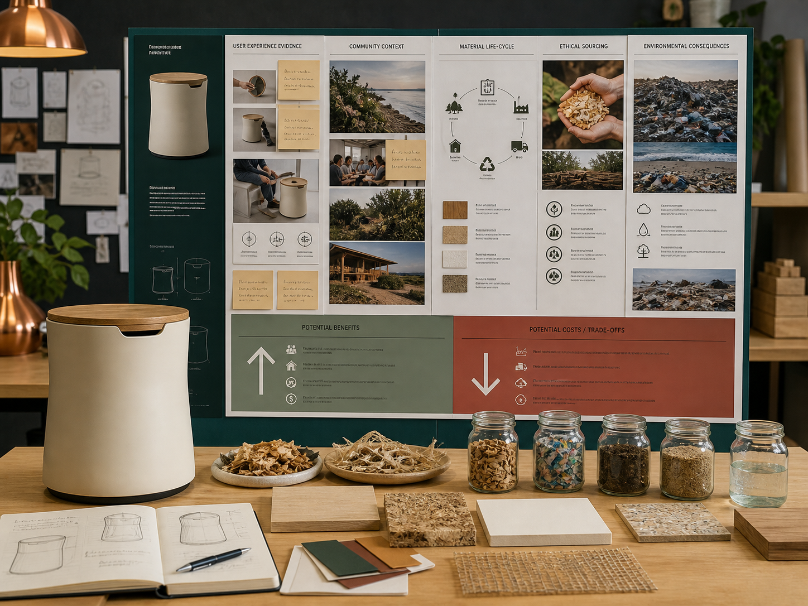
YEAR 11 DESIGN & TECHNOLOGY · MODULE 14
Life-cycle thinking and responsible design claims
Life-cycle thinking identifies where significant impacts and opportunities occur across the whole product system.
Durability, repairability, replaceable parts and disassembly can extend useful life and improve end-of-life options.
A lower-waste manufacturing process may still have high energy, transport or material impacts.
LOOK FOR · KEY RELATIONSHIPS AND EVIDENCE
EVIDENCE PROMPT · A student claims the product is environmentally friendly because offcuts were reused. How should the claim be repaired?
Year 11 Preliminary · Term 3 · Weeks 7–8
05
Notes:
Teaching focus: Evaluate environmental and social impacts across a product life cycle and qualify sustainability claims.
Talking points
- Life-cycle thinking identifies where significant impacts and opportunities occur across the whole product system.
- Durability, repairability, replaceable parts and disassembly can extend useful life and improve end-of-life options.
- A lower-waste manufacturing process may still have high energy, transport or material impacts.
- Responsible evaluation considers effects on individuals, society and the environment, including who benefits and who bears costs.
- Visual notice: Ask students what the scene makes visible about life-cycle thinking and responsible design claims, then connect observations to the stated principles.
- Evidence prompt: A student claims the product is environmentally friendly because offcuts were reused. How should the claim be repaired?
Likely misconceptions
- A recyclable material guarantees a recyclable product.
- The use stage is the only important impact for a reusable camping product.
- Local manufacture automatically creates the lowest environmental impact.
Transition: Move from teaching into retrieval across all three ideas.
[Sources]
- Y11 source note: NESA environmental and social issues content; teacher answer booklet life-cycle and sustainability responses.
- Visual: approved family-generated teaching asset, Year 12 D&T assets/images/m03s03.png
[/Sources]

Slide 6
YEAR 11 DESIGN & TECHNOLOGY · MODULE 14
Retrieve first; then check and improve
Answer without notes. Use one precise sentence for each check.
01
A compactness criterion was met, but user testing found the product awkward to set up. What is the strongest evaluation?
A calm checking cycle
1 Recall from memory
02
The product is intended for lightweight backpackers but requires bulky retail packaging. What should be reconsidered?
2 Check the matching section
3 Repair the reason, not just the word
03
A student claims the product is environmentally friendly because offcuts were reused. How should the claim be repaired?
4 Try the question again
Year 11 Preliminary · Term 3 · Weeks 7–8
06
Notes:
Teaching focus: Use retrieval to expose and repair reasoning gaps across all three sections.
Talking points
- Give quiet recall time before inviting answers.
- Check 1: A compactness criterion was met, but user testing found the product awkward to set up. What is the strongest evaluation?
- Indicative answer: Judge compactness as successful, usability as only partly successful, explain the test evidence and propose a targeted setup modification and retest.
- Check 2: The product is intended for lightweight backpackers but requires bulky retail packaging. What should be reconsidered?
- Indicative answer: Review product, packaging, distribution place, shipping cost and promotion together because the current package conflicts with the market’s portability values.
- Check 3: A student claims the product is environmentally friendly because offcuts were reused. How should the claim be repaired?
- Indicative answer: Limit the claim to the observed waste reduction, then discuss material source, production, durability, repair, use and end-of-life evidence that is still required.
- Ask students to explain why the answer is defensible before they return to notes.
Transition: Use the retrieved ideas to construct one sustained piece of evidence.
[Sources]
- Y11 source note: Current Camping Environment evaluation requirements; teacher answer booklet on continual and final evaluation.
- Y11 source note: Current Camping Environment marketing requirement; teacher answer booklet on RRP and commercial success; Drive marketing resources.
- Y11 source note: NESA environmental and social issues content; teacher answer booklet life-cycle and sustainability responses.
[/Sources]

Slide 7
YEAR 11 DESIGN & TECHNOLOGY · MODULE 14
Construct evidence that makes reasoning visible
Complete a criteria-based evaluation, life-cycle review and qualified marketing proposal for the camping product.
READ
Identify the design question
SELECT
• Name the user, context or design issue.
• Select one relevant principle from this module.
• Explain how the evidence changes a decision.
• Check the decision against the need, criteria or source.
Choose relevant evidence
EXPLAIN
Connect evidence to the decision
CHECK
Test against the requirement
SENTENCE SUPPORT · The evidence shows … This matters because … Therefore I would …
Year 11 Preliminary · Term 3 · Weeks 7–8
07
Notes:
Teaching focus: Guide one higher-order formative response using all three module ideas.
Talking points
- Prompt: Complete a criteria-based evaluation, life-cycle review and qualified marketing proposal for the camping product.
- Read: identify the user, context and design question.
- Select: choose source-bound evidence rather than a preference.
- Explain: connect the evidence to a design consequence or decision.
- Check: test the response against the relevant need, criterion or source.
- Remind students that this is formative learning evidence, not a formal submission instruction.
Transition: Close by asking each student to retain the response and name the next useful action.
[Sources]
- Y11 source note: Current Camping Environment evaluation requirements; teacher answer booklet on continual and final evaluation.
- Y11 source note: Current Camping Environment marketing requirement; teacher answer booklet on RRP and commercial success; Drive marketing resources.
- Y11 source note: NESA environmental and social issues content; teacher answer booklet life-cycle and sustainability responses.
[/Sources]

Slide 8
YEAR 11 DESIGN & TECHNOLOGY · MODULE 14
Leave with evidence, not just notes
01
02
03
RECALL
APPLY
ACT
One idea I can now explain accurately
One design decision or evidence judgement I can justify
One next action for Camping Environment - evaluation and communication
Save a dated response in your module learning record or design folio. Follow teacher directions for any formal submission.
Year 11 Preliminary · Term 3 · Weeks 7–8
08
Notes:
Teaching focus: Make the exit ticket produce a concrete learning record and a manageable next action.
Talking points
- Ask students to complete all three prompts individually before discussion.
- Keep the record labelled formative learning evidence; do not imply a cloud submission or formal assessment requirement.
- Next action: connect the module evidence to Camping Environment - evaluation and communication.
Transition: End with each student's own next action, not a generic summary.
[Sources]
- Y11 source note: Current Camping Environment evaluation requirements; teacher answer booklet on continual and final evaluation.
- Y11 source note: Current Camping Environment marketing requirement; teacher answer booklet on RRP and commercial success; Drive marketing resources.
- Y11 source note: NESA environmental and social issues content; teacher answer booklet life-cycle and sustainability responses.
[/Sources]

