Slide 1

TERM 1 · MODULE 1
Food Equity
Judge whether people can reliably obtain food and safe water that suit their needs.
YEAR 10 FOOD TECHNOLOGY · 2026
Notes:
Purpose: Judge whether people can reliably obtain food and safe water that suit their needs.
Teacher talking point: Introduce the term focus area and ask students what evidence they would need before making a judgement.
The original photograph is an illustrative teaching image, not a record of this class or a set practical.
Source boundary: year-10-food-technology-2026-source-map-v1; NESA Food Technology 7–10 Syllabus (2019). Live tasks and due dates remain in Google Classroom.

Slide 2
The learning path
01
What food equity means
02
Barriers to food and water
03
Investigate and respond
BEFORE WE BEGIN
A shop has food on its shelves. Does that prove everyone nearby can use it?
YEAR 10 FOOD TECHNOLOGY · FOOD EQUITY
02 / 08
Notes:
Route through the three named sections: What food equity means; Barriers to food and water; Investigate and respond.
Retrieval prompt: A shop has food on its shelves. Does that prove everyone nearby can use it?
Listen for students treating a visible product or photograph as complete evidence; ask what it does and does not show.
Sources: https://classroom.google.com/w/ODQxODU0NzM4OTcw/t/all; https://www.nsw.gov.au/education-and-training/nesa/curriculum/tas/food-technology-7-10-2019

Slide 3
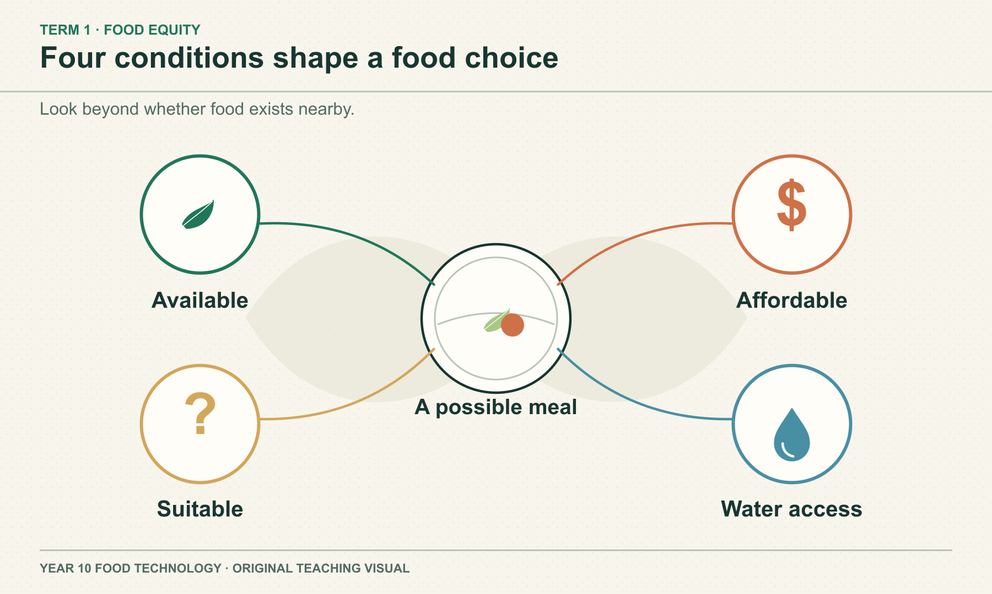
SECTION 1.1 · WHAT FOOD EQUITY MEANS
A stocked shelf does not prove access
Availability means food is there. Access asks whether someone can obtain and use it. Price, travel, time, storage and suitability can change the answer. Two households near one shop can face very different choices.
DISCUSS
Which condition could block a choice even when the food is in stock?
YEAR 10 FOOD TECHNOLOGY · FOOD EQUITY
03 / 08
Notes:
Teaching area: What food equity means.
Talking points: Availability means food is there. Access asks whether someone can obtain and use it. Price, travel, time, storage and suitability can change the answer. Two households near one shop can face very different choices.
Worked example from the approved source: A fruit shop may be close in kilometres but effectively distant if there is no affordable transport. Compare travel time and cost as well as the shelf price before judging access.
Ask: Which condition could block a choice even when the food is in stock?
Likely misconception: The same distance and shelf price mean equal access.
Visual: original authored diagram module-01-section-1.svg. Purpose: Help students explain food equity as a combination of access conditions rather than supply alone. Exception: Exact simultaneous relationship and reading order require a diagram; photography cannot show four abstract access conditions without stereotyping.
Sources: https://classroom.google.com/w/ODQxODU0NzM4OTcw/t/all ; https://www.nsw.gov.au/education-and-training/nesa/curriculum/tas/food-technology-7-10-2019 ; https://www.aihw.gov.au/reports/australias-health/social-determinants-of-health ; https://www.eatforhealth.gov.au/food-essentials/five-food-groups
Practical, recipe and assessment directions are controlled by the teacher and live Classroom posts.

Slide 4
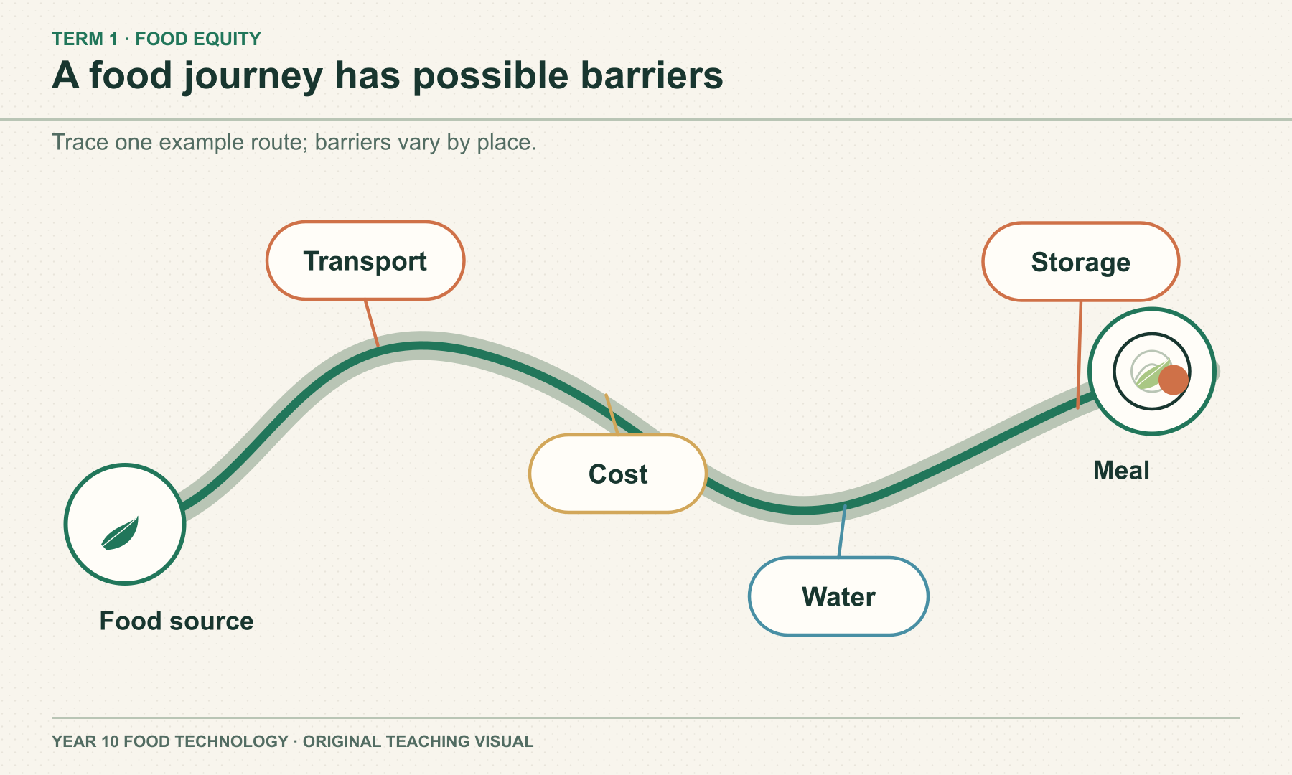
SECTION 1.2 · BARRIERS TO FOOD AND WATER
Barriers occur across the whole journey
The cost of food may include transport, electricity and time. Deliveries can be disrupted. Safe water also affects what people can drink and prepare. Name the actual barrier before choosing a response.
DISCUSS
Would a lower shelf price fix an unreliable water supply?
YEAR 10 FOOD TECHNOLOGY · FOOD EQUITY
04 / 08
Notes:
Teaching area: Barriers to food and water.
Talking points: The cost of food may include transport, electricity and time. Deliveries can be disrupted. Safe water also affects what people can drink and prepare. Name the actual barrier before choosing a response.
Worked example from the approved source: If a storm interrupts deliveries, compare a short-term supply response with a longer-term plan for reliable transport. The two actions address different time scales.
Ask: Would a lower shelf price fix an unreliable water supply?
Likely misconception: One solution, such as desalination, solves every access problem.
Visual: original authored diagram module-01-section-2.svg. Purpose: Prompt students to locate and explain possible barriers along an example food journey. Exception: A route diagram makes the position and multiple possible interruption points explicit; a photo cannot show this abstract pathway.
Sources: https://classroom.google.com/w/ODQxODU0NzM4OTcw/t/all ; https://www.nsw.gov.au/education-and-training/nesa/curriculum/tas/food-technology-7-10-2019 ; https://www.aihw.gov.au/reports/australias-health/social-determinants-of-health ; https://www.who.int/news-room/fact-sheets/detail/drinking-water ; https://www.who.int/publications/i/item/WHO-HSE-WSH-11.03
Practical, recipe and assessment directions are controlled by the teacher and live Classroom posts.

Slide 5
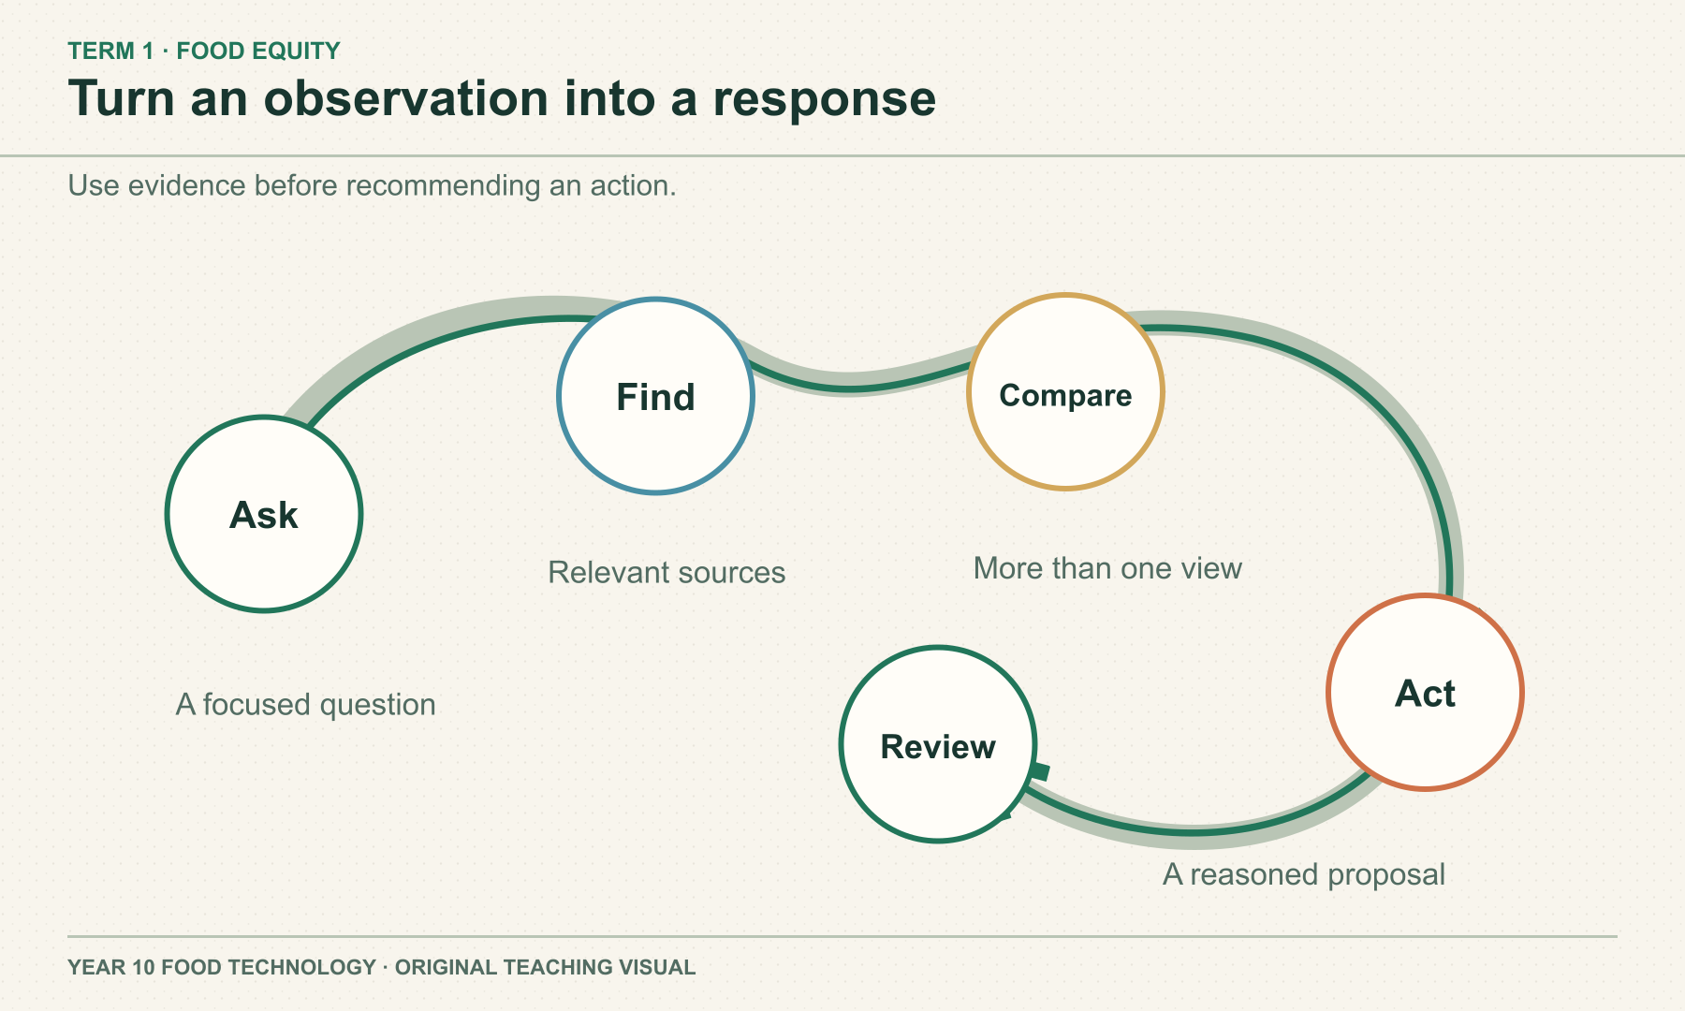
SECTION 1.3 · INVESTIGATE AND RESPOND
A response needs evidence of change
Begin with a focused question. Check the source, date and scale of each piece of evidence. Separate what a map or price shows from what you infer about people. Match the response to the barrier, then review who benefits.
DISCUSS
What would show whether a new shop improved real access?
YEAR 10 FOOD TECHNOLOGY · FOOD EQUITY
05 / 08
Notes:
Teaching area: Investigate and respond.
Talking points: Begin with a focused question. Check the source, date and scale of each piece of evidence. Separate what a map or price shows from what you infer about people. Match the response to the barrier, then review who benefits.
Worked example from the approved source: A map shows a supermarket 2 km away. Before calling it accessible, investigate the route, transport, opening hours, total cost and whether suitable food is consistently stocked.
Ask: What would show whether a new shop improved real access?
Likely misconception: A nearby shop proves everyone can reach suitable food.
Visual: original authored diagram module-01-section-3.svg. Purpose: Give students a reusable evidence path for investigating a food equity issue and proposing a response. Exception: The spatial feedback loop makes revision visible; a static photograph cannot express the inquiry sequence clearly.
Sources: https://classroom.google.com/w/ODQxODU0NzM4OTcw/t/all ; https://www.nsw.gov.au/education-and-training/nesa/curriculum/tas/food-technology-7-10-2019 ; https://www.aihw.gov.au/reports/australias-health/social-determinants-of-health ; https://www.who.int/news-room/fact-sheets/detail/drinking-water
Practical, recipe and assessment directions are controlled by the teacher and live Classroom posts.

Slide 6
Check what you can explain
Answer from the learning just shown. Add a reason or example.
01
What is the difference between availability and access?
02
Name one cost beyond the shelf price.
03
Why does safe water belong in a food access discussion?
04
What can a map show, and what must you still check?
YEAR 10 FOOD TECHNOLOGY · FOOD EQUITY
06 / 08
Notes:
Pause for retrieval before showing or discussing answers. Invite a short explanation, not just a keyword.
Question prompts: What is the difference between availability and access? | Name one cost beyond the shelf price. | Why does safe water belong in a food access discussion? | What can a map show, and what must you still check?
If an answer depends on a local recipe, due date or practical procedure, return to the source boundary and check the teacher's current Classroom instructions.
Source: year-10-food-technology-2026-source-map-v1.

Slide 7
Build a reasoned response
YOUR TASK
READ
A new shop opens in a community. Evaluate whether it improves access for the people it intends to serve.
Read the claim and identify who it concerns.
SELECT
Select evidence about total cost, travel, suitability and reliable supply.
EXPLAIN
Explain one likely benefit and one limit.
Sentence support
The new shop may improve ___ for ___ because ___. It may still leave ___ unresolved.
CHECK
Check what remains uncertain and choose an indicator for review.
YEAR 10 FOOD TECHNOLOGY · FOOD EQUITY
07 / 08
Notes:
Guide a short written response. Ask students to use course theory and state limits.
Prompt: A new shop opens in a community. Evaluate whether it improves access for the people it intends to serve.
Scaffold: Read the claim and identify who it concerns. / Select evidence about total cost, travel, suitability and reliable supply. / Explain one likely benefit and one limit. / Check what remains uncertain and choose an indicator for review.
Model one sentence only; leave the judgement to students.
Source: matching section theory in this module and https://www.nsw.gov.au/education-and-training/nesa/curriculum/tas/food-technology-7-10-2019.

Slide 8
Exit evidence
Before you leave, write:
01
One condition that shapes access
02
One piece of evidence I would collect
03
One limitation I would state
Save your written response in this module’s learning package. Export My folio for a backup. Check Google Classroom for live teacher instructions.
YEAR 10 FOOD TECHNOLOGY · FOOD EQUITY
08 / 08
Notes:
Exit ticket: One condition that shapes access; One piece of evidence I would collect; One limitation I would state.
Evidence destination: the module learning packages on the local course site. These save on this device; My folio provides an export backup. Google Classroom remains the authority for any live teacher task, due date or submission.
Transition: Ask students to identify the next evidence gap before moving to the following module.
Source boundary: year-10-food-technology-2026-source-map-v1.

