Slide 1
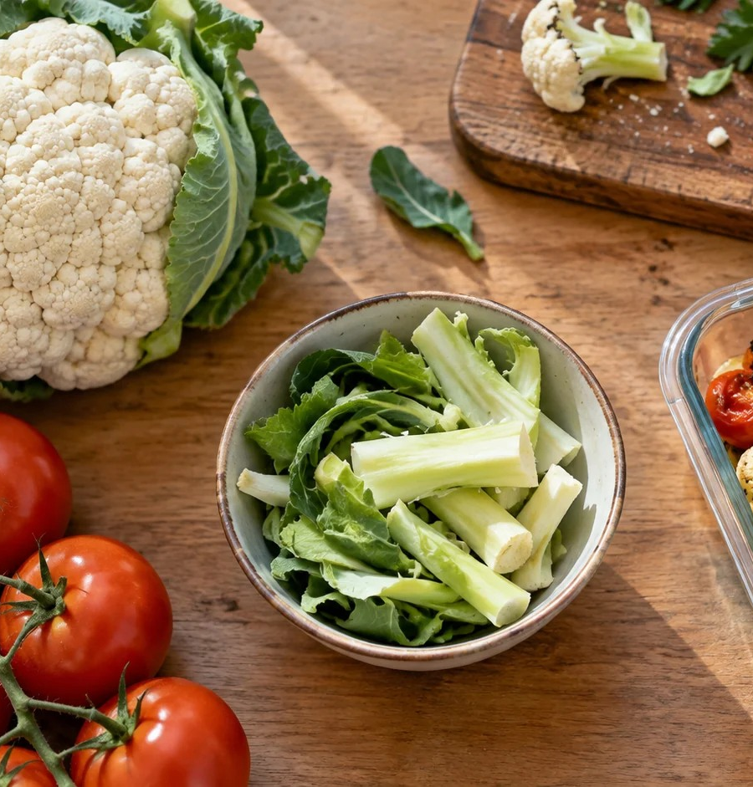
TERM 2 · MODULE 2
Food Trends
Explain why trends spread and test claims about benefit, waste and value.
YEAR 10 FOOD TECHNOLOGY · 2026
Notes:
Purpose: Explain why trends spread and test claims about benefit, waste and value.
Teacher talking point: Introduce the term focus area and ask students what evidence they would need before making a judgement.
The original photograph is an illustrative teaching image, not a record of this class or a set practical.
Source boundary: year-10-food-technology-2026-source-map-v1; NESA Food Technology 7–10 Syllabus (2019). Live tasks and due dates remain in Google Classroom.

Slide 2
The learning path
01
Why food trends emerge
02
Local produce, waste and value adding
03
Evaluate a food trend
BEFORE WE BEGIN
A product is popular online. Which claim would you test before recommending it?
YEAR 10 FOOD TECHNOLOGY · FOOD TRENDS
02 / 08
Notes:
Route through the three named sections: Why food trends emerge; Local produce, waste and value adding; Evaluate a food trend.
Retrieval prompt: A product is popular online. Which claim would you test before recommending it?
Listen for students treating a visible product or photograph as complete evidence; ask what it does and does not show.
Sources: https://classroom.google.com/w/ODQxODU0NzM4OTcw/t/all; https://www.nsw.gov.au/education-and-training/nesa/curriculum/tas/food-technology-7-10-2019

Slide 3
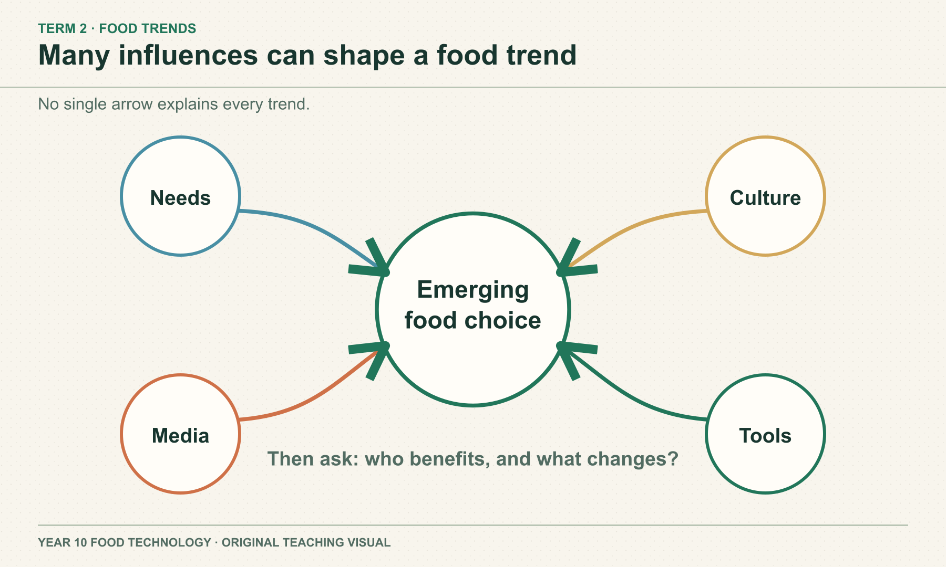
SECTION 2.1 · WHY FOOD TRENDS EMERGE
Popularity does not establish a benefit
Food trends can spread through lifestyle changes, culture, media and new products. A menu claim can attract attention without proving a health or environmental result. Ask who the trend suits and what evidence supports each claim.
DISCUSS
What evidence would test a menu claim of “local and healthy”?
YEAR 10 FOOD TECHNOLOGY · FOOD TRENDS
03 / 08
Notes:
Teaching area: Why food trends emerge.
Talking points: Food trends can spread through lifestyle changes, culture, media and new products. A menu claim can attract attention without proving a health or environmental result. Ask who the trend suits and what evidence supports each claim.
Worked example from the approved source: A menu calls a meal ‘local and healthy’. Identify two separate claims. Check origin evidence for ‘local’ and relevant nutrition information for ‘healthy’ rather than treating the phrase as one proven fact.
Ask: What evidence would test a menu claim of “local and healthy”?
Likely misconception: A trend that sells well must be healthier for everyone.
Visual: original authored diagram module-02-section-1.svg. Purpose: Show that a food trend can be influenced by several forces, so students should investigate rather than assume one cause. Exception: Exact many-to-one relationship without invented quantities is central to the concept; photography would show only one example.
Sources: https://classroom.google.com/w/ODQxODU0NzM4OTcw/t/all ; https://www.nsw.gov.au/education-and-training/nesa/curriculum/tas/food-technology-7-10-2019 ; https://education.nsw.gov.au/teaching-and-learning/curriculum/tas/tas-curriculum-resources-7-12/tas-7-10-curriculum-resources/food-technology-food-trends ; https://www.eatforhealth.gov.au/food-essentials/five-food-groups
Practical, recipe and assessment directions are controlled by the teacher and live Classroom posts.

Slide 4
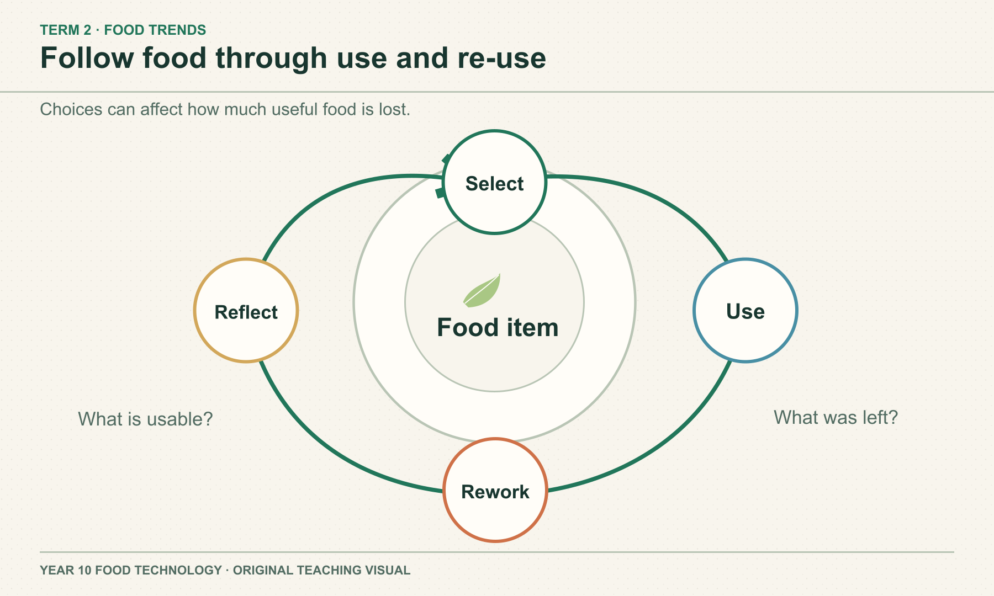
SECTION 2.2 · LOCAL PRODUCE, WASTE AND VALUE ADDING
Distance is one part of the food pathway
“Local” depends on the boundary being used. Food miles describe travel distance, yet production, storage, transport type, packaging and waste also matter. Value adding may use sound surplus food, but extra processing can use resources.
DISCUSS
What else would you compare besides the kilometres travelled?
YEAR 10 FOOD TECHNOLOGY · FOOD TRENDS
04 / 08
Notes:
Teaching area: Local produce, waste and value adding.
Talking points: “Local” depends on the boundary being used. Food miles describe travel distance, yet production, storage, transport type, packaging and waste also matter. Value adding may use sound surplus food, but extra processing can use resources.
Worked example from the approved source: A ‘local’ tomato and a tomato from another region cannot be compared fairly using distance alone. Ask about how each was produced, stored, moved and wasted before making an environmental claim.
Ask: What else would you compare besides the kilometres travelled?
Likely misconception: Shorter travel always means lower total environmental impact.
Visual: original authored diagram module-02-section-2.svg. Purpose: Connect local produce, food waste and value adding to repeated decisions across food use. Exception: Exact circular relationship and feedback make repeated decisions visible without inventing waste statistics or recipes.
Sources: https://classroom.google.com/w/ODQxODU0NzM4OTcw/t/all ; https://www.nsw.gov.au/education-and-training/nesa/curriculum/tas/food-technology-7-10-2019 ; https://education.nsw.gov.au/teaching-and-learning/curriculum/tas/tas-curriculum-resources-7-12/tas-7-10-curriculum-resources/food-technology-food-trends ; https://www.dcceew.gov.au/environment/protection/waste/food-waste ; https://www.dcceew.gov.au/environment/protection/waste/food-waste/end-food-waste-australia ; https://www.agriculture.gov.au/sites/default/files/documents/27308.pdf
Practical, recipe and assessment directions are controlled by the teacher and live Classroom posts.

Slide 5
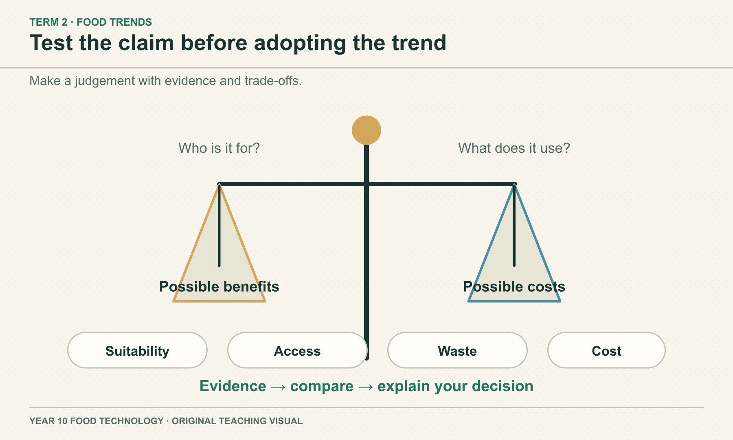
SECTION 2.3 · EVALUATE A FOOD TREND
A good trend judgement names the consumer
Define the intended consumer and test each claim separately. Compare nutrition information on a fair basis, including per 100 g when serving sizes differ. Then weigh price, access, suitability and possible waste. State what evidence is missing.
DISCUSS
Who benefits from the trend, and what would change your view?
YEAR 10 FOOD TECHNOLOGY · FOOD TRENDS
05 / 08
Notes:
Teaching area: Evaluate a food trend.
Talking points: Define the intended consumer and test each claim separately. Compare nutrition information on a fair basis, including per 100 g when serving sizes differ. Then weigh price, access, suitability and possible waste. State what evidence is missing.
Worked example from the approved source: Two similar snacks list different serving sizes. Compare the same nutrient per 100 g first, then consider the actual amount eaten, price, ingredients and the needs of the intended consumer.
Ask: Who benefits from the trend, and what would change your view?
Likely misconception: One label or headline is enough to prove a product is better.
Visual: original authored diagram module-02-section-3.svg. Purpose: Support evidence-based evaluation of a food trend against benefits and trade-offs. Exception: A balance explicitly places benefits and trade-offs side by side without false numeric scoring; a photo would privilege one product.
Sources: https://classroom.google.com/w/ODQxODU0NzM4OTcw/t/all ; https://classroom.google.com/c/ODQxODU0NzM4OTcw/a/ODYyOTA0NDM2MjUx/details ; https://www.nsw.gov.au/education-and-training/nesa/curriculum/tas/food-technology-7-10-2019 ; https://education.nsw.gov.au/teaching-and-learning/curriculum/tas/tas-curriculum-resources-7-12/tas-7-10-curriculum-resources/food-technology-food-trends ; https://www.foodstandards.gov.au/consumer/labelling/panels ; https://www.foodstandards.gov.au/consumer/labelling/nutrition ; https://www.accc.gov.au/consumers/advertising-and-promotions/environmental-and-sustainability-claims ; https://www.eatforhealth.gov.au/food-essentials/five-food-groups
Practical, recipe and assessment directions are controlled by the teacher and live Classroom posts.

Slide 6
Check what you can explain
Answer from the learning just shown. Add a reason or example.
01
Why might a food trend spread?
02
Why are food miles alone insufficient?
03
How could value adding create a cost as well as a benefit?
04
Why compare nutrition information per 100 g when servings differ?
YEAR 10 FOOD TECHNOLOGY · FOOD TRENDS
06 / 08
Notes:
Pause for retrieval before showing or discussing answers. Invite a short explanation, not just a keyword.
Question prompts: Why might a food trend spread? | Why are food miles alone insufficient? | How could value adding create a cost as well as a benefit? | Why compare nutrition information per 100 g when servings differ?
If an answer depends on a local recipe, due date or practical procedure, return to the source boundary and check the teacher's current Classroom instructions.
Source: year-10-food-technology-2026-source-map-v1.

Slide 7
Build a reasoned response
YOUR TASK
READ
A business promotes a “local, low waste, healthier” snack. Evaluate the claims for one defined group of consumers.
Read the three claims as separate statements.
SELECT
Select evidence for origin, waste, nutrition and affordability.
EXPLAIN
Explain a benefit and a trade-off for your consumer group.
Sentence support
For ___, the snack may be useful because ___. The claim about ___ still needs ___.
CHECK
Check what cannot yet be concluded.
YEAR 10 FOOD TECHNOLOGY · FOOD TRENDS
07 / 08
Notes:
Guide a short written response. Ask students to use course theory and state limits.
Prompt: A business promotes a “local, low waste, healthier” snack. Evaluate the claims for one defined group of consumers.
Scaffold: Read the three claims as separate statements. / Select evidence for origin, waste, nutrition and affordability. / Explain a benefit and a trade-off for your consumer group. / Check what cannot yet be concluded.
Model one sentence only; leave the judgement to students.
Source: matching section theory in this module and https://www.nsw.gov.au/education-and-training/nesa/curriculum/tas/food-technology-7-10-2019.

Slide 8
Exit evidence
Before you leave, write:
01
One reason a trend may spread
02
One claim I could test
03
One trade-off I would include
Save your written response in this module’s learning package. Export My folio for a backup. Check Google Classroom for live teacher instructions.
YEAR 10 FOOD TECHNOLOGY · FOOD TRENDS
08 / 08
Notes:
Exit ticket: One reason a trend may spread; One claim I could test; One trade-off I would include.
Evidence destination: the module learning packages on the local course site. These save on this device; My folio provides an export backup. Google Classroom remains the authority for any live teacher task, due date or submission.
Transition: Ask students to identify the next evidence gap before moving to the following module.
Source boundary: year-10-food-technology-2026-source-map-v1.

