Slide 1
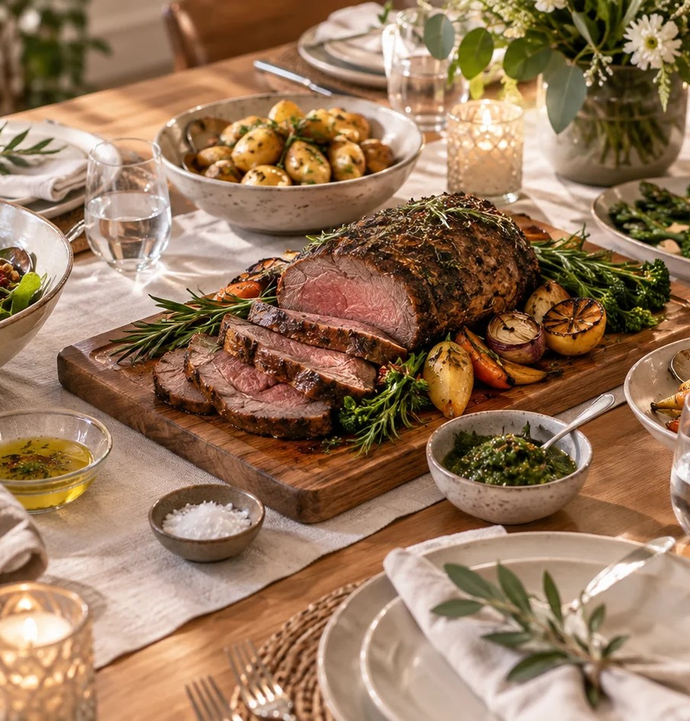
TERM 3 · MODULE 3
Food for Special Occasions
Explain the significance of occasion food and justify a menu against a brief.
YEAR 10 FOOD TECHNOLOGY · 2026
Notes:
Purpose: Explain the significance of occasion food and justify a menu against a brief.
Teacher talking point: Introduce the term focus area and ask students what evidence they would need before making a judgement.
The original photograph is an illustrative teaching image, not a record of this class or a set practical.
Source boundary: year-10-food-technology-2026-source-map-v1; NESA Food Technology 7–10 Syllabus (2019). Live tasks and due dates remain in Google Classroom.

Slide 2
The learning path
01
Food, identity and significance
02
Celebrations across time and place
03
Plan for an occasion
BEFORE WE BEGIN
Can one dish have different meanings for two people at the same celebration?
YEAR 10 FOOD TECHNOLOGY · FOOD FOR SPECIAL OCCASIONS
02 / 08
Notes:
Route through the three named sections: Food, identity and significance; Celebrations across time and place; Plan for an occasion.
Retrieval prompt: Can one dish have different meanings for two people at the same celebration?
Listen for students treating a visible product or photograph as complete evidence; ask what it does and does not show.
Sources: https://classroom.google.com/w/ODQxODU0NzM4OTcw/t/all; https://www.nsw.gov.au/education-and-training/nesa/curriculum/tas/food-technology-7-10-2019

Slide 3
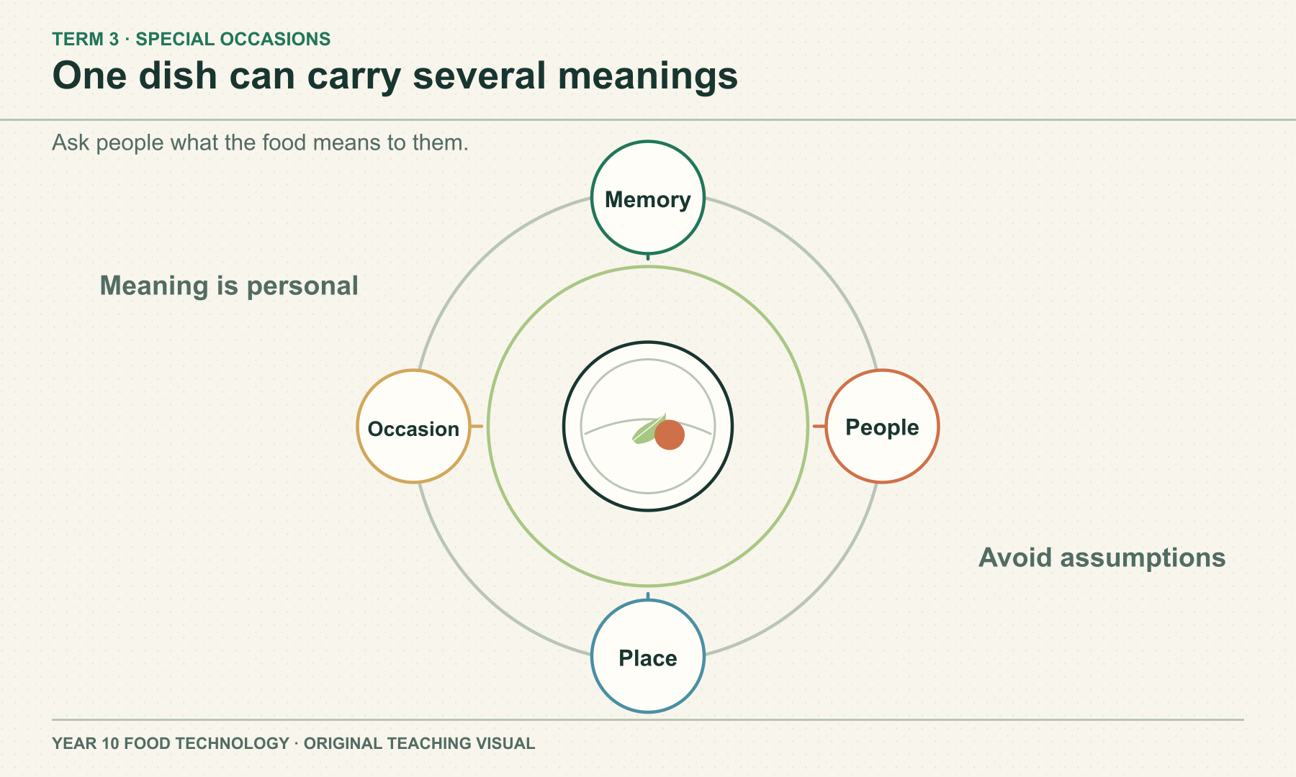
SECTION 3.1 · FOOD, IDENTITY AND SIGNIFICANCE
Meaning comes from people and context
Food can connect people to memory, place and an occasion. The same dish can mean different things to different guests. Ask the people involved rather than assuming one ingredient has a fixed cultural meaning.
DISCUSS
Whose account would help explain why a dish matters?
YEAR 10 FOOD TECHNOLOGY · FOOD FOR SPECIAL OCCASIONS
03 / 08
Notes:
Teaching area: Food, identity and significance.
Talking points: Food can connect people to memory, place and an occasion. The same dish can mean different things to different guests. Ask the people involved rather than assuming one ingredient has a fixed cultural meaning.
Worked example from the approved source: At a family reunion, a shared dish may matter because relatives associate it with a grandparent. The explanation should name that family connection; it should not claim the dish means the same thing to everyone from the family's cultural background.
Ask: Whose account would help explain why a dish matters?
Likely misconception: Everyone from one background gives a food the same meaning.
Visual: original authored diagram module-03-section-1.svg. Purpose: Help students discuss the significance of food without stereotyping a culture or person. Exception: A relationship diagram shows simultaneous personal meanings while avoiding fabricated cultural imagery or attribution.
Sources: https://classroom.google.com/w/ODQxODU0NzM4OTcw/t/all ; https://docs.google.com/presentation/d/1F5tWdHRnwj6Lyp9yJlimJKvDqyUaASmKsvpPUWhNv6U/edit ; https://www.nsw.gov.au/education-and-training/nesa/curriculum/tas/food-technology-7-10-2019
Practical, recipe and assessment directions are controlled by the teacher and live Classroom posts.

Slide 4
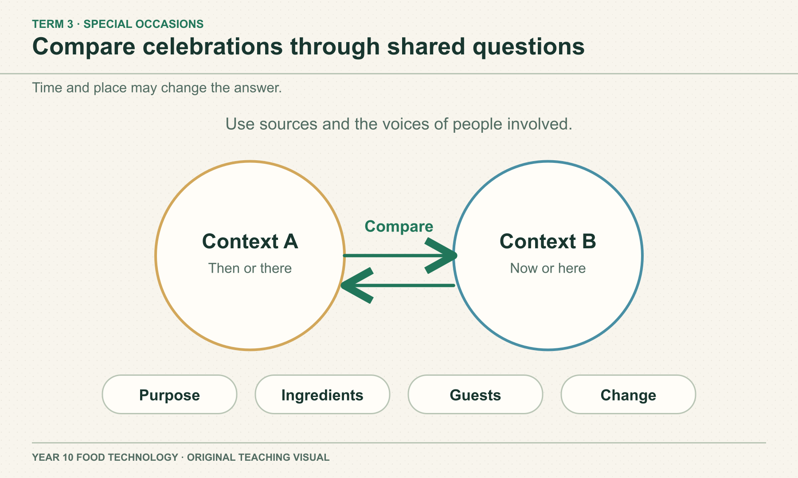
SECTION 3.2 · CELEBRATIONS ACROSS TIME AND PLACE
Traditions can continue while details change
A celebration food may change with location, available ingredients or family preferences while retaining a familiar purpose. Compare the same questions across two contexts: who attends, why it matters, what is served and what changed.
DISCUSS
Which comparison needs a source rather than a guess?
YEAR 10 FOOD TECHNOLOGY · FOOD FOR SPECIAL OCCASIONS
04 / 08
Notes:
Teaching area: Celebrations across time and place.
Talking points: A celebration food may change with location, available ingredients or family preferences while retaining a familiar purpose. Compare the same questions across two contexts: who attends, why it matters, what is served and what changed.
Worked example from the approved source: A family now living in NSW might use a locally available ingredient in a dish linked to a yearly gathering. Compare the current choice with a family account of an earlier version: identify what changed, what meaning stayed and what remains uncertain.
Ask: Which comparison needs a source rather than a guess?
Likely misconception: A changed ingredient means a tradition has lost its meaning.
Visual: original authored diagram module-03-section-2.svg. Purpose: Give students a respectful comparison method for celebrations across time and place. Exception: A two-context comparison matrix makes like-for-like questions explicit without invented cultural specifics.
Sources: https://docs.google.com/presentation/d/1Fx7HP9oMb_cXUpWrn9EMeiObqpbxsXQJK_HkYnV7fgg/edit ; https://docs.google.com/presentation/d/1VnzbmREjYv-K1F43LvhD164jetsDdUb_DkWl5JOapvY/edit ; https://docs.google.com/presentation/d/1X8vdTHYeN5H_DPLzqprPpD9piLguBmXMUE9prHGxDkg/edit ; https://www.nsw.gov.au/education-and-training/nesa/curriculum/tas/food-technology-7-10-2019
Practical, recipe and assessment directions are controlled by the teacher and live Classroom posts.

Slide 5
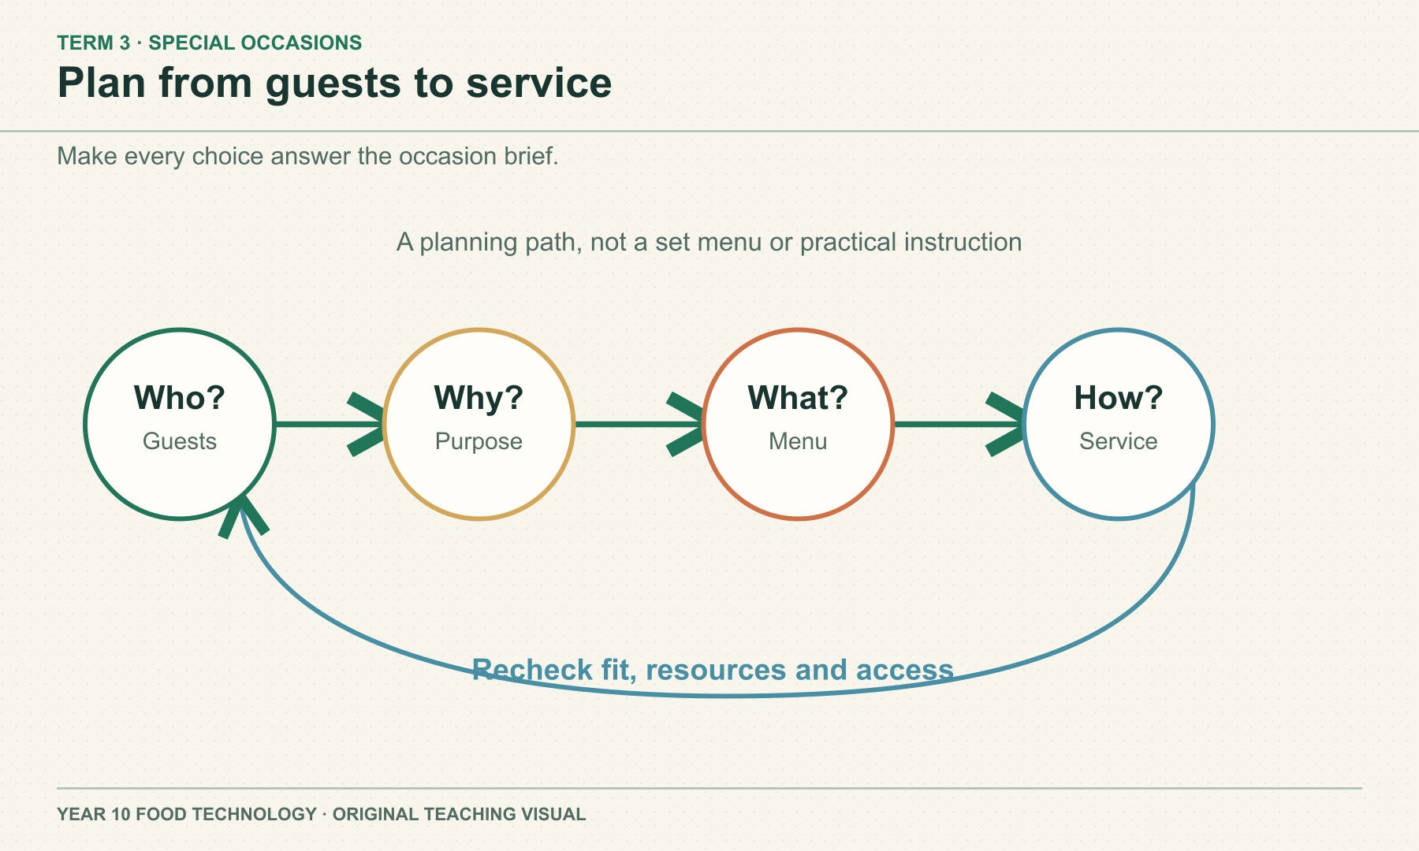
SECTION 3.3 · PLAN FOR AN OCCASION
The occasion brief guides menu choices
A menu should fit the guests, the purpose and the service setting. Check dietary needs, available resources and how food information will be communicated. Justify a choice against the brief, and name the trade-off it creates.
DISCUSS
What would make a shorter menu a better choice for some events?
YEAR 10 FOOD TECHNOLOGY · FOOD FOR SPECIAL OCCASIONS
05 / 08
Notes:
Teaching area: Plan for an occasion.
Talking points: A menu should fit the guests, the purpose and the service setting. Check dietary needs, available resources and how food information will be communicated. Justify a choice against the brief, and name the trade-off it creates.
Worked example from the approved source: For a community afternoon event, a planner compares two hypothetical menus against guest information, available resources and desired atmosphere. A shorter menu might be selected if the team can serve it more reliably and offer clearer dietary information.
Ask: What would make a shorter menu a better choice for some events?
Likely misconception: A larger menu is automatically more suitable.
Visual: original authored diagram module-03-section-3.svg. Purpose: Scaffold a reasoned occasion plan without inventing the class practical or assessment brief. Exception: Exact dependency and revision path is a planning relationship that photography cannot show without implying an approved menu.
Sources: https://www.nsw.gov.au/education-and-training/nesa/curriculum/tas/food-technology-7-10-2019 ; https://www.foodauthority.nsw.gov.au/consumer/food-allergies/living-food-allergy/eating-out ; https://www.foodauthority.nsw.gov.au/industry/food-allergen-rules ; https://classroom.google.com/w/ODQxODU0NzM4OTcw/t/all
Practical, recipe and assessment directions are controlled by the teacher and live Classroom posts.

Slide 6
Check what you can explain
Answer from the learning just shown. Add a reason or example.
01
Why can the same dish hold different meanings?
02
What might change when a celebration moves place?
03
Name two details a menu brief should establish.
04
Why must a menu choice include a trade-off?
YEAR 10 FOOD TECHNOLOGY · FOOD FOR SPECIAL OCCASIONS
06 / 08
Notes:
Pause for retrieval before showing or discussing answers. Invite a short explanation, not just a keyword.
Question prompts: Why can the same dish hold different meanings? | What might change when a celebration moves place? | Name two details a menu brief should establish. | Why must a menu choice include a trade-off?
If an answer depends on a local recipe, due date or practical procedure, return to the source boundary and check the teacher's current Classroom instructions.
Source: year-10-food-technology-2026-source-map-v1.

Slide 7
Build a reasoned response
YOUR TASK
READ
Plan a menu approach for a hypothetical community occasion with a mixed group of guests.
Read the occasion brief and identify the people involved.
SELECT
Select evidence about guest needs, resources and service.
EXPLAIN
Explain a menu approach and one trade-off.
Sentence support
This menu approach suits the occasion because ___. A trade-off is ___.
CHECK
Check that food information and uncertainty are clear.
YEAR 10 FOOD TECHNOLOGY · FOOD FOR SPECIAL OCCASIONS
07 / 08
Notes:
Guide a short written response. Ask students to use course theory and state limits.
Prompt: Plan a menu approach for a hypothetical community occasion with a mixed group of guests.
Scaffold: Read the occasion brief and identify the people involved. / Select evidence about guest needs, resources and service. / Explain a menu approach and one trade-off. / Check that food information and uncertainty are clear.
Model one sentence only; leave the judgement to students.
Source: matching section theory in this module and https://www.nsw.gov.au/education-and-training/nesa/curriculum/tas/food-technology-7-10-2019.

Slide 8
Exit evidence
Before you leave, write:
01
One question to ask the people involved
02
One menu criterion from the brief
03
One trade-off I can explain
Save your written response in this module’s learning package. Export My folio for a backup. Check Google Classroom for live teacher instructions.
YEAR 10 FOOD TECHNOLOGY · FOOD FOR SPECIAL OCCASIONS
08 / 08
Notes:
Exit ticket: One question to ask the people involved; One menu criterion from the brief; One trade-off I can explain.
Evidence destination: the module learning packages on the local course site. These save on this device; My folio provides an export backup. Google Classroom remains the authority for any live teacher task, due date or submission.
Transition: Ask students to identify the next evidence gap before moving to the following module.
Source boundary: year-10-food-technology-2026-source-map-v1.

