Slide 1
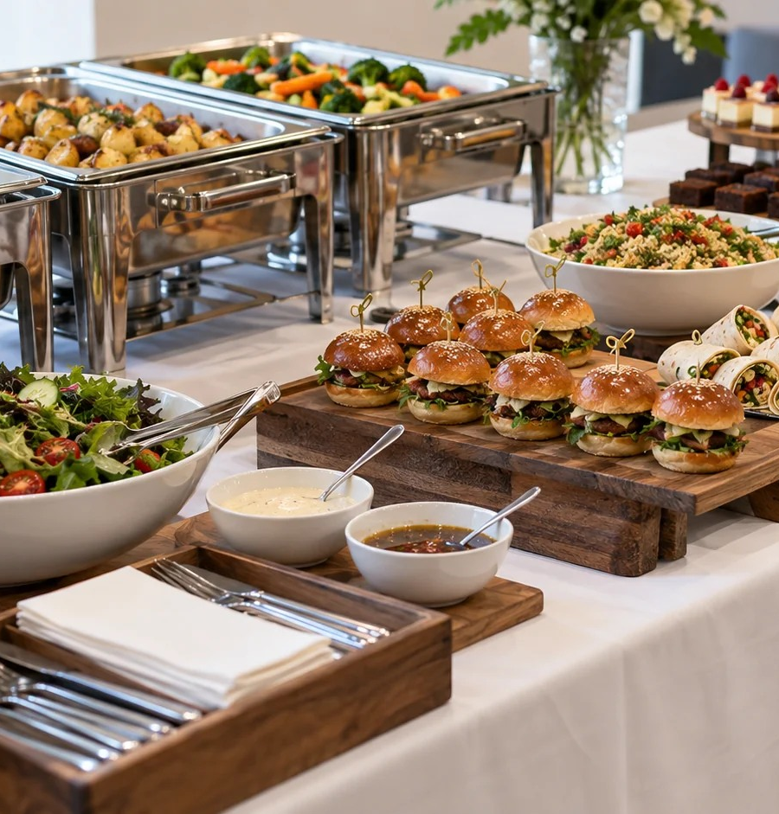
TERM 4 · MODULE 4
Food Service and Catering
Compare service settings and justify a catering decision using evidence.
YEAR 10 FOOD TECHNOLOGY · 2026
Notes:
Purpose: Compare service settings and justify a catering decision using evidence.
Teacher talking point: Introduce the term focus area and ask students what evidence they would need before making a judgement.
The original photograph is an illustrative teaching image, not a record of this class or a set practical.
Source boundary: year-10-food-technology-2026-source-map-v1; NESA Food Technology 7–10 Syllabus (2019). Live tasks and due dates remain in Google Classroom.

Slide 2
The learning path
01
Service settings and customers
02
Menus, teams and costs
03
Functional properties and review
BEFORE WE BEGIN
How would a short school break change the service choices a canteen makes?
YEAR 10 FOOD TECHNOLOGY · FOOD SERVICE AND CATERING
02 / 08
Notes:
Route through the three named sections: Service settings and customers; Menus, teams and costs; Functional properties and review.
Retrieval prompt: How would a short school break change the service choices a canteen makes?
Listen for students treating a visible product or photograph as complete evidence; ask what it does and does not show.
Sources: https://classroom.google.com/w/ODQxODU0NzM4OTcw/t/all; https://www.nsw.gov.au/education-and-training/nesa/curriculum/tas/food-technology-7-10-2019

Slide 3
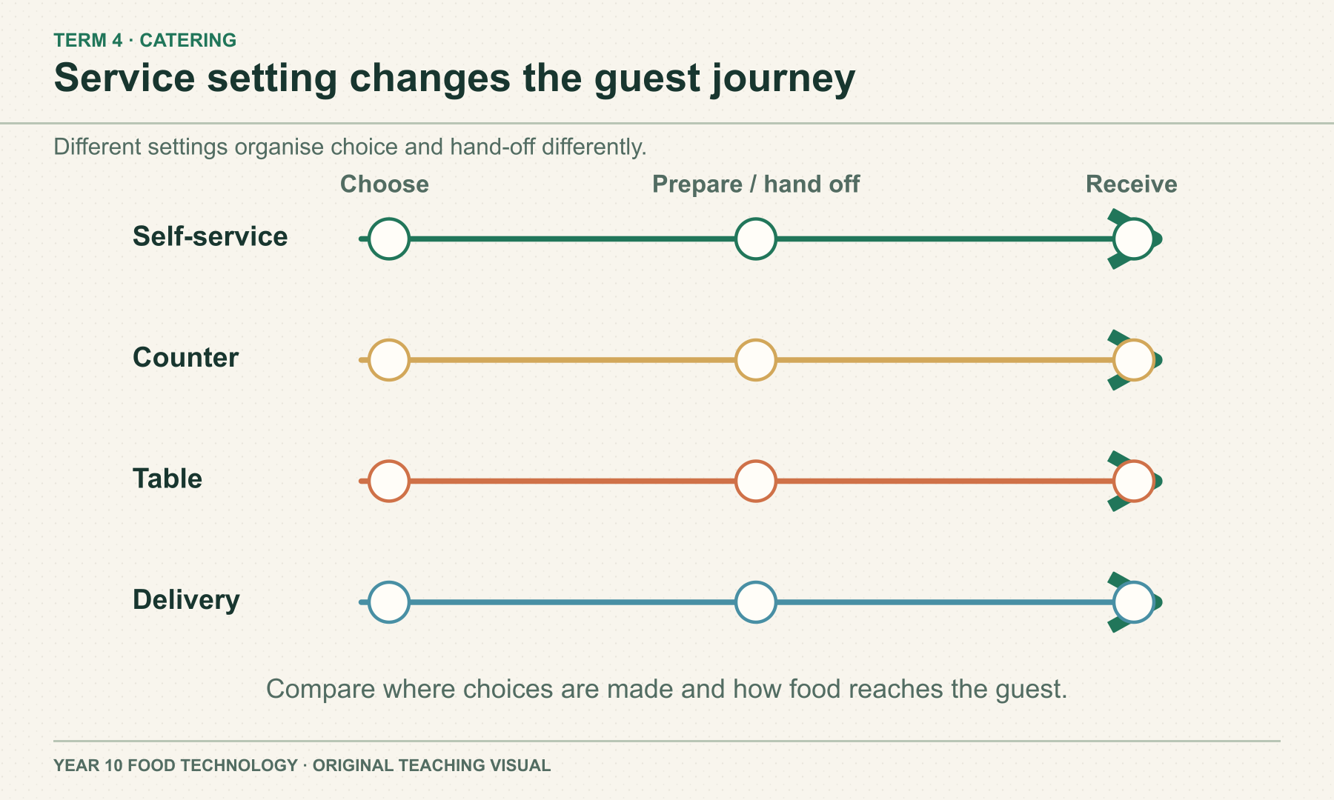
SECTION 4.1 · SERVICE SETTINGS AND CUSTOMERS
The service setting changes the guest journey
A canteen, event caterer and delivery service meet different customer needs. The points where guests choose, receive information and receive food can differ. Compare settings by the promise each makes to its customers, without assuming one format is best.
DISCUSS
Where does clear food information matter in each service setting?
YEAR 10 FOOD TECHNOLOGY · FOOD SERVICE AND CATERING
03 / 08
Notes:
Teaching area: Service settings and customers.
Talking points: A canteen, event caterer and delivery service meet different customer needs. The points where guests choose, receive information and receive food can differ. Compare settings by the promise each makes to its customers, without assuming one format is best.
Worked example from the approved source: Compare a canteen serving students during a short break with a caterer serving a planned community event. The canteen may value quick, clear ordering; the caterer must coordinate a known group and service time. Neither comparison tells you what a particular local business actually offers without checking it.
Ask: Where does clear food information matter in each service setting?
Likely misconception: Every food service setting should use the same workflow.
Visual: original authored diagram module-04-section-1.svg. Purpose: Help students compare service settings and customer experience without assuming one format is best. Exception: Parallel aligned journeys permit precise comparison of hand-off points; photography would show only one setting and hide the sequence.
Sources: https://www.nsw.gov.au/education-and-training/nesa/curriculum/tas/food-technology-7-10-2019 ; https://classroom.google.com/w/ODQxODU0NzM4OTcw/t/all ; https://www.foodauthority.nsw.gov.au/retail/caterers ; https://www.foodauthority.nsw.gov.au/industry/food-allergen-rules
Practical, recipe and assessment directions are controlled by the teacher and live Classroom posts.

Slide 4
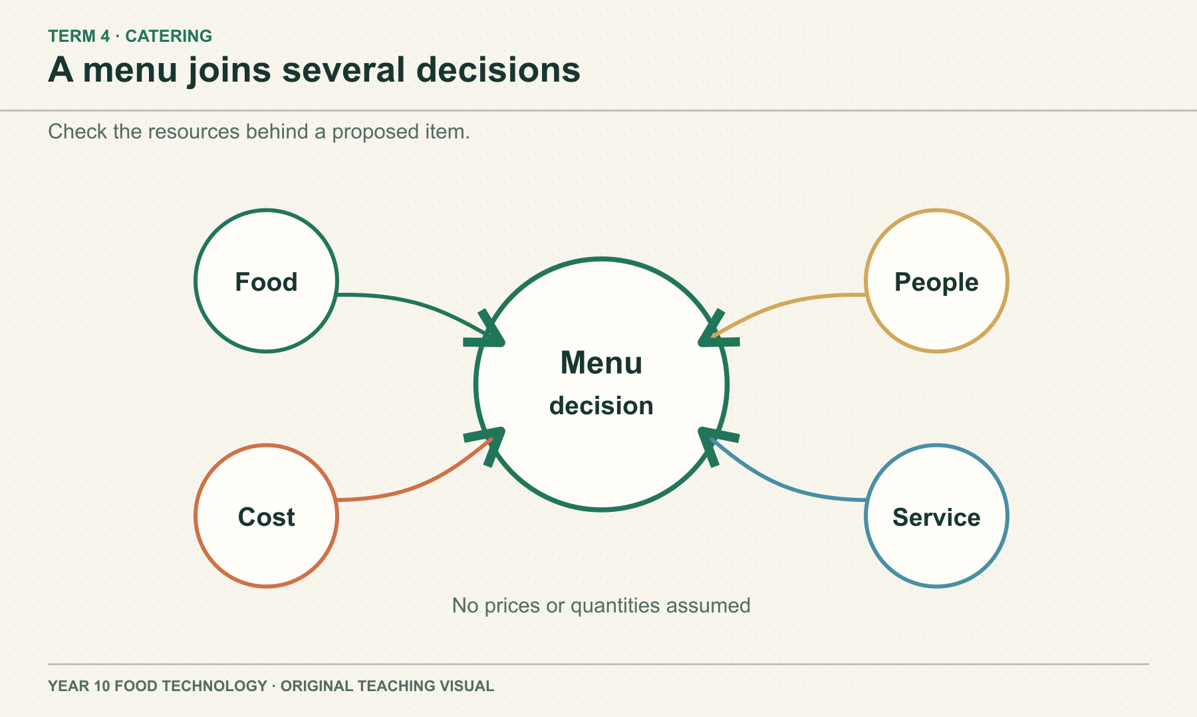
SECTION 4.2 · MENUS, TEAMS AND COSTS
A menu must fit people and resources
Menu choices affect portion yield, ingredient and service costs, team roles and likely waste. The price paid is revenue, not profit. Compare options against guest suitability and team capacity before deciding that a longer menu is better.
DISCUSS
What information is needed before choosing between two menu formats?
YEAR 10 FOOD TECHNOLOGY · FOOD SERVICE AND CATERING
04 / 08
Notes:
Teaching area: Menus, teams and costs.
Talking points: Menu choices affect portion yield, ingredient and service costs, team roles and likely waste. The price paid is revenue, not profit. Compare options against guest suitability and team capacity before deciding that a longer menu is better.
Worked example from the approved source: A hypothetical event team considers a short set menu and a longer choice menu. It compares guest suitability, the number of servings required, ingredient and service costs, staff capacity and likely waste. The team selects an approach only after checking the event brief and information available.
Ask: What information is needed before choosing between two menu formats?
Likely misconception: A sale proves the menu was suitable and financially sound.
Visual: original authored diagram module-04-section-2.svg. Purpose: Show why menu planning needs coordinated ingredient, team, cost and service decisions. Exception: Many-to-one planning dependency is the teaching point; exact connectors avoid an invented worked budget or menu.
Sources: https://www.nsw.gov.au/education-and-training/nesa/curriculum/tas/food-technology-7-10-2019 ; https://docs.google.com/document/d/1l_ITZD_vah4z4kt6vzCvAcOSj4ujIf-8LevvxpNYBBQ/edit ; https://www.foodauthority.nsw.gov.au/retail/caterers ; https://www.foodauthority.nsw.gov.au/industry/food-allergen-rules
Practical, recipe and assessment directions are controlled by the teacher and live Classroom posts.

Slide 5
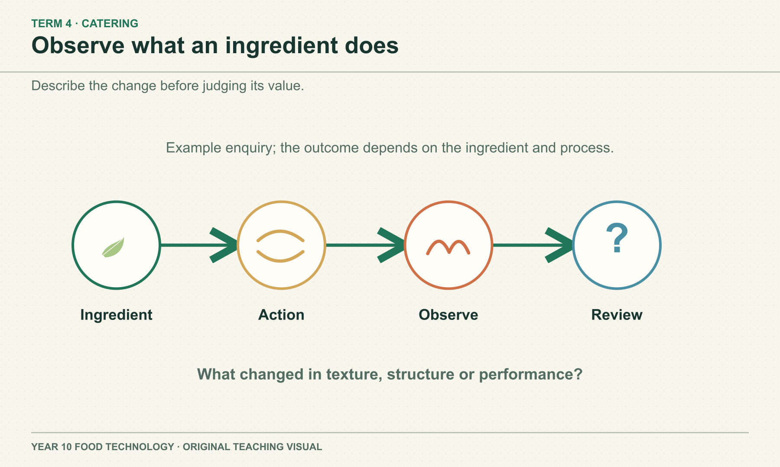
SECTION 4.3 · FUNCTIONAL PROPERTIES AND REVIEW
Observe a change before explaining its cause
A functional property describes what an ingredient does; a sensory characteristic describes the result people perceive. Link ingredient or process, change and observed result. A fair comparison changes one planned factor where possible and records uncertainty.
DISCUSS
If both ingredient amount and heating time changed, what remains uncertain?
YEAR 10 FOOD TECHNOLOGY · FOOD SERVICE AND CATERING
05 / 08
Notes:
Teaching area: Functional properties and review.
Talking points: A functional property describes what an ingredient does; a sensory characteristic describes the result people perceive. Link ingredient or process, change and observed result. A fair comparison changes one planned factor where possible and records uncertainty.
Worked example from the approved source: In a teacher-approved comparison of two hypothetical sauces, students would describe whether each stayed evenly mixed, note which single factor differed and relate the observation to the intended service. They could not claim an ingredient caused the change if several factors changed together.
Ask: If both ingredient amount and heating time changed, what remains uncertain?
Likely misconception: One observation proves that an ingredient always behaves the same way.
Visual: original authored diagram module-04-section-3.svg. Purpose: Give students a safe observation framework for discussing functional properties and reflecting on results. Exception: Exact enquiry sequence and accessible text are needed; a photograph of one food would falsely suggest a particular tested result.
Sources: https://www.nsw.gov.au/education-and-training/nesa/curriculum/tas/food-technology-7-10-2019 ; https://docs.google.com/document/d/1yenvSBQ8R_dL_CCJWJvOmzNthnMy8btoBh-n3KmLA7I/edit ; https://docs.google.com/document/d/1lQrJHepxdIbcPLcrrFAvvmaHYO5GV3_AIA5bBQOA0r8/edit ; https://www.foodstandards.gov.au/consumer/additives/additiveinfo
Practical, recipe and assessment directions are controlled by the teacher and live Classroom posts.

Slide 6
Check what you can explain
Answer from the learning just shown. Add a reason or example.
01
How can two service settings create different guest journeys?
02
Why is revenue different from profit?
03
What is a functional property?
04
Why change one planned factor in a comparison?
YEAR 10 FOOD TECHNOLOGY · FOOD SERVICE AND CATERING
06 / 08
Notes:
Pause for retrieval before showing or discussing answers. Invite a short explanation, not just a keyword.
Question prompts: How can two service settings create different guest journeys? | Why is revenue different from profit? | What is a functional property? | Why change one planned factor in a comparison?
If an answer depends on a local recipe, due date or practical procedure, return to the source boundary and check the teacher's current Classroom instructions.
Source: year-10-food-technology-2026-source-map-v1.

Slide 7
Build a reasoned response
YOUR TASK
READ
A hypothetical product changes texture during service. Recommend one improvement.
Read the service brief and describe the observed change.
SELECT
Select evidence about ingredient or process and service time.
EXPLAIN
Explain one plausible cause and one controlled comparison.
Sentence support
The observed change was ___. One possible cause is ___, but ___ is still uncertain.
CHECK
Check which cause is still uncertain.
YEAR 10 FOOD TECHNOLOGY · FOOD SERVICE AND CATERING
07 / 08
Notes:
Guide a short written response. Ask students to use course theory and state limits.
Prompt: A hypothetical product changes texture during service. Recommend one improvement.
Scaffold: Read the service brief and describe the observed change. / Select evidence about ingredient or process and service time. / Explain one plausible cause and one controlled comparison. / Check which cause is still uncertain.
Model one sentence only; leave the judgement to students.
Source: matching section theory in this module and https://www.nsw.gov.au/education-and-training/nesa/curriculum/tas/food-technology-7-10-2019.

Slide 8
Exit evidence
Before you leave, write:
01
One customer need a menu must meet
02
One cost or yield question to check
03
One controlled observation I would record
Save your written response in this module’s learning package. Export My folio for a backup. Check Google Classroom for live teacher instructions.
YEAR 10 FOOD TECHNOLOGY · FOOD SERVICE AND CATERING
08 / 08
Notes:
Exit ticket: One customer need a menu must meet; One cost or yield question to check; One controlled observation I would record.
Evidence destination: the module learning packages on the local course site. These save on this device; My folio provides an export backup. Google Classroom remains the authority for any live teacher task, due date or submission.
Transition: Ask students to identify the next evidence gap before moving to the following module.
Source boundary: year-10-food-technology-2026-source-map-v1.

