Slide 1

CNC PLASMA / MODULE 1 • WEEKS 1–2
Meet the system
Understand the plasma system, participation boundaries and the drawing information that makes a file meaningful.
AI-generated concept image
Learn → inspect → practise → explain
Standalone Year 10 unit • Teacher controls machine operation
01
Notes:
Module 1: Meet the system
Teaching purpose: Understand the plasma system, participation boundaries and the drawing information that makes a file meaningful.
Use the course module for the complete explanations and formative learning evidence. This presentation supports explanation; it is not operator certification or the local operating procedure.
Image: Supplier XT12 overview from the assembly manual, p1. This is a machine drawing, not a photograph of the school installation or its safety enclosure.
Source: XT12 Assembly Manual - ver 1.2.pdf
ILLUSTRATIVE IMAGE
AI-generated concept illustration for Meet the system. This illustration supports discussion and is not a photograph of the school installation, a software screenshot, or a machine-setting guide. Original source reference images remain on this slide where present.

Slide 2
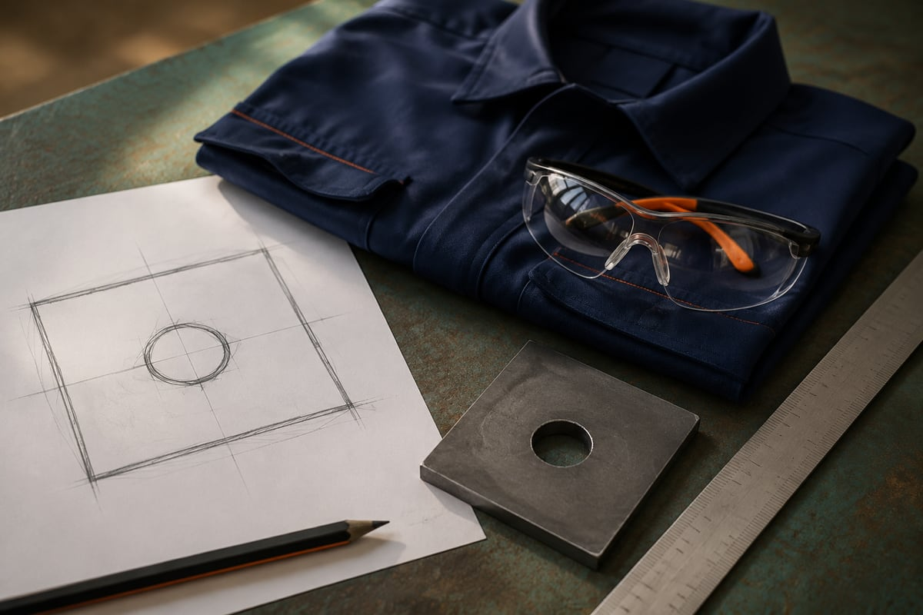
CNC PLASMA / CONNECT THE THREE LESSONS
Today’s learning map
01
From idea to CNC plasma cutting
02
Safe participation and responsibilities
03
Read diagrams, dimensions and coordinates
AI-generated concept image
Before we begin: which step in the workflow needs the strongest check?
Standalone Year 10 unit • Teacher controls machine operation
02
Notes:
Invite a short prediction before teaching. Accept uncertainty and record one question to revisit.
m01-s01: Explain how a student’s proposed square-and-hole drawing becomes a teacher-reviewed production job. Identify what CAD, CAM and CNC control each contribute, and justify two checks that prevent a plausible-looking file being mistaken for a ready-to-cut program.
m01-s02: Explain how a group can contribute to a proposed plasma project and observe a teacher demonstration responsibly. Compare offline preview with SureControl Simul, explain the separation and access boundaries, and distinguish learning evidence from operating authorisation.
m01-s03: Compare the two coordinate layouts for the proposed 100 mm square with a central Ø30 mm hole. Explain how you would establish that they represent the same geometry, and identify the information the trained teacher still needs before relating the drawing to a job on the table.
ILLUSTRATIVE IMAGE
AI-generated concept illustration for Today’s learning map. This illustration supports discussion and is not a photograph of the school installation, a software screenshot, or a machine-setting guide. Original source reference images remain on this slide where present.

Slide 3
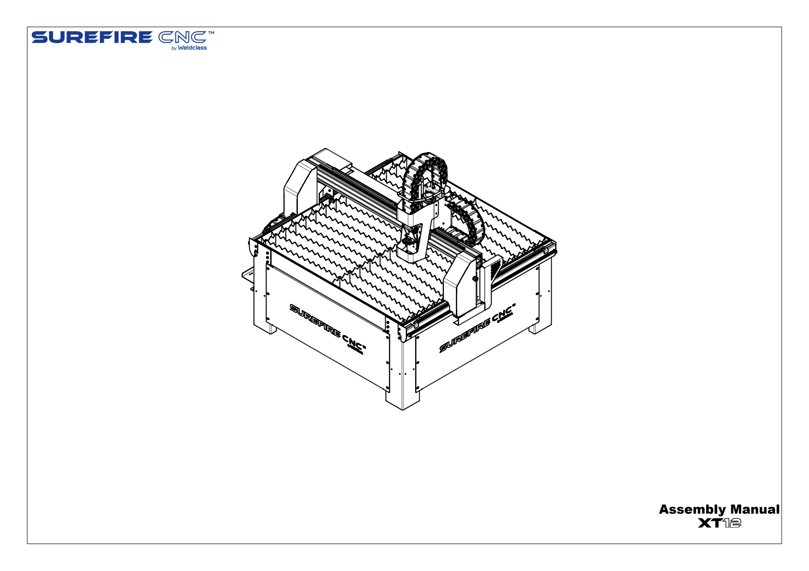
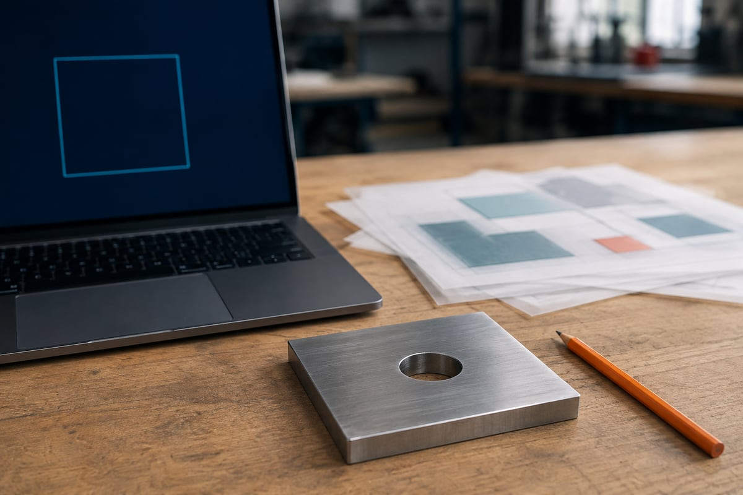
CNC PLASMA / SECTION 1 • M01-S01
Three software jobs, one physical process
CAD defines the geometry. CAM plans how the tool follows it. CNC control directs the machine.
A plasma arc melts a narrow region of conductive metal; gas removes the molten material. The removed width is the kerf. A correct-looking drawing is only the first check.
Supplier XT12 overview from the assembly manual, p1. This is a machine drawing, not a photograph of the school installation or its safety enclosure.
Trace one design decision from CAD to the finished edge.
AI-generated concept image
Standalone Year 10 unit • Teacher controls machine operation
03
Notes:
Section m01-s01: From idea to CNC plasma cutting
TEACHER EXPLANATION
A shaped electrical process A CNC plasma cutter turns a digital outline into a path through suitable metal. Plasma is an electrically conducting gas. The cutting system uses electrical energy to create a concentrated plasma arc; this heats and melts a narrow region of the workpiece, while gas flow removes molten metal. The resulting gap is the kerf. The process removes material along a path, so the finished edge depends on more than the drawing alone. Hypertherm’s plasma explanation describes this process. Plasma cutting works with electrically conductive materials. That general capability does not make every metal or coating suitable for a school job. The trained teacher must establish the approved material, thickness, torch parts and cutting process. A picture of a machine cutting thick plate is evidence about that demonstration, not permission to repeat its settings here. Several parts do different jobs The table supports the sheet and provides the motion system that positions the torch. The torch directs the cutting process towards the work. Its consumables are replaceable components used in that process; their type must match the approved setup. The power source supplies the electrical energy. These parts cooperate, but they are not interchangeable: a computer cannot replace the power source, and a drawing cannot establish which consumables are fitted. The computer displays the design, preparation or control software, depending on the stage. Mechanical fume extraction manages fumes under the approved installation arrangements. Screening, guarding and controlled access protect people around the process. Extraction is therefore part of the operating system’s required controls, even though it does not appear as a line in the design file. Follow three software roles Computer-aided design, or CAD, describes what you want to make. In Onshape or 2D Design, you create geometry and specify dimensions. The editable native master retains the design for later changes. A DXF is a separate exchange drawing that another application can read. Exporting it creates a handoff point: the next application must still check its units, dimensions and contours. Computer-aided manufacturing, or CAM, prepares how the geometry will be produced. SheetCam can organise cutting paths, sequence and process information using a verified local configuration. A post-processor converts the prepared job into instructions suitable for a particular control system. The supplier workflow uses a TAP file. Its extension identifies a file type; it does not prove that the correct post-processor or settings produced it. CNC means computer numerical control. SureControl uses the prepared program to control machine motion and report its state to the operator. Some software combines roles, and the supplied manual also describes basic direct DXF import. Nevertheless, design, manufacturing preparation and control remain different responsibilities. Understanding those roles helps locate a problem instead of treating every screen as “the cutter software”. Trace one small example Consider our proposed offline practice drawing: a 100 mm square with a central 30 mm diameter hole. In CAD, check the outer size and circle. Save the master and export a named DXF revision. In the receiving CAM application, verify the same size and two intended contours before a trained teacher reviews the production setup. The simple appearance does not bypass that review. If the hole is drawn incorrectly, return to CAD. If the correct drawing has an unsuitable toolpath, review CAM preparation. Loading a plausible-looking program into SureControl does not repair either problem. Students can prepare and explain the design evidence. Trained teachers operate the actual machine under the school procedure; an accurate file or completed course does not authorise a student to run it.
TEACHING NOTES
{
"main_explanation": "The plasma process removes material; a complete system joins physical equipment, software roles and required controls.",
"worked_example": "Trace the proposed 100 mm square and Ø30 mm hole from native CAD to DXF, reviewed CAM and teacher-controlled CNC. Contrast a geometry error with a toolpath error.",
"discussion_prompt": "A file looks correct in a preview. What evidence is still needed before a trained teacher can accept the job?"
}
VISUAL
Perspective drawing of the XT12 cutting table, slatted bed, gantry and torch carriage.
Supplier XT12 overview from the assembly manual, p1. This is a machine drawing, not a photograph of the school installation or its safety enclosure.
Locate the bed, gantry and torch carriage; explain which part holds the sheet and which assembly moves.
Source: XT12 Assembly Manual - ver 1.2.pdf
DISCUSSION
Trace one design decision from CAD to the finished edge.
Use the section’s ten questions for individual retrieval and feedback. Do not infer practical competence from online completion.
ILLUSTRATIVE IMAGE
AI-generated concept illustration for Three software jobs, one physical process. This illustration supports discussion and is not a photograph of the school installation, a software screenshot, or a machine-setting guide. Original source reference images remain on this slide where present.

Slide 4
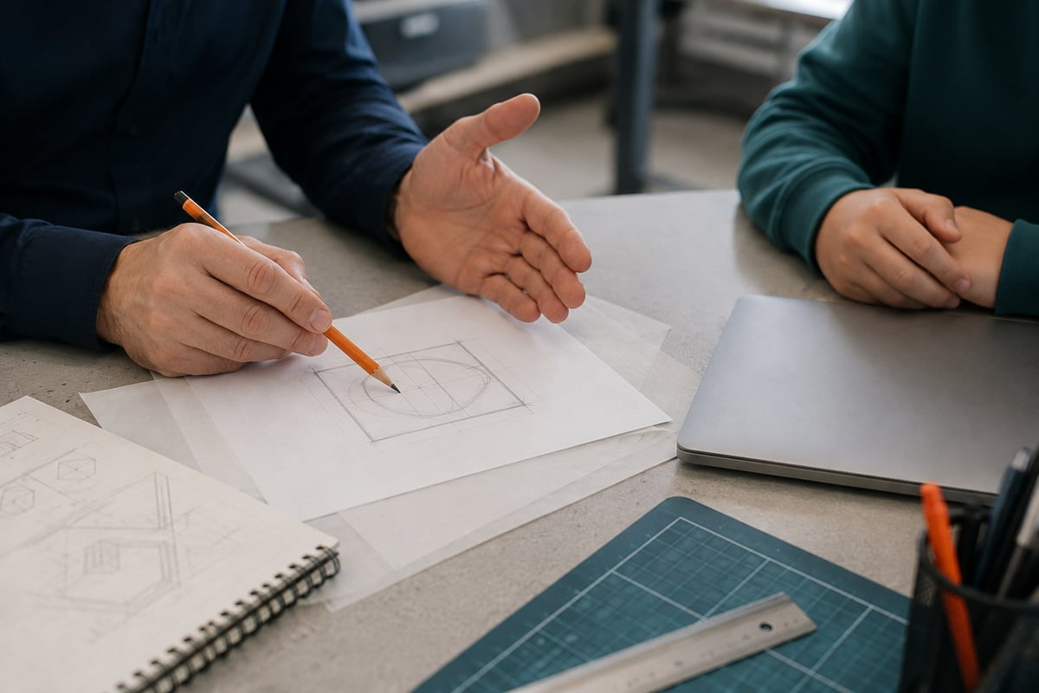
CNC PLASMA / SECTION 2 • M01-S02
Know who does what
Students develop drawings, inspect files and explain decisions. The supplied school guidance reserves machine operation for trained teachers.
During automatic cutting, the operator must be physically separated by the securely screened operating area and welding curtains. Supplier instruction and local approval establish the working arrangement. This assembly drawing cannot show those site controls.
Supplier XT12 overview from the assembly manual, p1. This is a machine drawing, not a photograph of the school installation or its safety enclosure.
What can this drawing tell us—and what needs checking onsite?
AI-generated concept image
Standalone Year 10 unit • Teacher controls machine operation
04
Notes:
Section m01-s02: Safe participation and responsibilities
TEACHER EXPLANATION
Contribute without operating Your role in this unit is active: develop ideas, create drawings, check exported files, explain decisions and evaluate available evidence. Students may prepare designs and programs before use. Actual plasma-table operation belongs to a trained, authorised teacher and cannot be delegated to a student. That boundary includes jogging, referencing, test firing, machine simulation and cutting. A student who understands the software can contribute valuable preparation without taking control of the machine. Keep computer practice separate from the connected controller. An offline design computer lets you inspect geometry and discuss a proposed path. A control connected to the table can cause physical movement or activate equipment. Similar-looking buttons do not establish similar risks. Follow the teacher’s direction about which computer and activities are available for student work. Connect hazards with controls A hazard is something with the potential to cause harm. Plasma cutting combines several: intense arc radiation, hot metal, electrical energy, fumes, sparks and moving axes. Handling a heavy sheet also creates lifting and strain risks. Recognising only the bright arc misses hazards that remain before or after the visible cut. A stopped torch may still be near hot stock, and an idle machine may still be energised. Controls work together. Mechanical extraction manages fumes. Secure screening and welding curtains separate people from the automatic cutting process. Guards cover exposed drives and pinch points; controlled access prevents people entering the operating area. Suitable protective clothing and equipment support the approved arrangements, but do not replace extraction, guarding or separation. A person wearing protective equipment is not therefore free to enter a restricted area. The operator needs separation too Students remain isolated from the operating work area. During automatic cutting, the trained teacher must also be physically separated from the machine by the securely screened operating area and welding curtains. “Teacher-only” does not mean the teacher stands inside the enclosure while cutting. Observation happens through the school’s approved viewing arrangements, with access controlled throughout the operation. Students may enter the shielded area only after the required electrical isolation under the school procedure. Program completion, an extinguished arc, the Stop button and software Offline do not establish that isolation. The authorised teacher controls when access and safe handling are permitted. Do not enter to retrieve a part, improve a photograph or investigate a fault because the machine appears quiet. A dry run can still move Imagine that a group has checked its drawing and wants to watch a simulation. On an offline CAM computer, an on-screen preview shows a proposed path. In SureControl, Simul followed by Start makes the actual CNC move without firing the torch. The absence of an arc does not remove the moving-machine hazard. The latter remains a teacher-operated activity with the motion area controlled. If the real movement is unexpected, students keep clear and alert the teacher using the agreed classroom arrangements. They do not try another direction, enter the enclosure or change a configuration value. A fault is useful information to report, not an invitation to experiment. Know the emergency arrangements before observation, including how to alert staff and where to remain clear. Knowledge supports responsibility Teacher readiness requires comprehensive supplier instruction, principal approval and the approved site arrangements. A tutorial, quiz score or attractive drawing cannot supply those requirements. Configuration work such as sensor assignments or axis-direction changes belongs to qualified support and the authorised setup process, rather than novice trial and error. Record learning honestly. “I explained the simulation boundary” is a learning claim. “The teacher demonstrated a controlled dry run” is an observation when it happened. Neither means “I am authorised to operate”. Clear evidence helps everyone understand what has been learned, what was actually observed and what still needs an authorised decision.
TEACHING NOTES
{
"main_explanation": "Students have an active design/evidence role; all real machine control remains with the trained authorised teacher. Controls protect students and the operator.",
"worked_example": "Compare an offline CAM animation with SureControl Simul and trace the consequences for access and supervision.",
"discussion_prompt": "The machine is quiet and the job is finished. What evidence is still needed before anyone retrieves the part?"
}
VISUAL
Perspective drawing of the XT12 cutting table, slatted bed, gantry and torch carriage.
Supplier XT12 overview from the assembly manual, p1. This is a machine drawing, not a photograph of the school installation or its safety enclosure.
Locate the bed, gantry and torch carriage; explain which part holds the sheet and which assembly moves.
Source: XT12 Assembly Manual - ver 1.2.pdf
DISCUSSION
What can this drawing tell us—and what needs checking onsite?
Use the section’s ten questions for individual retrieval and feedback. Do not infer practical competence from online completion.
ILLUSTRATIVE IMAGE
AI-generated concept illustration for Know who does what. This illustration supports discussion and is not a photograph of the school installation, a software screenshot, or a machine-setting guide. Original source reference images remain on this slide where present.

Slide 5
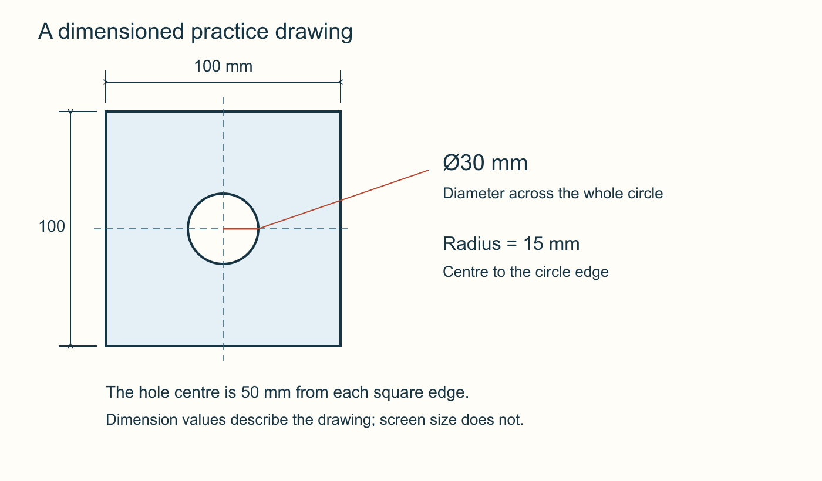
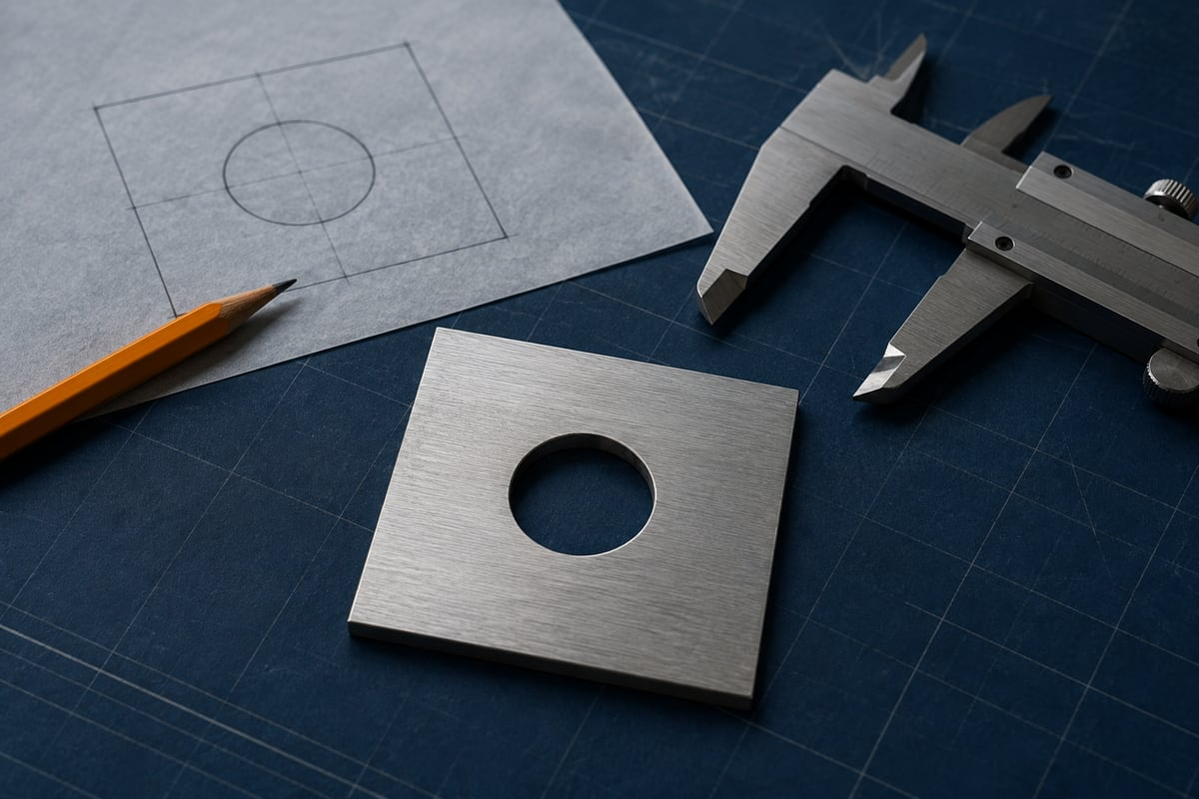
CNC PLASMA / SECTION 3 • M01-S03
Read dimensions before coordinates
The practice drawing is 100 × 100 mm with a central Ø30 mm hole. Diameter 30 mm means radius 15 mm.
A centred CAD origin and a corner CAD origin can describe the same shape. Check width, height and hole position after transfer. Neither drawing origin automatically establishes the machine’s job zero.
A dimensioned practice drawing. Original teaching diagram; proposed geometry, not a machine setting or approved project plan.
Show where the centre lies, then explain diameter versus radius.
AI-generated concept image
Standalone Year 10 unit • Teacher controls machine operation
05
Notes:
Section m01-s03: Read diagrams, dimensions and coordinates
TEACHER EXPLANATION
Read the purpose of a diagram Different diagrams answer different questions. A pictorial or assembly view helps you recognise parts and how they fit together. A dimensioned part drawing communicates the size and arrangement of a particular shape. A software screenshot shows controls and a recorded screen state. None automatically supplies all the information carried by the others. An assembly image may identify the torch support without specifying the dimensions of your design. Start by reading the title, view, units and any notes. Check whether an image is a supplier example, your own drawing or a record of an actual result. Supplier screenshots in this course are references, not photographs of the current school installation. Their displayed numbers may belong to another example. A clear caption helps you use the image for the right purpose. Numbers describe the intended size A dimension states an intended measurement. Millimetres, written mm, are our practice drawing units. A value without a known unit is incomplete information: “100” could describe very different lengths. One hundred millimetres equals ten centimetres. Keep the chosen unit explicit when creating the drawing and when checking it in another program. Screen zoom changes how large a drawing appears, not its numerical geometry. Similarly, a paper drawing printed at a scale of 1:2 shows a 100 mm length as 50 mm on the page while its dimension still describes 100 mm. Read the dimensions rather than measuring a screenshot with a ruler. When a drawing is imported, inspect the actual values in the receiving software; fitting the picture neatly into its window is not a size check. Distinguish radius and diameter The radius runs from the circle’s centre to its edge. The diameter passes through the centre from one edge to the opposite edge and is twice the radius. Drawings commonly use R for radius and Ø for diameter. Read the symbol or field label before entering a number, because some CAD tools ask for radius while others offer a diameter dimension. Our proposed offline example has a 100 × 100 mm square and a central Ø30 mm circle. Its radius is 15 mm. Entering 30 into a radius field would produce a 60 mm diameter circle, a different design. These numbers define a teaching drawing; they do not specify sheet thickness, cutting current or an approved physical job. A datum gives coordinates meaning Coordinates locate a point relative to a datum or reference origin. In a two-dimensional drawing, write the horizontal coordinate first as x and the vertical coordinate second as y. The pair (50, 50) means 50 units along each drawing axis from the origin. The origin is the zero reference; it is not necessarily the lowest corner of every shape. In the 2D Design practice layout, the square runs from (0, 0) to (100, 100), so its centre is (50, 50). In the centred Onshape layout, the same square runs from −50 to +50 on both axes and its centre is (0, 0). Both span 100 mm and hold the same Ø30 mm hole. Different coordinate values can therefore describe identical geometry when their datums differ. Keep drawing and machine references distinct CAD coordinates describe the drawing. A machine reference establishes the controller’s relationship to the table, while the job origin positions the program relative to the work. Those references must be deliberately related by the trained teacher; a CAD origin does not automatically place a part on a sheet. The SureControl labels also matter: Set Origin assigns the current location as job zero, whereas Origin commands movement to that origin. Students interpret those meanings rather than trying the controls. When handing over a drawing, record its units, overall dimensions, hole size and origin layout. That information makes the intended geometry understandable without guessing from the picture.
TEACHING NOTES
{
"main_explanation": "Choose the right diagram, then read its dimensions, units, symbols and datum. Coordinate values require a reference.",
"worked_example": "Compare 0–100 bounds / centre (50,50) with −50–+50 bounds / centre (0,0), both with Ø30 hole. Demonstrate radius-versus-diameter error without producing a machine file.",
"discussion_prompt": "Two drawings look different sizes on screen but list identical dimensions. Which evidence should guide the comparison?"
}
VISUAL
A 100 mm square with a central 30 mm diameter hole. Centre lines cross 50 mm from each edge. A radius reaches halfway across the diameter.
A dimensioned practice drawing. Original teaching diagram; proposed geometry, not a machine setting or approved project plan.
Find the diameter, then show why the radius is half that length.
Original course diagram; no numeric machine settings prescribed.
DISCUSSION
Show where the centre lies, then explain diameter versus radius.
Use the section’s ten questions for individual retrieval and feedback. Do not infer practical competence from online completion.
ILLUSTRATIVE IMAGE
AI-generated concept illustration for Read dimensions before coordinates. This illustration supports discussion and is not a photograph of the school installation, a software screenshot, or a machine-setting guide. Original source reference images remain on this slide where present.

Slide 6

CNC PLASMA / RETRIEVE AND EXPLAIN
Pause before looking back
1
Trace one design decision from CAD to the finished edge.
2
What can this drawing tell us—and what needs checking onsite?
3
Show where the centre lies, then explain diameter versus radius.
AI-generated concept image
Standalone Year 10 unit • Teacher controls machine operation
06
Notes:
Give students thinking time before pairing or discussing. Revisit the matching section if explanations are uncertain. These questions are formative and ungraded.
Trace one design decision from CAD to the finished edge.
What can this drawing tell us—and what needs checking onsite?
Show where the centre lies, then explain diameter versus radius.
ILLUSTRATIVE IMAGE
AI-generated concept illustration for Pause before looking back. This illustration supports discussion and is not a photograph of the school installation, a software screenshot, or a machine-setting guide. Original source reference images remain on this slide where present.

Slide 7
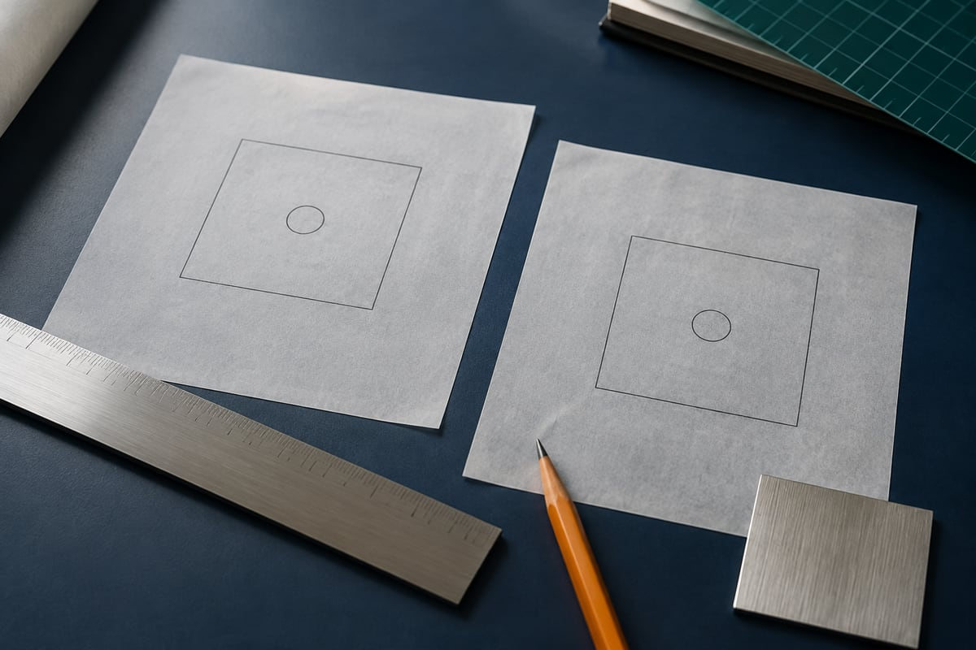
CNC PLASMA / BUILD A CONNECTED RESPONSE
Explain your decision with evidence
Compare the two coordinate layouts for the proposed 100 mm square with a central Ø30 mm hole. Explain how you would establish that they represent the same geometry, and identify the information the trained teacher still needs before relating the drawing to a job on the table.
01
State the bounds and centre of each layout.
02
Compare overall size, hole diameter and radius rather than screen appearance.
03
Distinguish the drawing datum from machine reference and job origin.
AI-generated concept image
Standalone Year 10 unit • Teacher controls machine operation
07
Notes:
Students write their own response in the module section. Scaffold prompts guide one connected explanation; they are not separate tasks.
Success criteria:
Correctly identifies equivalent 100 mm spans and central Ø30 mm holes despite different coordinates.
Explains radius/diameter and the need to inspect actual units and dimensions.
Keeps physical positioning and machine controls within the teacher’s verified procedure.
ILLUSTRATIVE IMAGE
AI-generated concept illustration for Explain your decision with evidence. This illustration supports discussion and is not a photograph of the school installation, a software screenshot, or a machine-setting guide. Original source reference images remain on this slide where present.

Slide 8

CNC PLASMA / EVIDENCE AND NEXT STEP
Leave with something useful
1 Check your three section packages.
2 Record the module activity and folio evidence.
3 Name one uncertainty and your next check.
AI-generated concept image
Exit prompt: What evidence changed your understanding today?
Browser saving keeps a local copy. Export and verify a backup; follow your teacher’s submission instructions.
Standalone Year 10 unit • Teacher controls machine operation
08
Notes:
Open modules/module-01.html#module-01-review. Review completion and feedback rather than treating checked answers as a competence result. Keep original CAD files separately. Students should state their own contribution and identify teacher-controlled production honestly.
ILLUSTRATIVE IMAGE
AI-generated concept illustration for Leave with something useful. This illustration supports discussion and is not a photograph of the school installation, a software screenshot, or a machine-setting guide. Original source reference images remain on this slide where present.

