Slide 1

CNC PLASMA / MODULE 2 • WEEKS 3–4
Design something that can be cut
Create and check simple CAD geometry, then develop a purposeful design through evidence and revision.
AI-generated concept image
Learn → inspect → practise → explain
Standalone Year 10 unit • Teacher controls machine operation
01
Notes:
Module 2: Design something that can be cut
Teaching purpose: Create and check simple CAD geometry, then develop a purposeful design through evidence and revision.
Use the course module for the complete explanations and formative learning evidence. This presentation supports explanation; it is not operator certification or the local operating procedure.
Image: Different CAD origins, equal dimensions. Original teaching diagram; proposed geometry, not a machine setting or approved project plan.
Original course diagram.
ILLUSTRATIVE IMAGE
AI-generated concept illustration for Design something that can be cut. This illustration supports discussion and is not a photograph of the school installation, a software screenshot, or a machine-setting guide. Original source reference images remain on this slide where present.

Slide 2
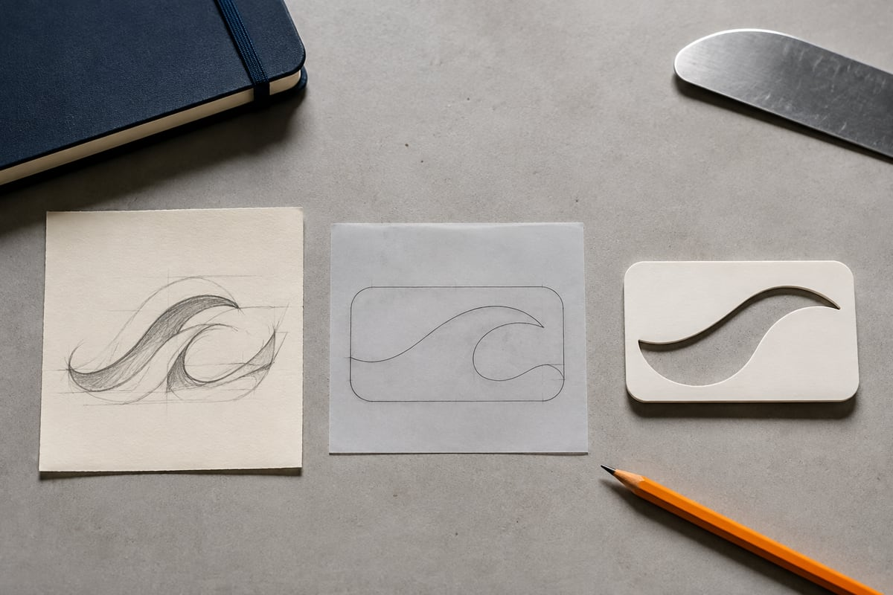
CNC PLASMA / CONNECT THE THREE LESSONS
Today’s learning map
01
Your first dimensioned CAD sketch
02
Geometry that makes a reliable outline
03
Develop a design that can be made
AI-generated concept image
Before we begin: which step in the workflow needs the strongest check?
Standalone Year 10 unit • Teacher controls machine operation
02
Notes:
Invite a short prediction before teaching. Accept uncertainty and record one question to revisit.
m02-s01: Explain how you would establish and check the intended square-and-hole geometry in either Onshape or 2D Design. Compare that method with the other pathway and justify how the editable master and export record preserve the design intention.
m02-s02: Evaluate a proposed handoff of a logo that opens successfully but has unset units, several complex curves and a letter centre that may become detached. Explain a source-preserving inspection and revision plan, and justify why successful opening is insufficient evidence of readiness.
m02-s03: Justify a revision to the proposed equipment-label concept using its intended user, purpose and two checkable criteria. Explain the evidence you would collect, the requirements that need confirmation before production, and how you would avoid claiming a physical result from digital evidence alone.
ILLUSTRATIVE IMAGE
AI-generated concept illustration for Today’s learning map. This illustration supports discussion and is not a photograph of the school installation, a software screenshot, or a machine-setting guide. Original source reference images remain on this slide where present.

Slide 3
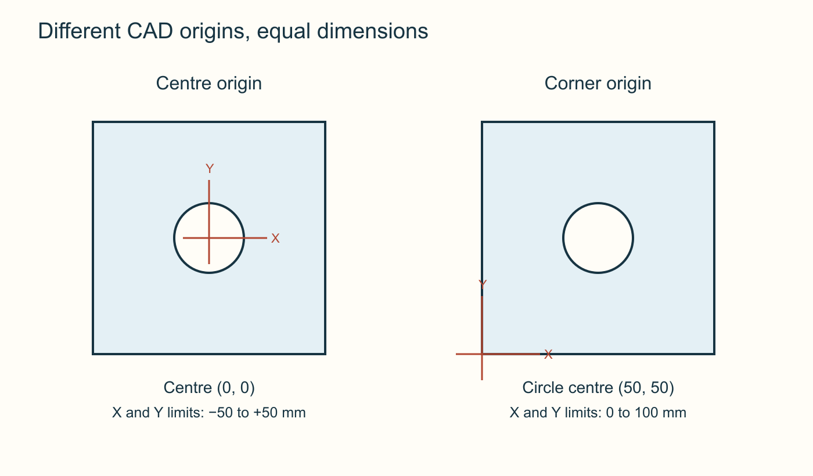
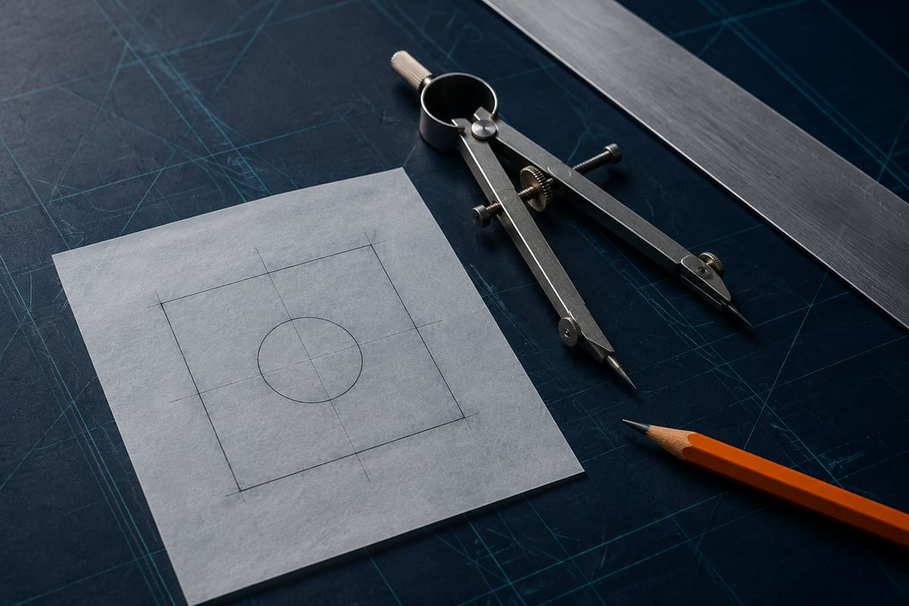
CNC PLASMA / SECTION 1 • M02-S01
Make the drawing deliberate
Use dimensions, relationships or precise coordinate entry to record your intention. Visual alignment alone is weak evidence.
In the proposed practice drawing, the centre can be 0,0 in a centred sketch or 50,50 in a corner-based drawing. Preserve the native editable file, then check the exported copy independently.
Different CAD origins, equal dimensions. Original teaching diagram; proposed geometry, not a machine setting or approved project plan.
Which measurements would prove that these drawings match?
AI-generated concept image
Standalone Year 10 unit • Teacher controls machine operation
03
Notes:
Section m02-s01: Your first dimensioned CAD sketch
TEACHER EXPLANATION
Tell CAD what must stay true A CAD sketch becomes reliable when it records your intention, not just the shape that happened to appear under the mouse. “A square with a central hole” includes several relationships: equal intended width and height, a circle of a particular diameter, and a shared centre. A drawing can look close while one of those relationships is wrong. Numerical checks turn a visual impression into evidence. Use the proposed offline example to practise: a 100 × 100 mm outer square with a central Ø30 mm hole. Those are teaching dimensions, not a specification for material or cutting. Set the workspace to millimetres before drawing and keep the geometry in one two-dimensional sketch or drawing. You do not need to invent a material thickness or a three-dimensional extrusion to describe these two outlines. Dimensions and constraints have different jobs A dimension controls or reports a size, such as a side length or circle diameter. A geometric constraint expresses a relationship, such as two points being coincident or a line remaining horizontal. Coincident means that the points occupy the same location. A centre that merely looks near the origin can still be misplaced; a confirmed coincident relationship records the intended shared location. In a parametric sketch such as Onshape’s, driving dimensions control geometry. A driven or reference dimension reports an existing measurement. Changing a displayed reference is not the same as controlling the shape. Adding more dimensions indiscriminately can also create conflicts or redundant information. If the sketch reports a problem, inspect the existing dimensions and relationships rather than stacking another measurement over them. Build the centred Onshape example In the Onshape walkthrough , choose millimetres, begin a sketch on the Top plane and use a centre rectangle anchored at the sketch origin. Enter 100 mm for its width and height. Add a centre-point circle at the same origin and set its diameter to 30 mm. The central relationship and the dimensions do different work: the origin keeps the parts aligned, while the values establish their size. Check the dimensions and centre relationships before accepting the sketch. This arrangement places the square’s bounds at −50 and +50 mm along both sketch axes, with the circle centre at (0, 0). If a dimension was missed during creation, use the documented Dimension tool or edit an existing dimension. A conflict is a reason to resolve the sketch, not a reason to ignore an error message. Use exact coordinates in 2D Design The 2D Design walkthrough establishes the same geometry through documented coordinate entry. In Absolute mode, draw the rectangle between (0, 0) and (100, 100). The centre-and-radius circle tool takes a radius of 15 mm and a centre of (50, 50). Read its radius field carefully; the Onshape example’s 30 mm diameter cannot be copied unchanged into it. Absolute coordinates locate a point from the drawing origin. They are different from a relative movement measured from a previous point. Confirm the entry mode before entering coordinates. In this example, exact corner and centre values establish the intended position; do not claim that this application uses the same parametric constraint workflow as Onshape. Inspect the object properties and the resulting dimensions. Preserve the design, then exchange it The two examples have identical size and a central hole despite their different origins. Compare dimensions and relationships, not coordinate values alone. Check for the intended two closed contours and any accidental extra geometry. A complete-looking sketch is still only the start of the handoff. Preserve the editable master: the Onshape document and named version, or the 2D Design DTD file. Export a separately named DXF revision and record the choices used. Keep later changes in the master before exporting again. The receiving application must check the transferred geometry because a correct native sketch does not guarantee a correct import. Your evidence should distinguish “checked in CAD” from “checked after transfer”.
TEACHING NOTES
{
"main_explanation": "Reliable CAD records intention through dimensions and relationships or precise coordinate entry. Similar appearance is insufficient evidence.",
"worked_example": "Centred Onshape rectangle/circle versus absolute-coordinate 2D Design rectangle and radius15 circle. Show how copying30 into a radius field changes the hole.",
"discussion_prompt": "A circle is visually near the origin. What evidence would establish that it is deliberately centred?"
}
VISUAL
Two identical 100 mm squares and 30 mm circles. The left origin lies at the centre; its coordinate limits are minus 50 to plus 50. The right origin is at the lower-left corner; the circle centre is 50,50.
Different CAD origins, equal dimensions. Original teaching diagram; proposed geometry, not a machine setting or approved project plan.
Compare coordinate limits while keeping the width, height and hole unchanged.
Original course diagram; no numeric machine settings prescribed.
DISCUSSION
Which measurements would prove that these drawings match?
Use the section’s ten questions for individual retrieval and feedback. Do not infer practical competence from online completion.
ILLUSTRATIVE IMAGE
AI-generated concept illustration for Make the drawing deliberate. This illustration supports discussion and is not a photograph of the school installation, a software screenshot, or a machine-setting guide. Original source reference images remain on this slide where present.

Slide 4
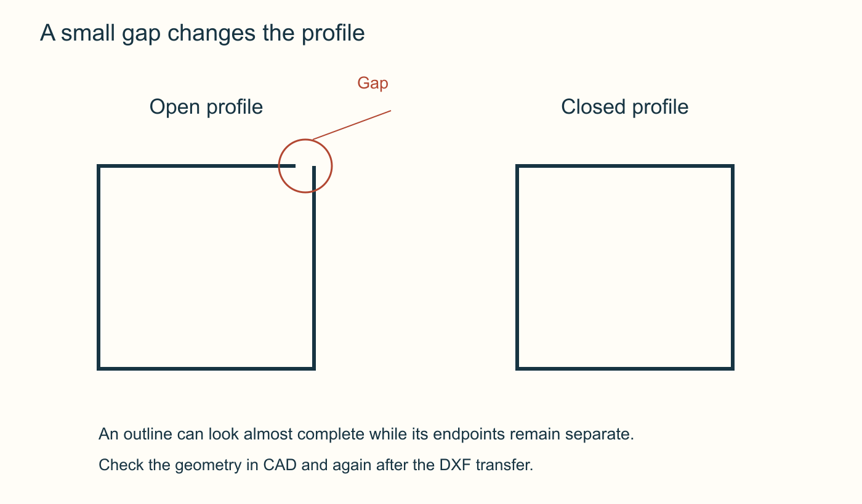

CNC PLASMA / SECTION 2 • M02-S02
A small gap changes the profile
A closed contour joins every endpoint. A tiny gap or duplicate segment can change what the receiving software recognises.
Trace each outline and inspect the imported geometry. For cut-out lettering, also follow the retained material: an enclosed centre needs a connected design if it is intended to remain attached.
A small gap changes the profile. Original teaching diagram; proposed geometry, not a machine setting or approved project plan.
Trace the two profiles without jumping across an endpoint gap.
AI-generated concept image
Standalone Year 10 unit • Teacher controls machine operation
04
Notes:
Section m02-s02: Geometry that makes a reliable outline
TEACHER EXPLANATION
Follow the boundary, not the picture A contour is a path that describes a boundary. For our proposed square-and-hole drawing, the intended result is one closed outer contour and one closed inner contour. The outer contour defines the square’s edge; the circle defines a hole. The retained material lies between them. Thinking about retained material and waste helps explain what the paths are meant to achieve before any CAM operation is chosen. A closed contour returns to its starting point without a gap. It can be represented by one object or several joined entities. A square exported as four connected lines can still describe one closed contour, while a single badly formed object may fail to describe one. Therefore, “two intended contours” is a geometry requirement, not a rule that every valid DXF must contain exactly two entities. Small geometric faults have consequences Two endpoints can appear to meet while remaining slightly apart. A small gap may be hidden by line thickness or a distant view. Use the application’s geometry checks, endpoint relationships or object information to investigate; visual neatness alone is not proof of closure. Correct the intended join in the editable design and recheck the exported result. Duplicate lines occupy the same location and may be difficult to notice. They can create repeated or ambiguous path information in the receiving system. An accidental crossing creates a different problem: a self-intersection can make the intended inside and outside unclear. Neither defect is repaired by adding more cutting power. Design errors belong in the geometry and file-preparation stages. A curve can travel in different forms CAD applications can represent circles, arcs and more complex curves in different ways. A spline is a flexible mathematical curve often used in logos and organic outlines. A receiving application may support some curve types better than others. Conversion can replace a smooth curve with a sequence of short straight segments, so compatibility and shape preservation both need attention. The installed 2D Design help describes a DXF choice between retaining arc commands and approximating arcs with lines. It also warns that transfer behaviour can leave small boundary gaps. This is a reason to check the receiving geometry, not an instruction to convert every curve. Preserve the native master, record any export or conversion choice and inspect the resulting shape and dimensions in a separate trial. Decide what must remain attached Text introduces a physical design issue as well as a file issue. Imagine cutting an O-shaped opening through a larger plate. Removing the complete ring around the letter’s centre leaves an isolated island that is no longer connected to the surrounding plate. If that centre is meant to remain, the design needs an intentional connection, such as a bridge, whose suitability the teacher reviews. The intended product matters. If the aim were a separate metal ring, its centre could be waste rather than a retained island. Do not add bridges simply because you see a circle or letter. First identify the material that should remain, then check whether it stays connected. No universal bridge width or smallest safe detail is established by this example. Work through an uncertain file The supplied complex logo DXF is a useful inspection case, not an approved cutting file. Its unit information is unset and it contains grouped geometry and many splines. Those findings do not establish its intended physical size or prove that every boundary is suitable. A successful opening merely shows that an application could read something from the file. For a repair exercise, preserve the original and work on a labelled copy. Establish intended size from reliable design evidence before interpreting units. Identify retained regions, inspect the relevant contours and investigate gaps, duplicates, crossings or unsupported curves. Make one traceable revision and re-import it to check the result. Stop the handoff when the size or boundary remains uncertain; an attractive logo is not a substitute for checked geometry.
TEACHING NOTES
{
"main_explanation": "Reliable outlines communicate closed boundaries and retained material; screen appearance and entity counts cannot prove readiness.",
"worked_example": "Inspect a hypothetical logo with unset units, a hidden gap and an isolated letter centre. Preserve the source and plan one traceable revision before re-importing.",
"discussion_prompt": "When is the centre of a letter a part that must stay attached, and when is it intentional waste?"
}
VISUAL
Two rectangular line profiles. The left has a visibly highlighted gap between its upper-right endpoints. The right joins every endpoint into a closed loop.
A small gap changes the profile. Original teaching diagram; proposed geometry, not a machine setting or approved project plan.
Trace each outline without jumping across a gap.
Original course diagram; no numeric machine settings prescribed.
DISCUSSION
Trace the two profiles without jumping across an endpoint gap.
Use the section’s ten questions for individual retrieval and feedback. Do not infer practical competence from online completion.
ILLUSTRATIVE IMAGE
AI-generated concept illustration for A small gap changes the profile. This illustration supports discussion and is not a photograph of the school installation, a software screenshot, or a machine-setting guide. Original source reference images remain on this slide where present.

Slide 5
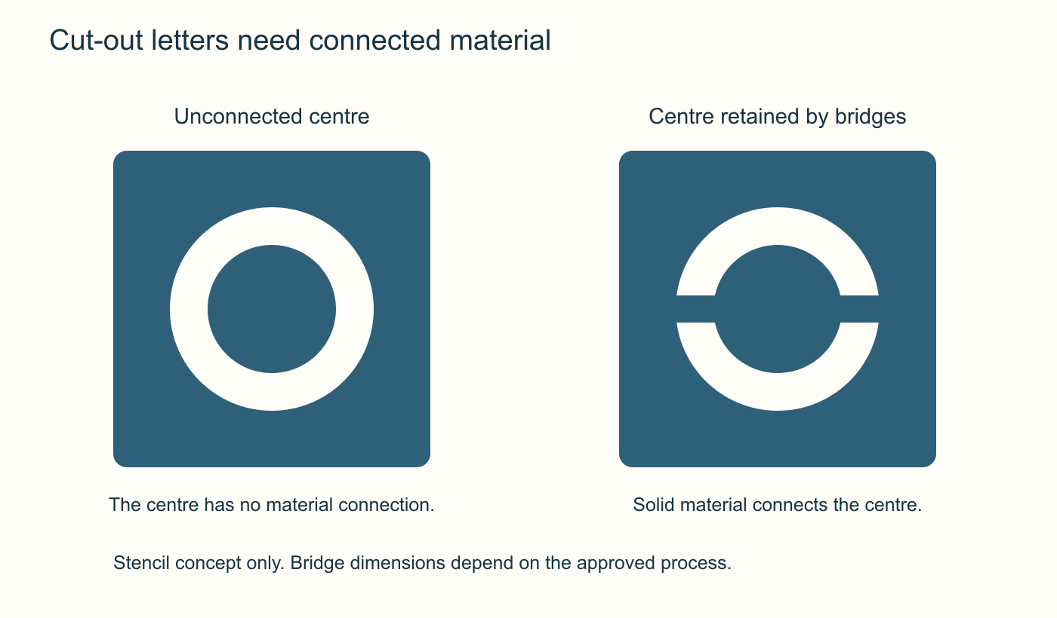
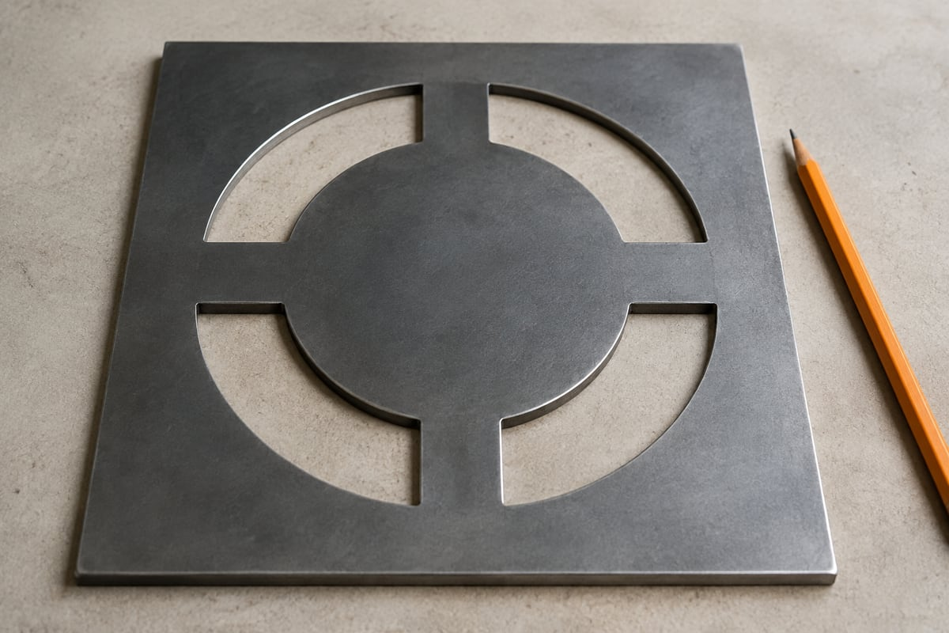
CNC PLASMA / SECTION 3 • M02-S03
Design for what remains
Think about the metal that will remain after the waste is removed. A recognisable sketch may still contain unsupported islands or unsuitable details.
Use a clear purpose, compare alternatives and seek teacher feedback on material and production limits. Record why the revised design is more suitable; do not invent minimum bridge widths or cutting settings.
Cut-out letters need connected material. Original teaching diagram; proposed geometry, not a machine setting or approved project plan.
Follow a solid path from each centre to the surrounding plate.
AI-generated concept image
Standalone Year 10 unit • Teacher controls machine operation
05
Notes:
Section m02-s03: Develop a design that can be made
TEACHER EXPLANATION
Begin with a useful intention A design is more than an attractive outline. It responds to a purpose for someone. Before adding detail, state who will use the proposed product, what it should help them do and where it would be used. This gives you a reason for each decision and a basis for checking the result. A decorative feature that makes the product harder to use may need reconsidering, even if it looks impressive. Suppose you are developing a concept for a flat equipment label that helps a group identify its gear. That is an example for design discussion, not an approved class manufacturing task. Your first intention might be that the message is recognisable and that the planned shape suits its proposed location. The offline square-and-hole exercise provides CAD practice; it does not automatically become the final product. Turn preferences into checkable criteria Criteria describe what a successful design should achieve. “Looks good” is difficult to evaluate by itself. “The intended viewer can recognise the message from the agreed viewing position” identifies an observable outcome. A geometry criterion might require the dimensions to match the drawing record and the intended retained areas to remain connected. State how you could collect evidence for each criterion. Functional criteria concern what the product does. Appearance also matters because shape, spacing and proportion affect how people understand and respond to it. Production criteria concern whether the design can be prepared and made through the approved process. These concerns can compete: extra detail may strengthen an identity but introduce difficult small features. Explain the trade-off rather than assuming the most detailed option is best. Keep a proposal within known limits Feasibility means whether a proposal can be achieved under its real constraints. A readable drawing is only part of that judgement. The approved stock, material, thickness, available process and feature limits affect the eventual product. Obtain the teacher’s confirmed requirements before treating those choices as settled. Do not select a numerical cutting setting to compensate for an uncertain design. Keep the outline suited to the information you can verify. Inspect closed contours, holes and any isolated pieces. Allow the trained teacher to review details that depend on the actual material and process, such as suitable connections and small features. A software preview cannot prove the strength of a narrow connection or the quality of a physical edge. Identifying an unanswered requirement is better evidence than disguising it with a confident claim. Improve one decision using evidence Return to the proposed equipment label. One concept uses detailed cut-out lettering with enclosed centres; another simplifies the message and has fewer small features. Compare them against the same purpose and criteria. A paper or on-screen review can reveal that the first is difficult to recognise or contains islands that would need deliberate connections. That evidence supports revision before consuming metal. Choose a change with a clear reason, such as revising the letter layout to improve recognition and connectivity. Preserve the earlier version, update the editable master and name the new revision. Then repeat the relevant checks. This cycle of proposing, reviewing, changing and checking is iteration. It is not simply making the design different: the change should address an identified issue and produce evidence about whether it helped. Explain what the evidence establishes Your design record should connect the intention, chosen criteria, comparison, change and result. Keep a useful sketch or CAD reference with a short caption explaining what it demonstrates. The design journal provides places to record those decisions and file checks without copying every theory note. Separate digital evidence from a physical result. You can establish that dimensions were checked in CAD or that a viewer understood a proposed layout without claiming that the part has been cut successfully. Manufacturing observation or feedback must describe what actually happened under teacher-controlled arrangements. Finish with one justified next improvement and any remaining check. Production and machine operation stay within the trained teacher’s approved process.
TEACHING NOTES
{
"main_explanation": "A feasible design connects user purpose, criteria, evidence and controlled revision. Digital success is one kind of evidence, not a manufacturing result.",
"worked_example": "Compare two proposed label concepts, use readability and retained-connectivity criteria, then justify one recorded revision without inventing material or cutting settings.",
"discussion_prompt": "Which parts of a promising CAD proposal can be evaluated now, and which require confirmed production conditions or an actual result?"
}
VISUAL
Two stencil-like O shapes in plates. On the left the central disc is disconnected. On the right solid horizontal bridges connect the disc to the surrounding plate. No bridge width is specified.
Cut-out letters need connected material. Original teaching diagram; proposed geometry, not a machine setting or approved project plan.
Follow a continuous solid path from each centre to its surrounding plate.
Original course diagram; no numeric machine settings prescribed.
DISCUSSION
Follow a solid path from each centre to the surrounding plate.
Use the section’s ten questions for individual retrieval and feedback. Do not infer practical competence from online completion.
ILLUSTRATIVE IMAGE
AI-generated concept illustration for Design for what remains. This illustration supports discussion and is not a photograph of the school installation, a software screenshot, or a machine-setting guide. Original source reference images remain on this slide where present.

Slide 6

CNC PLASMA / RETRIEVE AND EXPLAIN
Pause before looking back
1
Which measurements would prove that these drawings match?
2
Trace the two profiles without jumping across an endpoint gap.
3
Follow a solid path from each centre to the surrounding plate.
AI-generated concept image
Standalone Year 10 unit • Teacher controls machine operation
06
Notes:
Give students thinking time before pairing or discussing. Revisit the matching section if explanations are uncertain. These questions are formative and ungraded.
Which measurements would prove that these drawings match?
Trace the two profiles without jumping across an endpoint gap.
Follow a solid path from each centre to the surrounding plate.
ILLUSTRATIVE IMAGE
AI-generated concept illustration for Pause before looking back. This illustration supports discussion and is not a photograph of the school installation, a software screenshot, or a machine-setting guide. Original source reference images remain on this slide where present.

Slide 7
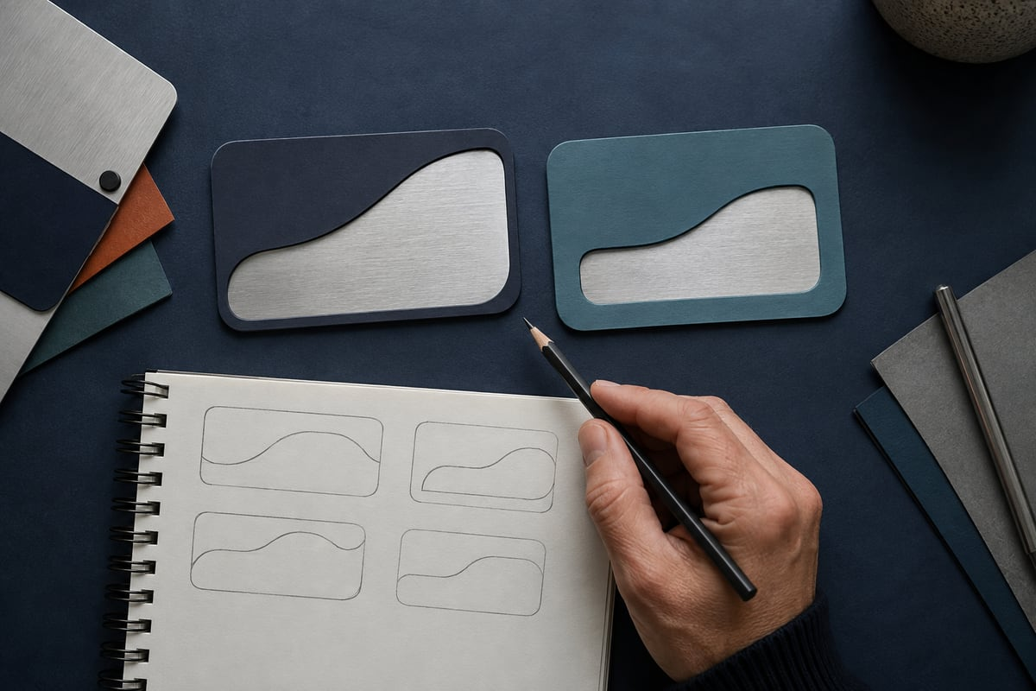
CNC PLASMA / BUILD A CONNECTED RESPONSE
Explain your decision with evidence
Justify a revision to the proposed equipment-label concept using its intended user, purpose and two checkable criteria. Explain the evidence you would collect, the requirements that need confirmation before production, and how you would avoid claiming a physical result from digital evidence alone.
01
State the user and useful purpose of the proposed label.
02
Choose two observable criteria and compare the concept against them.
03
Explain one revision and the evidence needed to judge it.
AI-generated concept image
Standalone Year 10 unit • Teacher controls machine operation
07
Notes:
Students write their own response in the module section. Scaffold prompts guide one connected explanation; they are not separate tasks.
Success criteria:
Connects the proposed revision to purpose and observable criteria.
Identifies a realistic evidence method and relevant constraints.
Preserves traceable iteration and distinguishes digital from physical evidence.
Keeps manufacturing approval and operation within the teacher’s process.
ILLUSTRATIVE IMAGE
AI-generated concept illustration for Explain your decision with evidence. This illustration supports discussion and is not a photograph of the school installation, a software screenshot, or a machine-setting guide. Original source reference images remain on this slide where present.

Slide 8

CNC PLASMA / EVIDENCE AND NEXT STEP
Leave with something useful
1 Check your three section packages.
2 Record the module activity and folio evidence.
3 Name one uncertainty and your next check.
AI-generated concept image
Exit prompt: What evidence changed your understanding today?
Browser saving keeps a local copy. Export and verify a backup; follow your teacher’s submission instructions.
Standalone Year 10 unit • Teacher controls machine operation
08
Notes:
Open modules/module-02.html#module-02-review. Review completion and feedback rather than treating checked answers as a competence result. Keep original CAD files separately. Students should state their own contribution and identify teacher-controlled production honestly.
ILLUSTRATIVE IMAGE
AI-generated concept illustration for Leave with something useful. This illustration supports discussion and is not a photograph of the school installation, a software screenshot, or a machine-setting guide. Original source reference images remain on this slide where present.

