Slide 1

CNC PLASMA / MODULE 3 • WEEKS 5–6
Prepare the production file
Prepare a checked and traceable production-file handoff through the offline CAD and CAM workflow.
AI-generated concept image
Learn → inspect → practise → explain
Standalone Year 10 unit • Teacher controls machine operation
01
Notes:
Module 3: Prepare the production file
Teaching purpose: Prepare a checked and traceable production-file handoff through the offline CAD and CAM workflow.
Use the course module for the complete explanations and formative learning evidence. This presentation supports explanation; it is not operator certification or the local operating procedure.
Image: Supplier SureControl manual V2.1, p15. Inspect units and drawing position; this is not the current school installation.
Source: Surecontrol Software Manual_Draft4.pdf
ILLUSTRATIVE IMAGE
AI-generated concept illustration for Prepare the production file. This illustration supports discussion and is not a photograph of the school installation, a software screenshot, or a machine-setting guide. Original source reference images remain on this slide where present.

Slide 2

CNC PLASMA / CONNECT THE THREE LESSONS
Today’s learning map
01
Export and check your DXF
02
From drawing to toolpath in SheetCam
03
Nest, name and hand over the job
AI-generated concept image
Before we begin: which step in the workflow needs the strongest check?
Standalone Year 10 unit • Teacher controls machine operation
02
Notes:
Invite a short prediction before teaching. Accept uncertainty and record one question to revisit.
m03-s01: Explain how you would check and hand over a revised training-square DXF when its coordinate origin differs from the example. Justify the checks that matter and state what your evidence cannot prove.
m03-s02: Explain how you would review a CAM preview of the practice square and hole before handing it to the authorised teacher. Justify why a correct-looking outline and successful preview are insufficient for production approval.
m03-s03: Evaluate a proposed handoff containing a tidy nest, two differently dated DXFs and a file named ready-to-cut.tap, but no revision record. Explain how you would make the handoff useful without claiming machine approval.
ILLUSTRATIVE IMAGE
AI-generated concept illustration for Today’s learning map. This illustration supports discussion and is not a photograph of the school installation, a software screenshot, or a machine-setting guide. Original source reference images remain on this slide where present.

Slide 3
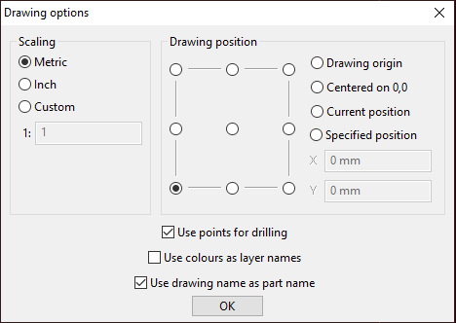

CNC PLASMA / SECTION 1 • M03-S01
Export, reopen, measure
Keep the native CAD master and export a separate DXF exchange copy. Check the receiving program’s units and drawing placement.
Then verify the overall dimensions, hole size, contours and revision. A file opening successfully does not prove its scale or geometry. Record the actual import result before accepting the transfer.
Supplier SureControl manual V2.1, p15. Inspect units and drawing position; this is not the current school installation.
Which check distinguishes a successful opening from a correct import?
AI-generated concept image
Standalone Year 10 unit • Teacher controls machine operation
03
Notes:
Section m03-s01: Export and check your DXF
TEACHER EXPLANATION
Keep a master and an exchange copy A CAD drawing is more than the picture on the screen. Its editable master keeps the information needed to change the design: dimensions, shapes and, in some programs, the steps used to construct it. In Onshape, the document and its named version provide that master. In 2D Design, the native .dtd file serves this purpose. Keep the master even after making an export. DXF is an exchange format that carries drawing information into another program. It is useful because the receiving software does not need to open your native CAD document. However, an exchange copy may not preserve every feature in the same way. An export is therefore a handoff that needs checking, not proof that the next stage will work. Changing the letters at the end of a filename does not convert its contents. Export the intended geometry The course’s practice drawing is a proposed 100 mm square with a central hole of 30 mm diameter. It is a geometry exercise, not an approved cutting project or material recipe. For the Onshape pathway, the guide exports the whole sketch as DXF. Selecting only one edge would send an incomplete description. In the installed 2D Design documentation, the route is File > Export File, followed by DXF File. The native Save command keeps the editable drawing instead. Record the export choices that actually appear. The 2D Design help describes an option for retaining DXF arcs or approximating them with short straight lines. It does not establish a DXF release selector. Curve conversion can affect smoothness and how endpoints meet, so use the teacher’s tested pathway rather than inventing a preferred version or changing approximation settings at random. The Onshape export and 2D Design export guides show the documented steps. Reopen and measure Reopen the DXF separately, using the offline receiving program where available. Check its units and scale before accepting what you see. A window can make a small drawing and a large drawing look almost identical by zooming to fit. Page-fitting options may also rescale geometry. In the documented 2D Design round-trip check, Interpret units and Position preserves deliberate unit interpretation; Fit to media can change the size. Use dimensions or object properties to compare the imported width, height and hole diameter with the design record. Write down the unit as well as the number. For the practice drawing, the expected width and height are each 100 mm and the hole diameter is 30 mm. A radius reading of 15 mm describes that same hole. Radius and diameter are different measurements, so comparing the numbers without their labels can suggest a fault that is not present. A different origin can preserve the size The two CAD pathways use different coordinate layouts. A centred square extending from −50 to +50 mm spans 100 mm. A square extending from 0 to 100 mm also spans 100 mm. Their hole centres have different coordinates, yet both holes can be central. Do not move a correct drawing simply to make its coordinate labels resemble another example. The CAD origin is also different from the physical job origin later set by the trained operator. Check the shape and identify the revision Inspect the complete outline, closed hole, duplicate lines, stray geometry and unwanted annotations. A dimension label is evidence about a shape; it should not accidentally become another cutting line. If a check fails, return to the master, correct the design and make a new identified export. For example, a revised master called v2 paired with an older v1 DXF is an incomplete handoff even if both files open. Record the application, revision, units, export choices and checks completed. Describe any check you could not perform honestly. This gives the teacher useful evidence for the next CAM stage; it does not approve a machine program. Follow the handoff record and practise the comparison in Does the drawing keep its size?
TEACHING NOTES
{
"main_explanation": "Native master → exchange copy → independent inspection. Preserve editability and record units, geometry and revision.",
"worked_example": "Compare 100 × 100 mm square with Ø30 mm hole in centred and 0–100 coordinate layouts; radius15 mm is equivalent.",
"discussion_prompt": "Which differences after import are genuine geometry faults, and which are only display or datum differences?"
}
VISUAL
SheetCam drawing import options showing Metric and drawing-position choices
Supplier SureControl manual V2.1, p15. Inspect units and drawing position; this is not the current school installation.
Source: Surecontrol Software Manual_Draft4.pdf
DISCUSSION
Which check distinguishes a successful opening from a correct import?
Use the section’s ten questions for individual retrieval and feedback. Do not infer practical competence from online completion.
ILLUSTRATIVE IMAGE
AI-generated concept illustration for Export, reopen, measure. This illustration supports discussion and is not a photograph of the school installation, a software screenshot, or a machine-setting guide. Original source reference images remain on this slide where present.

Slide 4
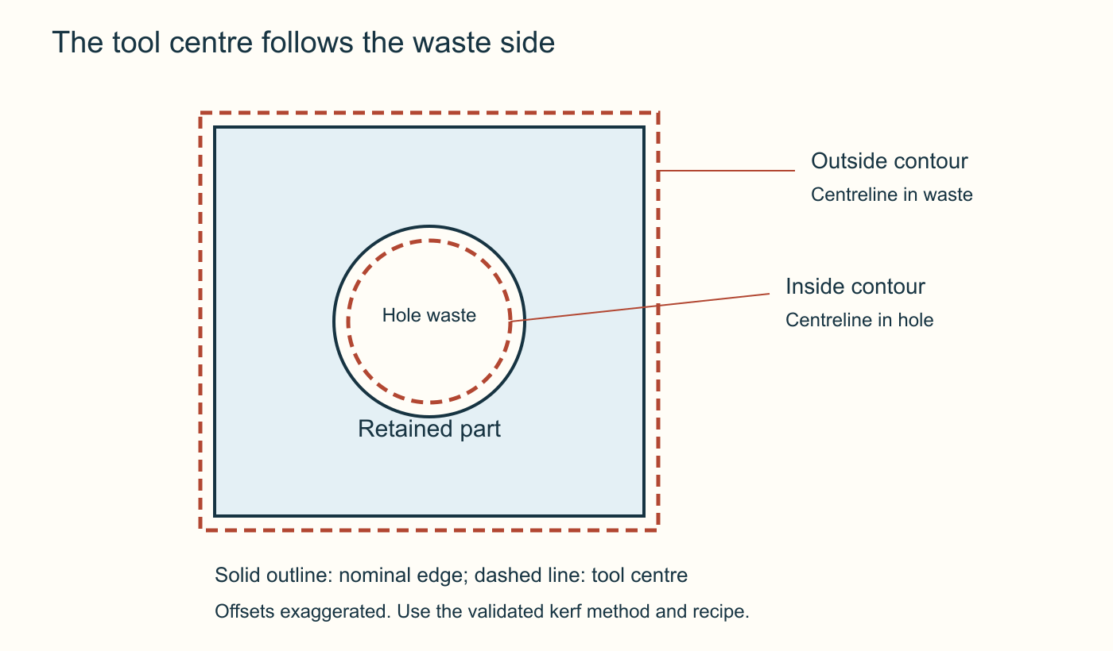

CNC PLASMA / SECTION 2 • M03-S02
Plan the toolpath on the waste side
CAM turns the outline into an operation using an approved tool and process. Identify inside and outside features, order, lead-ins and the agreed compensation method.
The tool centre is offset towards the waste side. The diagram exaggerates the offset and prescribes no value. Avoid applying the same kerf allowance twice.
The tool centre follows the waste side. Original teaching diagram; proposed geometry, not a machine setting or approved project plan.
Why is the waste side different for the hole and the outer edge?
AI-generated concept image
Standalone Year 10 unit • Teacher controls machine operation
04
Notes:
Section m03-s02: From drawing to toolpath in SheetCam
TEACHER EXPLANATION
The line is not yet a cutting instruction CAD describes the intended shape. CAM prepares how a machine could make that shape. In this course’s documented pathway, SheetCam is the CAM program between the checked DXF and SureControl. It combines drawing geometry with an operation, a tool definition and a sequence of movements. The resulting toolpath is the route prepared for the torch, not simply a coloured copy of the drawing. A useful comparison is a travel plan. A destination tells you where you want to finish, but it does not explain your route or stops. Similarly, a square with a hole describes the desired part; it does not yet specify where cutting starts, which contour is cut first or how the width of the cut is allowed for. Those choices need review before machine instructions are produced. Check the drawing again in CAM Importing is another transfer boundary. Check the imported units, overall dimensions, hole size and position against the drawing record. A DXF that passed a CAD round-trip can still be interpreted differently by a later program. The supplier’s example uses Metric in the import dialogue, but its example selections are not a school installation recipe. The SheetCam import guide identifies the documented controls and checks. Layers can organise drawing entities so that operations use the intended geometry. A layer name alone does not prove that its contents are correct. Inspect what is actually selected. A forgotten construction line or duplicate outline may become unwanted work when the operation is generated. Correct geometry in the master where necessary, then repeat the identified export and import. Allow for the cut, not just its centreline The plasma process removes a strip of material called the kerf. If the torch centre followed a finished outside boundary exactly, some of that strip would remove material intended to remain. An offset positions the toolpath on the appropriate side of the design line. For a closed outside profile, the waste is outside the part. For a hole, the waste is inside the opening. Consider the practice square with its central hole. Both contours belong to one part, but the material to keep lies on different sides of their lines. The supplier’s Outside Offset example can include outside contours and internal holes when the closed geometry is interpreted correctly. Inspect the resulting path instead of assuming the operation’s name proves each contour is correct. An open path has no enclosed inside or outside and needs separate consideration. Read the route and the sequence A lead-in approaches the contour before the torch follows the finished edge; a lead-out leaves it. These movements need space and may extend beyond the part’s nominal outline. The operation also uses values such as feed rate, pierce delay and heights. Their suitability depends on the confirmed material, thickness, torch, consumables and cutting system. A screenshot’s numbers demonstrate a dialogue, not values to copy. The preview can show path direction, start points, cutting paths and rapid moves. Examine the hole and outside contour separately, then follow their sequence. Internal features are normally completed before the surrounding outside profile so the part remains supported while those features are cut. Check lead locations and travel as well as the finished shape. The toolpath review provides the more detailed inspection sequence. Preview, then prepare a compatible output SheetCam’s on-screen simulation lets you inspect the prepared route offline. It does not test physical clearance, the actual material or the machine’s condition. It is different from SureControl’s Simul control, which commands real machine movement when the operator starts it. Students’ preparation remains offline. A postprocessor translates the CAM work into the machine’s required instruction format. The supplier manual describes TAP output with its SureControl postprocessor. A .tap extension alone cannot prove compatibility with a particular installed machine. Retain the CAM work and its revision, record the selected postprocessor, and leave compatibility and production approval to the authorised teacher. The postprocessing guide connects this explanation to the documented handoff.
TEACHING NOTES
{
"main_explanation": "Follow CAD geometry through imported layers, operation and offset to a reviewed CAM route. Explain why the path differs from the finished edge and why the output still needs a compatible postprocessor.",
"worked_example": "Use the practice square and hole to locate the retained material, waste, inner-first sequence and space required for leads. Keep all cutting recipe values unspecified.",
"discussion_prompt": "Which checks can an offline CAM preview support, and which require the authorised teacher at the installed machine?"
}
VISUAL
A retained rectangular part surrounds a circular hole. The dashed tool centreline runs outside the outer boundary and inside the hole boundary, on the waste side in both cases. Offsets are exaggerated and have no prescribed cutting value.
The tool centre follows the waste side. Original teaching diagram; proposed geometry, not a machine setting or approved project plan.
Trace the retained material and identify the waste side of each boundary.
Original course diagram; no numeric machine settings prescribed.
DISCUSSION
Why is the waste side different for the hole and the outer edge?
Use the section’s ten questions for individual retrieval and feedback. Do not infer practical competence from online completion.
ILLUSTRATIVE IMAGE
AI-generated concept illustration for Plan the toolpath on the waste side. This illustration supports discussion and is not a photograph of the school installation, a software screenshot, or a machine-setting guide. Original source reference images remain on this slide where present.

Slide 5
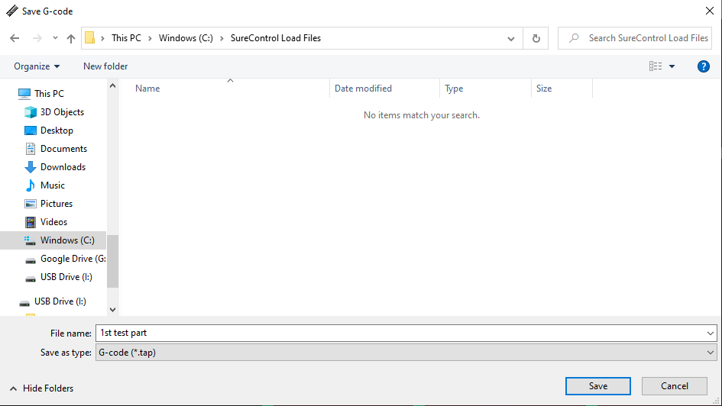
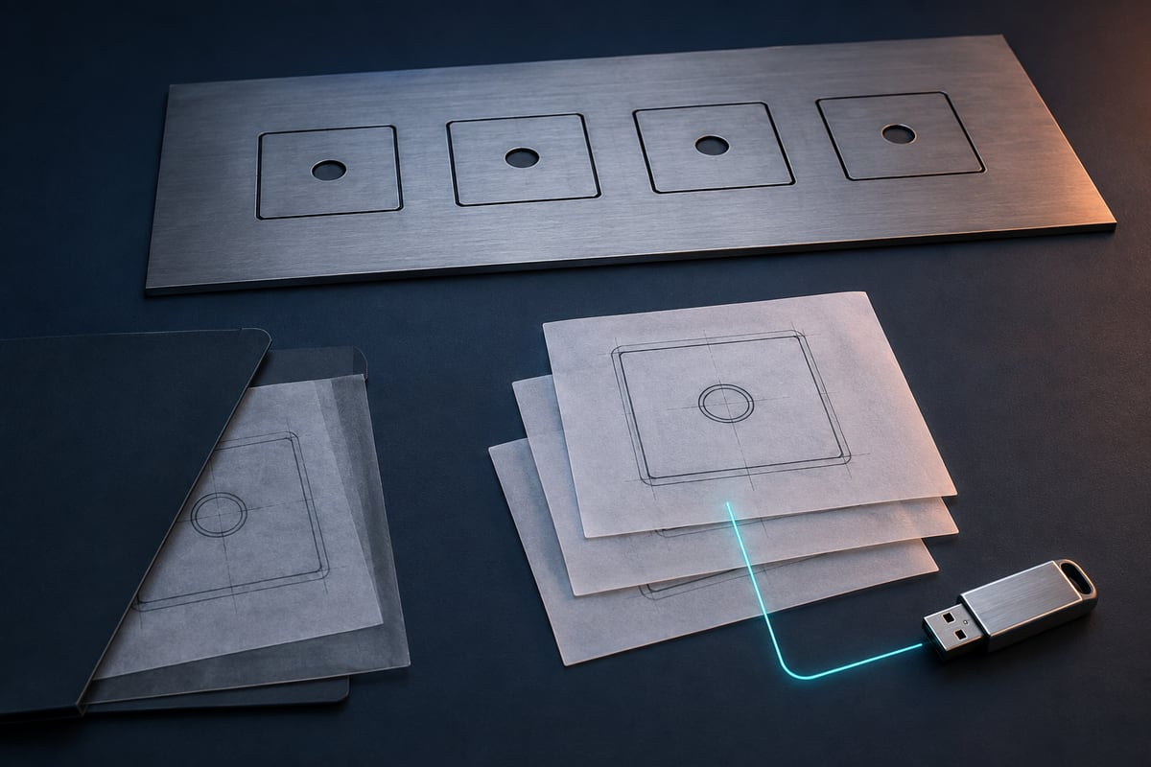
CNC PLASMA / SECTION 3 • M03-S03
Hand over a traceable job
Nesting arranges parts on a sheet, but spacing, clamps, edges and cutting behaviour still require review. Record file names and revisions so the teacher can identify the intended job.
The approved post-processor creates controller-specific output. The handover should connect the checked drawing, CAM setup, output and outstanding questions.
Supplier output example: identify the destination and revision rather than relying on a familiar filename. The folder and output are examples, not verification of the school installation. SureControl Software Manual V2.1, p. 17.
What would prevent an older output file being mistaken for the current revision?
AI-generated concept image
Standalone Year 10 unit • Teacher controls machine operation
05
Notes:
Section m03-s03: Nest, name and hand over the job
TEACHER EXPLANATION
A nest is a planned arrangement Nesting arranges parts on a sheet so the available material is used sensibly. It may involve moving, rotating or copying a part in CAM. The aim is not simply to make the shapes look tightly packed. A useful layout must still allow the planned cutting paths, leads and movements to be reviewed. The actual sheet size and usable area belong in the production record. Students can compare arrangements offline using the teacher’s design brief. Moving a part changes its position, not its intended dimensions. Rotating it changes its orientation. Copying adds another instance that must be included in the required quantity. Check these changes deliberately: two overlapping copies might look like one outline at first glance but still represent duplicate work. Scaling is a different action and must not be used casually to force a design into a space. Consider more than the finished shapes Imagine placing two practice squares side by side. Each outline might fit within a drawing of the available sheet, yet the toolpaths could need space outside those outlines. Leads and kerf offsets can extend into the gap. A visually small gap is not evidence of a safe or suitable gap. The authorised teacher uses the confirmed process and actual layout to establish the required spacing; this course does not supply a universal spacing value. Inspect the complete route after arranging the parts. Check for overlaps, unwanted copies, approach paths and rapid moves between cuts. Consider the sequence within each part as well as the order between parts. Keeping the outside profile attached while internal features are cut normally helps retain support. A layout that reduces waste but releases a part before its remaining features are complete needs further review. Keep the stages recognisable Several files can describe the same design at different stages. The editable CAD master preserves the design you can revise. DXF carries checked geometry between programs. The CAM job retains the arrangement and operation work needed to review or revise the production plan. Postprocessing produces machine instructions, described as TAP output in the supplier’s SureControl pathway. These records are related, but they are not interchangeable. If you change the master, check which downstream files now need updating. A new hole position can make the previous DXF, CAM arrangement and machine output stale even when their filenames still sound correct. Renaming an old file does not regenerate its contents. Keeping only the newest machine output would also make it difficult to understand or correct the decisions that produced it. Name a revision so another person can find it A useful handoff lets the next person identify the intended project, revision and stage without guessing. For example, a proposed offline drawing label such as practice-square-v02 distinguishes a revised design from v01. The label should agree with the actual content and the handoff record. It does not certify that a file is ready to cut. Use the teacher’s agreed naming and storage convention when one is provided. Keep the master and its matching export together in the record, with the application, units and checks completed. Record CAM changes such as quantity or rotation and identify the output produced from that job. Avoid vague descriptions such as “the good one”. If an earlier revision remains for reference, make its superseded status clear rather than leaving two apparently current files. Hand over evidence and unresolved questions A useful handoff states what you checked and what remains unverified. Include the intended dimensions, revision, quantity, export choices, CAM preview observations and selected postprocessor where that stage has been completed. “Preview reviewed offline” is precise. “Machine tested” would be false unless that separate authorised check actually occurred. The teacher must match the production output to the installed software and machine, the actual material and the authorised procedure. A familiar filename, a TAP extension or a tidy nest cannot establish that match. A missing dimension or uncertain revision is a reason to resolve the record before proceeding, not to guess. Use the file handoff guide and Follow the file through the workflow to rehearse a clear transfer without creating machine code.
TEACHING NOTES
{
"main_explanation": "Explain nesting as arrangement plus route review, then show the dependency chain from editable master through DXF and CAM work to postprocessed output.",
"worked_example": "Compare two arrangements of the practice square. Keep dimensions fixed; ask what changes when a copy is added or a lead extends outside the outline. Trace a moved hole from v01 to v02.",
"discussion_prompt": "What evidence would allow another person to identify the intended file without relying on a filename such as 'the good one'?"
}
VISUAL
Supplier screenshot of saving the postprocessed TAP output in a named folder.
Supplier output example: identify the destination and revision rather than relying on a familiar filename. The folder and output are examples, not verification of the school installation. SureControl Software Manual V2.1, p. 17.
Source: Surecontrol Software Manual_Draft4.pdf
DISCUSSION
What would prevent an older output file being mistaken for the current revision?
Use the section’s ten questions for individual retrieval and feedback. Do not infer practical competence from online completion.
ILLUSTRATIVE IMAGE
AI-generated concept illustration for Hand over a traceable job. This illustration supports discussion and is not a photograph of the school installation, a software screenshot, or a machine-setting guide. Original source reference images remain on this slide where present.

Slide 6

CNC PLASMA / RETRIEVE AND EXPLAIN
Pause before looking back
1
Which check distinguishes a successful opening from a correct import?
2
Why is the waste side different for the hole and the outer edge?
3
What would prevent an older output file being mistaken for the current revision?
AI-generated concept image
Standalone Year 10 unit • Teacher controls machine operation
06
Notes:
Give students thinking time before pairing or discussing. Revisit the matching section if explanations are uncertain. These questions are formative and ungraded.
Which check distinguishes a successful opening from a correct import?
Why is the waste side different for the hole and the outer edge?
What would prevent an older output file being mistaken for the current revision?
ILLUSTRATIVE IMAGE
AI-generated concept illustration for Pause before looking back. This illustration supports discussion and is not a photograph of the school installation, a software screenshot, or a machine-setting guide. Original source reference images remain on this slide where present.

Slide 7
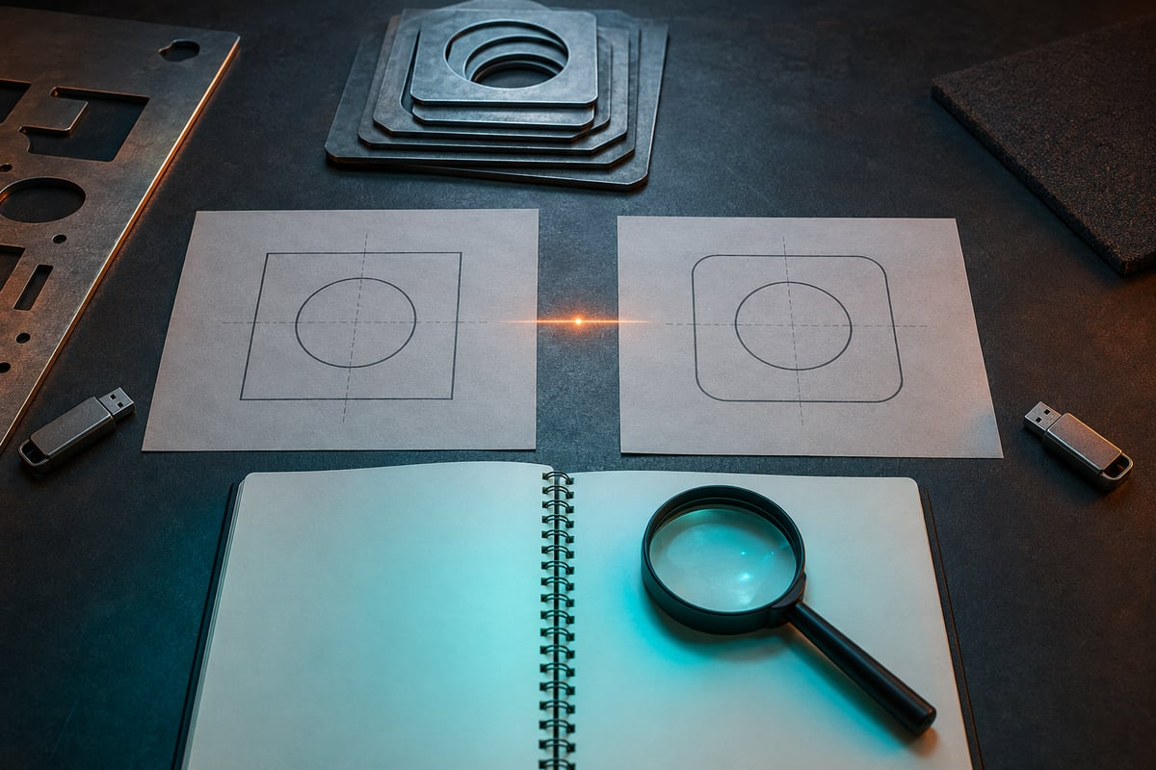
CNC PLASMA / BUILD A CONNECTED RESPONSE
Explain your decision with evidence
Evaluate a proposed handoff containing a tidy nest, two differently dated DXFs and a file named ready-to-cut.tap, but no revision record. Explain how you would make the handoff useful without claiming machine approval.
01
Identify what the tidy layout does and does not demonstrate.
02
Trace the files back to the intended editable master and revision.
03
Explain the layout, quantity and route checks that belong in the record.
AI-generated concept image
Standalone Year 10 unit • Teacher controls machine operation
07
Notes:
Students write their own response in the module section. Scaffold prompts guide one connected explanation; they are not separate tasks.
Success criteria:
Justifies a clear relationship between design revision, exchange geometry, CAM work and output.
Distinguishes completed offline checks from production compatibility and authorisation.
ILLUSTRATIVE IMAGE
AI-generated concept illustration for Explain your decision with evidence. This illustration supports discussion and is not a photograph of the school installation, a software screenshot, or a machine-setting guide. Original source reference images remain on this slide where present.

Slide 8

CNC PLASMA / EVIDENCE AND NEXT STEP
Leave with something useful
1 Check your three section packages.
2 Record the module activity and folio evidence.
3 Name one uncertainty and your next check.
AI-generated concept image
Exit prompt: What evidence changed your understanding today?
Browser saving keeps a local copy. Export and verify a backup; follow your teacher’s submission instructions.
Standalone Year 10 unit • Teacher controls machine operation
08
Notes:
Open modules/module-03.html#module-03-review. Review completion and feedback rather than treating checked answers as a competence result. Keep original CAD files separately. Students should state their own contribution and identify teacher-controlled production honestly.
ILLUSTRATIVE IMAGE
AI-generated concept illustration for Leave with something useful. This illustration supports discussion and is not a photograph of the school installation, a software screenshot, or a machine-setting guide. Original source reference images remain on this slide where present.

