Slide 1
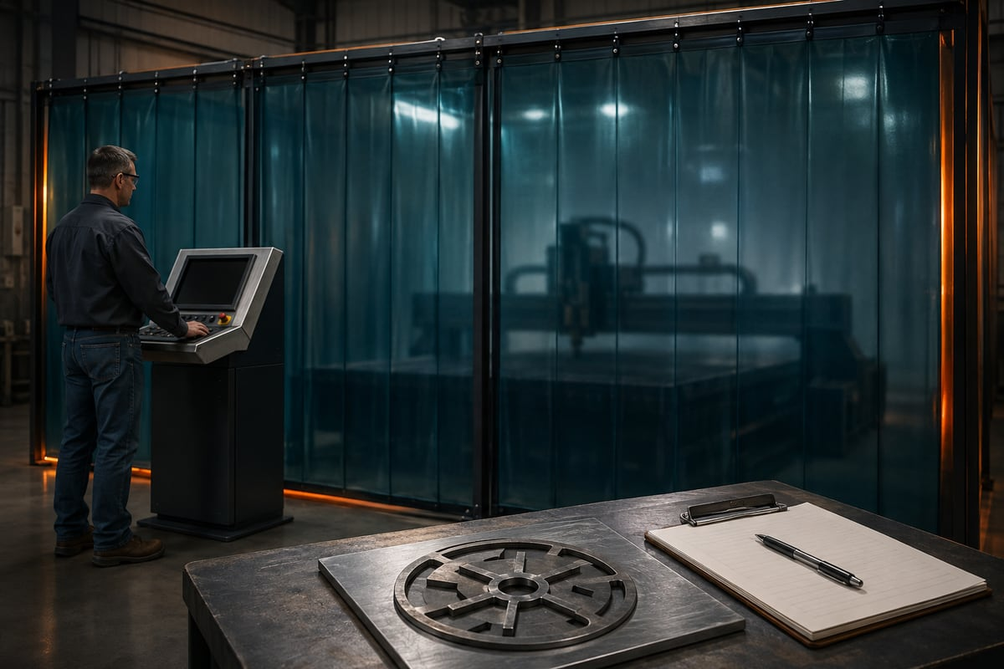
CNC PLASMA / MODULE 4 • WEEKS 7–8
Understand teacher-controlled production
Understand what the authorised teacher checks on the screen, in the process record and during the controlled production sequence.
AI-generated concept image
Learn → inspect → practise → explain
Standalone Year 10 unit • Teacher controls machine operation
01
Notes:
Module 4: Understand teacher-controlled production
Teaching purpose: Understand what the authorised teacher checks on the screen, in the process record and during the controlled production sequence.
Use the course module for the complete explanations and formative learning evidence. This presentation supports explanation; it is not operator certification or the local operating procedure.
Image: SureControl main interface, supplier manual p25. This is a historical supplier screenshot, not the currently connected school controller.
Source: Surecontrol Software Manual_Draft4.pdf
ILLUSTRATIVE IMAGE
AI-generated concept illustration for Understand teacher-controlled production. This illustration supports discussion and is not a photograph of the school installation, a software screenshot, or a machine-setting guide. Original source reference images remain on this slide where present.

Slide 2
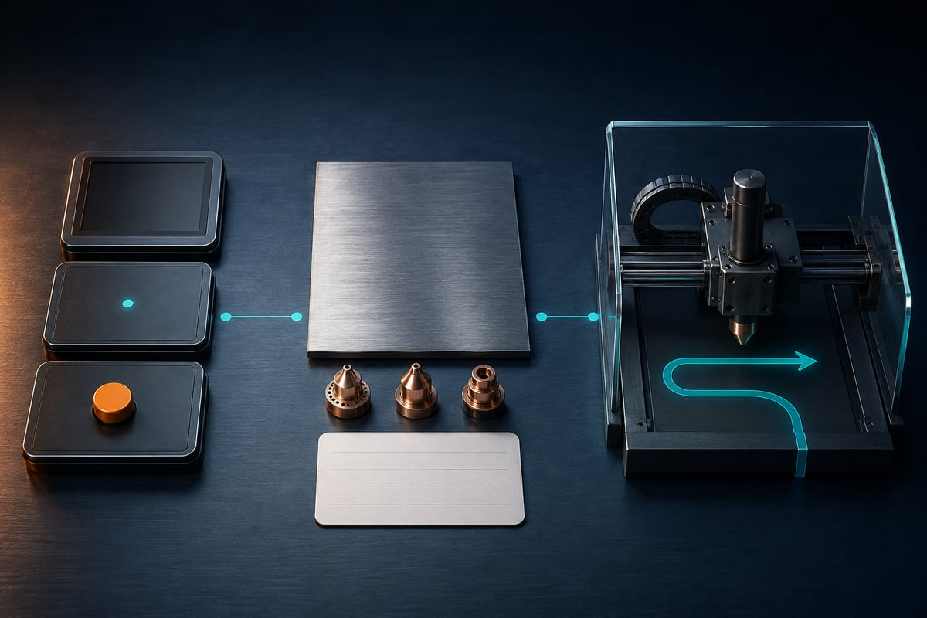
CNC PLASMA / CONNECT THE THREE LESSONS
Today’s learning map
01
Read the SureControl screen
02
Understand the settings and cut chart
03
Follow and observe the production sequence
AI-generated concept image
Before we begin: which step in the workflow needs the strongest check?
Standalone Year 10 unit • Teacher controls machine operation
02
Notes:
Invite a short prediction before teaching. Accept uncertainty and record one question to revisit.
m04-s01: Explain why a student observing a loaded job, Idle status and a selected Touch option cannot conclude that the machine is ready to cut. Use the difference between information, signals, options and actions.
m04-s02: Evaluate a settings record that includes material thickness and software Amp but omits the consumable identity, feed unit and physical current check. Explain why completing those gaps matters before the teacher considers production.
m04-s03: Explain how a class can learn from a teacher-controlled demonstration when the offline preview is correct but the physical dry run fails the fit check. Justify the pause, the student role and the conditions that still apply before any later cut or retrieval.
ILLUSTRATIVE IMAGE
AI-generated concept illustration for Today’s learning map. This illustration supports discussion and is not a photograph of the school installation, a software screenshot, or a machine-setting guide. Original source reference images remain on this slide where present.

Slide 3
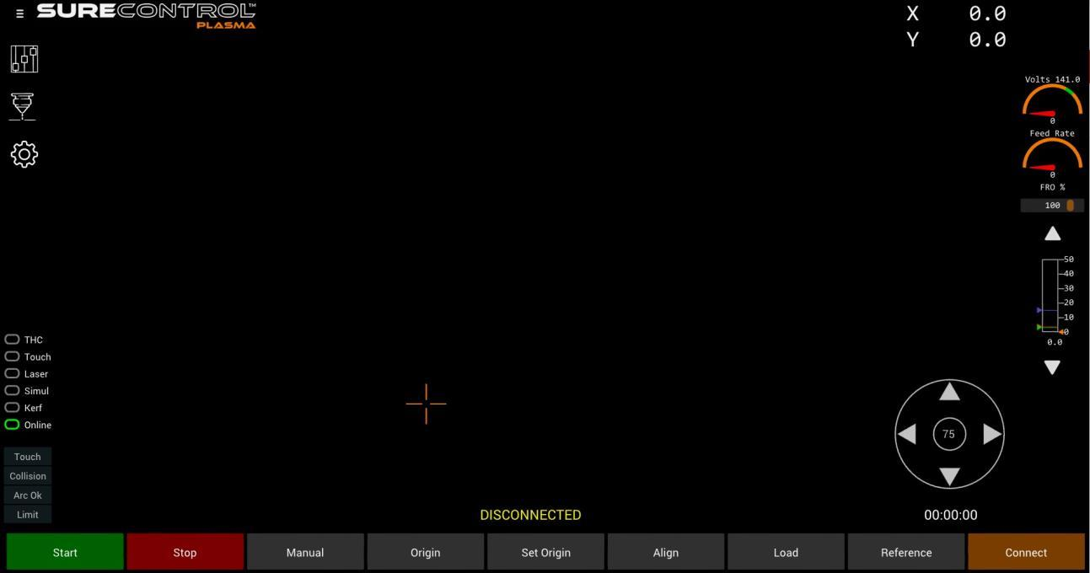

CNC PLASMA / SECTION 1 • M04-S01
Read the screen in categories
Coordinates display position. Collision is an input indicator. Selecting the Touch option does not prove that the sensing check succeeded.
Set Origin assigns the job reference; Origin is a motion command. Students interpret the screen. The trained teacher controls movement under the approved local procedure.
SureControl main interface, supplier manual p25. This is a historical supplier screenshot, not the currently connected school controller.
Find one display, one indicator and one control that can cause motion.
AI-generated concept image
Standalone Year 10 unit • Teacher controls machine operation
03
Notes:
Section m04-s01: Read the SureControl screen
TEACHER EXPLANATION
Read the screen as a set of different messages SureControl displays information and gives the operator controls that can affect the machine. Learning to read its screen is useful for observing a demonstration, but it does not authorise you to click those controls. Students use the supplied screenshots and offline learning activities. Only a trained, authorised teacher follows the installed machine’s operating procedure. The supplier manual’s V2.1 main screen groups the loaded job, coordinates, cutting parameters, status indicators and command buttons. Start by asking what each item represents: a drawing, a measured value, a selected option, a machine state or an action. They can appear close together while serving very different purposes. The loaded-job stage connects these groups to a documented example; the installed version must be matched by the teacher. Separate the job picture from live information The job view shows the loaded geometry or toolpath. It helps the teacher compare the file with the intended design, but a familiar outline does not prove that the revision, size or placement is correct. A displayed job is also not evidence that the actual sheet beneath the torch is suitable. Those are separate checks against the job record and physical setup. The coordinate display reports position in the controller’s coordinate system. Coordinate values become meaningful only when the teacher knows the reference and job origin being used. The manual also shows cutting feed information, a feed-rate override percentage and arc-voltage information. Read the label and unit before interpreting a number. A percentage describes an override relative to a feed value; it is not itself a feed in millimetres per second. A status describes a condition, not permission The documented states include Disconnected, Offline, Not Referenced, Idle, Jogging and Executing. They help the operator understand what the controller is doing or waiting for. Connected or Online does not mean the whole production setup has been approved. Idle does not mean the machine is electrically isolated. Executing indicates an active operation rather than an invitation to approach. For example, a job may be loaded while the controller still requires an origin to be set. Loading the right file resolves only one part of the sequence. The teacher reads the status alongside the job record and physical checks. Students should describe the visible state accurately instead of translating every reassuring-looking message into “safe to start”. Indicators and options are different The manual shows input indicators labelled Touch, Collision, Arc OK and Limit. These report signals received by the control system. It also shows selectable options such as Touch, THC, Laser, Simul, Kerf and Online. An option requests or enables a function; an indicator reports a signal. Similar labels do not make them interchangeable. The distinction matters particularly for Touch. A selected Touch option is not proof that the sensing contact has operated correctly. The authorised teacher must observe the expected signal during the documented check and resolve an unexpected result through the approved support pathway. A green indicator alone cannot establish that every other safety or setup check has passed. Students record what they observe rather than alter sensors or configuration. Some familiar-looking buttons cause motion Set Origin and Origin sound similar but have different consequences. Set Origin assigns the current position as the job origin. Origin commands the machine to move to that origin. Reference also involves movement towards the machine’s reference switches, and jogging physically moves an axis. These controls belong to the teacher’s authorised sequence, not a student screen-exploration activity. See the origin explanation and checks . SureControl’s Simul option is another important distinction. With Start, it runs real machine movement without firing the torch. It is not the offline animation used to review a SheetCam job. Stop or Offline may stop or inhibit control actions, but neither is electrical isolation. During automatic cutting, the operator must remain physically separated from the machine by the securely screened operating area and welding curtains. Understanding a screen therefore includes understanding the limits of what its messages and buttons can establish.
TEACHING NOTES
{
"main_explanation": "Read the main screen in five categories: job display, measured information, controller state, input indicators and action controls. Explain how a selection differs from a successful physical response.",
"worked_example": "Interpret a loaded square-and-hole job with Idle status and Touch selected. Ask what is known, what is still unproven and which actions must remain teacher-only.",
"discussion_prompt": "Why can reassuring-looking status information never replace the physical checks and required operator separation?"
}
VISUAL
SureControl main screen showing the program view, coordinates, state, option indicators, jog area and bottom command row.
SureControl main interface, supplier manual p25. This is a historical supplier screenshot, not the currently connected school controller.
Find the program view and command row; distinguish this controller screen from the external drawing application.
Source: Surecontrol Software Manual_Draft4.pdf
DISCUSSION
Find one display, one indicator and one control that can cause motion.
Use the section’s ten questions for individual retrieval and feedback. Do not infer practical competence from online completion.
ILLUSTRATIVE IMAGE
AI-generated concept illustration for Read the screen in categories. This illustration supports discussion and is not a photograph of the school installation, a software screenshot, or a machine-setting guide. Original source reference images remain on this slide where present.

Slide 4
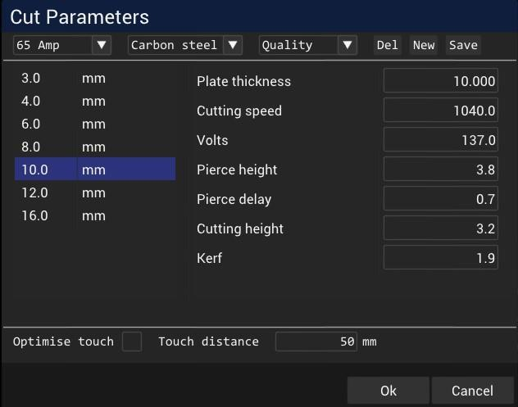
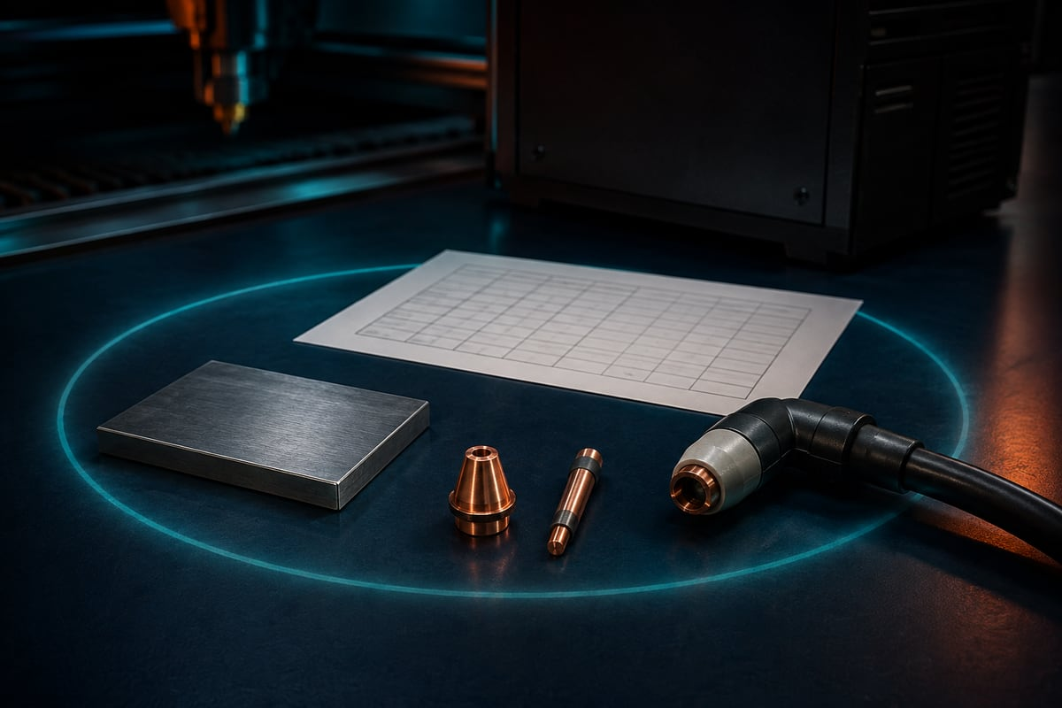
CNC PLASMA / SECTION 2 • M04-S02
Match the whole recipe
Current, material and thickness selections must belong to the actual power source, torch, consumables and approved material. Match the verified cut chart and local process.
Software Amp selection does not set or verify physical power-source current. Supplier screenshots contain demonstration values; they are not a ready-made school cutting recipe.
Use this supplier panel to recognise labels and quantities. Every displayed number is an example; the school’s actual recipe and physical power-source current require separate verification. SureControl Software Manual V2.1, p. 27.
What needs checking away from the computer screen?
AI-generated concept image
Standalone Year 10 unit • Teacher controls machine operation
04
Notes:
Section m04-s02: Understand the settings and cut chart
TEACHER EXPLANATION
A cut chart belongs to a particular process A cut chart links a material and thickness to a specified cutting setup. It may identify the power source, torch, consumables and process before listing operating values. The trained teacher must establish that these conditions match the installed equipment and actual job. A row from a different torch or consumable is not made suitable simply because its material thickness looks familiar. The supplier’s V2.1 manual includes example tools and settings to explain the software. Those examples are not validated school recipes. Learn what each field means without treating the visible numbers as instructions. A production record needs the matching source chart, its identified row and the installed setup. If that relationship is missing, the useful action is to resolve it before operation, rather than choose a plausible-looking value. Read the quantity, unit and control location A setting is more than a number. Its label tells you the quantity; its unit tells you how that quantity is expressed. Height and kerf width describe distances, commonly shown in millimetres in the documented metric pathway. Feed rate describes distance travelled per time. Pierce delay describes time. Current is measured in amperes, and arc voltage in volts. A feed-rate override is a percentage rather than a distance or time. The supplier pathway uses millimetres per second for feed display. Other source information may use millimetres per minute. There are sixty seconds in one minute, so the same physical feed has different numerical expressions in those two units. Copying a number while dropping its unit can create a substantial mismatch. The teacher must reconcile the source and software units explicitly; students can inspect and explain that match without entering values into a live controller. Software Amp is not the power-source control The manual distinguishes the software’s Amp field from the physical current setting on the plasma power source. Entering a value in the software field does not change the physical amperage. The authorised teacher must check the actual source control against the confirmed process. Matching-looking software information cannot substitute for checking the physical setting. Consider a review in which the software Amp field agrees with the selected chart, but nobody has checked the power source. The record is incomplete. Changing the software field again would not solve the missing physical check. This is a useful example of why a job record identifies both the required information and where that information must be verified. The recipe-match guide and physical setup stage keep those checks connected. Different settings control different parts of the cut Pierce height positions the torch for piercing. Pierce delay allows time for the piercing stage before the cutting movement proceeds. Cut height describes the torch position for following the cutting path. These fields concern different stages, so one cannot simply replace another. Their suitable values must come from the matched process information. Feed rate controls how quickly the torch follows the cutting route. Kerf width describes the removed strip used when compensating the path relative to the finished boundary. A feed-rate override changes the commanded feed relative to its base value, so an unnoticed override can make a record misleading. Read the base value, unit and override together. The settings and units guide provides a field-by-field reference. Height control and evidence-based changes Torch height control, labelled THC, uses arc-voltage information to adjust torch height during cutting under the configured system. The target arc voltage is part of that control process; it is not the same control as physical amperage. A visible voltage difference should not prompt a student to press height arrows or alter configuration. Cut appearance may reflect several interacting conditions, including speed, height, consumable condition and alignment. A rough edge therefore does not identify one certain correction. The teacher records the symptom and process conditions, checks the approved references and seeks supplier support where needed. Students can compare the evidence and explain unresolved questions in Read a settings record . They do not invent replacement recipes or test adjustments on the machine.
TEACHING NOTES
{
"main_explanation": "Start with process matching, then read setting name, quantity, unit and control location. Distinguish current, voltage, height, time, feed, kerf and override.",
"worked_example": "Review an incomplete record containing thickness and software Amp but missing consumable identity, feed unit and the physical source-current check. Explain each missing check without supplying values.",
"discussion_prompt": "Why is a plausible numerical value insufficient evidence that a setting suits this actual job?"
}
VISUAL
Supplier SureControl cut-parameters panel showing named setting fields.
Use this supplier panel to recognise labels and quantities. Every displayed number is an example; the school’s actual recipe and physical power-source current require separate verification. SureControl Software Manual V2.1, p. 27.
Source: Surecontrol Software Manual_Draft4.pdf
DISCUSSION
What needs checking away from the computer screen?
Use the section’s ten questions for individual retrieval and feedback. Do not infer practical competence from online completion.
ILLUSTRATIVE IMAGE
AI-generated concept illustration for Match the whole recipe. This illustration supports discussion and is not a photograph of the school installation, a software screenshot, or a machine-setting guide. Original source reference images remain on this slide where present.

Slide 5
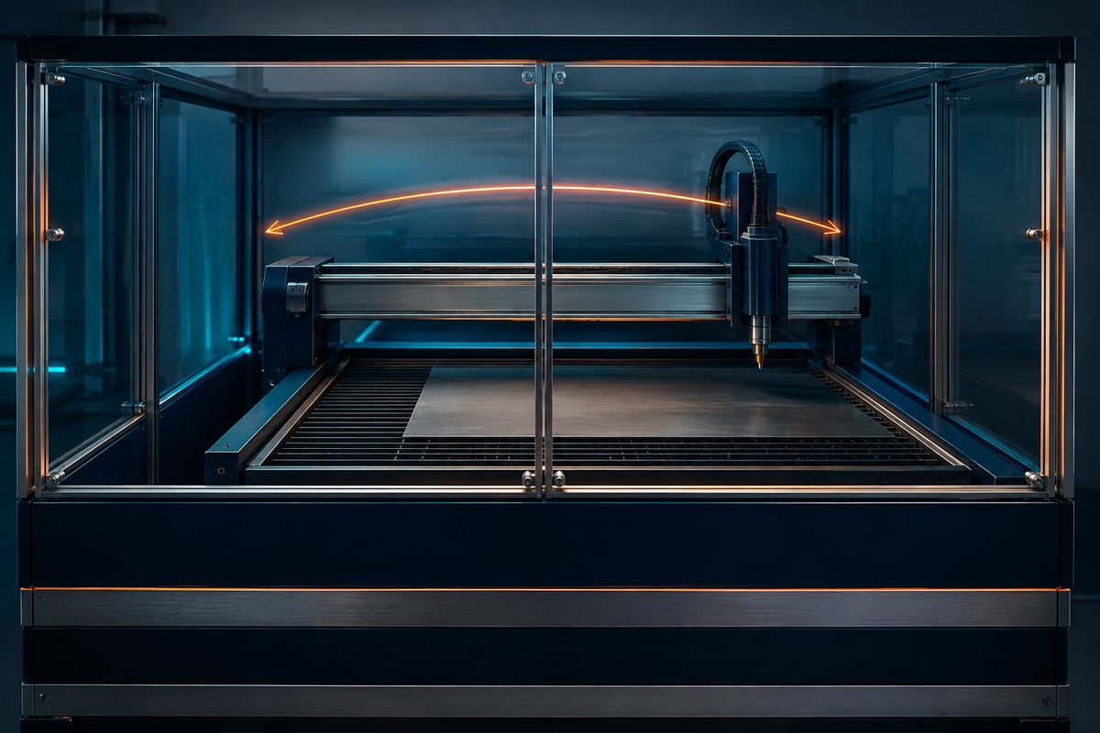
CNC PLASMA / SECTION 3 • M04-S03
A dry run still moves the machine
SureControl Simul follows the program without firing, but the axes still move. It requires the trained teacher and motion controls. Offline SheetCam preview is a separate check.
For automatic cutting, the operator must be physically separated by the securely screened area and welding curtains. Follow the full guided sequence. Stop and Offline are not electrical isolation.
SureControl main interface, supplier manual p25. This is a historical supplier screenshot, not the currently connected school controller.
Explain why no arc does not make entry safe. Use the operating guide to locate Simul.
AI-generated concept image
Standalone Year 10 unit • Teacher controls machine operation
05
Notes:
Section m04-s03: Follow and observe the production sequence
TEACHER EXPLANATION
Observe a controlled process Production combines a digital plan with a physical machine, moving axes, an electrical arc, hot metal and fumes. Understanding the sequence helps students explain what the teacher is checking and why the stages occur in order. It does not make students machine operators. Students prepare and review work offline and observe only from the teacher’s designated position. The operator must be trained and authorised for the actual equipment, with the required school approval and site procedure in place. A teacher who is new to the system needs the specified training and supported commissioning before delivering live operation. Reading this unit or completing its formative questions is preparation for understanding; neither replaces that authority or practical training. Check the job and the operating area Before machine preparation, the teacher checks that the design, CAM work and production output belong to the intended revision and installed system. The actual material, consumables and recipe must also match. These checks prevent a correct file from being paired with the wrong process, or the correct process from being applied to a stale file. The physical operating area is a separate part of the check. The supplied school requirements include the securely screened operating area, welding curtains and effective fume extraction. During automatic cutting, the operator must also remain physically separated from the machine by that screened area and the curtains. Being the teacher does not permit standing inside the enclosure while it cuts. Students follow the designated observation arrangement and do not enter the shielded area until the required electrical isolation has occurred. The controlled-area stage explains these requirements alongside the job checks. Clothing, protective equipment, material handling and other site controls belong to the approved local procedure. An unresolved requirement is a reason to stop preparation and obtain the missing check, not to treat the software’s readiness message as permission. Establish position before using it The documented control sequence includes connection, reference, job loading and origin preparation. Reference establishes a known machine position through real axis movement. The loaded job provides the intended program. Set Origin then assigns a job origin at the teacher-selected physical position. These ideas are related, but loading a drawing cannot replace reference or establish where a particular sheet lies. The teacher verifies the expected state at each stage instead of racing through buttons. Touch sensing and any test firing are also physical checks within the authorised procedure. Unexpected sensing or motion is not a student troubleshooting opportunity. The connection stage begins the illustrated sequence, with actions, expected results and reasons to stop at each step. A physical dry run checks another kind of evidence The offline SheetCam preview helps review the planned route. SureControl’s Simul mode, when started by the operator, moves the real machine without firing the torch. This physical dry run therefore requires the controlled area and the teacher’s operating authority. It cannot be treated as a harmless student animation. Consider a file whose offline preview looked correct, but whose physical dry run would travel beyond the usable sheet area. The drawing may still have the intended dimensions; the physical placement or setup requires resolution. Continuing to a live cut would not be a valid test. The teacher stops, follows the approved review pathway and repeats the required checks after a verified correction. See the Simul stage for the documented distinction and fit checks. Monitor, stop and finish within the procedure Before automatic cutting, the teacher completes the final checks and observes from the physically separated operator position behind the required screens and curtains. During production, unexpected motion, an arc fault or another abnormal result calls for the approved stop and escalation response. Students describe the event and follow directions; they do not approach, restart the job or adjust settings. Stopping movement or selecting Offline does not electrically isolate the equipment. At completion, the teacher follows the required isolation, cooling and handling procedure before access or retrieval. A motionless part can still be hot and have sharp edges. The finish and retrieval stage closes the sequence. Student evidence records what was observed and explained, rather than claiming operator approval or a practical demonstration that did not occur.
TEACHING NOTES
{
"main_explanation": "Connect preflight, physical setup, position establishment, loading, sensing, dry run, cutting and retrieval to the evidence each stage adds. Keep all physical control with the trained, authorised teacher.",
"worked_example": "A successful offline preview is followed by a failed physical fit check. Explain why pausing preserves a useful learning opportunity and what evidence students can record.",
"discussion_prompt": "Why do 'the file is right', 'the machine has stopped' and 'the teacher is operating' each fall short of the conditions needed for safe production or access?"
}
VISUAL
SureControl main screen showing the program view, coordinates, state, option indicators, jog area and bottom command row.
SureControl main interface, supplier manual p25. This is a historical supplier screenshot, not the currently connected school controller.
Find the program view and command row; distinguish this controller screen from the external drawing application.
Source: Surecontrol Software Manual_Draft4.pdf
DISCUSSION
Explain why no arc does not make entry safe. Use the operating guide to locate Simul.
Use the section’s ten questions for individual retrieval and feedback. Do not infer practical competence from online completion.
ILLUSTRATIVE IMAGE
AI-generated concept illustration for A dry run still moves the machine. This illustration supports discussion and is not a photograph of the school installation, a software screenshot, or a machine-setting guide. Original source reference images remain on this slide where present.

Slide 6

CNC PLASMA / RETRIEVE AND EXPLAIN
Pause before looking back
1
Find one display, one indicator and one control that can cause motion.
2
What needs checking away from the computer screen?
3
Explain why no arc does not make entry safe. Use the operating guide to locate Simul.
AI-generated concept image
Standalone Year 10 unit • Teacher controls machine operation
06
Notes:
Give students thinking time before pairing or discussing. Revisit the matching section if explanations are uncertain. These questions are formative and ungraded.
Find one display, one indicator and one control that can cause motion.
What needs checking away from the computer screen?
Explain why no arc does not make entry safe. Use the operating guide to locate Simul.
ILLUSTRATIVE IMAGE
AI-generated concept illustration for Pause before looking back. This illustration supports discussion and is not a photograph of the school installation, a software screenshot, or a machine-setting guide. Original source reference images remain on this slide where present.

Slide 7

CNC PLASMA / BUILD A CONNECTED RESPONSE
Explain your decision with evidence
Explain how a class can learn from a teacher-controlled demonstration when the offline preview is correct but the physical dry run fails the fit check. Justify the pause, the student role and the conditions that still apply before any later cut or retrieval.
01
Explain why offline success does not settle the physical fit.
02
Describe the teacher’s response and what students can record.
03
Include the operator’s physical separation during any later automatic cutting.
AI-generated concept image
Standalone Year 10 unit • Teacher controls machine operation
07
Notes:
Students write their own response in the module section. Scaffold prompts guide one connected explanation; they are not separate tasks.
Success criteria:
Explains the purpose and limits of each kind of check rather than treating the pause as failure.
Maintains teacher-only authority, screened operator separation and the required isolation and handling boundary.
ILLUSTRATIVE IMAGE
AI-generated concept illustration for Explain your decision with evidence. This illustration supports discussion and is not a photograph of the school installation, a software screenshot, or a machine-setting guide. Original source reference images remain on this slide where present.

Slide 8
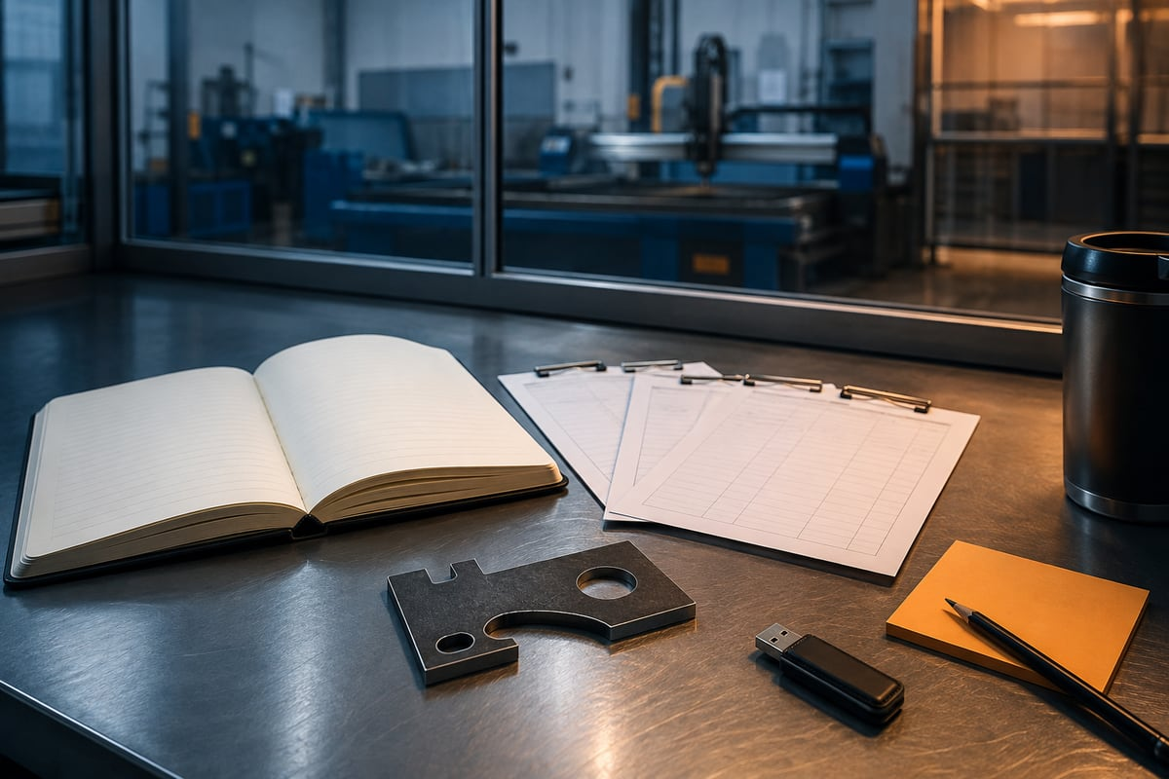
CNC PLASMA / EVIDENCE AND NEXT STEP
Leave with something useful
1 Check your three section packages.
2 Record the module activity and folio evidence.
3 Name one uncertainty and your next check.
AI-generated concept image
Exit prompt: What evidence changed your understanding today?
Browser saving keeps a local copy. Export and verify a backup; follow your teacher’s submission instructions.
Standalone Year 10 unit • Teacher controls machine operation
08
Notes:
Open modules/module-04.html#module-04-review. Review completion and feedback rather than treating checked answers as a competence result. Keep original CAD files separately. Students should state their own contribution and identify teacher-controlled production honestly.
ILLUSTRATIVE IMAGE
AI-generated concept illustration for Leave with something useful. This illustration supports discussion and is not a photograph of the school installation, a software screenshot, or a machine-setting guide. Original source reference images remain on this slide where present.

