Slide 1
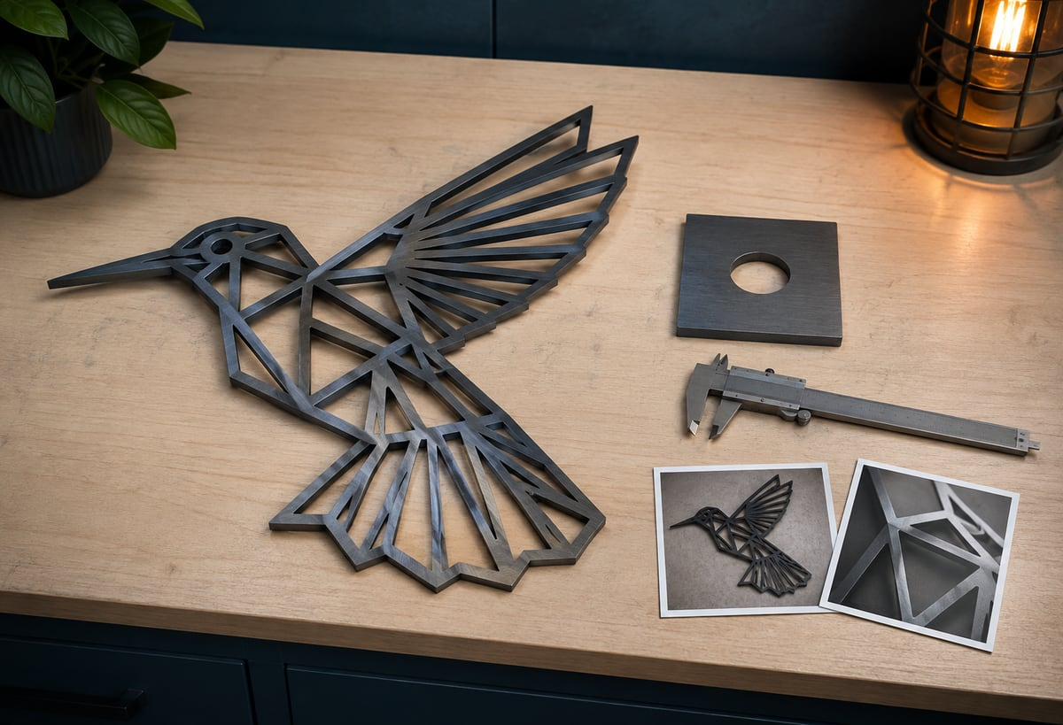
CNC PLASMA / MODULE 5 • WEEKS 9–10
Check, improve and communicate
Use safe inspection, traceable evidence and clear evaluation to explain the result and justify a practical improvement.
AI-generated concept image
Learn → inspect → practise → explain
Standalone Year 10 unit • Teacher controls machine operation
01
Notes:
Module 5: Check, improve and communicate
Teaching purpose: Use safe inspection, traceable evidence and clear evaluation to explain the result and justify a practical improvement.
Use the course module for the complete explanations and formative learning evidence. This presentation supports explanation; it is not operator certification or the local operating procedure.
Image: Positive bevel reference photograph, SureFire CNC cut-quality guidance p1. Supplier example, not the school’s cutting result.
Source: Improving cut quality taper and bevel.pdf
ILLUSTRATIVE IMAGE
AI-generated concept illustration for Check, improve and communicate. This illustration supports discussion and is not a photograph of the school installation, a software screenshot, or a machine-setting guide. Original source reference images remain on this slide where present.

Slide 2
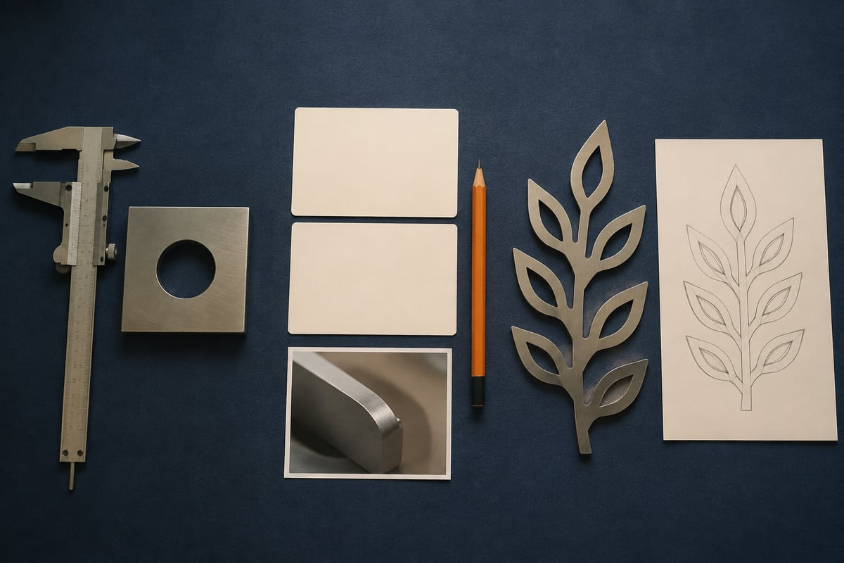
CNC PLASMA / CONNECT THE THREE LESSONS
Today’s learning map
01
Measure the result and recognise cut quality
02
Investigate a problem using evidence
03
Evaluate and present your finished design
AI-generated concept image
Before we begin: which step in the workflow needs the strongest check?
Standalone Year 10 unit • Teacher controls machine operation
02
Notes:
Invite a short prediction before teaching. Accept uncertainty and record one question to revisit.
m05-s01: Evaluate the evidence you would need to judge a teacher-cleared cut sample. Use the proposed 100 mm square with a 30 mm hole, or your teacher-approved design. Explain what you can conclude from measurements and photographs and what remains uncertain.
m05-s02: Analyse this proposed investigation: the master and imported DXF have matching dimensions, but a teacher-cleared sample is undersize and has underside deposits. Explain a justified next step without prescribing a machine-setting change.
m05-s03: Justify your final evaluation and one practical improvement to your design or file-preparation process. Connect your judgement to evidence and identify what has actually been completed, what the trained teacher undertook and what still needs checking.
ILLUSTRATIVE IMAGE
AI-generated concept illustration for Today’s learning map. This illustration supports discussion and is not a photograph of the school installation, a software screenshot, or a machine-setting guide. Original source reference images remain on this slide where present.

Slide 3
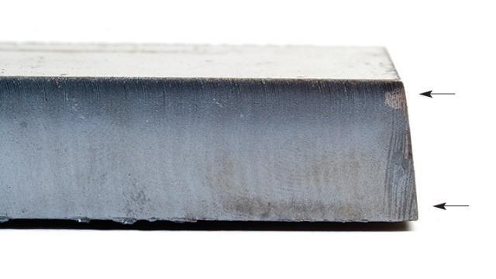
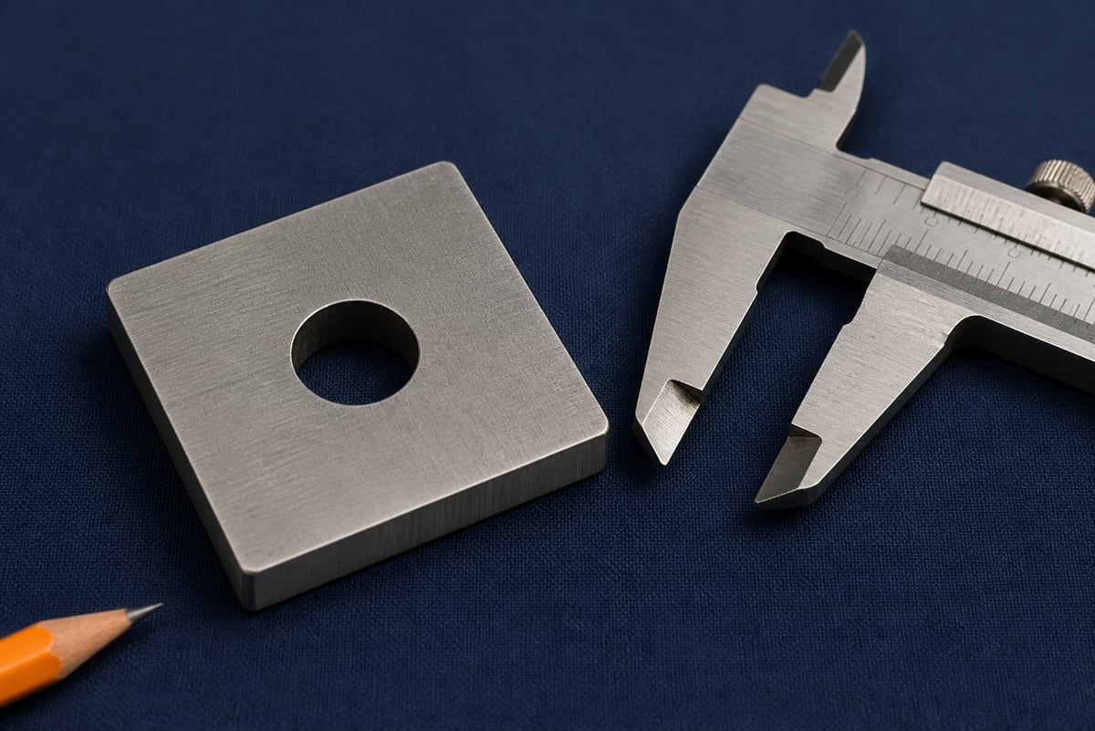
CNC PLASMA / SECTION 1 • M05-S01
Describe the result precisely
Use a sample released by the teacher after approved cooling and retrieval. Record feature, unit, instrument and measurement location.
Compare intended and measured dimensions. A difference is not an agreed tolerance. Describe bevel, deposits and finish separately, using top, underside and edge views. A photograph alone cannot prove the cause of a defect.
Positive bevel reference photograph, SureFire CNC cut-quality guidance p1. Supplier example, not the school’s cutting result.
What extra observation would strengthen a judgement based on this photograph?
AI-generated concept image
Standalone Year 10 unit • Teacher controls machine operation
03
Notes:
Section m05-s01: Measure the result and recognise cut quality
TEACHER EXPLANATION
Begin with a safe, identified sample The finished shape can tell you how successfully an idea became a physical part. First, the trained teacher must complete the approved finishing, isolation, cooling and retrieval procedure. A stopped program or an extinguished arc does not prove electrical isolation. Metal can remain hot and edges can be sharp. Begin student inspection only when the teacher has released a safely handled sample and explained the permitted measuring method. Keep the sample connected to its records. Record the part name, CAD and production-file revisions, material description and teacher-recorded recipe identifier. Mark the top and bottom in your evidence so that later photographs and measurements describe the same orientation. Do not alter a sharp edge simply to make measuring easier; ask the teacher how it should be made safe. Compare the same dimensions The intended or nominal dimension is the size specified in the drawing. The measured dimension is what the available instrument shows. Record the feature, unit, instrument and measurement location. Overall width and hole diameter are different features; radius and diameter are different ways of describing a circle. An unclear label can create an apparent error even when the part is correct. Measure important features more than once using the teacher-demonstrated method. Reposition the instrument consistently and note any difficulty, such as an uneven edge. Do not claim more precision than the instrument supports. Where bevel is visible, identify whether a measurement describes the top, bottom or another defined location. One width measured at the top cannot establish the bottom width. Worked example: describe a difference Consider the course’s proposed 100 mm square with a 30 mm diameter hole. These are practice dimensions, not an approved cutting job. Suppose a safely supplied example measures 99.6 mm across its top. Calculate measured minus intended: 99.6 − 100 = −0.4 mm. The minus sign means this measurement is 0.4 mm below the intended width. If the hole measures 30.3 mm, it is 0.3 mm above its intended diameter. Those differences are evidence, not automatic pass or fail decisions. A tolerance is the permitted variation agreed for a particular feature and purpose. Without an agreed tolerance, report the measured difference and discuss fitness for purpose. Do not invent an allowable error after seeing the result. Recognise bevel without guessing its cause Bevel describes the cut edge’s departure from a square edge. In the supplied guidance, positive bevel means the outside of the part is smaller at the top than at the bottom; a hole is wider at the top. Negative bevel reverses those relationships. Irregular bevel varies around the part and can include differently sloping opposite edges. Compare the supplier photographs with the sample’s top, bottom and edge views. A photograph can support a description such as ‘the edge slopes’ or ‘opposite sides differ’. It cannot establish an exact angle without a suitable measurement, nor prove which machine condition caused the appearance. The supplier lists several possible causes. Your role is to document the pattern for the trained operator. Look at deposits and preserve useful evidence Dross is metal left attached around a cut edge. Record whether deposits are on the underside or top and where they occur. The supplier distinguishes hardened underside dross from more easily removed deposits, but students must not scrape or handle unsafe edges to classify them. Use teacher-provided observations where removal has not been approved. Take an overall photograph and useful top, underside and edge views when the teacher permits. Include a scale reference where practical, label the feature and record the observation beside the image. Describe accuracy, bevel, deposits and edge finish separately. A neat-looking top view does not prove correct dimensions or a clean underside; several connected observations produce a stronger judgement.
TEACHING NOTES
[
{
"title": "Receive a safe sample",
"points": [
"Teacher release after approved isolation, cooling and retrieval",
"Identify revision and orientation"
],
"speaker_notes": "Ask what a finished program does not prove. Do not demonstrate student entry to the controlled area."
},
{
"title": "Compare like with like",
"points": [
"Feature, unit, instrument and location",
"Nominal and measured dimensions"
],
"speaker_notes": "Use a safe teacher-provided sample or the clearly hypothetical measurement example."
},
{
"title": "A difference is not a tolerance",
"points": [
"99.6 − 100 = −0.4 mm",
"Judge against agreed purpose and criteria"
],
"speaker_notes": "State that these are example measurements, not a tested school cut."
},
{
"title": "Read the edge",
"points": [
"Positive, negative and irregular bevel",
"Record top, underside and edge observations"
],
"speaker_notes": "Compare authentic supplier photographs. Keep observation separate from diagnosis."
},
{
"title": "Build a useful inspection record",
"points": [
"Dimensions, bevel, deposits and finish",
"Label images and retain the job record"
],
"speaker_notes": "Use the section response to justify which evidence supports which judgement."
}
]
VISUAL
Cut metal edge with supplier arrows indicating a top edge set inward relative to the bottom edge.
Positive bevel reference photograph, SureFire CNC cut-quality guidance p1. Supplier example, not the school’s cutting result.
Follow the arrows and compare the top and bottom of the edge; identify the relationship without estimating a setting.
Source: Improving cut quality taper and bevel.pdf
DISCUSSION
What extra observation would strengthen a judgement based on this photograph?
Use the section’s ten questions for individual retrieval and feedback. Do not infer practical competence from online completion.
ILLUSTRATIVE IMAGE
AI-generated concept illustration for Describe the result precisely. This illustration supports discussion and is not a photograph of the school installation, a software screenshot, or a machine-setting guide. Original source reference images remain on this slide where present.

Slide 4
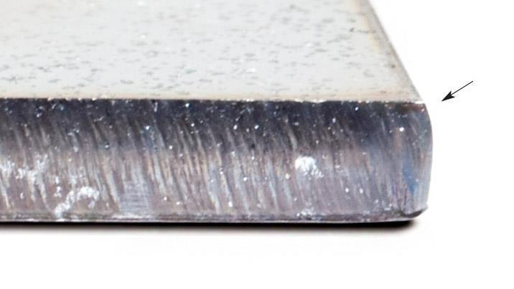

CNC PLASMA / SECTION 2 • M05-S02
Separate observation from diagnosis
Record what you can see or measure before proposing an explanation. Several conditions can produce similar edge defects.
Preserve the job revision, settings record, location and photographs. The trained operator decides whether a controlled investigation or maintenance is appropriate. Students explain the evidence; they do not adjust the machine to test a guess.
Irregular bevel reference photograph, SureFire CNC cut-quality guidance p2. An uneven edge is evidence to describe, not a diagnosis by itself.
Write one observation and one possible explanation without confusing them.
AI-generated concept image
Standalone Year 10 unit • Teacher controls machine operation
04
Notes:
Section m05-s02: Investigate a problem using evidence
TEACHER EXPLANATION
Make safe before investigating A useful investigation starts by protecting people and preserving evidence. If production behaves unexpectedly, the trained teacher applies the school’s stop, emergency and isolation procedures as appropriate. Students remain outside the controlled area. Do not approach moving equipment, repeat a test fire or try a different control to see whether the problem disappears. Software Stop and Offline are not proof of electrical isolation. Once the situation is safe, write down what actually happened. Copy the exact message or code, identify the file revision, and record whether the problem occurred before cutting, at the start or part-way through. The same general description, such as ‘it did not cut’, can hide very different events. Separate observation, possibility and conclusion An observation is what you can support: ‘the arc stopped halfway around the outline’ or ‘the hole is wider at the top’. A possible cause is an explanation to investigate. A conclusion is a judgement supported by checks. Keeping these separate prevents a guess from becoming an instruction. Write ‘possible’ when the evidence does not yet establish a cause. For example, an arc-loss report is not proof that the DXF is corrupt. The supplied references identify several equipment and job conditions that can interrupt cutting. The trained operator uses the actual message, approved fault procedure and correct equipment manual. Students can organise the evidence and compare files offline; they do not change wiring, bypass controls or attempt repairs. Follow the evidence through the file chain Trace a dimensional problem from the editable CAD master to the exported DXF, the CAM job and the recorded production result. Compare the intended revision, units and important dimensions at each available stage. An offline screen preview can show geometry and path order, but it cannot prove that the physical machine travelled correctly or that a cut recipe is suitable. Suppose a proposed 100 mm square is 100 mm wide in the master but 10 mm in the imported DXF. That is a file-stage scale discrepancy worth resolving before production. Check import and export records, correct the relevant preparation step and repeat the offline measurement. Increasing machine current would not repair a drawing that already has the wrong size. These dimensions are a worked example, not a cutting instruction. Change one explanation at a time If the files agree but the physical result differs, retain the sample and job record for the trained operator. Cutting speed, current, torch height and consumable condition can affect the result in different and overlapping ways. The supplied cut-quality guidance reviews speed and current, then height, and treats kerf compensation as the final sizing consideration. This is a diagnostic relationship, not a list of settings for students to adjust. Kerf is the width of material removed by the process. Compensation positions the path to account for that removal; it cannot repair every kind of poor cut. Changing compensation to conceal unexplained bevel or a wrong-scale drawing can hide the real issue. Any authorised physical comparison must use the operator’s approved method, with its conditions and changes recorded. Worked example: a report that helps Compare ‘bad cut; slow it down’ with this proposed report: ‘Sample A, revision v2: the top outside width measures 99.6 mm against 100 mm intended. The hole measures 30.3 mm against 30 mm intended. The bottom has attached deposits. File-stage dimensions matched the drawing. Deposit removal has not been assessed. Please review the sample and recorded recipe.’ The second report tells the operator what is known and what remains uncertain. A future comparison needs the same labelled features and a clear record of any approved change. If no physical test has occurred, write ‘proposed investigation’, not ‘problem solved’. A strong investigation may end by ruling out an incorrect file or identifying missing evidence. Success means a justified next step and an accurate record, even when a qualified person must finish the diagnosis.
TEACHING NOTES
[
{
"title": "Make safe, then record",
"points": [
"Trained teacher controls the fault response",
"Exact event, timing and message"
],
"speaker_notes": "Do not provide fault-clearing controls as student activities."
},
{
"title": "Observation or explanation?",
"points": [
"Observed event",
"Possible cause",
"Supported conclusion"
],
"speaker_notes": "Compare ‘arc stopped halfway’ with ‘the DXF is corrupt’."
},
{
"title": "Trace the first discrepancy",
"points": [
"Master → DXF → CAM → result",
"Offline preview has a limited scope"
],
"speaker_notes": "Use 100 mm becoming 10 mm as a file-stage example, without cutting."
},
{
"title": "Keep physical diagnosis controlled",
"points": [
"Several conditions influence the result",
"Compensation is not a universal repair"
],
"speaker_notes": "Explain the supplier’s diagnostic order without presenting numerical settings or adjustment instructions."
},
{
"title": "Write the report a technician needs",
"points": [
"Revision and recipe record",
"Labelled measurements and unknowns"
],
"speaker_notes": "Ask students to improve ‘bad cut; slow it down’ using evidence."
}
]
VISUAL
Cut edge with an uneven sloping face and a supplier arrow pointing to the upper-right edge.
Irregular bevel reference photograph, SureFire CNC cut-quality guidance p2. An uneven edge is evidence to describe, not a diagnosis by itself.
Describe the visible edge pattern, then identify what further evidence the trained operator would need.
Source: Improving cut quality taper and bevel.pdf
DISCUSSION
Write one observation and one possible explanation without confusing them.
Use the section’s ten questions for individual retrieval and feedback. Do not infer practical competence from online completion.
ILLUSTRATIVE IMAGE
AI-generated concept illustration for Separate observation from diagnosis. This illustration supports discussion and is not a photograph of the school installation, a software screenshot, or a machine-setting guide. Original source reference images remain on this slide where present.

Slide 5

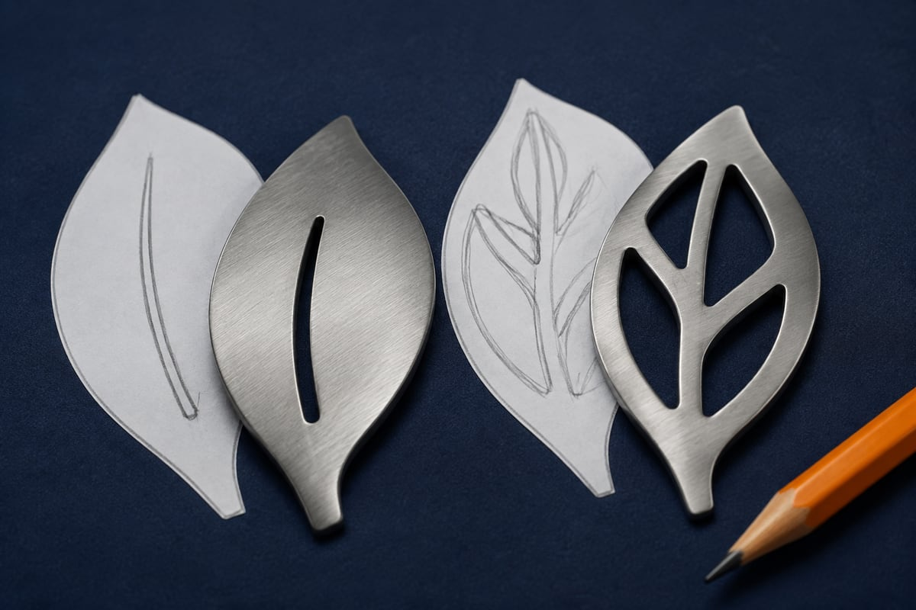
CNC PLASMA / SECTION 3 • M05-S03
Make the improvement traceable
Evaluate the design against its purpose and agreed criteria. Connect the CAD revision, imported geometry, teacher production record and measured result.
Propose a specific improvement and explain what evidence would show whether it helped. Present labelled images and concise reasoning. Keep original files and record teacher-produced cutting honestly in your contribution statement.
Teacher-supplied TAS Plasma artwork: a design-analysis example. It is not a beginner-ready production file or a photograph of a finished part.
Which two pieces of evidence best support your proposed improvement?
AI-generated concept image
Standalone Year 10 unit • Teacher controls machine operation
05
Notes:
Section m05-s03: Evaluate and present your finished design
TEACHER EXPLANATION
Judge the design against its purpose An evaluation explains how well a design meets its purpose and what the evidence supports. It is more useful than saying ‘I like it’ or ‘it worked’. Begin with the intended user, function and agreed design requirements. Consider dimensions, readable shapes, retained material, appearance and the resources used, where those features belong to your brief. Do not add a new requirement simply to make the finished result look successful. Keep design quality and production quality distinguishable. A clearly dimensioned, sensible drawing may still produce a poor physical edge. A clean cut may reproduce an unsuitable design exactly. Explain which part of the process your evidence tests: the idea, CAD geometry, exported file, CAM preparation or physical result. Connect each judgement to evidence Build a short evidence chain. Show the intended design and identified master revision, the checked DXF, relevant offline CAM views, the teacher’s production record if a cut occurred, and your permitted measurements or photographs. Label each item so a reader can connect the files to the same version. A screenshot shows what was visible at that moment; it does not replace the editable file or prove every check was completed. For each criterion, write a claim followed by evidence and a reason. For example: ‘The drawing retained its intended scale: the imported width remained 100 mm, matching the master.’ That is a file-transfer judgement. It does not establish a 100 mm physical result. If a cut was not made, evaluate the digital preparation and describe physical testing as still required. Propose a change and explain the trade-off A useful improvement names a specific feature, explains why it matters and predicts how it could be checked. Revising CAD geometry belongs in the editable master, followed by a new export and repeated checks. Keep the previous version so the change remains traceable. A suggested machine-setting change requires trained operator review against the approved job; it is not a student instruction to alter the equipment. For a proposed stencil-style design, a small enclosed centre may fall away unless the design retains a connection to the surrounding material. A student might propose a bridge and explain the trade-off: keeping the centre changes the letter’s appearance. The bridge dimensions still require design review for the chosen material and process. Do not turn an illustrative sketch into an untested minimum-width rule. Worked example: a balanced conclusion Consider the practice square and hole. The master and imported DXF both show a 100 mm square and a 30 mm hole. A hypothetical teacher-cleared sample measures 99.6 mm across the top and shows underside deposits. A fair conclusion is that the checked export preserved the intended digital dimensions, while physical size and edge quality need review. Without an agreed tolerance, the 0.4 mm difference does not automatically establish acceptance or rejection. The next step is to retain the records and sample for trained review, rather than enlarge the drawing to hide an unexplained cutting difference. If the teacher later authorises a comparison, preserve its conditions and results. These example measurements illustrate evaluation; they do not claim that this course’s machine has produced or passed a test. Make the work understandable to another person Present the journey in a clear sequence: purpose, development, checked file handoff, available production evidence, evaluation and proposed improvement. Select images that explain decisions rather than filling space. A labelled underside photograph can support a deposit observation; a CAD image can explain a revised outline. Add concise captions identifying the feature and why it matters. Distinguish what you completed yourself, what the trained teacher operated and what remains proposed. Credit supplier images used for comparison and label them as reference examples, never as photographs of your own result. Before handing over, check that filenames, revisions, units and image labels agree. Keep the editable master and a backup of your evidence. A well-presented folio lets the reader follow your reasoning, including honest limits and a practical next step.
TEACHING NOTES
[
{
"title": "Evaluate against purpose",
"points": [
"Criterion, evidence and reason",
"Design quality and production quality"
],
"speaker_notes": "Ask whether a cleanly cut unsuitable design meets its brief."
},
{
"title": "Show the evidence chain",
"points": [
"Identified master and checked export",
"Physical evidence only if production occurred"
],
"speaker_notes": "Avoid implying screenshots prove unperformed machine tests."
},
{
"title": "Make one improvement defensible",
"points": [
"Specific feature and benefit",
"Trade-off, revision and repeated checks"
],
"speaker_notes": "A stencil bridge is a proposed geometry example, not a material-specific minimum-width rule."
},
{
"title": "Present an honest result",
"points": [
"Student work, teacher operation and proposed work",
"Credit reference images"
],
"speaker_notes": "Explain that supplier samples cannot represent the student’s own finished product."
},
{
"title": "Finish the folio",
"points": [
"Purpose → development → handoff → evidence → evaluation",
"Keep the master and evidence backup"
],
"speaker_notes": "Model a short balanced conclusion that identifies a justified next step."
}
]
VISUAL
Circular Wagga Wagga High School TAS Department artwork with lettering and overlapping hand-tool outlines.
Teacher-supplied TAS Plasma artwork: a design-analysis example. It is not a beginner-ready production file or a photograph of a finished part.
Find an enclosed letter centre and a narrow feature. Explain what might remain or fall away when an outline is cut, without assuming this artwork is already suitable.
Source: TAS Plasma.ai
DISCUSSION
Which two pieces of evidence best support your proposed improvement?
Use the section’s ten questions for individual retrieval and feedback. Do not infer practical competence from online completion.
ILLUSTRATIVE IMAGE
AI-generated concept illustration for Make the improvement traceable. This illustration supports discussion and is not a photograph of the school installation, a software screenshot, or a machine-setting guide. Original source reference images remain on this slide where present.

Slide 6

CNC PLASMA / RETRIEVE AND EXPLAIN
Pause before looking back
1
What extra observation would strengthen a judgement based on this photograph?
2
Write one observation and one possible explanation without confusing them.
3
Which two pieces of evidence best support your proposed improvement?
AI-generated concept image
Standalone Year 10 unit • Teacher controls machine operation
06
Notes:
Give students thinking time before pairing or discussing. Revisit the matching section if explanations are uncertain. These questions are formative and ungraded.
What extra observation would strengthen a judgement based on this photograph?
Write one observation and one possible explanation without confusing them.
Which two pieces of evidence best support your proposed improvement?
ILLUSTRATIVE IMAGE
AI-generated concept illustration for Pause before looking back. This illustration supports discussion and is not a photograph of the school installation, a software screenshot, or a machine-setting guide. Original source reference images remain on this slide where present.

Slide 7
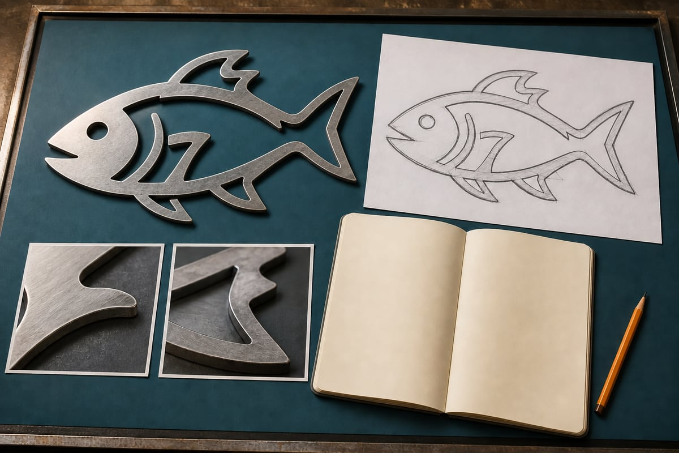
CNC PLASMA / BUILD A CONNECTED RESPONSE
Explain your decision with evidence
Justify your final evaluation and one practical improvement to your design or file-preparation process. Connect your judgement to evidence and identify what has actually been completed, what the trained teacher undertook and what still needs checking.
01
State the intended purpose and one agreed criterion, then cite the evidence that tests it.
02
Propose a specific improvement, its expected benefit and a trade-off or further check.
03
Describe the revision trail and distinguish completed digital work from any physical production or proposed test.
AI-generated concept image
Standalone Year 10 unit • Teacher controls machine operation
07
Notes:
Students write their own response in the module section. Scaffold prompts guide one connected explanation; they are not separate tasks.
Success criteria:
Justifies a judgement using relevant evidence while acknowledging its scope and limits.
Explains a specific improvement and a traceable checking process without inventing a physical result or operational permission.
ILLUSTRATIVE IMAGE
AI-generated concept illustration for Explain your decision with evidence. This illustration supports discussion and is not a photograph of the school installation, a software screenshot, or a machine-setting guide. Original source reference images remain on this slide where present.

Slide 8
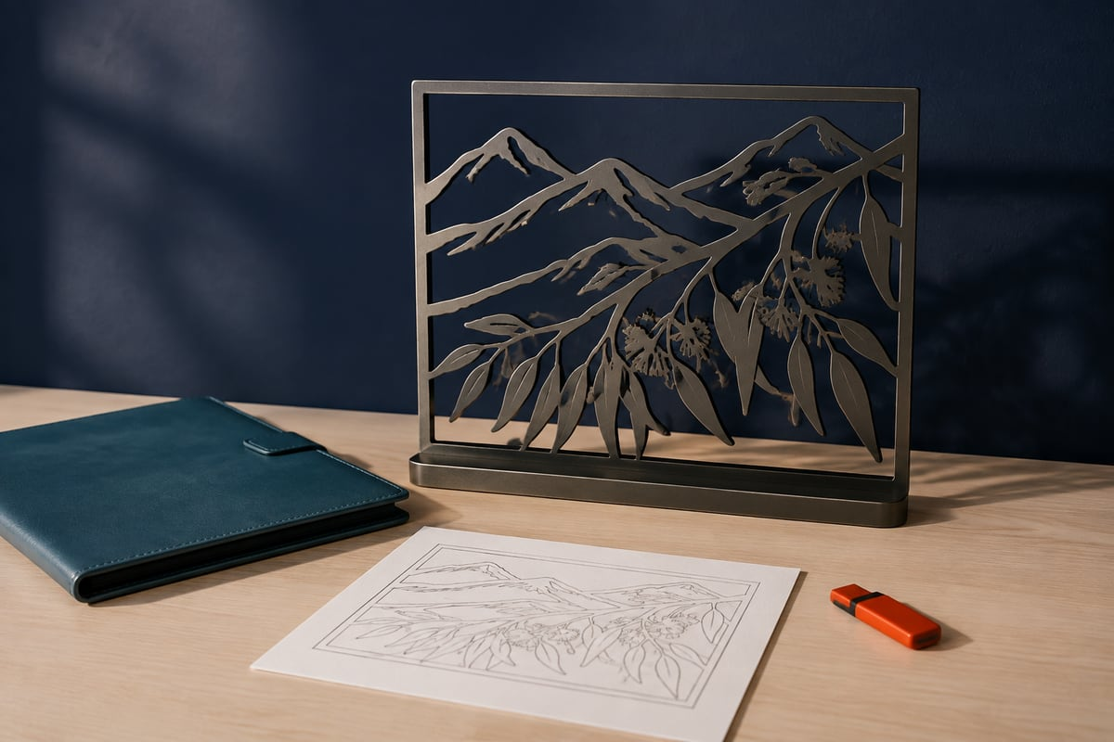
CNC PLASMA / EVIDENCE AND NEXT STEP
Leave with something useful
1 Check your three section packages.
2 Record the module activity and folio evidence.
3 Name one uncertainty and your next check.
AI-generated concept image
Exit prompt: What evidence changed your understanding today?
Browser saving keeps a local copy. Export and verify a backup; follow your teacher’s submission instructions.
Standalone Year 10 unit • Teacher controls machine operation
08
Notes:
Open modules/module-05.html#module-05-review. Review completion and feedback rather than treating checked answers as a competence result. Keep original CAD files separately. Students should state their own contribution and identify teacher-controlled production honestly.
ILLUSTRATIVE IMAGE
AI-generated concept illustration for Leave with something useful. This illustration supports discussion and is not a photograph of the school installation, a software screenshot, or a machine-setting guide. Original source reference images remain on this slide where present.

