Slide 1
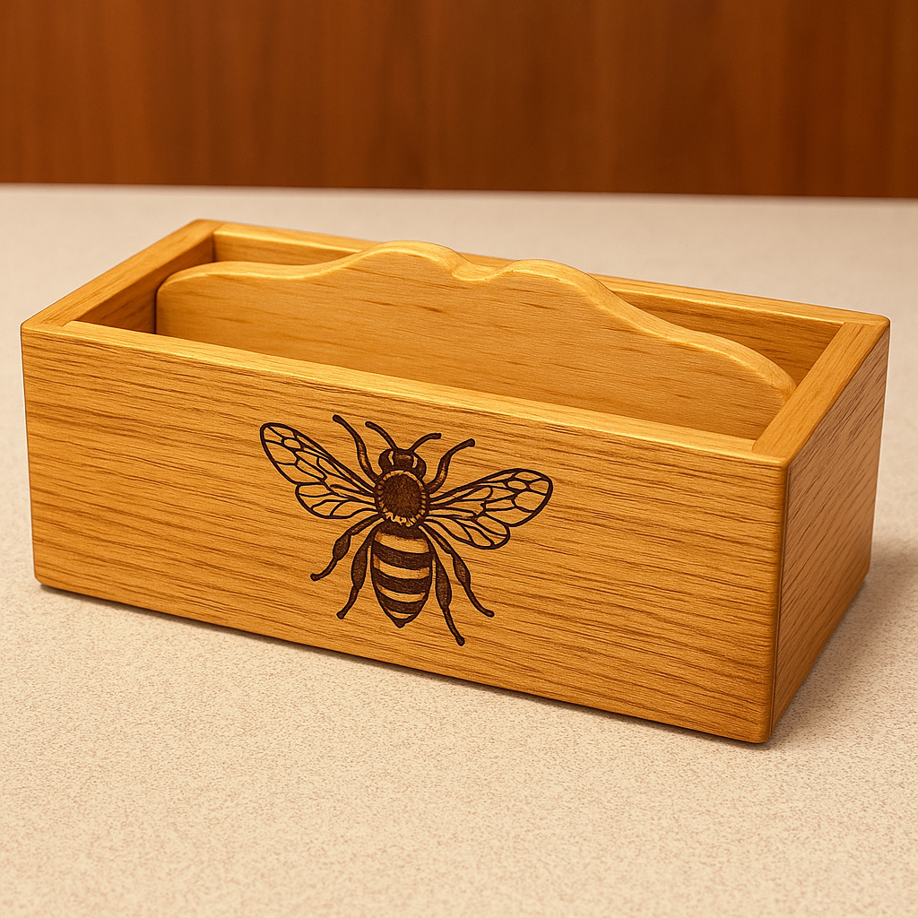
SMALL BOX GUIDED COURSE
1 / 8
Small Box: Weeks 5–6
Lid fitting, finish and evaluation

Slide 2
SMALL BOX GUIDED COURSE
2 / 8
What you will learn
1. Lid and hinge checks
2. Surface readiness and finish
3. Final quality review

Slide 3
SMALL BOX GUIDED COURSE
3 / 8
Lid and hinge checks
Use the approved project source and teacher direction for exact dimensions, settings and practical methods.

Slide 4
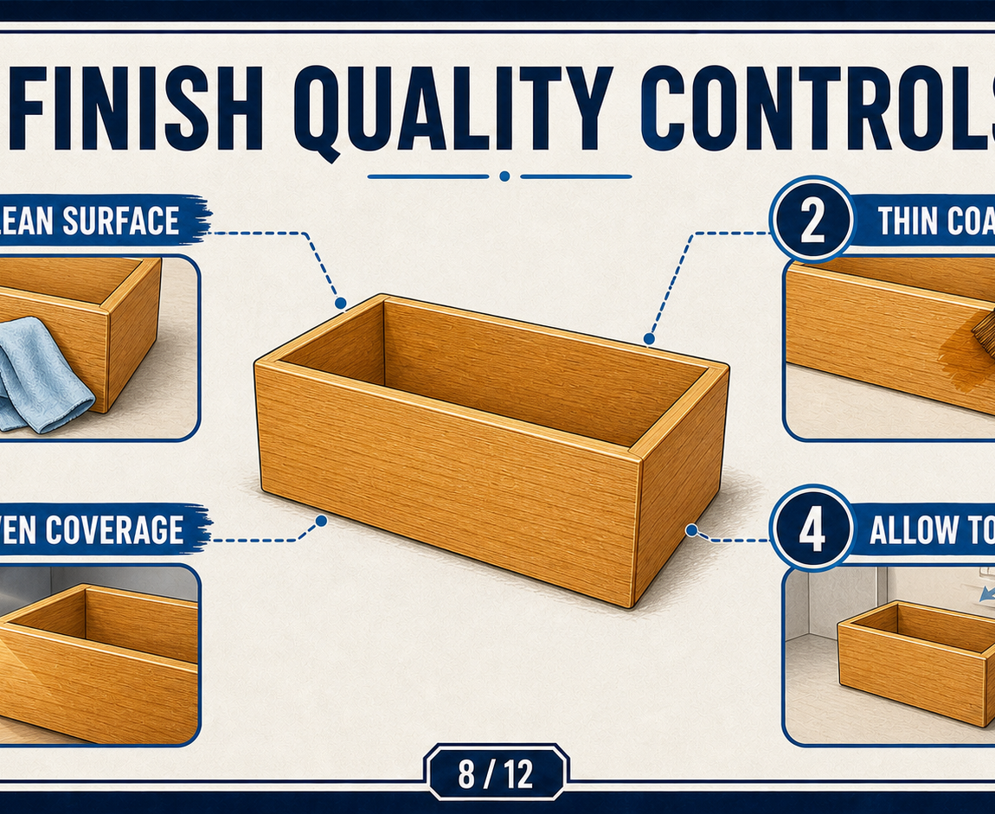
SMALL BOX GUIDED COURSE
4 / 8
Surface readiness and finish
Use the approved project source and teacher direction for exact dimensions, settings and practical methods.

Slide 5
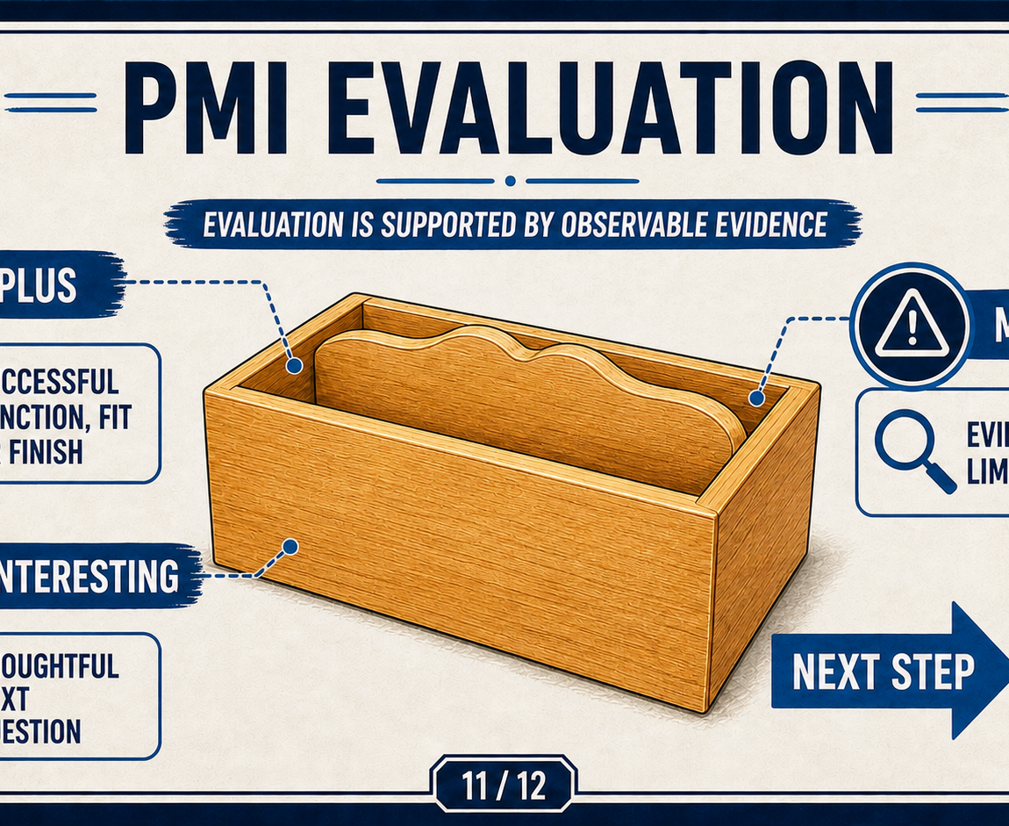
SMALL BOX GUIDED COURSE
5 / 8
Final quality review
Use the approved project source and teacher direction for exact dimensions, settings and practical methods.

Slide 6
SMALL BOX GUIDED COURSE
6 / 8
Check your understanding
Use the module knowledge checks after each theory section. Revisit the relevant explanation before changing an answer.

Slide 7
SMALL BOX GUIDED COURSE
7 / 8
Read · Select · Explain · Check
Read the question. Select evidence from the theory. Explain your decision in a complete sentence. Check it against the supplied guidance.

Slide 8
SMALL BOX GUIDED COURSE
8 / 8
Before you leave the module
Save your evidence, record any teacher questions and download your completed module PDF.

