Slide 1

MODULE 1
Graphic Design & Communication
Use visual conventions, vector workflows and ethical design decisions to make graphics that communicate quickly and responsibly.
Read the visuals. Explain the decision. Save the evidence.
Notes:
Talking points:
- Establish the module as a connected communication problem, not three isolated topics.
- Read the outcome aloud and ask students to identify the decision word in each sentence.
Likely misconception: A polished image is enough evidence of successful graphical communication.
Prompt: What must a viewer understand or decide because of your graphic?
Transition: Map the three ideas that will build this outcome.
[Sources]
- classroom-topic-sequence-2026-08-30
- t1-assessment-graphic-design-2025
- graphics-technology-syllabus-2019

Slide 2
Three ideas build one communication workflow
Keep this sequence in mind: understand the context, make a controlled representation, then justify what the evidence means.
1
2
3
Safety signs and visual conventions
Vector graphics and Illustrator workflows
Design principles, audience, culture and intellectual property
Retrieval prompt • Which idea depends most on the one before it?
YEAR 10 GRAPHICS • MODULE 1
02
Notes:
Talking points:
- Name the three sections exactly as they appear on the course site.
- Ask for one predicted connection before teaching the detail.
Likely misconception: The three topics can be completed independently without cross-checking.
Prompt: Which connection on this pathway seems most important, and why?
Transition: Move from the pathway into the first precise idea.
[Sources]
- classroom-topic-sequence-2026-08-30
- t1-assessment-graphic-design-2025
- graphics-technology-syllabus-2019

Slide 3
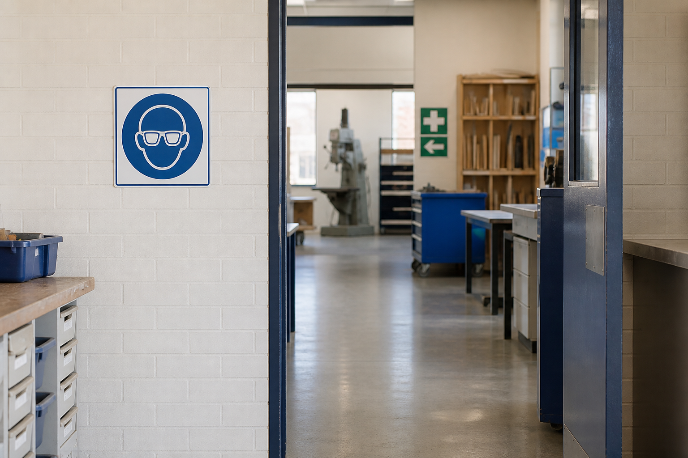
A sign works only when its meaning survives the glance
Shape, colour, contrast and symbol form a visual system. They help a viewer recognise the type of message before reading every word. Context still matters: a familiar form does not prove the sign is authorised, correctly placed or suitable for a new purpose. Read the whole situation before acting.
Notice → Which feature establishes the message first? Explain why context still controls the decision.
Look at the sign and its setting together. Meaning comes from the visual convention plus where, why and by whom it is used.
YEAR 10 GRAPHICS • MODULE 1
03
Notes:
Talking points:
- Describe what students are looking at before interpreting it.
- Point to the exact feature named in the caption.
- Require a decision or explanation, not a description alone.
Likely misconception: The visual convention or view is meaningful without context.
Prompt: Notice → Which feature establishes the message first? Explain why context still controls the decision.
Transition: Connect this decision to vectors store construction logic, not a fixed grid of pixels.
[Sources]
- safety-signs-template
- ten-safety-signs-template
- SafeWork NSW safety-sign guidance
- NESA Graphics Technology 7–10 (2019)

Slide 4

Vectors store construction logic, not a fixed grid of pixels
Vector artwork uses paths, points, fills and strokes. That structure allows clean scaling and deliberate editing, but it does not guarantee a clear design. Build simple geometry, organise related elements, check curves at useful zoom levels and export for the real communication context rather than assuming the working file is the final answer.
Compare → Which changes remain clean when the graphic is enlarged, and which quality checks still require judgement?
The enlarged edge reveals how the two image structures differ. Choose the structure that suits the editing and output job.
YEAR 10 GRAPHICS • MODULE 1
04
Notes:
Talking points:
- Describe what students are looking at before interpreting it.
- Point to the exact feature named in the caption.
- Require a decision or explanation, not a description alone.
Likely misconception: The software or drawing automatically makes the communication correct.
Prompt: Compare → Which changes remain clean when the graphic is enlarged, and which quality checks still require judgement?
Transition: Connect this decision to good design directs attention and respects the people it reaches.
[Sources]
- t1-assessment-graphic-design-2025
- Adobe Illustrator live shapes
- Adobe Illustrator colour workflow
- NESA Graphics Technology 7–10 (2019)

Slide 5

Good design directs attention and respects the people it reaches
Hierarchy, contrast, balance, alignment and proximity shape the reading order. Their value depends on audience, purpose and context rather than a universal style recipe. Responsible communication also requires source records, attribution, permission, privacy checks and cultural authority where relevant. A polished image is not automatically an ethical one.
Decide → What should the audience notice first, and what rights or cultural checks must be resolved before release?
Visual decisions and source decisions belong in the same workflow. Both affect whether a graphic is fit to share.
YEAR 10 GRAPHICS • MODULE 1
05
Notes:
Talking points:
- Describe what students are looking at before interpreting it.
- Point to the exact feature named in the caption.
- Require a decision or explanation, not a description alone.
Likely misconception: A polished output proves that every criterion, right or real-world condition is resolved.
Prompt: Decide → What should the audience notice first, and what rights or cultural checks must be resolved before release?
Transition: Retrieve across all three taught ideas.
[Sources]
- t1-assessment-graphic-design-2025
- Australian Government Office for the Arts ICIP guidance
- NESA Graphics Technology 7–10 (2019)

Slide 6
Retrieve before you look back
Answer in a phrase first. Then add the because.
01
How can a sign be visually familiar but still unsuitable for a particular location?
02
What structural difference lets vector artwork scale cleanly?
03
Name two design principles and explain the reading decision each supports.
04
Why is attribution alone sometimes insufficient before sharing a design?
Check: can your partner point to the slide evidence that supports the answer?
YEAR 10 GRAPHICS • MODULE 1
06
Notes:
Talking points:
- Give silent retrieval time before discussion.
- Ask students to point back to the visual or explanation that supports each answer.
- Correct the reasoning, not only the missing term.
Likely misconception: Recognition after re-reading is the same as retrieval from memory.
Prompt: Which answer can you support most confidently, and what evidence supports it?
Transition: Use one retrieved idea to construct a durable folio response.
[Sources]
- classroom-topic-sequence-2026-08-30
- t1-assessment-graphic-design-2025
- graphics-technology-syllabus-2019

Slide 7
Build evidence: Read → Select → Explain → Check
READ
SELECT
EXPLAIN
CHECK
Name the brief, source or criterion.
→
Choose one drawing, image or decision.
→
State what it proves and why it matters.
→
Limit the claim to the actual evidence.
Sentence support
The strongest communication decision is ___ because the audience needs ___. The visual evidence is ___. Before release I still need to check ___.
YEAR 10 GRAPHICS • MODULE 1
07
Notes:
Talking points:
- Model the four moves with one familiar example.
- Keep the explanation tied to a visible artifact or decision.
- Make the final check explicit: what does this evidence not prove?
Likely misconception: A long description automatically counts as strong evidence.
Prompt: Which selected artifact gives you the clearest because statement?
Transition: Close with a small exit ticket and an exact saving action.
[Sources]
- classroom-topic-sequence-2026-08-30
- t1-assessment-graphic-design-2025
- graphics-technology-syllabus-2019

Slide 8
MODULE 1
1 One idea I can now explain
EXIT
2 One visual feature or relationship I can point to
EVIDENCE
3 One claim I must keep within the evidence
SAVE TO MY FOLIO
One dated drawing, process image or decision record; a caption explaining what it proves; and your reasoned reflection.
Next: open the matching section package for feedback, then save the stronger response—not every draft.
YEAR 10 GRAPHICS • MODULE 1
08
Notes:
Talking points:
- Collect one response for each numbered line.
- Remind students that the folio holds selected evidence, not every quiz answer.
- Point students to the matching section package and the exact folio route.
Likely misconception: Saving more files is automatically stronger evidence.
Prompt: What single artifact best demonstrates today’s decision or learning?
Transition: Students move to the matching course section and My folio.
[Sources]
- classroom-topic-sequence-2026-08-30
- t1-assessment-graphic-design-2025
- graphics-technology-syllabus-2019

