Slide 1
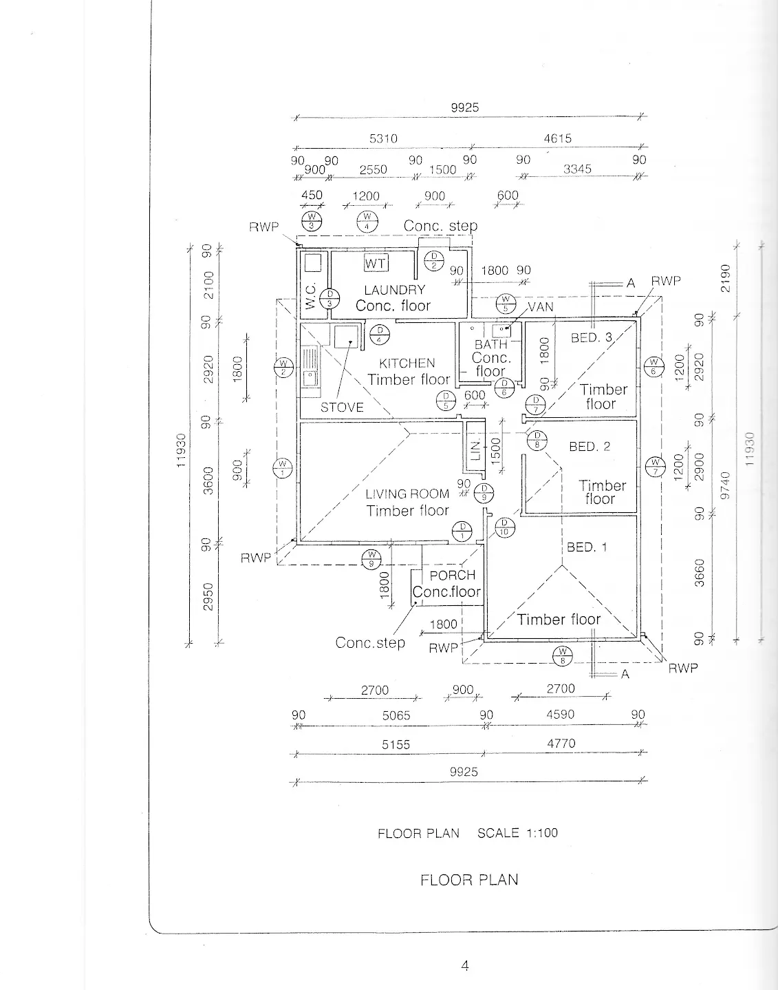
MODULE 2
Architectural Drawing
Read spatial needs, coordinate architectural views and use evidence to explain sustainable, professional design decisions.
Read the visuals. Explain the decision. Save the evidence.
Notes:
Talking points:
- Establish the module as a connected communication problem, not three isolated topics.
- Read the outcome aloud and ask students to identify the decision word in each sentence.
Likely misconception: A polished image is enough evidence of successful graphical communication.
Prompt: What must a viewer understand or decide because of your graphic?
Transition: Map the three ideas that will build this outcome.
[Sources]
- classroom-topic-sequence-2026-08-30
- t2-assessment-architectural-drawing-2025
- autocad-floorplan-guide
- teacher-source-drawing-set
- graphics-technology-syllabus-2019

Slide 2
Three ideas build one communication workflow
Keep this sequence in mind: understand the context, make a controlled representation, then justify what the evidence means.
1
2
3
Spatial planning and architectural research
CAD drafting, drawing views and conventions
Sustainability, building context and professional roles
Retrieval prompt • Which idea depends most on the one before it?
YEAR 10 GRAPHICS • MODULE 2
02
Notes:
Talking points:
- Name the three sections exactly as they appear on the course site.
- Ask for one predicted connection before teaching the detail.
Likely misconception: The three topics can be completed independently without cross-checking.
Prompt: Which connection on this pathway seems most important, and why?
Transition: Move from the pathway into the first precise idea.
[Sources]
- classroom-topic-sequence-2026-08-30
- t2-assessment-architectural-drawing-2025
- autocad-floorplan-guide
- teacher-source-drawing-set
- graphics-technology-syllabus-2019

Slide 3
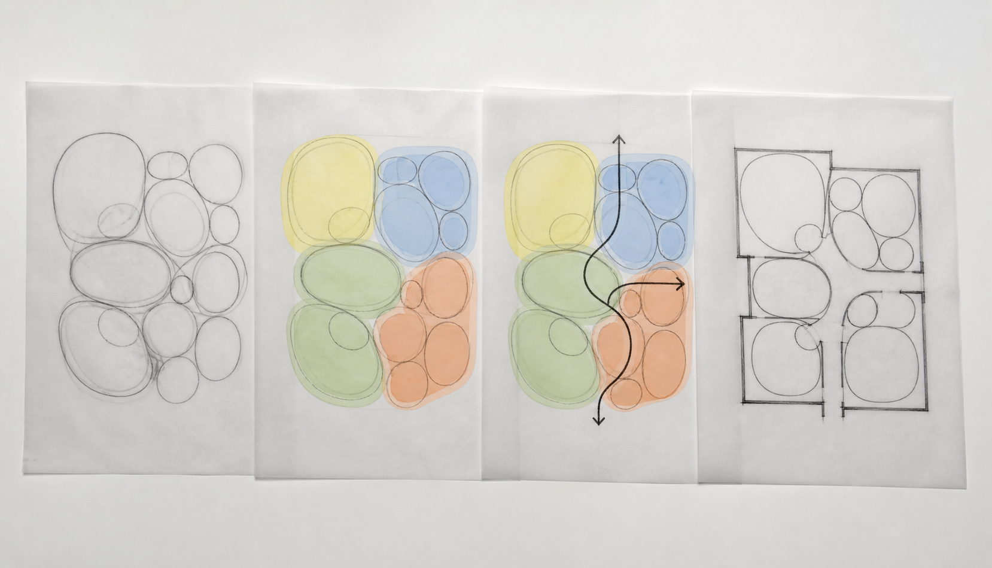
A plan translates activities into relationships between spaces
Spatial planning begins with people, activities, movement and connections. A room list is not yet a plan. Adjacency, circulation, privacy, orientation and access must work together. Research is useful when it reveals a principle you can test against the brief; copying a famous building or a convenient floor plan does not prove suitability.
Trace → Follow one movement path through the plan. What relationship helps or hinders the intended use?
Trace the arrows through the zoned sketch. Notice how adjacency and circulation turn a room list into connected spatial decisions.
YEAR 10 GRAPHICS • MODULE 2
03
Notes:
Talking points:
- Describe what students are looking at before interpreting it.
- Point to the exact feature named in the caption.
- Require a decision or explanation, not a description alone.
Likely misconception: The visual convention or view is meaningful without context.
Prompt: Trace → Follow one movement path through the plan. What relationship helps or hinders the intended use?
Transition: Connect this decision to coordinated views describe one proposal from different directions.
[Sources]
- stage-08-m02s01-spatial-zones-v2
- t2-assessment-architectural-drawing-2025
- NESA Graphics Technology 7–10 (2019)

Slide 4
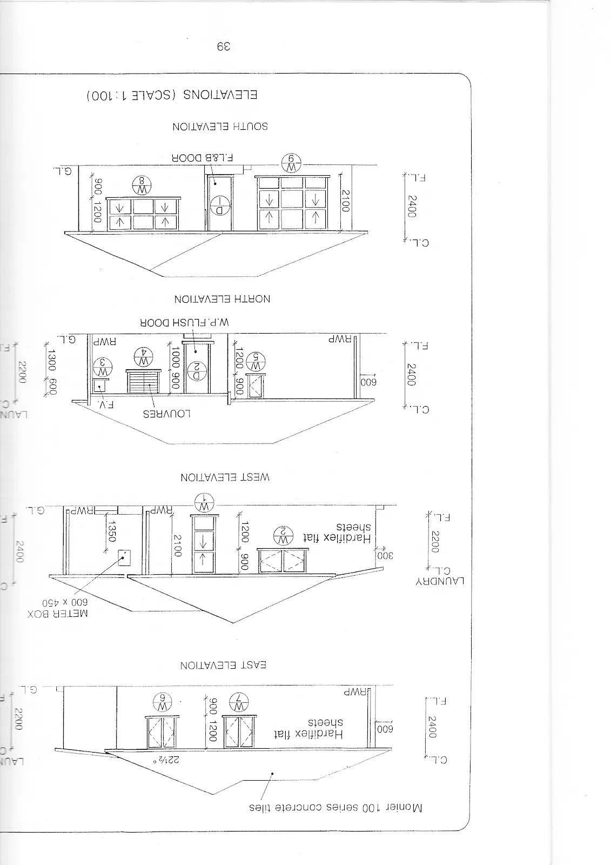
Coordinated views describe one proposal from different directions
Each view answers a different question about the same proposal. A change in one view creates a checking job across the others before the set can be trusted.
Cross-check → Which feature should appear consistently in both this elevation and the related plan?
The West elevation is enlarged for projection. Compare its openings and ground line with the matching plan; open the full drawing set for the other views.
YEAR 10 GRAPHICS • MODULE 2
04
Notes:
Talking points:
- Orient students to the enlarged complete elevation before asking them to compare it.
- Point to one opening and the ground line as cross-view reference features.
- Open the complete source drawing when another elevation is required.
Likely misconception: The drawing software coordinates every view automatically.
Prompt: Cross-check → Which feature should appear consistently in both this elevation and the related plan?
Transition: Connect this cross-check to sustainability claims need evidence and coordinated professional input.
[Sources]
- autocad-floorplan-guide
- teacher-source-drawing-set
- Autodesk AutoCAD foundations and layers
- NESA Graphics Technology 7–10 (2019)

Slide 5

Sustainability claims need evidence and coordinated professional input
Orientation, site conditions, daylight, ventilation, water, materials and energy use can shape a proposal, but none should be claimed from appearance alone. Different professionals supply different evidence. BASIX and the NCC provide context; they do not turn a school concept into an approved building.
Evaluate → What site or drawing evidence would you need before defending one sustainability claim?
Visible features suggest questions to investigate; they do not prove performance. Name the drawing, calculation or professional evidence needed for one claim.
YEAR 10 GRAPHICS • MODULE 2
05
Notes:
Talking points:
- Describe what students are looking at before interpreting it.
- Point to the exact feature named in the caption.
- Require a decision or explanation, not a description alone.
Likely misconception: A polished output proves that every criterion, right or real-world condition is resolved.
Prompt: Evaluate → What site or drawing evidence would you need before defending one sustainability claim?
Transition: Retrieve across all three taught ideas.
[Sources]
- stage-08-m02s03-sustainable-context
- t2-assessment-architectural-drawing-2025
- NSW Planning Portal BASIX
- National Construction Code
- NESA Graphics Technology 7–10 (2019)

Slide 6
Retrieve before you look back
Answer in a phrase first. Then add the because.
01
Why is a list of rooms not yet a spatial plan?
02
What different question does a section answer compared with a floor plan?
03
How can one CAD change create a coordination problem?
04
What evidence would make a sustainability claim more credible?
Check: can your partner point to the slide evidence that supports the answer?
YEAR 10 GRAPHICS • MODULE 2
06
Notes:
Talking points:
- Give silent retrieval time before discussion.
- Ask students to point back to the visual or explanation that supports each answer.
- Correct the reasoning, not only the missing term.
Likely misconception: Recognition after re-reading is the same as retrieval from memory.
Prompt: Which answer can you support most confidently, and what evidence supports it?
Transition: Use one retrieved idea to construct a durable folio response.
[Sources]
- classroom-topic-sequence-2026-08-30
- t2-assessment-architectural-drawing-2025
- autocad-floorplan-guide
- teacher-source-drawing-set
- graphics-technology-syllabus-2019

Slide 7
Build evidence: Read → Select → Explain → Check
READ
SELECT
EXPLAIN
CHECK
Name the brief, source or criterion.
→
Choose one drawing, image or decision.
→
State what it proves and why it matters.
→
Limit the claim to the actual evidence.
Sentence support
The drawing relationship I checked was ___ across ___. It matters because ___. The evidence supports ___, but it does not yet prove ___.
YEAR 10 GRAPHICS • MODULE 2
07
Notes:
Talking points:
- Model the four moves with one familiar example.
- Keep the explanation tied to a visible artifact or decision.
- Make the final check explicit: what does this evidence not prove?
Likely misconception: A long description automatically counts as strong evidence.
Prompt: Which selected artifact gives you the clearest because statement?
Transition: Close with a small exit ticket and an exact saving action.
[Sources]
- classroom-topic-sequence-2026-08-30
- t2-assessment-architectural-drawing-2025
- autocad-floorplan-guide
- teacher-source-drawing-set
- graphics-technology-syllabus-2019

Slide 8
MODULE 2
1 One idea I can now explain
EXIT
2 One visual feature or relationship I can point to
EVIDENCE
3 One claim I must keep within the evidence
SAVE TO MY FOLIO
One dated drawing, process image or decision record; a caption explaining what it proves; and your reasoned reflection.
Next: open the matching section package for feedback, then save the stronger response—not every draft.
YEAR 10 GRAPHICS • MODULE 2
08
Notes:
Talking points:
- Collect one response for each numbered line.
- Remind students that the folio holds selected evidence, not every quiz answer.
- Point students to the matching section package and the exact folio route.
Likely misconception: Saving more files is automatically stronger evidence.
Prompt: What single artifact best demonstrates today’s decision or learning?
Transition: Students move to the matching course section and My folio.
[Sources]
- classroom-topic-sequence-2026-08-30
- t2-assessment-architectural-drawing-2025
- autocad-floorplan-guide
- teacher-source-drawing-set
- graphics-technology-syllabus-2019

