Slide 1
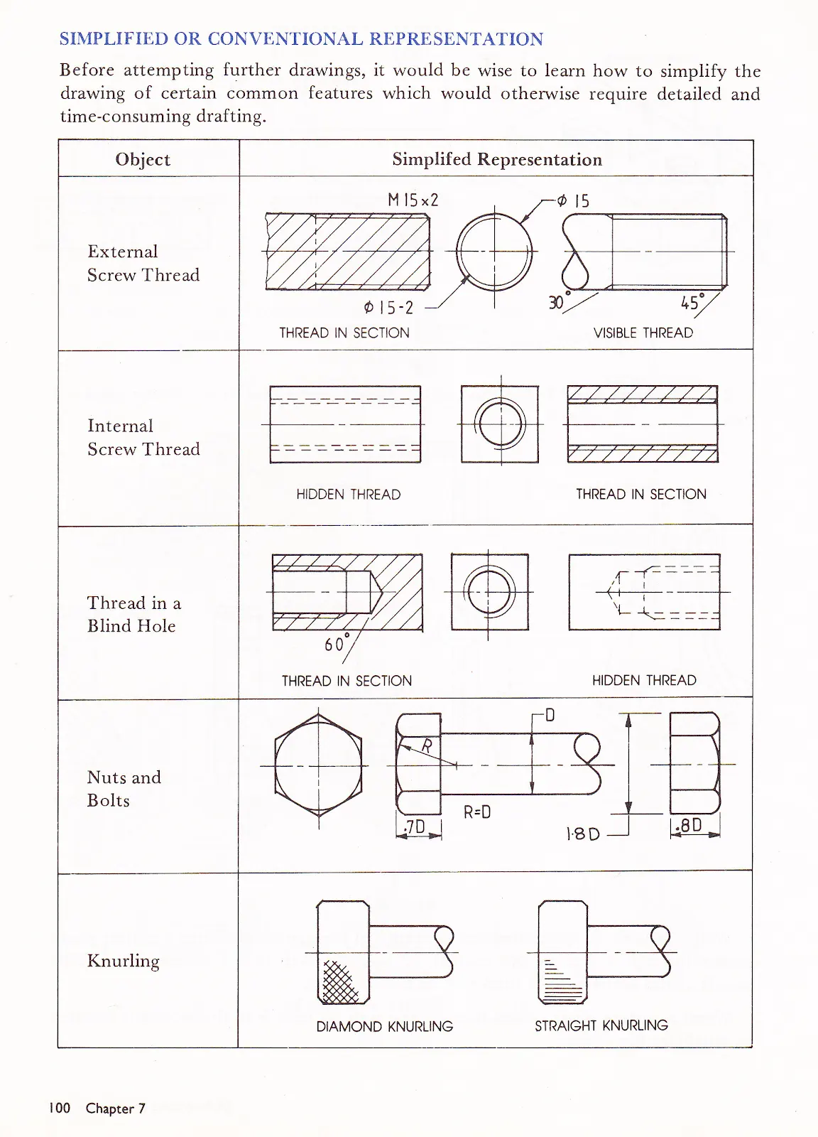
MODULE 3
Engineering Drawing
Use projections, controlled source information and CAD relationships to communicate parts, assemblies and design intent accurately.
Read the visuals. Explain the decision. Save the evidence.
Notes:
Talking points:
- Establish the module as a connected communication problem, not three isolated topics.
- Read the outcome aloud and ask students to identify the decision word in each sentence.
Likely misconception: A polished image is enough evidence of successful graphical communication.
Prompt: What must a viewer understand or decide because of your graphic?
Transition: Map the three ideas that will build this outcome.
[Sources]
- classroom-topic-sequence-2026-08-30
- t3-assessment-engineering-drawing-2025
- teacher-source-drawing-set
- graphics-technology-syllabus-2019

Slide 2
Three ideas build one communication workflow
Keep this sequence in mind: understand the context, make a controlled representation, then justify what the evidence means.
1
2
3
Projection systems and freehand communication
CAD modelling, materials and manufacturing
Dimensioning, standards, assemblies and animation
Retrieval prompt • Which idea depends most on the one before it?
YEAR 10 GRAPHICS • MODULE 3
02
Notes:
Talking points:
- Name the three sections exactly as they appear on the course site.
- Ask for one predicted connection before teaching the detail.
Likely misconception: The three topics can be completed independently without cross-checking.
Prompt: Which connection on this pathway seems most important, and why?
Transition: Move from the pathway into the first precise idea.
[Sources]
- classroom-topic-sequence-2026-08-30
- t3-assessment-engineering-drawing-2025
- teacher-source-drawing-set
- graphics-technology-syllabus-2019

Slide 3
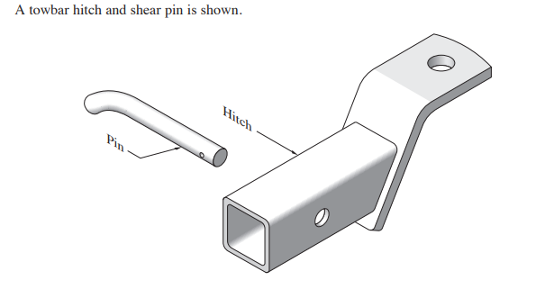
Projection systems turn three-dimensional form into readable evidence
Orthogonal and pictorial views solve different communication problems. View selection matters because one view can hide a feature that another reveals. Freehand sketches remain useful when they preserve proportion, alignment and visible relationships. They are thinking tools, not permission to estimate dimensions missing from the controlled source.
Choose → Which additional view would remove the greatest ambiguity, and what feature would it reveal?
Use the views to infer shape relationships, never missing measurements. The controlled drawing remains the authority.
YEAR 10 GRAPHICS • MODULE 3
03
Notes:
Talking points:
- Describe what students are looking at before interpreting it.
- Point to the exact feature named in the caption.
- Require a decision or explanation, not a description alone.
Likely misconception: The visual convention or view is meaningful without context.
Prompt: Choose → Which additional view would remove the greatest ambiguity, and what feature would it reveal?
Transition: Connect this decision to a useful cad model preserves design intent when something changes.
[Sources]
- t3-assessment-engineering-drawing-2025
- teacher-source-drawing-set
- NESA Graphics Technology 7–10 (2019)

Slide 4
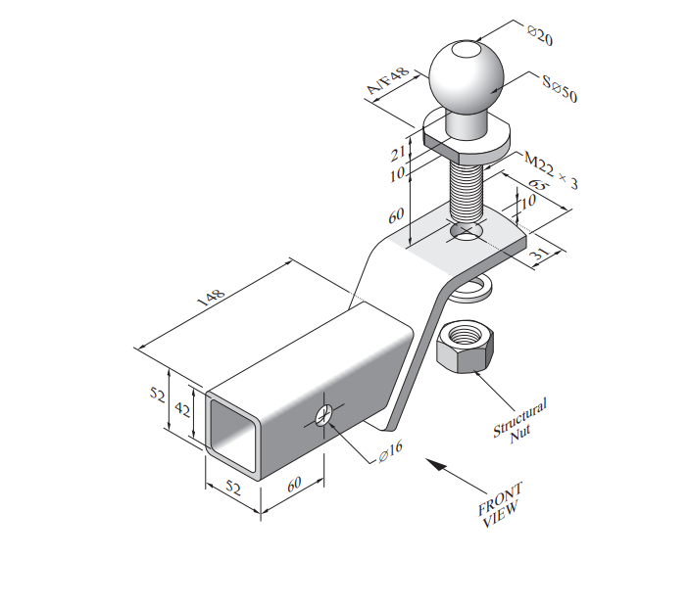
A useful CAD model preserves design intent when something changes
Sketch constraints, dimensions, features and references create dependencies. A fully constrained sketch can still encode a poor decision; design intent is shown when important relationships update predictably. Material and manufacturing thinking influence geometry and documentation, but CAD does not choose a grade, method, cost or load for an actual component.
Test → If one authorised dimension changes, which dependent feature should move or resize, and why?
Each supplied dimension has a communication job. Model from the source and test whether dependencies preserve the intended relationships.
YEAR 10 GRAPHICS • MODULE 3
04
Notes:
Talking points:
- Describe what students are looking at before interpreting it.
- Point to the exact feature named in the caption.
- Require a decision or explanation, not a description alone.
Likely misconception: The software or drawing automatically makes the communication correct.
Prompt: Test → If one authorised dimension changes, which dependent feature should move or resize, and why?
Transition: Connect this decision to digital motion communicates intent, not physical proof.
[Sources]
- t3-assessment-engineering-drawing-2025
- teacher-source-drawing-set
- Onshape Drawings and Assemblies
- NESA Graphics Technology 7–10 (2019)

Slide 5
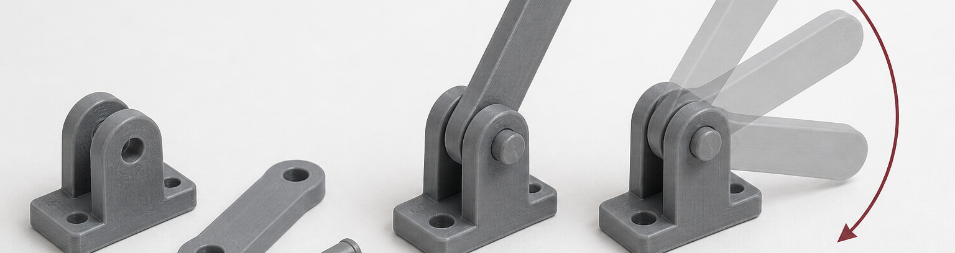
Digital motion communicates intent, not physical proof
Dimensions define necessary size and location. Tolerances and fits describe controlled relationships. Part drawings, assemblies and animation can expose coordination or interference, but smooth motion does not prove physical performance, safe manufacture or compliance.
Release-check → What does the drawing or animation demonstrate, and what important claim remains unproven?
The motion arc exposes clearance and interference questions. It communicates intended movement without proving strength, manufacture or safe real-world performance.
YEAR 10 GRAPHICS • MODULE 3
05
Notes:
Talking points:
- Describe what students are looking at before interpreting it.
- Point to the exact feature named in the caption.
- Require a decision or explanation, not a description alone.
Likely misconception: A polished output proves that every criterion, right or real-world condition is resolved.
Prompt: Release-check → What does the drawing or animation demonstrate, and what important claim remains unproven?
Transition: Retrieve across all three taught ideas.
[Sources]
- stage-08-m03s03-assembly-motion-check
- t3-assessment-engineering-drawing-2025
- Onshape Drawings and Assemblies
- NESA Graphics Technology 7–10 (2019)

Slide 6
Retrieve before you look back
Answer in a phrase first. Then add the because.
01
Why can one view be insufficient to communicate a part?
02
What is the difference between a constrained sketch and sound design intent?
03
Why should dimensions not be estimated from an image?
04
What can animation reveal, and what can it not prove?
Check: can your partner point to the slide evidence that supports the answer?
YEAR 10 GRAPHICS • MODULE 3
06
Notes:
Talking points:
- Give silent retrieval time before discussion.
- Ask students to point back to the visual or explanation that supports each answer.
- Correct the reasoning, not only the missing term.
Likely misconception: Recognition after re-reading is the same as retrieval from memory.
Prompt: Which answer can you support most confidently, and what evidence supports it?
Transition: Use one retrieved idea to construct a durable folio response.
[Sources]
- classroom-topic-sequence-2026-08-30
- t3-assessment-engineering-drawing-2025
- teacher-source-drawing-set
- graphics-technology-syllabus-2019

Slide 7
Build evidence: Read → Select → Explain → Check
READ
SELECT
EXPLAIN
CHECK
Name the brief, source or criterion.
→
Choose one drawing, image or decision.
→
State what it proves and why it matters.
→
Limit the claim to the actual evidence.
Sentence support
The controlled source shows ___. I represented it using ___. My cross-check found ___. This demonstrates ___, but it does not prove ___.
YEAR 10 GRAPHICS • MODULE 3
07
Notes:
Talking points:
- Model the four moves with one familiar example.
- Keep the explanation tied to a visible artifact or decision.
- Make the final check explicit: what does this evidence not prove?
Likely misconception: A long description automatically counts as strong evidence.
Prompt: Which selected artifact gives you the clearest because statement?
Transition: Close with a small exit ticket and an exact saving action.
[Sources]
- classroom-topic-sequence-2026-08-30
- t3-assessment-engineering-drawing-2025
- teacher-source-drawing-set
- graphics-technology-syllabus-2019

Slide 8
MODULE 3
1 One idea I can now explain
EXIT
2 One visual feature or relationship I can point to
EVIDENCE
3 One claim I must keep within the evidence
SAVE TO MY FOLIO
One dated drawing, process image or decision record; a caption explaining what it proves; and your reasoned reflection.
Next: open the matching section package for feedback, then save the stronger response—not every draft.
YEAR 10 GRAPHICS • MODULE 3
08
Notes:
Talking points:
- Collect one response for each numbered line.
- Remind students that the folio holds selected evidence, not every quiz answer.
- Point students to the matching section package and the exact folio route.
Likely misconception: Saving more files is automatically stronger evidence.
Prompt: What single artifact best demonstrates today’s decision or learning?
Transition: Students move to the matching course section and My folio.
[Sources]
- classroom-topic-sequence-2026-08-30
- t3-assessment-engineering-drawing-2025
- teacher-source-drawing-set
- graphics-technology-syllabus-2019

