Slide 1

MODULE 4
Student Negotiated Project
Turn an approved graphics brief into controlled development evidence, purposeful presentation and an honest evaluation.
Read the visuals. Explain the decision. Save the evidence.
Notes:
Talking points:
- Establish the module as a connected communication problem, not three isolated topics.
- Read the outcome aloud and ask students to identify the decision word in each sentence.
Likely misconception: A polished image is enough evidence of successful graphical communication.
Prompt: What must a viewer understand or decide because of your graphic?
Transition: Map the three ideas that will build this outcome.
[Sources]
- classroom-topic-sequence-2026-08-30
- t4-student-negotiated-project-2025
- graphics-technology-syllabus-2019

Slide 2
Three ideas build one communication workflow
Keep this sequence in mind: understand the context, make a controlled representation, then justify what the evidence means.
1
2
3
Brief, audience, criteria and constraints
Ideation, project management and digital development
Presentation, feedback and evaluation
Retrieval prompt • Which idea depends most on the one before it?
YEAR 10 GRAPHICS • MODULE 4
02
Notes:
Talking points:
- Name the three sections exactly as they appear on the course site.
- Ask for one predicted connection before teaching the detail.
Likely misconception: The three topics can be completed independently without cross-checking.
Prompt: Which connection on this pathway seems most important, and why?
Transition: Move from the pathway into the first precise idea.
[Sources]
- classroom-topic-sequence-2026-08-30
- t4-student-negotiated-project-2025
- graphics-technology-syllabus-2019

Slide 3

A brief converts an interesting topic into a purposeful graphics problem
A usable brief names the audience, purpose, context, deliverables, criteria and constraints. Required, preferred and optional features must be separated before production expands. Feasibility includes time, access, rights, privacy and cultural authority—not only whether software can make the idea look impressive. Current teacher approval controls the final scope.
Clarify → Which criterion is observable, and which part of the idea still needs approval or evidence?
The brief keeps the graphics work connected to a real communication purpose. Every deliverable should answer part of it.
YEAR 10 GRAPHICS • MODULE 4
03
Notes:
Talking points:
- Describe what students are looking at before interpreting it.
- Point to the exact feature named in the caption.
- Require a decision or explanation, not a description alone.
Likely misconception: The visual convention or view is meaningful without context.
Prompt: Clarify → Which criterion is observable, and which part of the idea still needs approval or evidence?
Transition: Connect this decision to strong development keeps alternatives, milestones and versions visible.
[Sources]
- t4-student-negotiated-project-2025
- Australian Government Office for the Arts ICIP guidance
- NESA Graphics Technology 7–10 (2019)

Slide 4
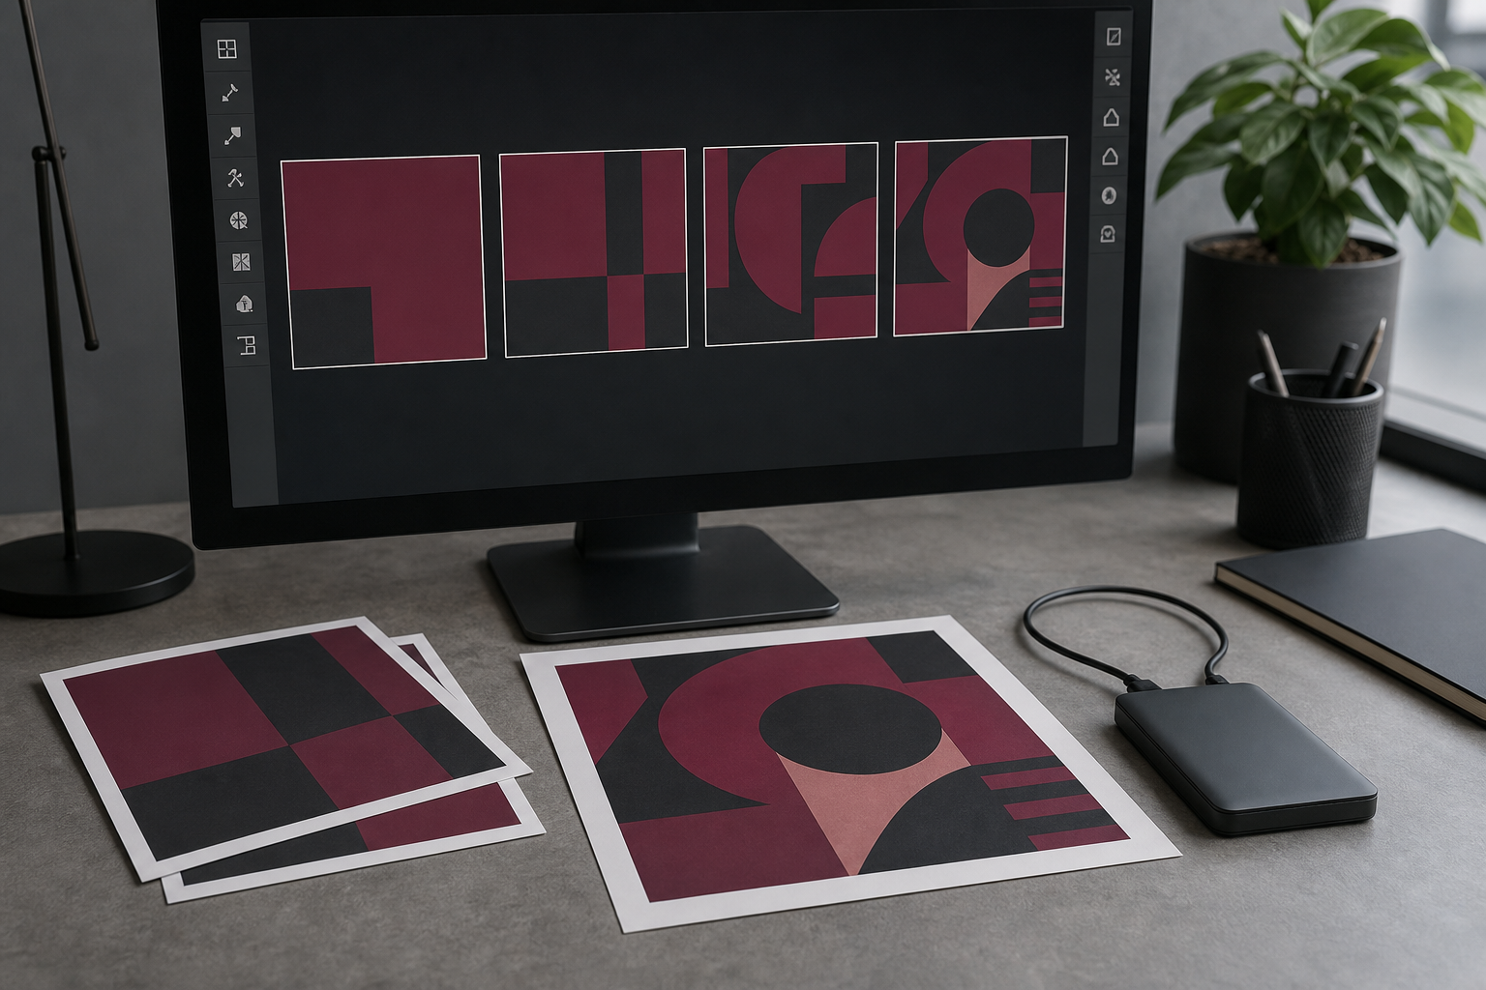
Strong development keeps alternatives, milestones and versions visible
Divergent ideas create genuine choices; annotations record why each direction may work. Convergent thinking compares those ideas with the approved criteria without pretending a score makes the decision. Milestones, dependencies, progress notes, source records and recoverable versions reduce drift and make significant revisions understandable rather than accidental.
Control → What should be simplified or deferred now to protect the essential deliverables?
The development trail shows alternatives, decisions and recoverable versions—not merely a polished final file.
YEAR 10 GRAPHICS • MODULE 4
04
Notes:
Talking points:
- Describe what students are looking at before interpreting it.
- Point to the exact feature named in the caption.
- Require a decision or explanation, not a description alone.
Likely misconception: The software or drawing automatically makes the communication correct.
Prompt: Control → What should be simplified or deferred now to protect the essential deliverables?
Transition: Connect this decision to evaluation is a judgement supported by selected evidence.
[Sources]
- t4-student-negotiated-project-2025
- NESA Graphics Technology 7–10 (2019)

Slide 5
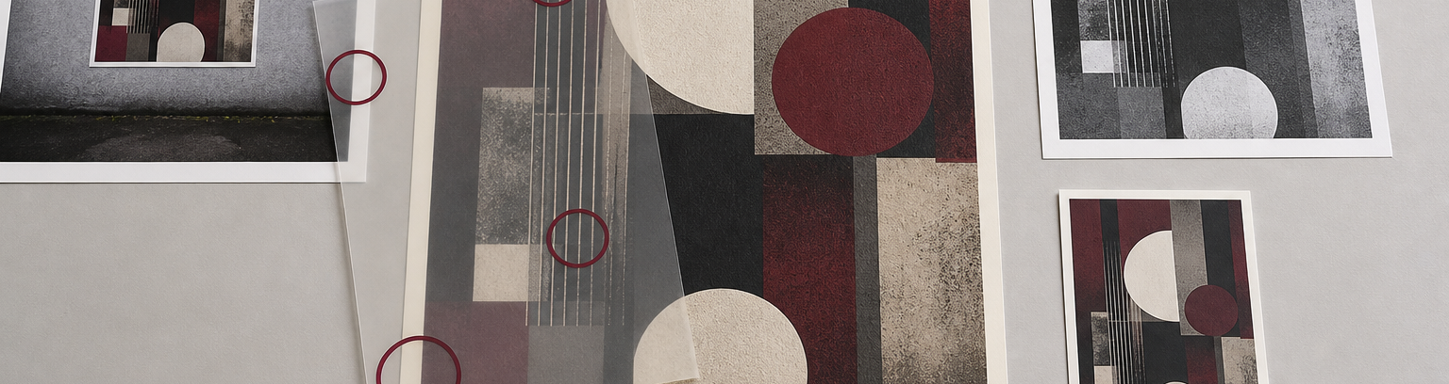
Evaluation is a judgement supported by selected evidence
Presentation should reveal the problem, significant decisions and final response in a clear hierarchy. Feedback becomes useful when the question tests a criterion rather than collecting a vote. Evaluation then joins a claim, relevant evidence and reasoning. A limitation can demonstrate critical judgement; a polished render alone cannot prove the brief was met.
Evaluate → What claim can you defend with process, audience and technical evidence—and what remains a limitation?
Select evidence that explains a decision or improvement. Quantity is less useful than a clear claim-evidence-reasoning link.
YEAR 10 GRAPHICS • MODULE 4
05
Notes:
Talking points:
- Describe what students are looking at before interpreting it.
- Point to the exact feature named in the caption.
- Require a decision or explanation, not a description alone.
Likely misconception: A polished output proves that every criterion, right or real-world condition is resolved.
Prompt: Evaluate → What claim can you defend with process, audience and technical evidence—and what remains a limitation?
Transition: Retrieve across all three taught ideas.
[Sources]
- t4-student-negotiated-project-2025
- NESA Graphics Technology 7–10 (2019)

Slide 6
Retrieve before you look back
Answer in a phrase first. Then add the because.
01
What turns a broad topic into a usable brief?
02
Why should required, preferred and optional features be separated?
03
How do versions and decision notes strengthen project evidence?
04
What makes evaluation different from a timeline of what happened?
Check: can your partner point to the slide evidence that supports the answer?
YEAR 10 GRAPHICS • MODULE 4
06
Notes:
Talking points:
- Give silent retrieval time before discussion.
- Ask students to point back to the visual or explanation that supports each answer.
- Correct the reasoning, not only the missing term.
Likely misconception: Recognition after re-reading is the same as retrieval from memory.
Prompt: Which answer can you support most confidently, and what evidence supports it?
Transition: Use one retrieved idea to construct a durable folio response.
[Sources]
- classroom-topic-sequence-2026-08-30
- t4-student-negotiated-project-2025
- graphics-technology-syllabus-2019

Slide 7
Build evidence: Read → Select → Explain → Check
READ
SELECT
EXPLAIN
CHECK
Name the brief, source or criterion.
→
Choose one drawing, image or decision.
→
State what it proves and why it matters.
→
Limit the claim to the actual evidence.
Sentence support
My brief required ___. I changed ___ after evidence showed ___. The result meets ___ because ___. A remaining limitation is ___, so the next improvement would be ___.
YEAR 10 GRAPHICS • MODULE 4
07
Notes:
Talking points:
- Model the four moves with one familiar example.
- Keep the explanation tied to a visible artifact or decision.
- Make the final check explicit: what does this evidence not prove?
Likely misconception: A long description automatically counts as strong evidence.
Prompt: Which selected artifact gives you the clearest because statement?
Transition: Close with a small exit ticket and an exact saving action.
[Sources]
- classroom-topic-sequence-2026-08-30
- t4-student-negotiated-project-2025
- graphics-technology-syllabus-2019

Slide 8
MODULE 4
1 One idea I can now explain
EXIT
2 One visual feature or relationship I can point to
EVIDENCE
3 One claim I must keep within the evidence
SAVE TO MY FOLIO
One dated drawing, process image or decision record; a caption explaining what it proves; and your reasoned reflection.
Next: open the matching section package for feedback, then save the stronger response—not every draft.
YEAR 10 GRAPHICS • MODULE 4
08
Notes:
Talking points:
- Collect one response for each numbered line.
- Remind students that the folio holds selected evidence, not every quiz answer.
- Point students to the matching section package and the exact folio route.
Likely misconception: Saving more files is automatically stronger evidence.
Prompt: What single artifact best demonstrates today’s decision or learning?
Transition: Students move to the matching course section and My folio.
[Sources]
- classroom-topic-sequence-2026-08-30
- t4-student-negotiated-project-2025
- graphics-technology-syllabus-2019

