Slide 1
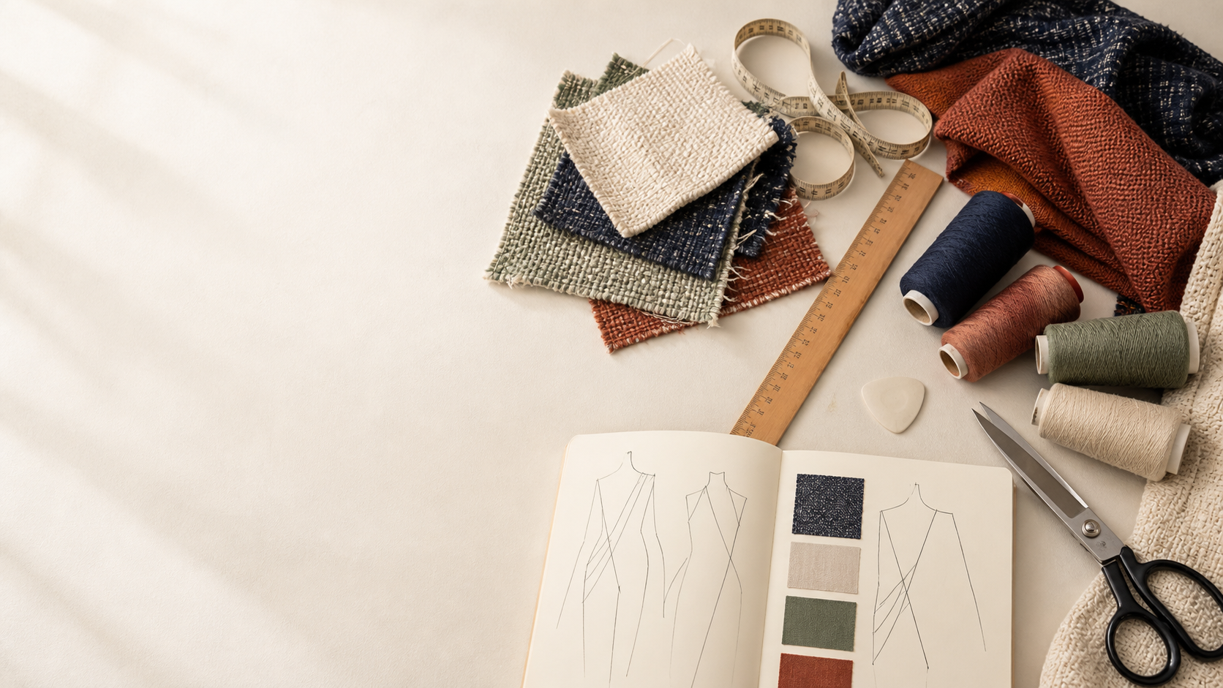
YEAR 11 TEXTILES AND DESIGN · MODULE 1 · WEEKS 1–2
Design starts with a reason
Connect the user, end use, requirements, elements and principles before you judge a textile idea.
BEFORE YOU BEGIN
Choose one textile item. What must it do, and what should it communicate?
Notes:
Open with the retrieval question. Ask students to name an item, its user and its end use before judging appearance.
[Sources]
- SRC-NESA-SYL-2013: Preliminary Design content.
- SRC-LOCAL-SCOPE-2023: Module 1 design foundations.
- Generated asset: textiles-design-workspace.png, built-in image-generation tool, 18 August 2026.

Slide 2
Three lenses turn an idea into a justified decision
Move from purpose → visual ingredients → organised effect → evidence you can justify.
01
02
03
Purpose and requirements
Who will use it? What must it do? Which functional and aesthetic requirements matter?
Elements of design
Identify line, shape, size, texture, colour and value in the actual textile item.
Principles of design
Explain how proportion, balance, rhythm, emphasis, contrast, harmony or unity organise the elements.
2
Notes:
Use the three lenses as a reasoning sequence. A student should move from purpose to observable design evidence and then to a justified judgement.
[Sources]
- SRC-NESA-SYL-2013: Design content and Preliminary outcomes P1.1–P1.2.
- work/student-course-foundation/course-data.js: Module 1 sections m01-s01 to m01-s03.

Slide 3
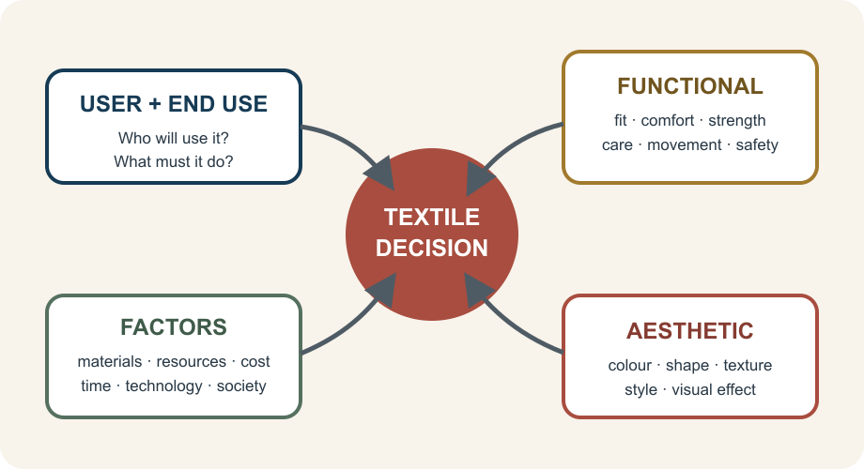
THEORY 1 OF 3
Start with the user, end use and requirements
01 Purpose identifies the user, end use and what a successful result must achieve.
02 Functional requirements cover performance: fit, comfort, strength, movement, care or durability.
03 Aesthetic requirements cover colour, shape, texture, style and the intended visual effect.
EVIDENCE Compare one real item: link one functional and one aesthetic choice to the same user and purpose.
Notice the relationship: requirements and factors shape the textile decision; they do not replace judgement.
3
Notes:
Keep the examples tied to one user and end use. Functional and aesthetic requirements should be explained together, not as disconnected lists.
[Sources]
- SRC-NESA-SYL-2013: functional and aesthetic design; factors affecting design.
- work/student-course-foundation/course-data.js: section m01-s01.
- Course-owned visual: assets/design-lens.svg.

Slide 4
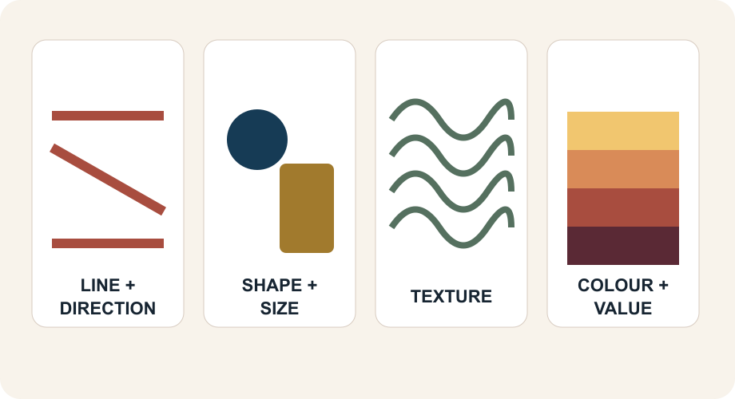
THEORY 2 OF 3
Elements are the ingredients you can point to
01
Line and direction guide the eye through seams, piping, print or contours.
02
Shape and size establish form, scale and the relationship between parts.
03
Texture, colour and value influence how the textile looks, feels and communicates.
EVIDENCE Name two elements, locate them in one textile item and explain their combined effect.
4
Notes:
Ask students to identify where each element appears before explaining its effect. Avoid accepting labels such as “nice colour” without evidence.
[Sources]
- SRC-NESA-SYL-2013: elements of design.
- work/student-course-foundation/course-data.js: section m01-s02.
- Course-owned visual: assets/elements.svg.

Slide 5
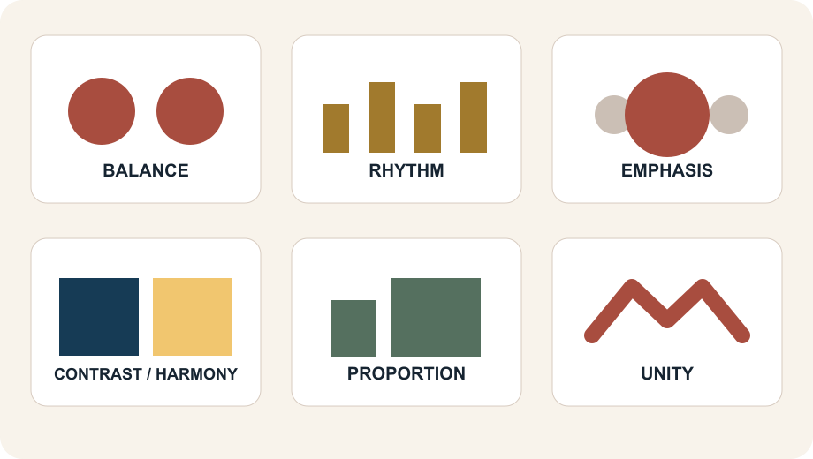
THEORY 3 OF 3
Principles organise the elements into a coherent design
01 Proportion relates the size of one part to another and to the whole.
02 Balance and rhythm distribute visual weight and create movement.
03 Emphasis, contrast, harmony and unity control focus and connection.
EVIDENCE Judge one principle against the intended user or purpose—not personal preference alone.
A design can use several principles together. Point to visible evidence before you make a judgement.
5
Notes:
Model one supported judgement: identify the principle, point to the elements and placement that create it, then link effectiveness to purpose.
[Sources]
- SRC-NESA-SYL-2013: principles of design.
- work/student-course-foundation/course-data.js: section m01-s03.
- Course-owned visual: assets/principles.svg.

Slide 6
Retrieve the relationship—not just the definition
Answer aloud or write one precise sentence for each prompt.
01
02
03
PURPOSE
How can a textile item meet a functional and an aesthetic requirement at the same time?
ELEMENTS
Choose two elements. Where can you see them, and what combined effect do they create?
PRINCIPLES
Which principle organises one textile example most effectively, and what evidence supports your judgement?
6
Notes:
Use this as a formative pause. Each prompt can be answered from slides 3–5. Do not display teacher-only answers.
[Sources]
- work/student-course-foundation/course-data.js: Module 1 theory and knowledge checks.

Slide 7
Build a response that shows your thinking
Prompt: Explain how one textile design choice suits its intended user and end use.
READ
Name the item, user and end use.
SELECT
Choose a requirement, element or principle.
EXPLAIN
Connect visible evidence to the design effect.
CHECK
Support the final judgement and answer every part.
Sentence starter: In the ___ used by ___, the designer uses ___ through ___. This is effective because ___.
7
Notes:
Model the response process without supplying a finished student answer. Direct students back to the precise theory and visible evidence.
[Sources]
- work/student-course-foundation/course-data.js: Module 1 written-response scaffolds.
- Read → Select → Explain → Check course routine.

Slide 8
YOUR NEXT MOVE
Exit ticket: save a supported design judgement
1. Name one textile decision you can now justify.
2. Record the evidence that makes your explanation convincing.
3. Complete the Design-analysis studio and review the response in My folio.
Notes:
Finish with a spoken or written exit response, then direct students to the Design-analysis studio and My folio. No formal submission condition is asserted here.
[Sources]
- work/student-course-foundation/activities/module-01-design-analysis.html.
- work/student-course-foundation/folio.html.
- Generated asset: textiles-design-workspace.png, built-in image-generation tool, 18 August 2026.

