Slide 1
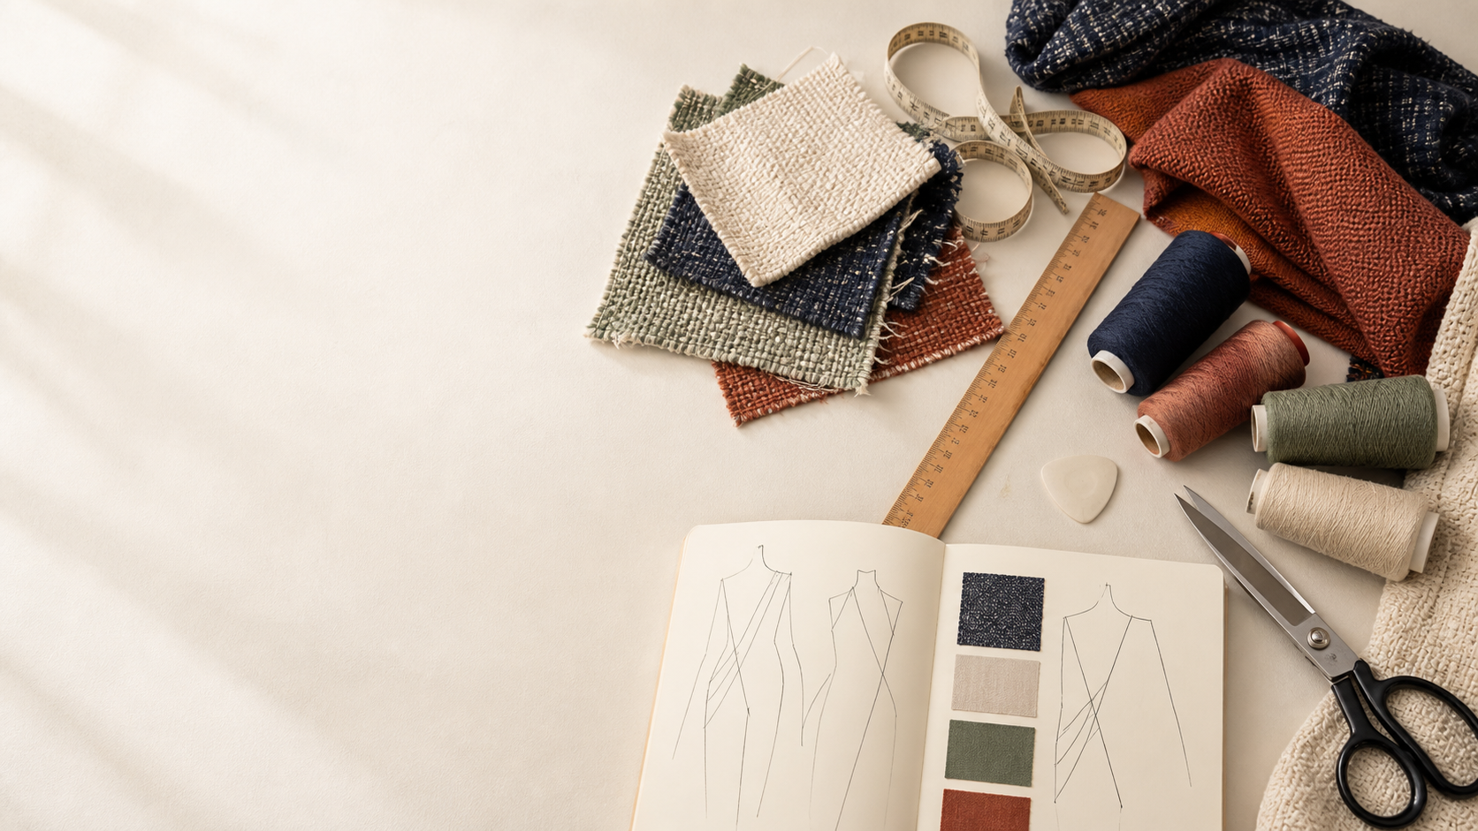
YEAR 11 TEXTILES AND DESIGN · MODULE 2 · WEEKS 3–4
Applying design
Use three connected ideas to explain, apply and justify the learning in Module 2.
BEFORE YOU BEGIN
What do you already know about applying design, and what evidence would show it?
Notes:
Introduce Module 2 and ask the retrieval prompt before showing the learning map.
[Sources]
- SRC-NESA-SYL-2013: Year 11 Preliminary Textiles and Design syllabus.
- THEORY-QUESTION-MANIFEST-v1: Module 2 named sections.
- Course-owned image: textiles-design-workspace.png.

Slide 2
Module 2: three connected ideas
Connect the three ideas, then justify one decision with evidence.
01
02
03
Focus areas and design types
In Textiles and Design, a focus area is a broad category that helps organise textile design according to purpose and…
Factors affecting design
Textile design is influenced by a range of factors .
Inspiration and design development
Textile design ideas can begin with many sources of inspiration .
2
Notes:
Use the three ideas as a cumulative learning pathway rather than an agenda.
[Sources]
- SRC-NESA-SYL-2013.
- Theory files m02-s01 to s03.

Slide 3
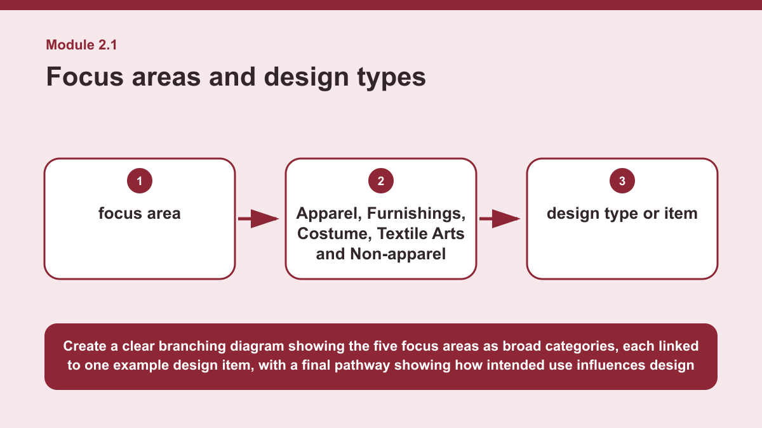
THEORY 1 OF 3
Focus areas and design types
01 In Textiles and Design, a focus area is a broad category that helps organise textile design according to purpose and use.
02 The five focus areas are Apparel, Furnishings, Costume, Textile Arts and Non-apparel .
03 Apparel includes textile products worn as everyday or functional clothing, while Furnishings includes textile products designed for…
EVIDENCE Compare two of the five textile focus areas. Explain one important similarity or difference between them and show how the intended use of products…
Create a clear branching diagram showing the five focus areas as broad categories, each linked to one example design item, with a final pathway showing how…
3
Notes:
Teach the named section, then ask students to point to evidence in the diagram before attempting the prompt.
[Sources]
- SRC-NESA-SYL-2013.
- m02-s01.json.
- Generated course diagram: m02-s01.png; source-bound visual brief: Create a clear branching diagram showing the five focus areas as broad categories, each linked to one example design item, with a final pathway showing how intended use influences design decisions.

Slide 4
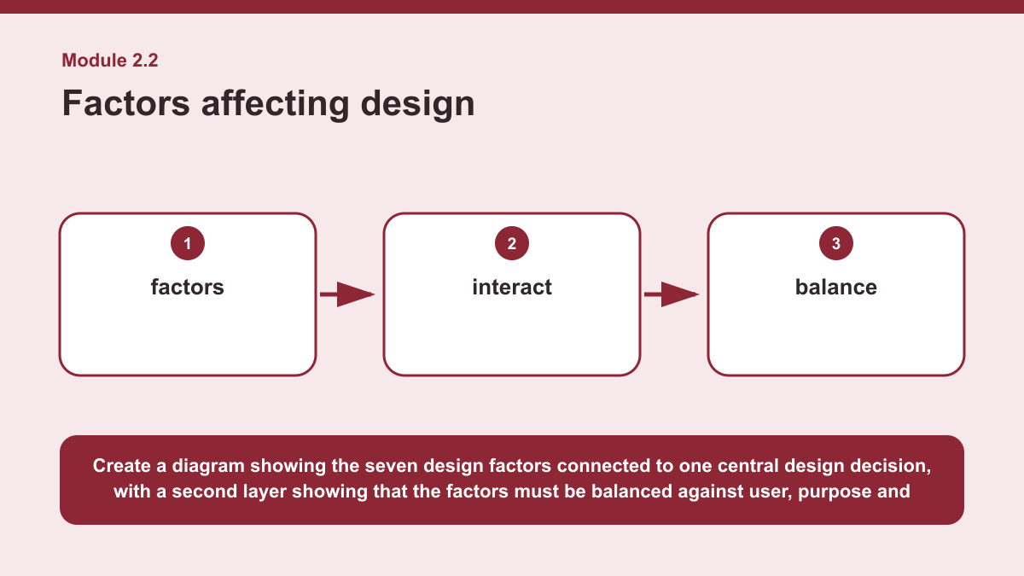
THEORY 2 OF 3
Factors affecting design
01
01 Textile design is influenced by a range of factors .
02
02 These include trends, culture, resources, technology, environment, economic conditions and consumer needs.
03
03 Each factor can affect the direction of a design by creating opportunities, expectations or limitations that a designer must consider.
EVIDENCE Analyse how two interacting factors could influence one textile design decision. Explain how the designer would need to balance both factors against…
4
Notes:
Teach the named section, then ask students to point to evidence in the diagram before attempting the prompt.
[Sources]
- SRC-NESA-SYL-2013.
- m02-s02.json.
- Generated course diagram: m02-s02.png; source-bound visual brief: Create a diagram showing the seven design factors connected to one central design decision, with a second layer showing that the factors must be balanced against user, purpose and requirements.

Slide 5
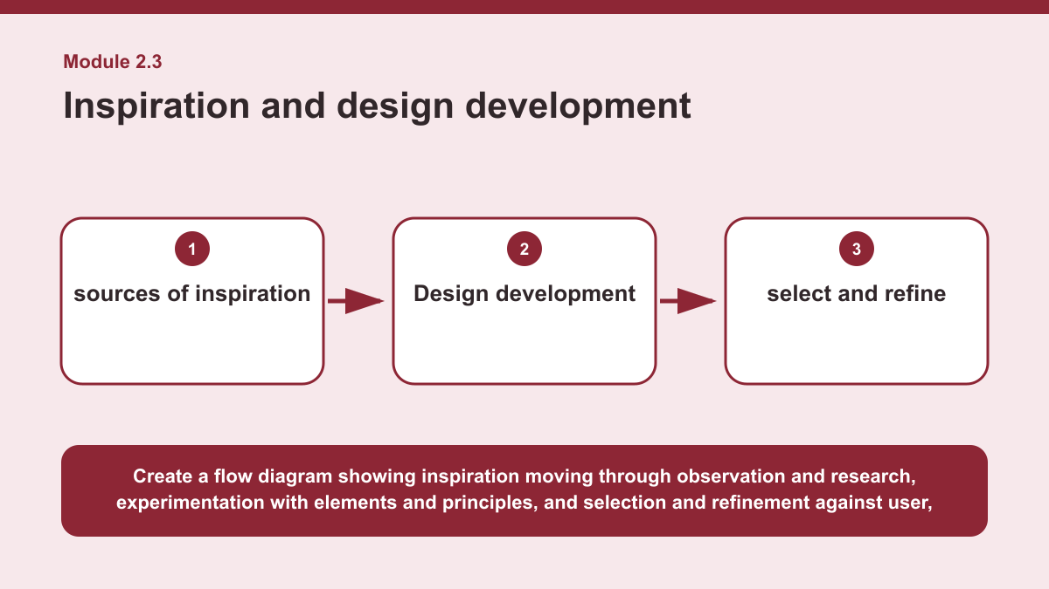
THEORY 3 OF 3
Inspiration and design development
01 Textile design ideas can begin with many sources of inspiration .
02 Designers use observation and research to investigate ideas, forms, colours, textures, patterns and other visual qualities that may…
03 Inspiration provides a starting point, but the designer needs to interpret and develop what has been observed rather than simply…
EVIDENCE Explain how a source of inspiration could be transformed into an original, fit-for-purpose textile idea. Justify how observation, research,…
Create a flow diagram showing inspiration moving through observation and research, experimentation with elements and principles, and selection and refinement…
5
Notes:
Teach the named section, then ask students to point to evidence in the diagram before attempting the prompt.
[Sources]
- SRC-NESA-SYL-2013.
- m02-s03.json.
- Generated course diagram: m02-s03.png; source-bound visual brief: Create a flow diagram showing inspiration moving through observation and research, experimentation with elements and principles, and selection and refinement against user, purpose and design requirements to produce an original textile idea.

Slide 6
Retrieve the relationships—not isolated definitions
Answer aloud or write one precise sentence for each prompt.
01
02
03
FOCUS AREAS AND DESIGN TYPES
Two textile products use similar materials but have different intended uses. What is most likely?
FACTORS AFFECTING DESIGN
Why should consumer needs be considered with other factors?
INSPIRATION AND DESIGN DEVELOPMENT
Why might a designer reject an interesting developed idea?
6
Notes:
Use these as formative retrieval prompts. Each is answerable from slides 3–5.
[Sources]
- Module 2 theory and knowledge checks.

Slide 7
Build a response that uses evidence
Prompt: Explain how a source of inspiration could be transformed into an original, fit-for-purpose textile…
READ
Identify a source of inspiration and useful qualities within it.
SELECT
Explain how observation and research could develop understanding of…
EXPLAIN
Describe how elements and principles could be experimented with to…
CHECK
Justify how the idea would be selected and refined to meet user,…
Sentence starter: A designer could begin with ___ as a source of inspiration. Observation and research could identify ___. Rather than…
7
Notes:
Model the response process without supplying a finished student submission.
[Sources]
- Module 2 written-response scaffold.
- Read → Select → Explain → Check course routine.

Slide 8
YOUR NEXT MOVE
Exit ticket: carry Module 2 evidence forward
1. Name one relationship from Module 2 you can now explain.
2. Save one supported response in My folio.
3. Complete the Module 2 applied-practice activity.
Notes:
Direct students to the Module 2 activity and My folio. No formal submission condition is asserted.
[Sources]
- Course route busy-work/activity-02.html.
- Course route folio.html.
- Course-owned image: textiles-design-workspace.png.

