Slide 1
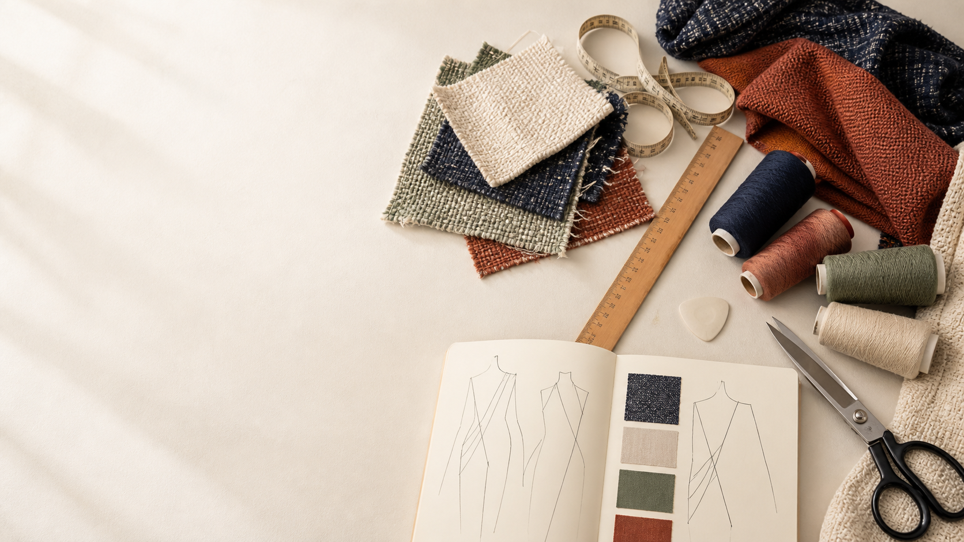
YEAR 11 TEXTILES AND DESIGN · MODULE 3 · WEEKS 5–6
Manufacturing foundations
Use three connected ideas to explain, apply and justify the learning in Module 3.
BEFORE YOU BEGIN
What do you already know about manufacturing foundations, and what evidence would show it?
Notes:
Introduce Module 3 and ask the retrieval prompt before showing the learning map.
[Sources]
- SRC-NESA-SYL-2013: Year 11 Preliminary Textiles and Design syllabus.
- THEORY-QUESTION-MANIFEST-v1: Module 3 named sections.
- Course-owned image: textiles-design-workspace.png.

Slide 2
Module 3: three connected ideas
Connect the three ideas, then justify one decision with evidence.
01
02
03
Manufacturing methods
Manufacturing is the planned sequence used to convert a design idea into a textile product.
Commercial pattern information
A commercial pattern communicates the information needed to interpret and make a textile design accurately.
Planning and quality checkpoints
Production planning organises the work needed to move through a textile manufacturing process in a logical way.
2
Notes:
Use the three ideas as a cumulative learning pathway rather than an agenda.
[Sources]
- SRC-NESA-SYL-2013.
- Theory files m03-s01 to s03.

Slide 3
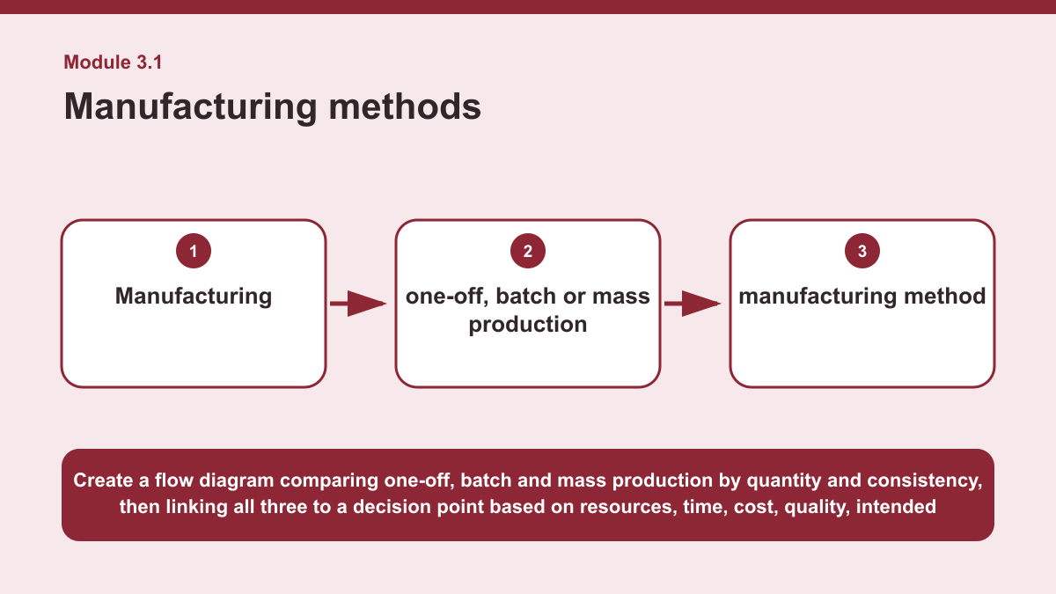
THEORY 1 OF 3
Manufacturing methods
01 Manufacturing is the planned sequence used to convert a design idea into a textile product.
02 A manufacturing sequence organises the stages of production so that work can be completed efficiently and consistently.
03 The sequence may include points where quality is checked before production continues.
EVIDENCE Compare two manufacturing scales from one-off, batch and mass production, then justify which would be more suitable for a stated textile context.
Create a flow diagram comparing one-off, batch and mass production by quantity and consistency, then linking all three to a decision point based on resources,…
3
Notes:
Teach the named section, then ask students to point to evidence in the diagram before attempting the prompt.
[Sources]
- SRC-NESA-SYL-2013.
- m03-s01.json.
- Generated course diagram: m03-s01.png; source-bound visual brief: Create a flow diagram comparing one-off, batch and mass production by quantity and consistency, then linking all three to a decision point based on resources, time, cost, quality, intended use and quality checkpoints.

Slide 4
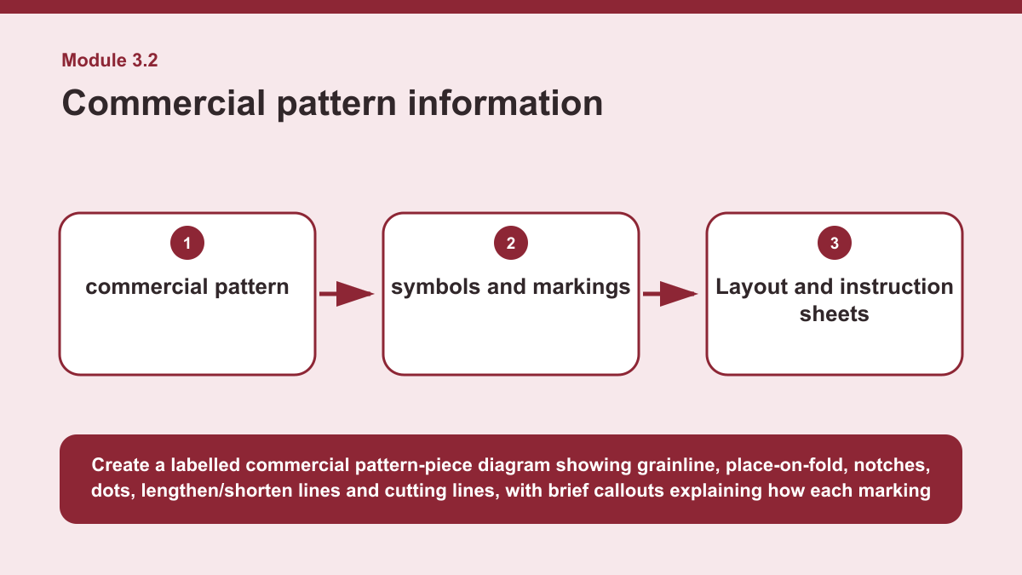
THEORY 2 OF 3
Commercial pattern information
01
01 A commercial pattern communicates the information needed to interpret and make a textile design accurately.
02
02 The pattern envelope provides important information about the design and the pattern contents, while the pattern pieces identify the…
03
03 Pattern-piece names and quantities help the user recognise each component and understand how many of each piece are needed.
EVIDENCE Interpret several commercial pattern markings and explain how they work together to support accuracy when using a pattern.
4
Notes:
Teach the named section, then ask students to point to evidence in the diagram before attempting the prompt.
[Sources]
- SRC-NESA-SYL-2013.
- m03-s02.json.
- Generated course diagram: m03-s02.png; source-bound visual brief: Create a labelled commercial pattern-piece diagram showing grainline, place-on-fold, notches, dots, lengthen/shorten lines and cutting lines, with brief callouts explaining how each marking supports accurate interpretation.

Slide 5
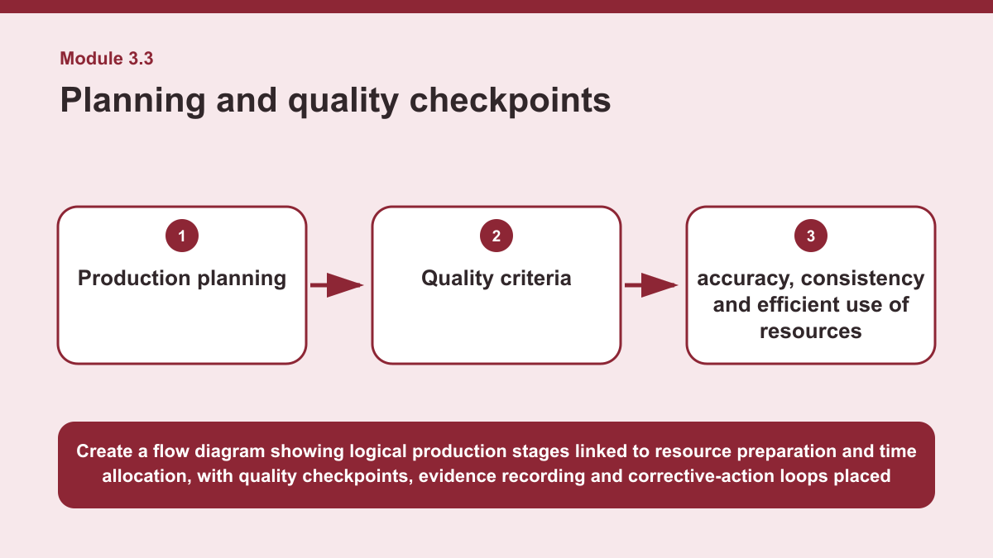
THEORY 3 OF 3
Planning and quality checkpoints
01 Production planning organises the work needed to move through a textile manufacturing process in a logical way.
02 A plan can identify the sequence of stages, prepare required resources, allocate time and provide a way to monitor progress.
03 Recording evidence during production can also help show what has been completed and support later decisions about quality and…
EVIDENCE Construct a short production plan for a stated textile context and justify where you would place quality checkpoints within the sequence.
Create a flow diagram showing logical production stages linked to resource preparation and time allocation, with quality checkpoints, evidence recording and…
5
Notes:
Teach the named section, then ask students to point to evidence in the diagram before attempting the prompt.
[Sources]
- SRC-NESA-SYL-2013.
- m03-s03.json.
- Generated course diagram: m03-s03.png; source-bound visual brief: Create a flow diagram showing logical production stages linked to resource preparation and time allocation, with quality checkpoints, evidence recording and corrective-action loops placed within the sequence.

Slide 6
Retrieve the relationships—not isolated definitions
Answer aloud or write one precise sentence for each prompt.
01
02
03
MANUFACTURING METHODS
Why can quality checkpoints occur within a manufacturing sequence?
COMMERCIAL PATTERN INFORMATION
How do layout and instruction sheets support pattern use?
PLANNING AND QUALITY CHECKPOINTS
How can logical sequencing improve production?
6
Notes:
Use these as formative retrieval prompts. Each is answerable from slides 3–5.
[Sources]
- Module 3 theory and knowledge checks.

Slide 7
Build a response that uses evidence
Prompt: Construct a short production plan for a stated textile context and justify where you would place…
READ
Outline a short logical sequence of production stages.
SELECT
Identify the resources and time considerations for the sequence.
EXPLAIN
Place at least two quality checkpoints and state the criteria each…
CHECK
Justify how monitoring, evidence and corrective action would support…
Sentence starter: My production plan would begin with ___, followed by ___ and ___. Before production, I would prepare ___. A quality…
7
Notes:
Model the response process without supplying a finished student submission.
[Sources]
- Module 3 written-response scaffold.
- Read → Select → Explain → Check course routine.

Slide 8
YOUR NEXT MOVE
Exit ticket: carry Module 3 evidence forward
1. Name one relationship from Module 3 you can now explain.
2. Save one supported response in My folio.
3. Complete the Module 3 applied-practice activity.
Notes:
Direct students to the Module 3 activity and My folio. No formal submission condition is asserted.
[Sources]
- Course route busy-work/activity-03.html.
- Course route folio.html.
- Course-owned image: textiles-design-workspace.png.

