Slide 1
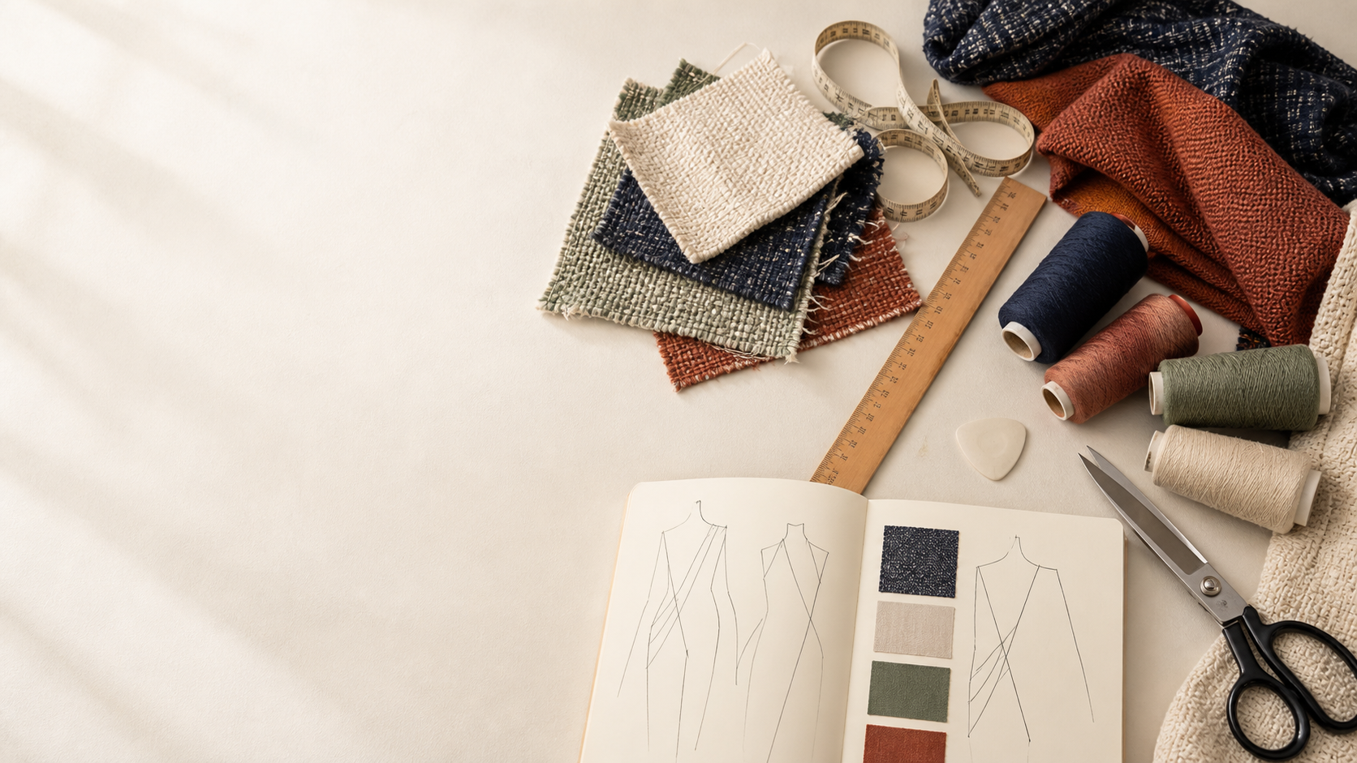
YEAR 11 TEXTILES AND DESIGN · MODULE 4 · WEEKS 7–8
Communicating design
Use three connected ideas to explain, apply and justify the learning in Module 4.
BEFORE YOU BEGIN
What do you already know about communicating design, and what evidence would show it?
Notes:
Introduce Module 4 and ask the retrieval prompt before showing the learning map.
[Sources]
- SRC-NESA-SYL-2013: Year 11 Preliminary Textiles and Design syllabus.
- THEORY-QUESTION-MANIFEST-v1: Module 4 named sections.
- Course-owned image: textiles-design-workspace.png.

Slide 2
Module 4: three connected ideas
Connect the three ideas, then justify one decision with evidence.
01
02
03
Drawing and annotation
Textile designers use different drawing methods to communicate ideas clearly.
Production communication
Production communication uses clear written and visual information to explain how a textile product is intended to be…
Digital and presentation methods
Digital presentation methods help designers communicate textile concepts to different audiences.
2
Notes:
Use the three ideas as a cumulative learning pathway rather than an agenda.
[Sources]
- SRC-NESA-SYL-2013.
- Theory files m04-s01 to s03.

Slide 3
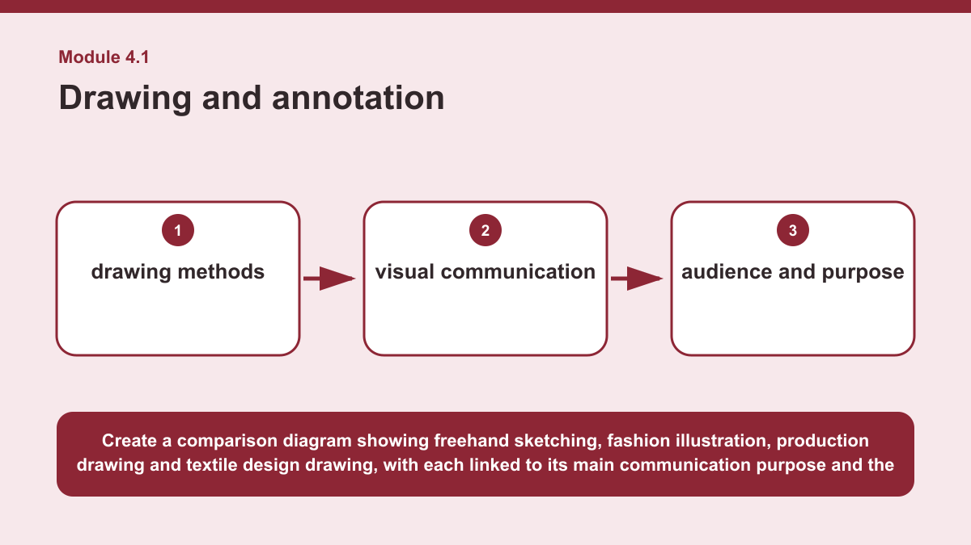
THEORY 1 OF 3
Drawing and annotation
01 Textile designers use different drawing methods to communicate ideas clearly.
02 Freehand sketching is useful for quickly exploring and recording ideas, while fashion illustration communicates the appearance,…
03 Production drawing presents design information in a more controlled and accurate way, while textile design drawing can communicate…
EVIDENCE Select and justify the most suitable drawing method for a stated textile design audience and purpose.
Create a comparison diagram showing freehand sketching, fashion illustration, production drawing and textile design drawing, with each linked to its main…
3
Notes:
Teach the named section, then ask students to point to evidence in the diagram before attempting the prompt.
[Sources]
- SRC-NESA-SYL-2013.
- m04-s01.json.
- Generated course diagram: m04-s01.png; source-bound visual brief: Create a comparison diagram showing freehand sketching, fashion illustration, production drawing and textile design drawing, with each linked to its main communication purpose and the audience information it is best suited to convey.

Slide 4
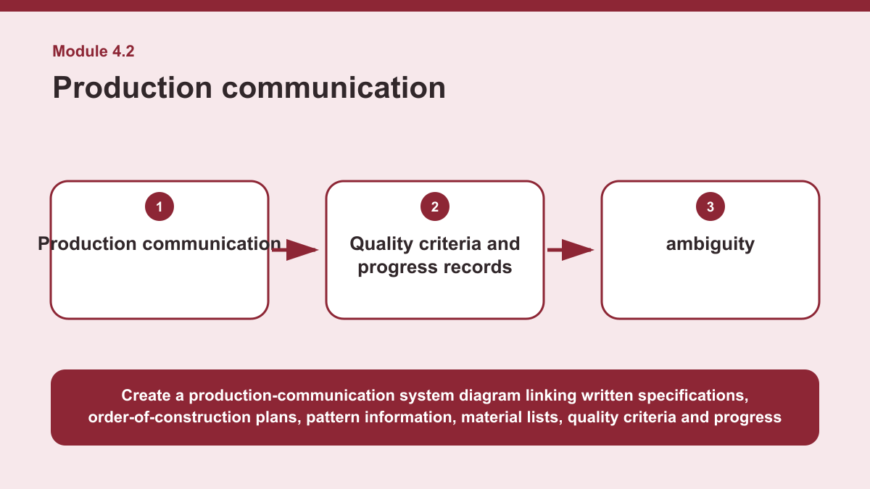
THEORY 2 OF 3
Production communication
01
01 Production communication uses clear written and visual information to explain how a textile product is intended to be produced and…
02
02 Written specifications describe important requirements, while order-of-construction plans organise the intended sequence of work.
03
03 Pattern information communicates details needed to interpret pattern pieces, and material lists identify the resources required for…
EVIDENCE Evaluate which production documents would be needed for a stated textile making scenario and explain why each selected document would be useful.
4
Notes:
Teach the named section, then ask students to point to evidence in the diagram before attempting the prompt.
[Sources]
- SRC-NESA-SYL-2013.
- m04-s02.json.
- Generated course diagram: m04-s02.png; source-bound visual brief: Create a production-communication system diagram linking written specifications, order-of-construction plans, pattern information, material lists, quality criteria and progress records to the outcomes of reduced ambiguity, repeatable work, checking and collaboration.

Slide 5
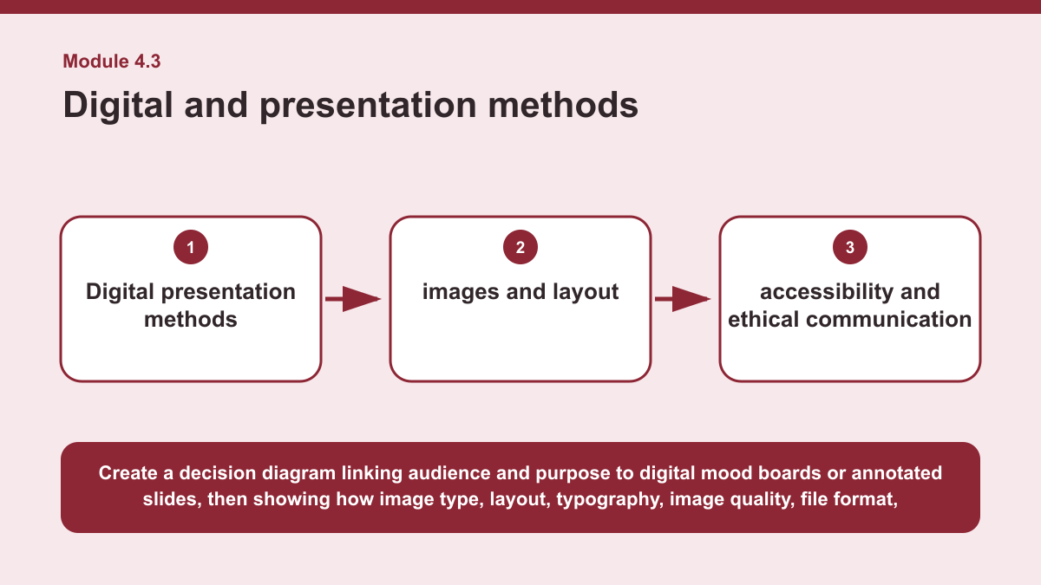
THEORY 3 OF 3
Digital and presentation methods
01 Digital presentation methods help designers communicate textile concepts to different audiences.
02 A digital mood board can organise visual inspiration, colours, textures and related ideas, while annotated slides can combine images…
03 The most suitable method depends on the audience, purpose and information that needs to be understood clearly.
EVIDENCE Develop a justified digital communication plan for presenting a textile concept to a specific audience.
Create a decision diagram linking audience and purpose to digital mood boards or annotated slides, then showing how image type, layout, typography, image quality,…
5
Notes:
Teach the named section, then ask students to point to evidence in the diagram before attempting the prompt.
[Sources]
- SRC-NESA-SYL-2013.
- m04-s03.json.
- Generated course diagram: m04-s03.png; source-bound visual brief: Create a decision diagram linking audience and purpose to digital mood boards or annotated slides, then showing how image type, layout, typography, image quality, file format, accessibility, source acknowledgement and revision support clear textile communication.

Slide 6
Retrieve the relationships—not isolated definitions
Answer aloud or write one precise sentence for each prompt.
01
02
03
DRAWING AND ANNOTATION
What should determine the choice of drawing method?
PRODUCTION COMMUNICATION
Why does reducing ambiguity matter in production?
DIGITAL AND PRESENTATION METHODS
Why should sources be acknowledged in digital design work?
6
Notes:
Use these as formative retrieval prompts. Each is answerable from slides 3–5.
[Sources]
- Module 4 theory and knowledge checks.

Slide 7
Build a response that uses evidence
Prompt: Develop a justified digital communication plan for presenting a textile concept to a specific audience.
READ
Identify the audience, purpose and key information to communicate.
SELECT
Select suitable digital methods such as a mood board or annotated…
EXPLAIN
Explain choices for images, layout, typography, file format and…
CHECK
Justify how the plan supports clarity, ethical use of sources and…
Sentence starter: To present this textile concept to ___, I would use ___. This method suits the audience and purpose because ___. I…
7
Notes:
Model the response process without supplying a finished student submission.
[Sources]
- Module 4 written-response scaffold.
- Read → Select → Explain → Check course routine.

Slide 8
YOUR NEXT MOVE
Exit ticket: carry Module 4 evidence forward
1. Name one relationship from Module 4 you can now explain.
2. Save one supported response in My folio.
3. Complete the Module 4 applied-practice activity.
Notes:
Direct students to the Module 4 activity and My folio. No formal submission condition is asserted.
[Sources]
- Course route busy-work/activity-04.html.
- Course route folio.html.
- Course-owned image: textiles-design-workspace.png.

