Slide 1
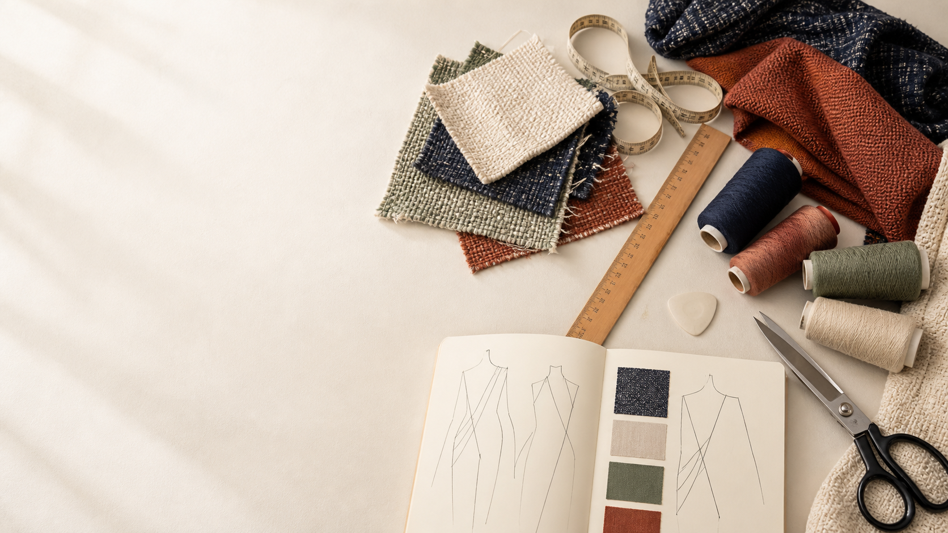
YEAR 11 TEXTILES AND DESIGN · MODULE 5 · WEEKS 9–10
Textile Project 1 evidence
Use three connected ideas to explain, apply and justify the learning in Module 5.
BEFORE YOU BEGIN
What do you already know about textile project 1 evidence, and what evidence would show it?
Notes:
Introduce Module 5 and ask the retrieval prompt before showing the learning map.
[Sources]
- SRC-NESA-SYL-2013: Year 11 Preliminary Textiles and Design syllabus.
- THEORY-QUESTION-MANIFEST-v1: Module 5 named sections.
- Course-owned image: textiles-design-workspace.png.

Slide 2
Module 5: three connected ideas
Connect the three ideas, then justify one decision with evidence.
01
02
03
Design refinement
Design refinement is the purposeful improvement of a design idea after research, experimentation, feedback and checking.
Project management
Project management helps organise a textile project so that work can be completed in a realistic and controlled way.
Evaluation and folio evidence
Evaluation is a supported judgement about how well a textile design meets relevant design criteria.
2
Notes:
Use the three ideas as a cumulative learning pathway rather than an agenda.
[Sources]
- SRC-NESA-SYL-2013.
- Theory files m05-s01 to s03.

Slide 3
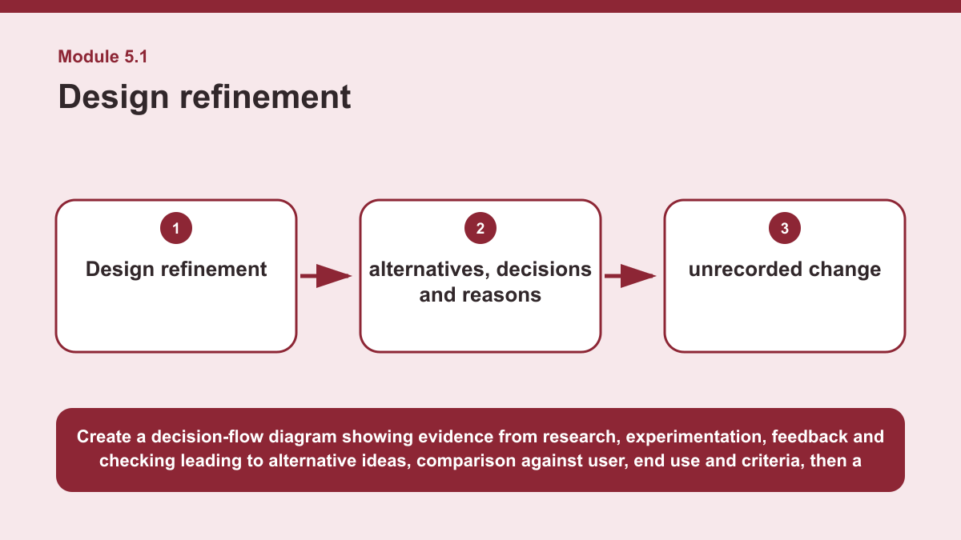
THEORY 1 OF 3
Design refinement
01 Design refinement is the purposeful improvement of a design idea after research, experimentation, feedback and checking.
02 Refinement should respond to evidence rather than happen randomly.
03 A designer considers what has been learned and decides whether a change will better suit the intended user, end use and relevant…
EVIDENCE Analyse one proposed change to a textile design idea and justify whether it should be accepted as a refinement.
Create a decision-flow diagram showing evidence from research, experimentation, feedback and checking leading to alternative ideas, comparison against user, end…
3
Notes:
Teach the named section, then ask students to point to evidence in the diagram before attempting the prompt.
[Sources]
- SRC-NESA-SYL-2013.
- m05-s01.json.
- Generated course diagram: m05-s01.png; source-bound visual brief: Create a decision-flow diagram showing evidence from research, experimentation, feedback and checking leading to alternative ideas, comparison against user, end use and criteria, then a recorded decision to accept, modify or reject a proposed refinement.

Slide 4
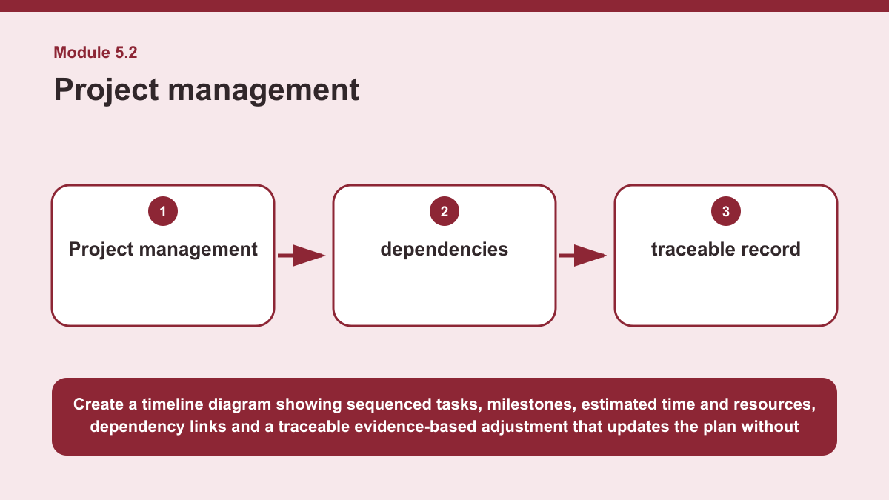
THEORY 2 OF 3
Project management
01
01 Project management helps organise a textile project so that work can be completed in a realistic and controlled way.
02
02 A project plan can include milestones, a logical sequence of tasks, estimated time and required resources.
03
03 Milestones identify important points of progress, while sequencing helps show which tasks need to occur first and which can follow…
EVIDENCE Create a realistic milestone plan for a textile project context and explain one adjustment that could be made if new evidence changed the original…
4
Notes:
Teach the named section, then ask students to point to evidence in the diagram before attempting the prompt.
[Sources]
- SRC-NESA-SYL-2013.
- m05-s02.json.
- Generated course diagram: m05-s02.png; source-bound visual brief: Create a timeline diagram showing sequenced tasks, milestones, estimated time and resources, dependency links and a traceable evidence-based adjustment that updates the plan without removing the original reasoning.

Slide 5
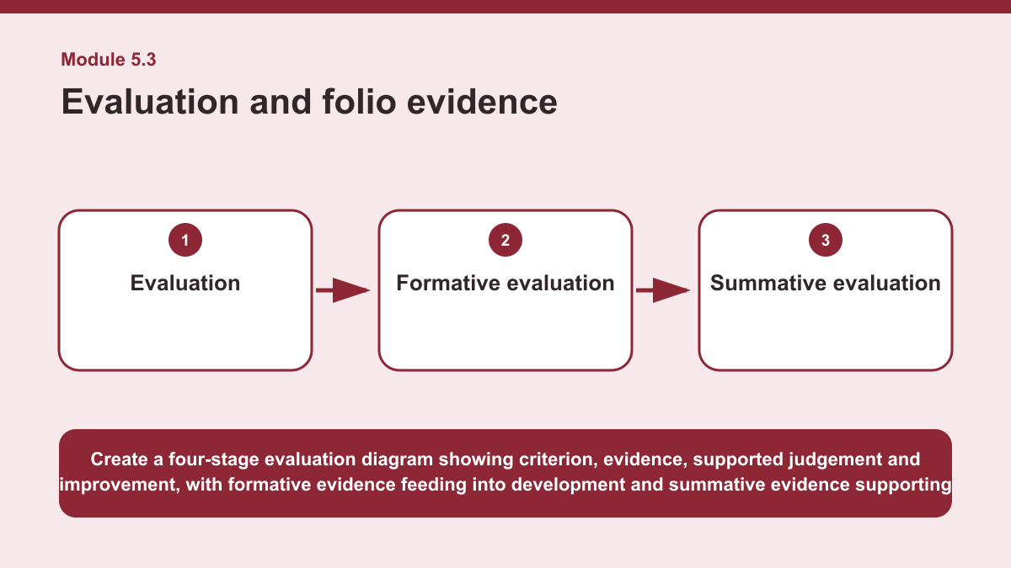
THEORY 3 OF 3
Evaluation and folio evidence
01 Evaluation is a supported judgement about how well a textile design meets relevant design criteria.
02 A strong evaluation does more than describe what happened; it uses evidence to explain whether requirements have been met and why.
03 The judgement should remain connected to the intended design criteria rather than relying only on personal opinion.
EVIDENCE Write a concise evaluation of one aspect of a textile design using the sequence criterion, evidence, judgement and improvement.
Create a four-stage evaluation diagram showing criterion, evidence, supported judgement and improvement, with formative evidence feeding into development and…
5
Notes:
Teach the named section, then ask students to point to evidence in the diagram before attempting the prompt.
[Sources]
- SRC-NESA-SYL-2013.
- m05-s03.json.
- Generated course diagram: m05-s03.png; source-bound visual brief: Create a four-stage evaluation diagram showing criterion, evidence, supported judgement and improvement, with formative evidence feeding into development and summative evidence supporting the final evaluation.

Slide 6
Retrieve the relationships—not isolated definitions
Answer aloud or write one precise sentence for each prompt.
01
02
03
DESIGN REFINEMENT
What should a designer do before accepting an alternative?
PROJECT MANAGEMENT
Which approach best demonstrates effective project management?
EVALUATION AND FOLIO EVIDENCE
Why should an improvement be linked to a limitation?
6
Notes:
Use these as formative retrieval prompts. Each is answerable from slides 3–5.
[Sources]
- Module 5 theory and knowledge checks.

Slide 7
Build a response that uses evidence
Prompt: Write a concise evaluation of one aspect of a textile design using the sequence criterion, evidence,…
READ
State the design criterion being evaluated.
SELECT
Identify evidence that relates directly to the criterion.
EXPLAIN
Make a supported judgement and acknowledge any limitation.
CHECK
Propose one realistic improvement linked to the evidence.
Sentence starter: The criterion being evaluated is ___. Evidence from ___ shows that ___. This means the criterion was ___ because…
7
Notes:
Model the response process without supplying a finished student submission.
[Sources]
- Module 5 written-response scaffold.
- Read → Select → Explain → Check course routine.

Slide 8
YOUR NEXT MOVE
Exit ticket: carry Module 5 evidence forward
1. Name one relationship from Module 5 you can now explain.
2. Save one supported response in My folio.
3. Complete the Module 5 applied-practice activity.
Notes:
Direct students to the Module 5 activity and My folio. No formal submission condition is asserted.
[Sources]
- Course route busy-work/activity-05.html.
- Course route folio.html.
- Course-owned image: textiles-design-workspace.png.

