Slide 1
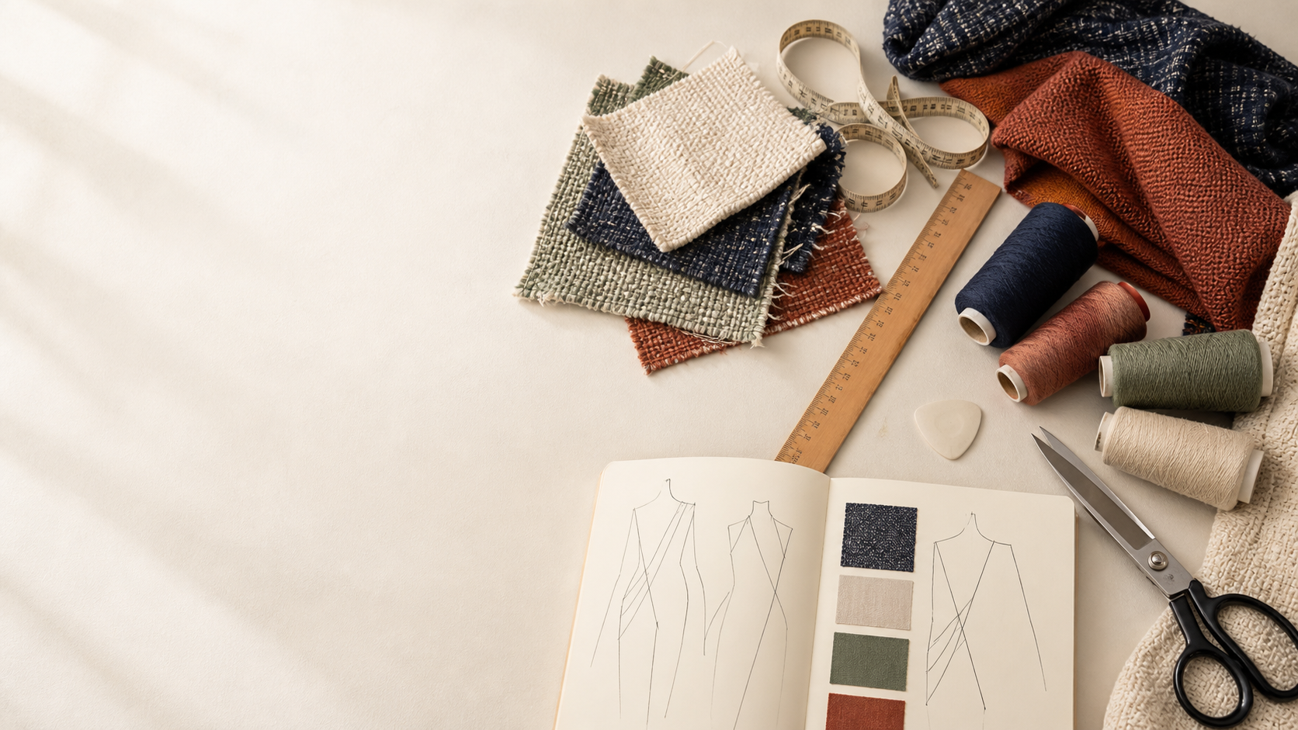
YEAR 11 TEXTILES AND DESIGN · MODULE 6 · WEEKS 11–12
Fibre foundations
Use three connected ideas to explain, apply and justify the learning in Module 6.
BEFORE YOU BEGIN
What do you already know about fibre foundations, and what evidence would show it?
Notes:
Introduce Module 6 and ask the retrieval prompt before showing the learning map.
[Sources]
- SRC-NESA-SYL-2013: Year 11 Preliminary Textiles and Design syllabus.
- THEORY-QUESTION-MANIFEST-v1: Module 6 named sections.
- Course-owned image: textiles-design-workspace.png.

Slide 2
Module 6: three connected ideas
Connect the three ideas, then justify one decision with evidence.
01
02
03
Fibre classification
A fibre is the smallest textile unit from which yarns and fabrics can be formed.
Molecular and morphological structure
Textile fibres are made from polymers , which are large molecules formed from repeating molecular units joined into…
From fibre to textile
Textile materials can be understood as a hierarchy from fibre to yarn to fabric to textile product .
2
Notes:
Use the three ideas as a cumulative learning pathway rather than an agenda.
[Sources]
- SRC-NESA-SYL-2013.
- Theory files m06-s01 to s03.

Slide 3
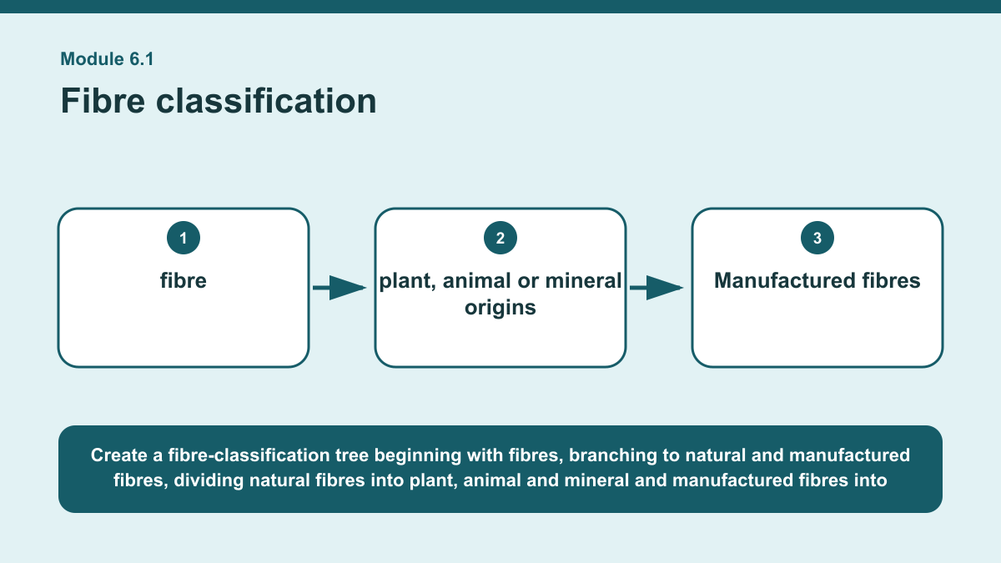
THEORY 1 OF 3
Fibre classification
01 A fibre is the smallest textile unit from which yarns and fabrics can be formed.
02 Fibres can first be classified according to their origin.
03 Natural fibres occur in nature and are grouped according to plant, animal or mineral origins .
EVIDENCE Classify several unfamiliar fibre examples and justify each classification using evidence about fibre origin and production.
Create a fibre-classification tree beginning with fibres, branching to natural and manufactured fibres, dividing natural fibres into plant, animal and mineral and…
3
Notes:
Teach the named section, then ask students to point to evidence in the diagram before attempting the prompt.
[Sources]
- SRC-NESA-SYL-2013.
- m06-s01.json.
- Generated course diagram: m06-s01.png; source-bound visual brief: Create a fibre-classification tree beginning with fibres, branching to natural and manufactured fibres, dividing natural fibres into plant, animal and mineral and manufactured fibres into regenerated and synthetic, with blends shown separately as combinations of identified fibre components.

Slide 4
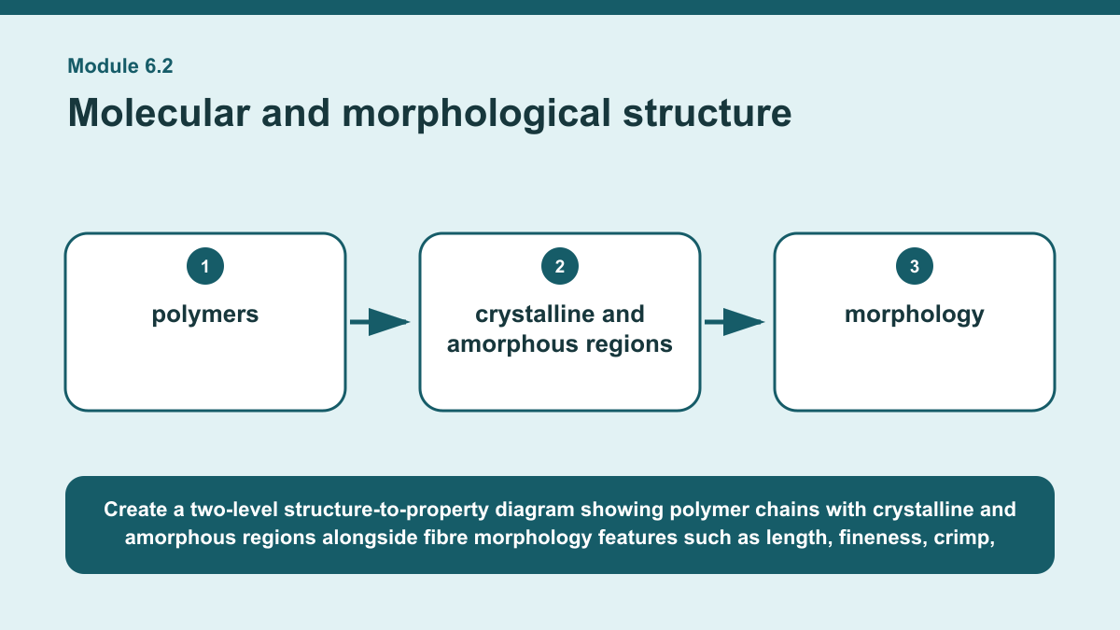
THEORY 2 OF 3
Molecular and morphological structure
01
01 Textile fibres are made from polymers , which are large molecules formed from repeating molecular units joined into chains.
02
02 Different fibre families contain different kinds of polymers.
03
03 Cellulose-based fibres contain cellulose polymers, protein-based fibres contain protein polymers, and synthetic fibres are made from…
EVIDENCE Explain how the structure of one fibre could contribute to one of its properties, using at least two pieces of structural evidence.
4
Notes:
Teach the named section, then ask students to point to evidence in the diagram before attempting the prompt.
[Sources]
- SRC-NESA-SYL-2013.
- m06-s02.json.
- Generated course diagram: m06-s02.png; source-bound visual brief: Create a two-level structure-to-property diagram showing polymer chains with crystalline and amorphous regions alongside fibre morphology features such as length, fineness, crimp, cross-section and surface, all linking to properties while clearly showing that end-use performance depends on additional factors.

Slide 5
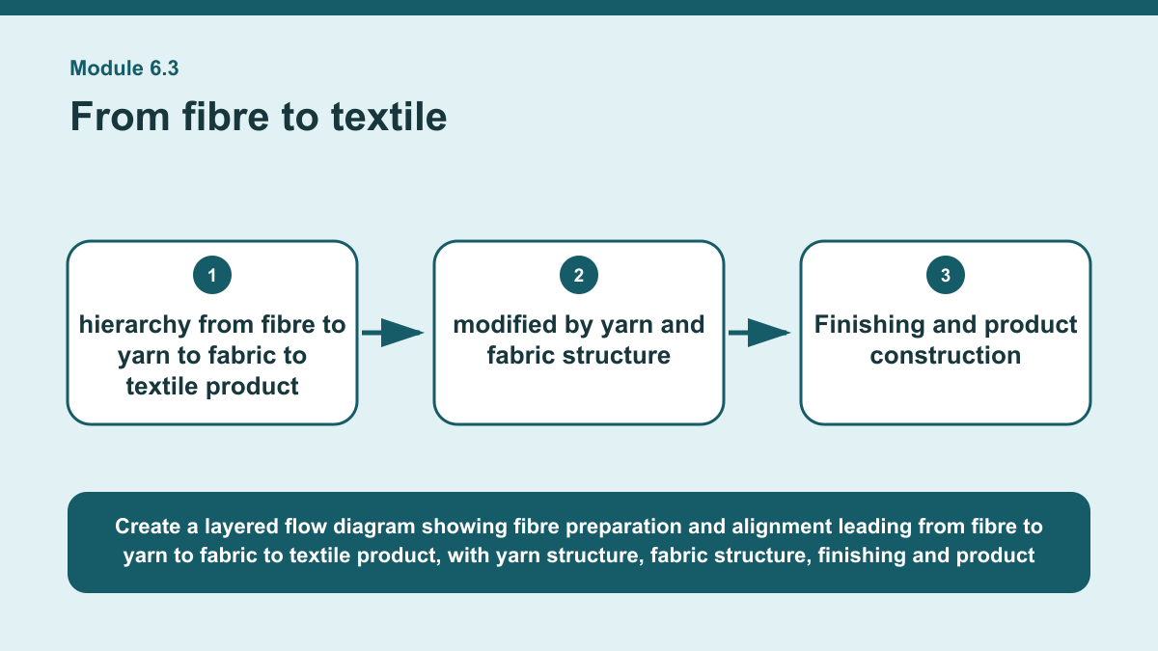
THEORY 3 OF 3
From fibre to textile
01 Textile materials can be understood as a hierarchy from fibre to yarn to fabric to textile product .
02 Fibres are the basic units.
03 Before they become yarn or fabric, fibres may be prepared and aligned so they can be organised into a useful textile structure.
EVIDENCE Trace one fibre characteristic through the yarn, fabric and textile product levels and explain how other structural influences could modify its…
Create a layered flow diagram showing fibre preparation and alignment leading from fibre to yarn to fabric to textile product, with yarn structure, fabric…
5
Notes:
Teach the named section, then ask students to point to evidence in the diagram before attempting the prompt.
[Sources]
- SRC-NESA-SYL-2013.
- m06-s03.json.
- Generated course diagram: m06-s03.png; source-bound visual brief: Create a layered flow diagram showing fibre preparation and alignment leading from fibre to yarn to fabric to textile product, with yarn structure, fabric structure, finishing and product construction shown as successive influences on final performance.

Slide 6
Retrieve the relationships—not isolated definitions
Answer aloud or write one precise sentence for each prompt.
01
02
03
FIBRE CLASSIFICATION
How should a fibre blend be described accurately?
MOLECULAR AND MORPHOLOGICAL STRUCTURE
Why is fibre length useful when explaining properties?
FROM FIBRE TO TEXTILE
Why does product construction matter?
6
Notes:
Use these as formative retrieval prompts. Each is answerable from slides 3–5.
[Sources]
- Module 6 theory and knowledge checks.

Slide 7
Build a response that uses evidence
Prompt: Trace one fibre characteristic through the yarn, fabric and textile product levels and explain how…
READ
Identify one fibre characteristic and describe its likely influence.
SELECT
Explain how yarn structure could modify or support that…
EXPLAIN
Explain how fabric structure could further affect its expression.
CHECK
Explain how finishing and product construction could influence final…
Sentence starter: The fibre characteristic I am tracing is ___. At the fibre level, this may contribute to ___. When the fibres form a…
7
Notes:
Model the response process without supplying a finished student submission.
[Sources]
- Module 6 written-response scaffold.
- Read → Select → Explain → Check course routine.

Slide 8
YOUR NEXT MOVE
Exit ticket: carry Module 6 evidence forward
1. Name one relationship from Module 6 you can now explain.
2. Save one supported response in My folio.
3. Complete the Module 6 applied-practice activity.
Notes:
Direct students to the Module 6 activity and My folio. No formal submission condition is asserted.
[Sources]
- Course route busy-work/activity-06.html.
- Course route folio.html.
- Course-owned image: textiles-design-workspace.png.

