Slide 1
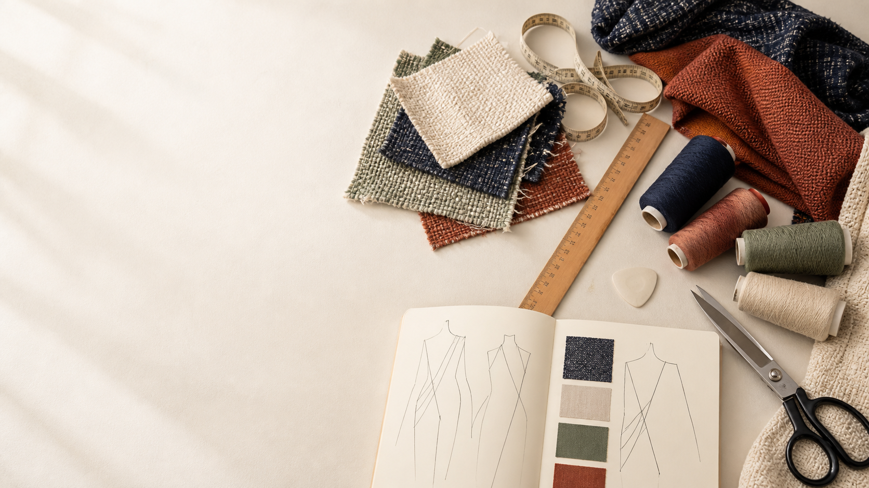
YEAR 11 TEXTILES AND DESIGN · MODULE 7 · WEEKS 13–14
Natural and manufactured fibres
Use three connected ideas to explain, apply and justify the learning in Module 7.
BEFORE YOU BEGIN
What do you already know about natural and manufactured fibres, and what evidence would show it?
Notes:
Introduce Module 7 and ask the retrieval prompt before showing the learning map.
[Sources]
- SRC-NESA-SYL-2013: Year 11 Preliminary Textiles and Design syllabus.
- THEORY-QUESTION-MANIFEST-v1: Module 7 named sections.
- Course-owned image: textiles-design-workspace.png.

Slide 2
Module 7: three connected ideas
Connect the three ideas, then justify one decision with evidence.
01
02
03
Natural cellulosic fibres
Cotton and linen are natural cellulosic fibres because their main structural material is cellulose.
Natural protein fibres
Wool and silk are natural protein fibres obtained from animal sources.
Regenerated, synthetic and blended fibres
Regenerated and synthetic fibres are both manufactured fibres, but they are produced from different types of raw…
2
Notes:
Use the three ideas as a cumulative learning pathway rather than an agenda.
[Sources]
- SRC-NESA-SYL-2013.
- Theory files m07-s01 to s03.

Slide 3
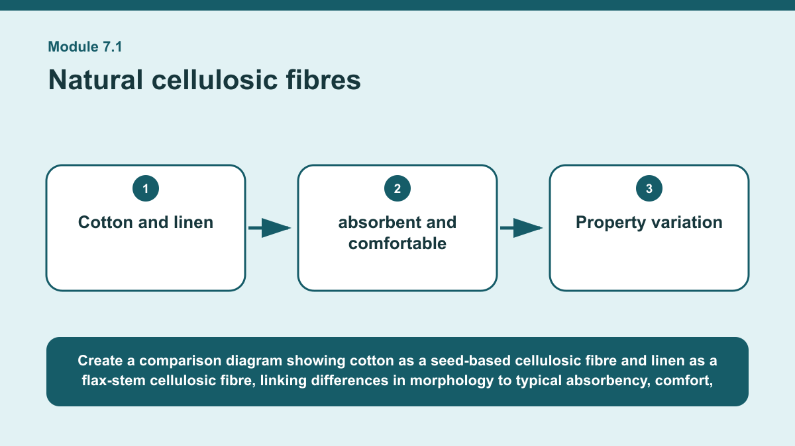
THEORY 1 OF 3
Natural cellulosic fibres
01 Cotton and linen are natural cellulosic fibres because their main structural material is cellulose.
02 Cotton fibres develop around the seeds of the cotton plant, while linen fibres are obtained from the stem of the flax plant.
03 Cotton fibres are relatively short and commonly show natural twists, while flax fibres are longer, straighter and have a more rigid…
EVIDENCE Compare cotton and linen for a stated textile end-use requirement and justify which fibre would be more suitable.
Create a comparison diagram showing cotton as a seed-based cellulosic fibre and linen as a flax-stem cellulosic fibre, linking differences in morphology to typical…
3
Notes:
Teach the named section, then ask students to point to evidence in the diagram before attempting the prompt.
[Sources]
- SRC-NESA-SYL-2013.
- m07-s01.json.
- Generated course diagram: m07-s01.png; source-bound visual brief: Create a comparison diagram showing cotton as a seed-based cellulosic fibre and linen as a flax-stem cellulosic fibre, linking differences in morphology to typical absorbency, comfort, strength and creasing tendencies, with a final end-use selection decision based on evidence.

Slide 4
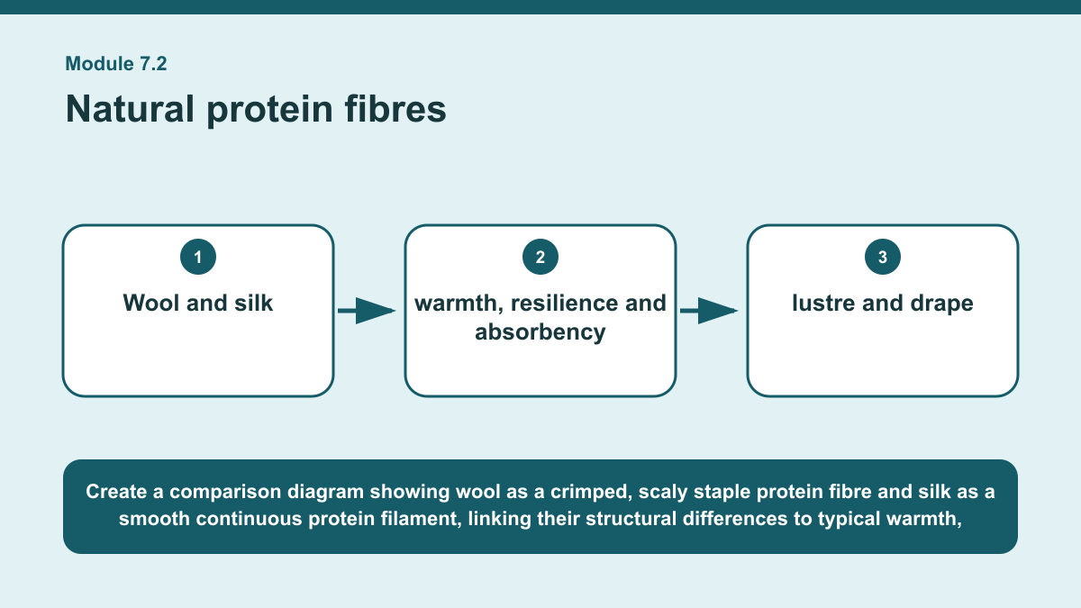
THEORY 2 OF 3
Natural protein fibres
01
01 Wool and silk are natural protein fibres obtained from animal sources.
02
02 Wool is typically produced as a staple fibre, meaning the fibres are relatively short, while silk is naturally produced as a…
03
03 Wool fibres generally have a scaly surface and natural crimp, while silk filaments are typically smoother and straighter.
EVIDENCE Choose between wool and silk for a specified textile context that has both a performance requirement and an appearance requirement, and justify your…
4
Notes:
Teach the named section, then ask students to point to evidence in the diagram before attempting the prompt.
[Sources]
- SRC-NESA-SYL-2013.
- m07-s02.json.
- Generated course diagram: m07-s02.png; source-bound visual brief: Create a comparison diagram showing wool as a crimped, scaly staple protein fibre and silk as a smooth continuous protein filament, linking their structural differences to typical warmth, resilience, lustre, drape, absorbency and care considerations.

Slide 5
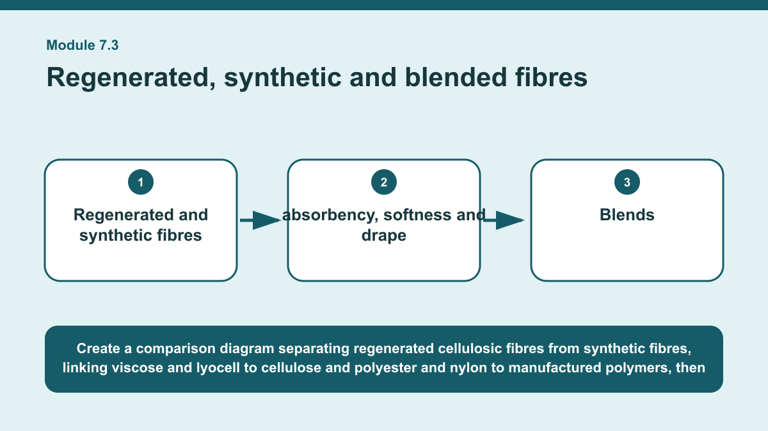
THEORY 3 OF 3
Regenerated, synthetic and blended fibres
01 Regenerated and synthetic fibres are both manufactured fibres, but they are produced from different types of raw material.
02 Regenerated cellulosic fibres such as viscose and lyocell are made by processing cellulose and forming it into new fibres.
03 Synthetic fibres such as polyester and nylon are made from manufactured polymers.
EVIDENCE Compare two manufactured fibre choices, or one manufactured fibre with a blend, for a stated textile end-use requirement using both property…
Create a comparison diagram separating regenerated cellulosic fibres from synthetic fibres, linking viscose and lyocell to cellulose and polyester and nylon to…
5
Notes:
Teach the named section, then ask students to point to evidence in the diagram before attempting the prompt.
[Sources]
- SRC-NESA-SYL-2013.
- m07-s03.json.
- Generated course diagram: m07-s03.png; source-bound visual brief: Create a comparison diagram separating regenerated cellulosic fibres from synthetic fibres, linking viscose and lyocell to cellulose and polyester and nylon to manufactured polymers, then showing blends as proportion-dependent combinations and lifecycle evidence as a separate requirement for environmental judgement.

Slide 6
Retrieve the relationships—not isolated definitions
Answer aloud or write one precise sentence for each prompt.
01
02
03
NATURAL CELLULOSIC FIBRES
How can a finish affect a natural cellulosic textile?
NATURAL PROTEIN FIBRES
Why might two wool fabrics have different properties?
REGENERATED, SYNTHETIC AND BLENDED FIBRES
What is the best basis for an environmental comparison between fibres?
6
Notes:
Use these as formative retrieval prompts. Each is answerable from slides 3–5.
[Sources]
- Module 7 theory and knowledge checks.

Slide 7
Build a response that uses evidence
Prompt: Compare two manufactured fibre choices, or one manufactured fibre with a blend, for a stated textile…
READ
Identify the end-use requirements and the two fibre options being…
SELECT
Compare relevant property evidence for each option.
EXPLAIN
Consider how proportions, textile structure, finish or lifecycle…
CHECK
Justify the preferred option while acknowledging any limitation or…
Sentence starter: For an end use requiring ___, I would compare ___ and ___. The first option typically ___, while the second…
7
Notes:
Model the response process without supplying a finished student submission.
[Sources]
- Module 7 written-response scaffold.
- Read → Select → Explain → Check course routine.

Slide 8
YOUR NEXT MOVE
Exit ticket: carry Module 7 evidence forward
1. Name one relationship from Module 7 you can now explain.
2. Save one supported response in My folio.
3. Complete the Module 7 applied-practice activity.
Notes:
Direct students to the Module 7 activity and My folio. No formal submission condition is asserted.
[Sources]
- Course route busy-work/activity-07.html.
- Course route folio.html.
- Course-owned image: textiles-design-workspace.png.

