Slide 1
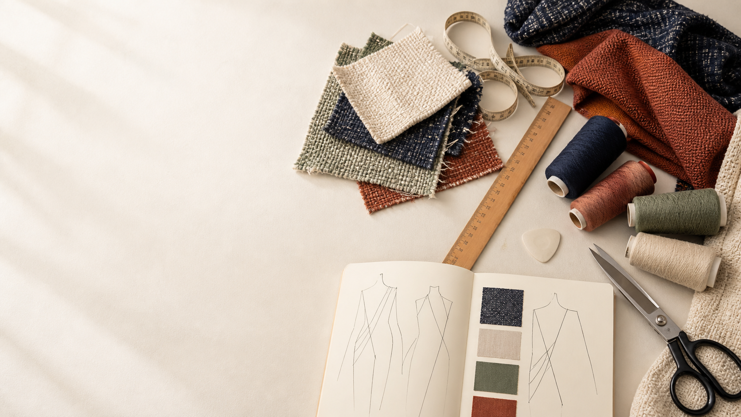
YEAR 11 TEXTILES AND DESIGN · MODULE 8 · WEEKS 15–16
Yarn structures
Use three connected ideas to explain, apply and justify the learning in Module 8.
BEFORE YOU BEGIN
What do you already know about yarn structures, and what evidence would show it?
Notes:
Introduce Module 8 and ask the retrieval prompt before showing the learning map.
[Sources]
- SRC-NESA-SYL-2013: Year 11 Preliminary Textiles and Design syllabus.
- THEORY-QUESTION-MANIFEST-v1: Module 8 named sections.
- Course-owned image: textiles-design-workspace.png.

Slide 2
Module 8: three connected ideas
Connect the three ideas, then justify one decision with evidence.
01
02
03
Staple-spun and filament yarns
Textile yarns can be formed from either staple fibres or continuous filaments .
Twist and spinning systems
Twist binds fibres together in a yarn by increasing contact and friction between them.
Textured and novelty yarns
Textured yarns are usually made by changing the structure of continuous filament yarns so they develop greater bulk,…
2
Notes:
Use the three ideas as a cumulative learning pathway rather than an agenda.
[Sources]
- SRC-NESA-SYL-2013.
- Theory files m08-s01 to s03.

Slide 3
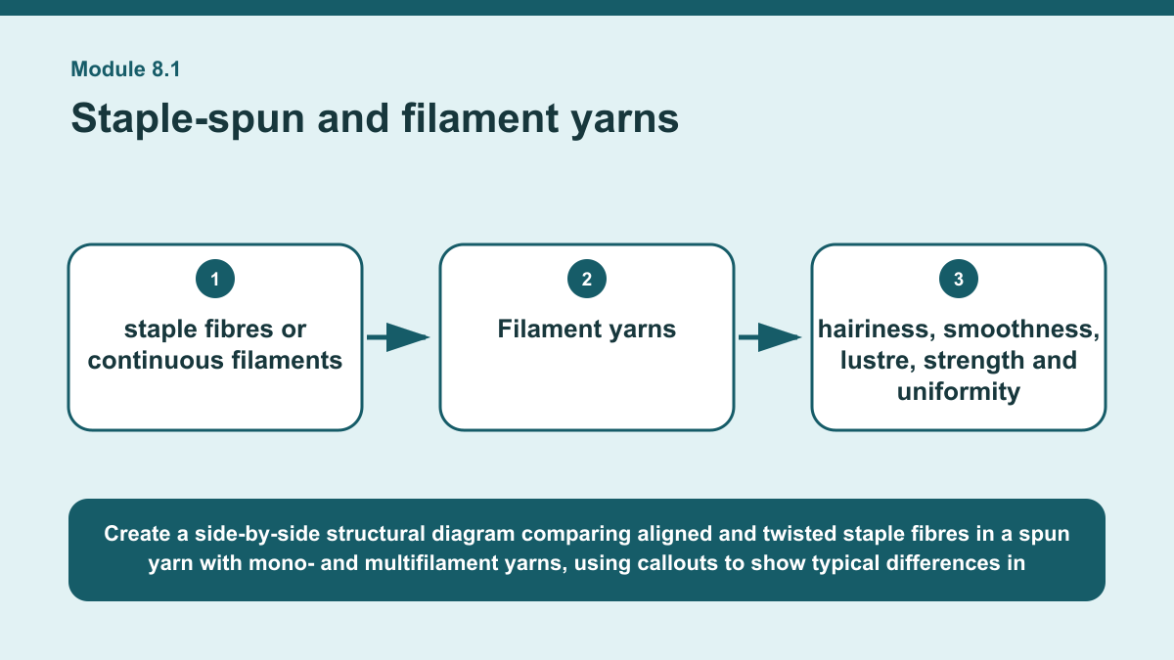
THEORY 1 OF 3
Staple-spun and filament yarns
01 Textile yarns can be formed from either staple fibres or continuous filaments .
02 Staple fibres have a limited length, while continuous filaments extend for much greater lengths.
03 Spun yarns are generally produced by aligning staple fibres and twisting them together so that the fibres form a continuous yarn.
EVIDENCE Identify and compare one staple-spun yarn and one filament yarn using visible or structural evidence, then explain how that evidence supports your…
Create a side-by-side structural diagram comparing aligned and twisted staple fibres in a spun yarn with mono- and multifilament yarns, using callouts to show…
3
Notes:
Teach the named section, then ask students to point to evidence in the diagram before attempting the prompt.
[Sources]
- SRC-NESA-SYL-2013.
- m08-s01.json.
- Generated course diagram: m08-s01.png; source-bound visual brief: Create a side-by-side structural diagram comparing aligned and twisted staple fibres in a spun yarn with mono- and multifilament yarns, using callouts to show typical differences in hairiness, smoothness, lustre, strength and uniformity.

Slide 4
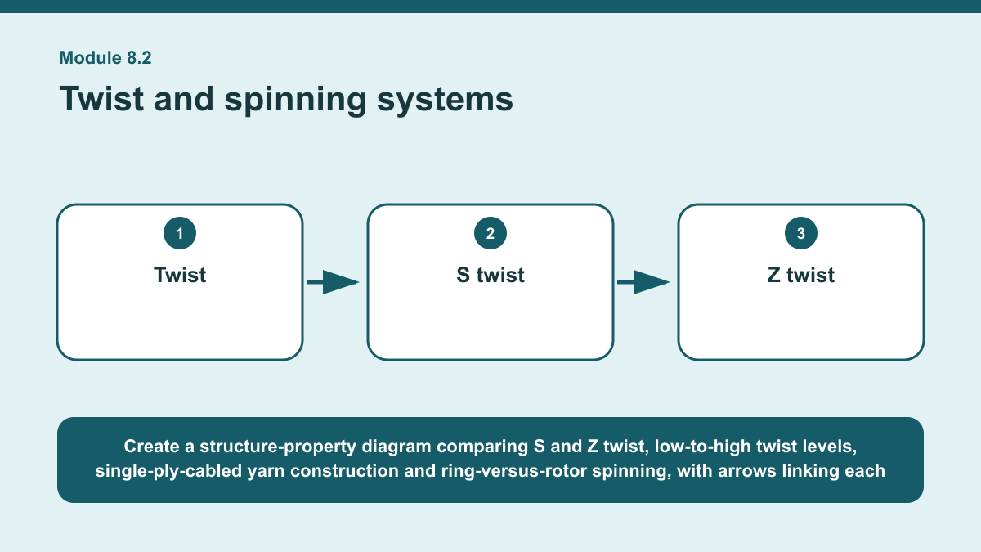
THEORY 2 OF 3
Twist and spinning systems
01
01 Twist binds fibres together in a yarn by increasing contact and friction between them.
02
02 Twist direction is described as S twist or Z twist according to the direction of the yarn's diagonal fibres.
03
03 The amount of twist also affects behaviour.
EVIDENCE Explain how two yarn construction decisions could change the likely performance of a yarn.
4
Notes:
Teach the named section, then ask students to point to evidence in the diagram before attempting the prompt.
[Sources]
- SRC-NESA-SYL-2013.
- m08-s02.json.
- Generated course diagram: m08-s02.png; source-bound visual brief: Create a structure-property diagram comparing S and Z twist, low-to-high twist levels, single-ply-cabled yarn construction and ring-versus-rotor spinning, with arrows linking each structural choice to typical effects on cohesion, strength, firmness, handle, lustre and uniformity.

Slide 5
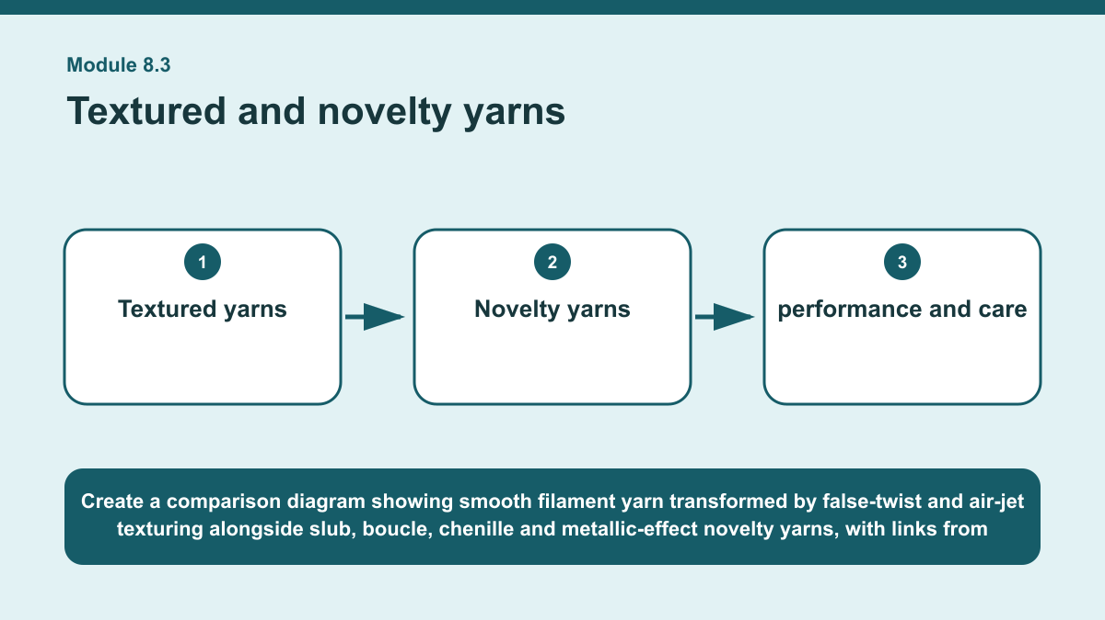
THEORY 3 OF 3
Textured and novelty yarns
01 Textured yarns are usually made by changing the structure of continuous filament yarns so they develop greater bulk, stretch, warmth,…
02 Texturing changes the way filaments are arranged rather than changing the basic fibre polymer.
03 False-twist texturing introduces temporary twist and heat-related shape changes to create crimp or elasticity, while air-jet…
EVIDENCE Select a textured or novelty yarn for a stated textile context with both an aesthetic requirement and a performance requirement, and justify your…
Create a comparison diagram showing smooth filament yarn transformed by false-twist and air-jet texturing alongside slub, boucle, chenille and metallic-effect…
5
Notes:
Teach the named section, then ask students to point to evidence in the diagram before attempting the prompt.
[Sources]
- SRC-NESA-SYL-2013.
- m08-s03.json.
- Generated course diagram: m08-s03.png; source-bound visual brief: Create a comparison diagram showing smooth filament yarn transformed by false-twist and air-jet texturing alongside slub, boucle, chenille and metallic-effect novelty yarns, with links from each structure to typical aesthetic effects and possible performance considerations such as bulk, stretch, warmth, snagging, abrasion, sewing and care.

Slide 6
Retrieve the relationships—not isolated definitions
Answer aloud or write one precise sentence for each prompt.
01
02
03
STAPLE-SPUN AND FILAMENT YARNS
Why are filament yarns often more uniform?
TWIST AND SPINNING SYSTEMS
Why can high twist reduce yarn lustre?
TEXTURED AND NOVELTY YARNS
Why can novelty yarns affect sewing performance?
6
Notes:
Use these as formative retrieval prompts. Each is answerable from slides 3–5.
[Sources]
- Module 8 theory and knowledge checks.

Slide 7
Build a response that uses evidence
Prompt: Select a textured or novelty yarn for a stated textile context with both an aesthetic requirement and a…
READ
Identify the required aesthetic and performance qualities.
SELECT
Select a suitable textured or novelty yarn and describe its structure.
EXPLAIN
Explain how the structure contributes to the required appearance and…
CHECK
Justify the choice while acknowledging one possible limitation.
Sentence starter: For an end use requiring ___ in appearance and ___ in performance, I would select ___. Its structure includes ___,…
7
Notes:
Model the response process without supplying a finished student submission.
[Sources]
- Module 8 written-response scaffold.
- Read → Select → Explain → Check course routine.

Slide 8
YOUR NEXT MOVE
Exit ticket: carry Module 8 evidence forward
1. Name one relationship from Module 8 you can now explain.
2. Save one supported response in My folio.
3. Complete the Module 8 applied-practice activity.
Notes:
Direct students to the Module 8 activity and My folio. No formal submission condition is asserted.
[Sources]
- Course route busy-work/activity-08.html.
- Course route folio.html.
- Course-owned image: textiles-design-workspace.png.

