Slide 1
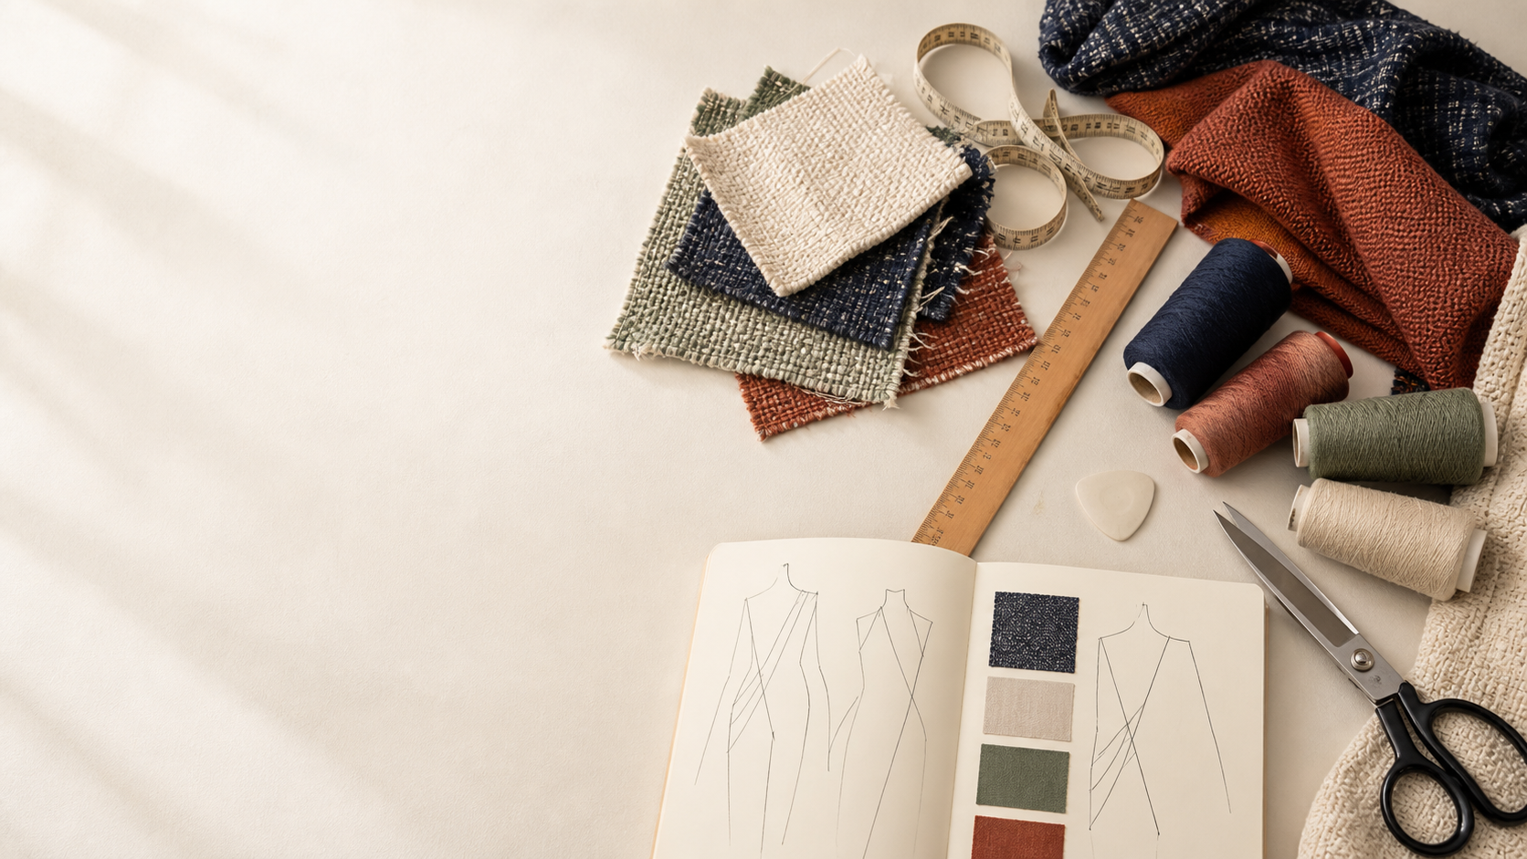
YEAR 11 TEXTILES AND DESIGN · MODULE 9 · WEEKS 17–18
Yarn performance
Use three connected ideas to explain, apply and justify the learning in Module 9.
BEFORE YOU BEGIN
What do you already know about yarn performance, and what evidence would show it?
Notes:
Introduce Module 9 and ask the retrieval prompt before showing the learning map.
[Sources]
- SRC-NESA-SYL-2013: Year 11 Preliminary Textiles and Design syllabus.
- THEORY-QUESTION-MANIFEST-v1: Module 9 named sections.
- Course-owned image: textiles-design-workspace.png.

Slide 2
Module 9: three connected ideas
Connect the three ideas, then justify one decision with evidence.
01
02
03
Yarn characteristics
Yarns can be described using a range of measurable and observable characteristics .
Structure–property relationships
Yarn performance can be explained through a structure–property relationship .
End-use justification
End-use justification begins with the user and the performance requirements of the intended textile product.
2
Notes:
Use the three ideas as a cumulative learning pathway rather than an agenda.
[Sources]
- SRC-NESA-SYL-2013.
- Theory files m09-s01 to s03.

Slide 3
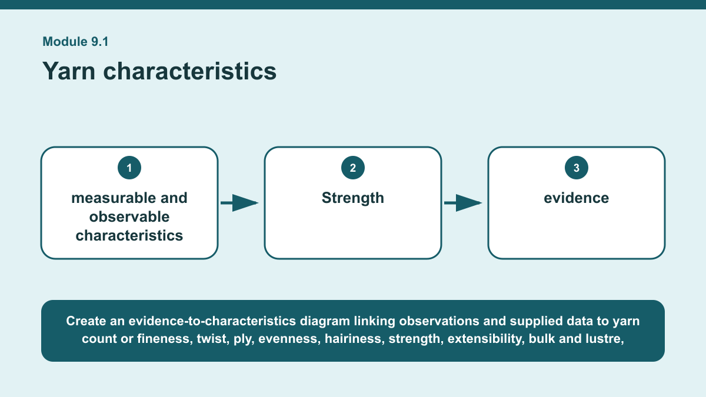
THEORY 1 OF 3
Yarn characteristics
01 Yarns can be described using a range of measurable and observable characteristics .
02 These include count or fineness, twist, ply, evenness, hairiness, strength, extensibility, bulk and lustre.
03 Count or fineness describes the relative thickness of a yarn, while twist and ply describe aspects of its construction.
EVIDENCE Interpret a small set of supplied yarn observations and data to describe the likely characteristics of two yarns.
Create an evidence-to-characteristics diagram linking observations and supplied data to yarn count or fineness, twist, ply, evenness, hairiness, strength,…
3
Notes:
Teach the named section, then ask students to point to evidence in the diagram before attempting the prompt.
[Sources]
- SRC-NESA-SYL-2013.
- m09-s01.json.
- Generated course diagram: m09-s01.png; source-bound visual brief: Create an evidence-to-characteristics diagram linking observations and supplied data to yarn count or fineness, twist, ply, evenness, hairiness, strength, extensibility, bulk and lustre, with fibre properties and yarn structure shown as combined influences.

Slide 4
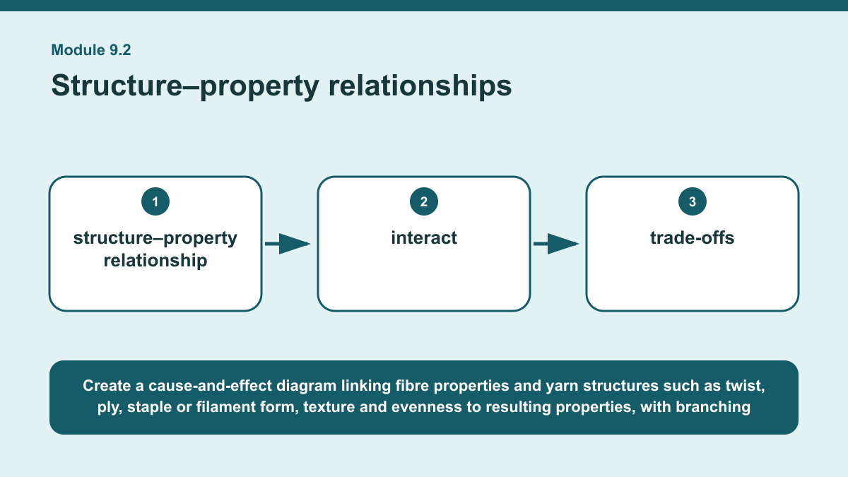
THEORY 2 OF 3
Structure–property relationships
01
01 Yarn performance can be explained through a structure–property relationship .
02
02 Fibre characteristics provide the starting point, but yarn structure changes how those fibres interact.
03
03 Features such as twist, ply, filament or staple form, texture and evenness can influence properties including strength, firmness,…
EVIDENCE Explain how two changes to yarn structure could affect likely yarn performance, including at least one trade-off.
4
Notes:
Teach the named section, then ask students to point to evidence in the diagram before attempting the prompt.
[Sources]
- SRC-NESA-SYL-2013.
- m09-s02.json.
- Generated course diagram: m09-s02.png; source-bound visual brief: Create a cause-and-effect diagram linking fibre properties and yarn structures such as twist, ply, staple or filament form, texture and evenness to resulting properties, with branching arrows showing possible performance benefits and trade-offs in different contexts.

Slide 5
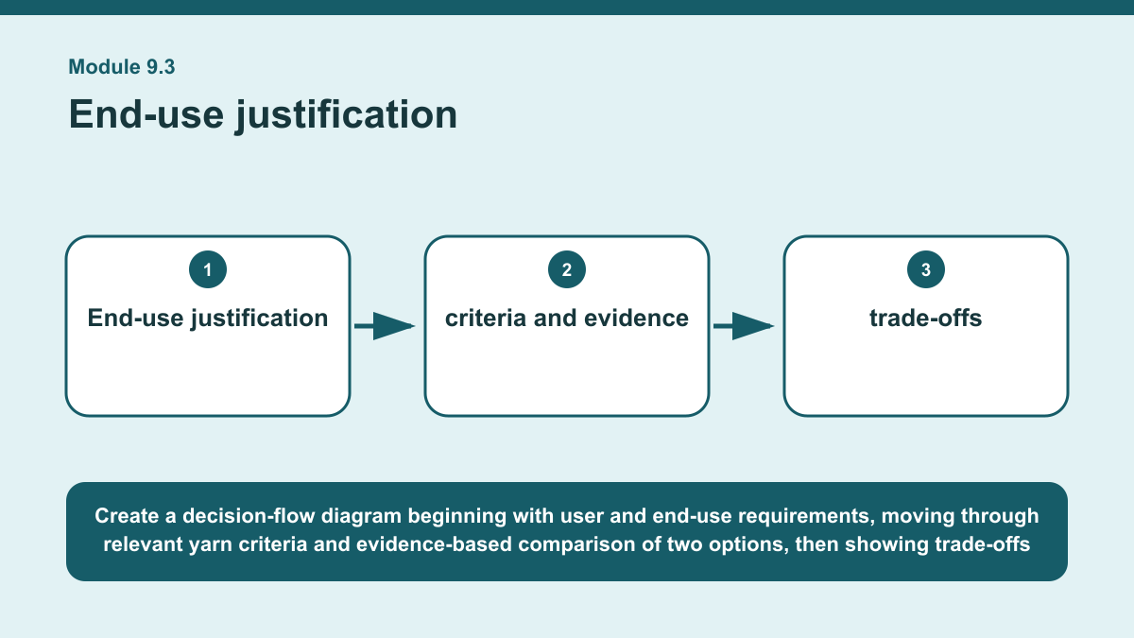
THEORY 3 OF 3
End-use justification
01 End-use justification begins with the user and the performance requirements of the intended textile product.
02 The first step is to identify what the yarn needs to contribute, such as strength, extensibility, bulk, smoothness, lustre, evenness…
03 Relevant yarn characteristics should then be selected according to these requirements rather than choosing a yarn first and trying to…
EVIDENCE Recommend one of two yarn options for a stated textile end use using clear criteria, evidence and at least one trade-off.
Create a decision-flow diagram beginning with user and end-use requirements, moving through relevant yarn criteria and evidence-based comparison of two options,…
5
Notes:
Teach the named section, then ask students to point to evidence in the diagram before attempting the prompt.
[Sources]
- SRC-NESA-SYL-2013.
- m09-s03.json.
- Generated course diagram: m09-s03.png; source-bound visual brief: Create a decision-flow diagram beginning with user and end-use requirements, moving through relevant yarn criteria and evidence-based comparison of two options, then showing trade-offs before a final supported recommendation.

Slide 6
Retrieve the relationships—not isolated definitions
Answer aloud or write one precise sentence for each prompt.
01
02
03
YARN CHARACTERISTICS
Why should appearance not be used alone to judge yarn performance?
STRUCTURE–PROPERTY RELATIONSHIPS
What makes a structure–property claim strong?
END-USE JUSTIFICATION
Why should claims about yarn suitability use qualifiers when needed?
6
Notes:
Use these as formative retrieval prompts. Each is answerable from slides 3–5.
[Sources]
- Module 9 theory and knowledge checks.

Slide 7
Build a response that uses evidence
Prompt: Recommend one of two yarn options for a stated textile end use using clear criteria, evidence and at…
READ
Identify the user, end use and most important criteria.
SELECT
Compare relevant characteristics of the two yarn options using…
EXPLAIN
Explain at least one trade-off between the options.
CHECK
Recommend the more suitable yarn and justify the judgement against…
Sentence starter: For an end use requiring ___ for the user, the most important criteria are ___ and ___. Yarn A shows ___, while Yarn…
7
Notes:
Model the response process without supplying a finished student submission.
[Sources]
- Module 9 written-response scaffold.
- Read → Select → Explain → Check course routine.

Slide 8
YOUR NEXT MOVE
Exit ticket: carry Module 9 evidence forward
1. Name one relationship from Module 9 you can now explain.
2. Save one supported response in My folio.
3. Complete the Module 9 applied-practice activity.
Notes:
Direct students to the Module 9 activity and My folio. No formal submission condition is asserted.
[Sources]
- Course route busy-work/activity-09.html.
- Course route folio.html.
- Course-owned image: textiles-design-workspace.png.

