Slide 1
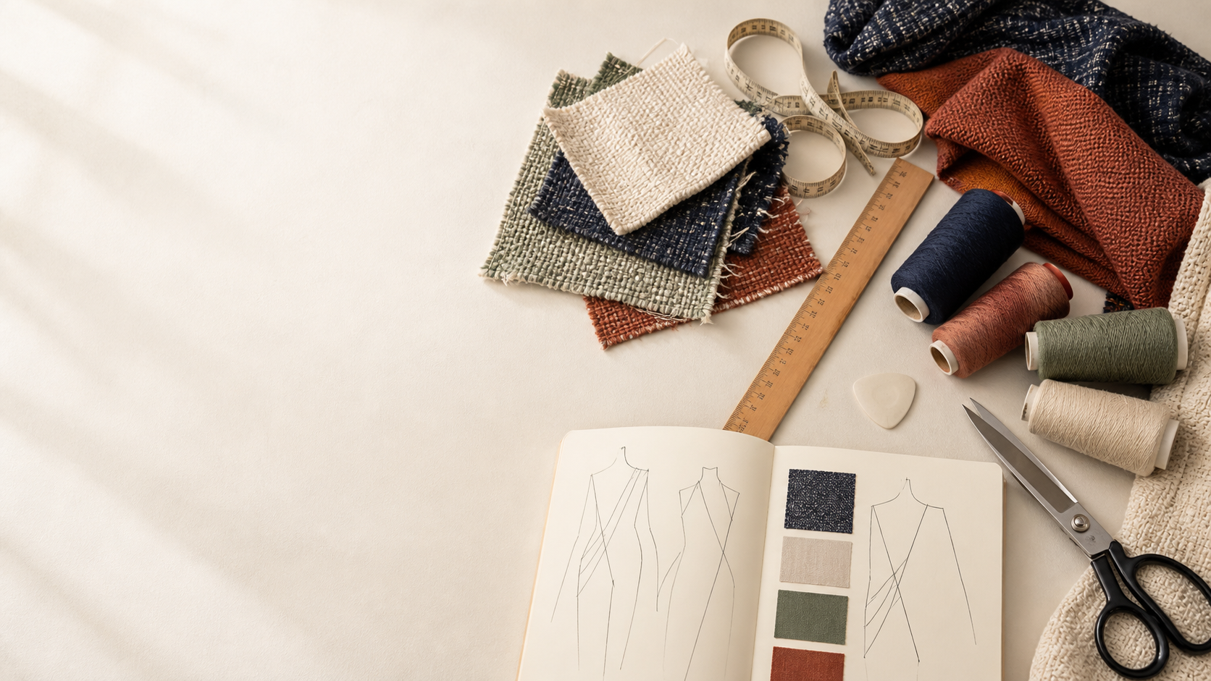
YEAR 11 TEXTILES AND DESIGN · MODULE 10 · WEEKS 19–20
Fabric structures
Use three connected ideas to explain, apply and justify the learning in Module 10.
BEFORE YOU BEGIN
What do you already know about fabric structures, and what evidence would show it?
Notes:
Introduce Module 10 and ask the retrieval prompt before showing the learning map.
[Sources]
- SRC-NESA-SYL-2013: Year 11 Preliminary Textiles and Design syllabus.
- THEORY-QUESTION-MANIFEST-v1: Module 10 named sections.
- Course-owned image: textiles-design-workspace.png.

Slide 2
Module 10: three connected ideas
Connect the three ideas, then justify one decision with evidence.
01
02
03
Woven structures
Woven fabrics are formed by interlacing two yarn systems at approximately right angles.
Knitted structures
Knitted fabrics are formed by interlooping yarn rather than interlacing separate warp and weft yarn systems.
Non-woven structures
Non-woven textiles are formed by creating a web of fibres and bonding that web without first making yarn.
2
Notes:
Use the three ideas as a cumulative learning pathway rather than an agenda.
[Sources]
- SRC-NESA-SYL-2013.
- Theory files m10-s01 to s03.

Slide 3
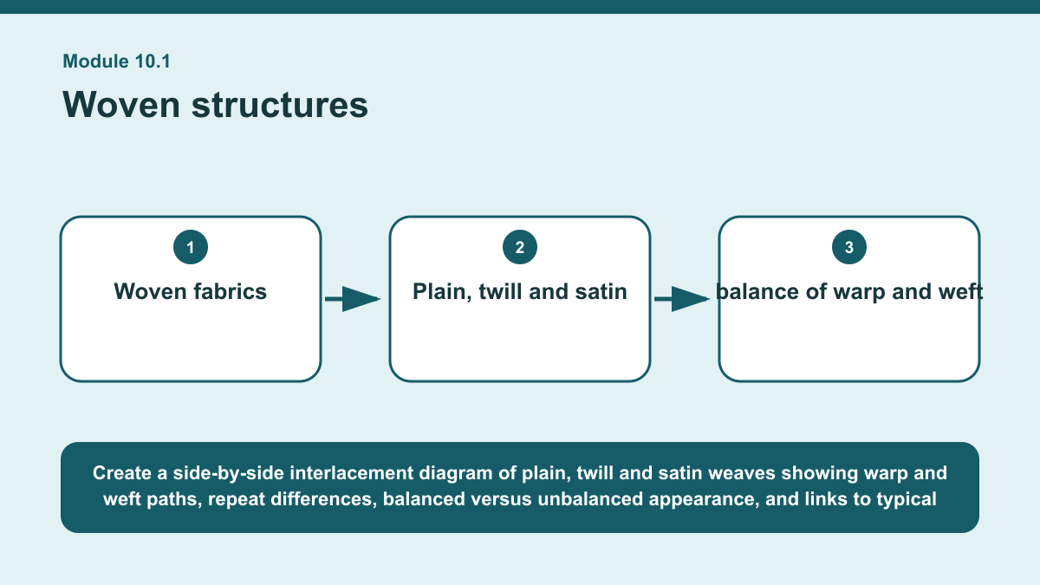
THEORY 1 OF 3
Woven structures
01 Woven fabrics are formed by interlacing two yarn systems at approximately right angles.
02 Warp yarns run lengthwise through the fabric, while weft yarns pass across the width.
03 The pattern of over-and-under interlacement creates the weave structure.
EVIDENCE Compare plain, twill and satin weave structures for a specified textile need and justify which structure would be the most suitable.
Create a side-by-side interlacement diagram of plain, twill and satin weaves showing warp and weft paths, repeat differences, balanced versus unbalanced…
3
Notes:
Teach the named section, then ask students to point to evidence in the diagram before attempting the prompt.
[Sources]
- SRC-NESA-SYL-2013.
- m10-s01.json.
- Generated course diagram: m10-s01.png; source-bound visual brief: Create a side-by-side interlacement diagram of plain, twill and satin weaves showing warp and weft paths, repeat differences, balanced versus unbalanced appearance, and links to typical stability, drape, surface, durability and snagging effects.

Slide 4
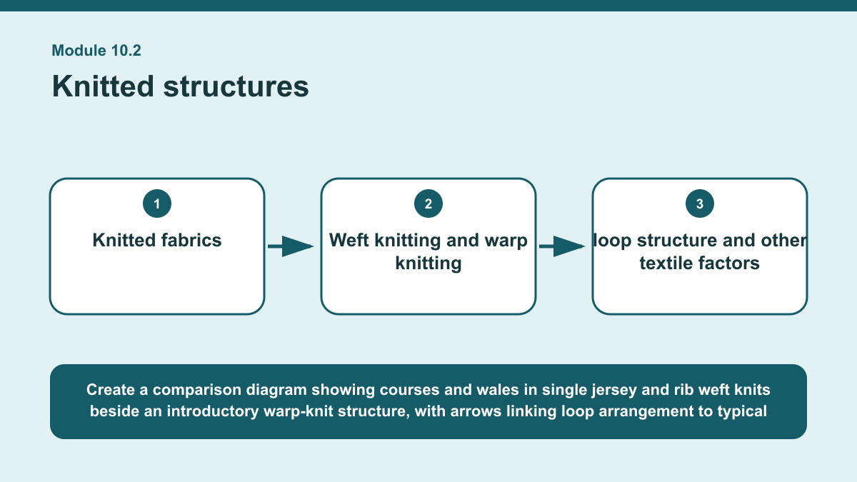
THEORY 2 OF 3
Knitted structures
01
01 Knitted fabrics are formed by interlooping yarn rather than interlacing separate warp and weft yarn systems.
02
02 The horizontal rows of loops are called courses, while the vertical columns are called wales.
03
03 Because loops can change shape and move in relation to one another, knitted structures commonly provide greater stretch, flexibility…
EVIDENCE Interpret evidence from a knitted structure and justify whether it would suit a stated requirement for movement or stability.
4
Notes:
Teach the named section, then ask students to point to evidence in the diagram before attempting the prompt.
[Sources]
- SRC-NESA-SYL-2013.
- m10-s02.json.
- Generated course diagram: m10-s02.png; source-bound visual brief: Create a comparison diagram showing courses and wales in single jersey and rib weft knits beside an introductory warp-knit structure, with arrows linking loop arrangement to typical stretch, flexibility, drape, stability, curling, laddering and shape-retention behaviour.

Slide 5
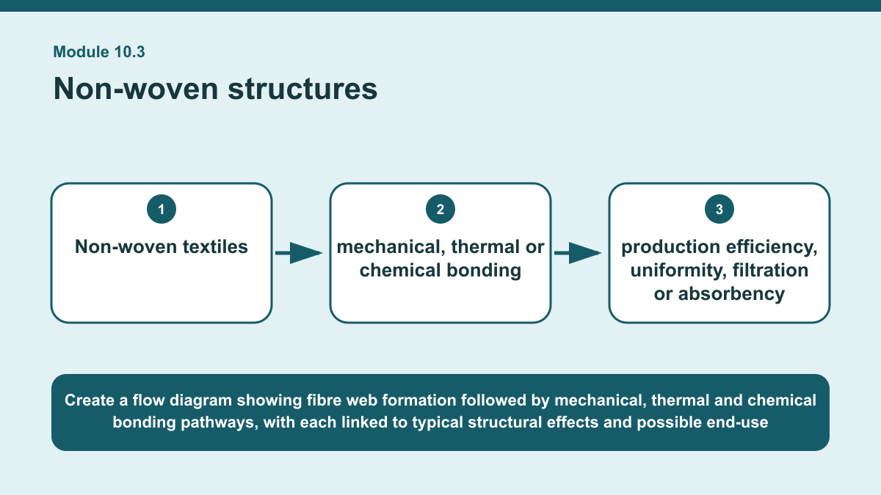
THEORY 3 OF 3
Non-woven structures
01 Non-woven textiles are formed by creating a web of fibres and bonding that web without first making yarn.
02 Fibres may be arranged randomly or in a more controlled direction before bonding.
03 Because yarn formation can be bypassed, non-woven production can be relatively efficient, but the resulting properties depend…
EVIDENCE Compare two non-woven bonding approaches and justify which would be more suitable for a stated textile end use.
Create a flow diagram showing fibre web formation followed by mechanical, thermal and chemical bonding pathways, with each linked to typical structural effects and…
5
Notes:
Teach the named section, then ask students to point to evidence in the diagram before attempting the prompt.
[Sources]
- SRC-NESA-SYL-2013.
- m10-s03.json.
- Generated course diagram: m10-s03.png; source-bound visual brief: Create a flow diagram showing fibre web formation followed by mechanical, thermal and chemical bonding pathways, with each linked to typical structural effects and possible end-use requirements such as filtration, absorbency, uniformity, efficiency, disposability and drape.

Slide 6
Retrieve the relationships—not isolated definitions
Answer aloud or write one precise sentence for each prompt.
01
02
03
WOVEN STRUCTURES
What does a balanced woven appearance mean?
KNITTED STRUCTURES
Why can laddering occur in some knitted fabrics?
NON-WOVEN STRUCTURES
Why may some non-wovens have limited drape?
6
Notes:
Use these as formative retrieval prompts. Each is answerable from slides 3–5.
[Sources]
- Module 10 theory and knowledge checks.

Slide 7
Build a response that uses evidence
Prompt: Compare two non-woven bonding approaches and justify which would be more suitable for a stated textile…
READ
Identify the end-use requirements and two bonding approaches.
SELECT
Explain how each bonding approach joins the fibre web.
EXPLAIN
Compare relevant likely properties such as uniformity, flexibility,…
CHECK
Recommend the more suitable approach and justify the choice using…
Sentence starter: For an end use requiring ___, I would compare ___ bonding with ___ bonding. The first approach joins fibres by ___,…
7
Notes:
Model the response process without supplying a finished student submission.
[Sources]
- Module 10 written-response scaffold.
- Read → Select → Explain → Check course routine.

Slide 8
YOUR NEXT MOVE
Exit ticket: carry Module 10 evidence forward
1. Name one relationship from Module 10 you can now explain.
2. Save one supported response in My folio.
3. Complete the Module 10 applied-practice activity.
Notes:
Direct students to the Module 10 activity and My folio. No formal submission condition is asserted.
[Sources]
- Course route busy-work/activity-10.html.
- Course route folio.html.
- Course-owned image: textiles-design-workspace.png.

