Slide 1
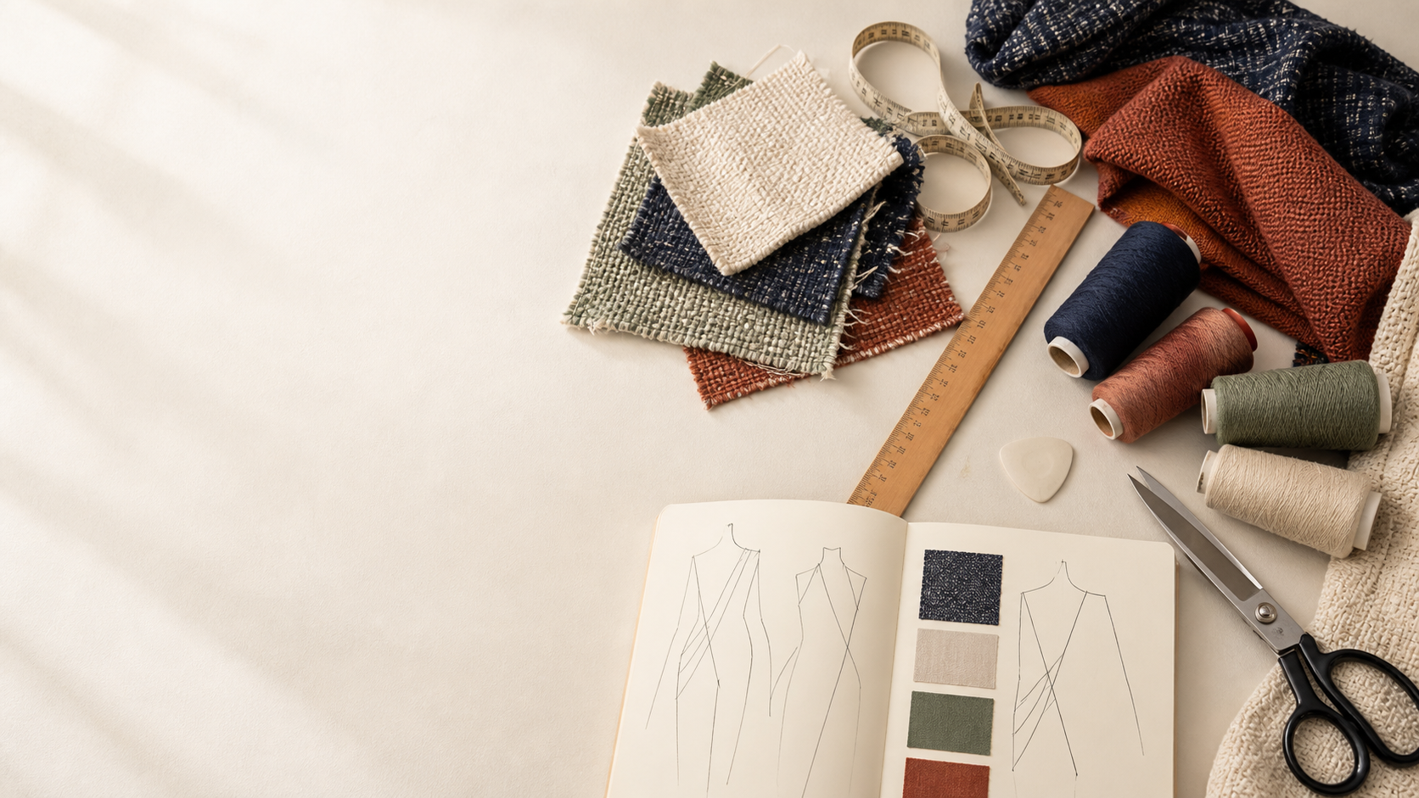
YEAR 11 TEXTILES AND DESIGN · MODULE 11 · WEEKS 21–22
Textile properties and testing
Use three connected ideas to explain, apply and justify the learning in Module 11.
BEFORE YOU BEGIN
What do you already know about textile properties and testing, and what evidence would show it?
Notes:
Introduce Module 11 and ask the retrieval prompt before showing the learning map.
[Sources]
- SRC-NESA-SYL-2013: Year 11 Preliminary Textiles and Design syllabus.
- THEORY-QUESTION-MANIFEST-v1: Module 11 named sections.
- Course-owned image: textiles-design-workspace.png.

Slide 2
Module 11: three connected ideas
Connect the three ideas, then justify one decision with evidence.
01
02
03
Properties and end use
Textile properties can be grouped into aesthetic, durability, comfort, stability and care characteristics.
Planning a fair textile test
A fair textile investigation begins by turning a property question into a testable aim .
Recording and interpreting results
Textile test results should be recorded in a clear and organised way.
2
Notes:
Use the three ideas as a cumulative learning pathway rather than an agenda.
[Sources]
- SRC-NESA-SYL-2013.
- Theory files m11-s01 to s03.

Slide 3
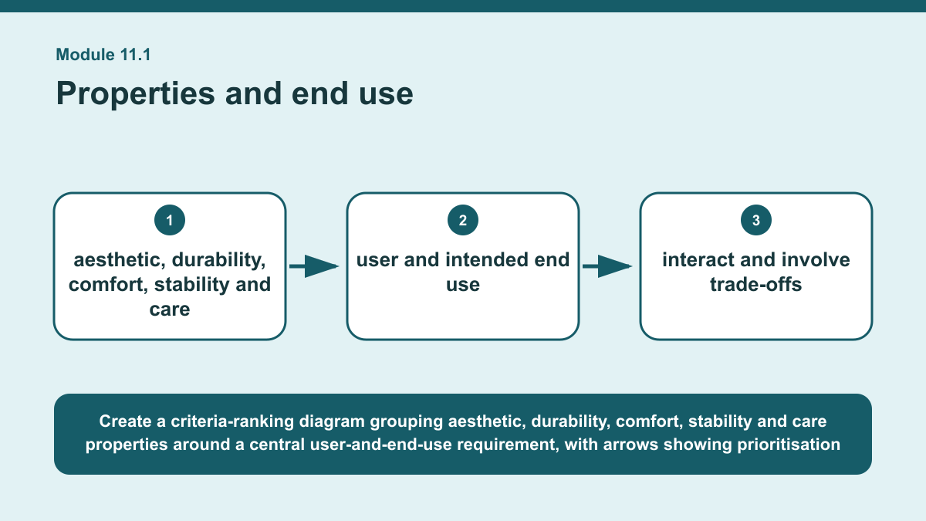
THEORY 1 OF 3
Properties and end use
01 Textile properties can be grouped into aesthetic, durability, comfort, stability and care characteristics.
02 Aesthetic properties include features such as lustre, handle and drape.
03 Durability includes properties such as strength and resistance to abrasion, while comfort can involve absorbency and thermal behaviour.
EVIDENCE Rank the textile properties that would be most important for one unfamiliar end use and justify your ranking using clear criteria.
Create a criteria-ranking diagram grouping aesthetic, durability, comfort, stability and care properties around a central user-and-end-use requirement, with arrows…
3
Notes:
Teach the named section, then ask students to point to evidence in the diagram before attempting the prompt.
[Sources]
- SRC-NESA-SYL-2013.
- m11-s01.json.
- Generated course diagram: m11-s01.png; source-bound visual brief: Create a criteria-ranking diagram grouping aesthetic, durability, comfort, stability and care properties around a central user-and-end-use requirement, with arrows showing prioritisation and possible trade-offs between competing properties.

Slide 4
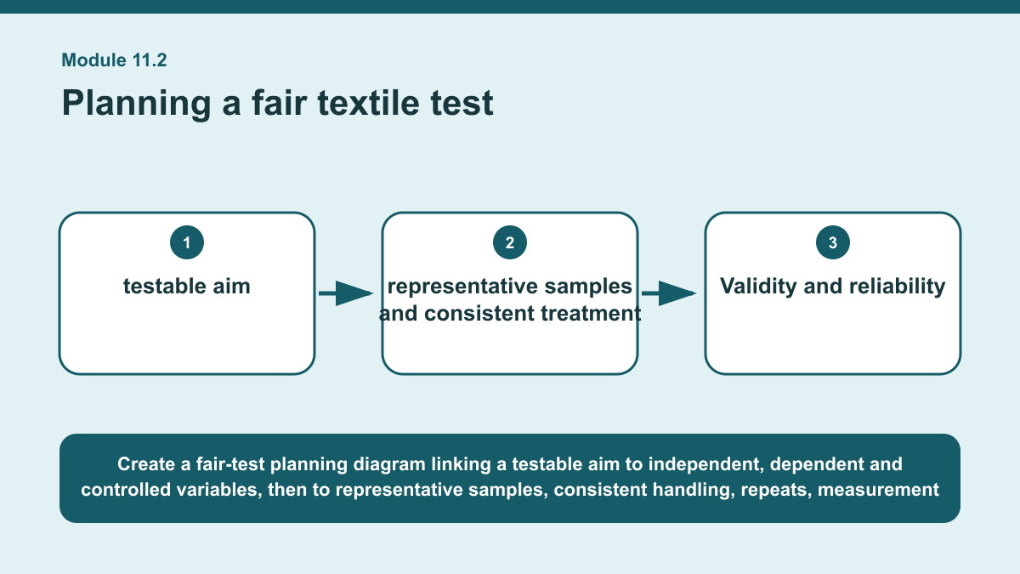
THEORY 2 OF 3
Planning a fair textile test
01
01 A fair textile investigation begins by turning a property question into a testable aim .
02
02 The aim should identify what is being changed and what will be measured.
03
03 The independent variable is the factor deliberately changed between samples, the dependent variable is the measured response, and…
EVIDENCE Design a fair comparative textile test plan at the conceptual level for investigating one property in two textile samples.
4
Notes:
Teach the named section, then ask students to point to evidence in the diagram before attempting the prompt.
[Sources]
- SRC-NESA-SYL-2013.
- m11-s02.json.
- Generated course diagram: m11-s02.png; source-bound visual brief: Create a fair-test planning diagram linking a testable aim to independent, dependent and controlled variables, then to representative samples, consistent handling, repeats, measurement with units, validity, reliability and a clearly repeatable method.

Slide 5
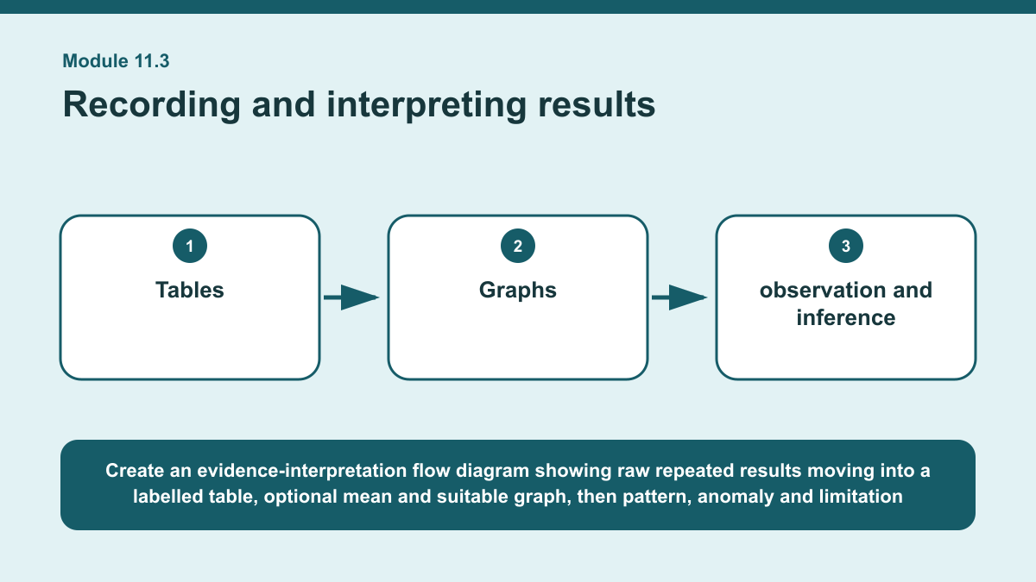
THEORY 3 OF 3
Recording and interpreting results
01 Textile test results should be recorded in a clear and organised way.
02 Tables should use descriptive headings and include units where measurements require them.
03 Repeated results can show variation between trials, while a summary measure such as the mean may be useful when it fairly represents…
EVIDENCE Interpret a simple set of textile test results and write a defensible conclusion that includes one identified pattern, one anomaly and one limitation.
Create an evidence-interpretation flow diagram showing raw repeated results moving into a labelled table, optional mean and suitable graph, then pattern, anomaly…
5
Notes:
Teach the named section, then ask students to point to evidence in the diagram before attempting the prompt.
[Sources]
- SRC-NESA-SYL-2013.
- m11-s03.json.
- Generated course diagram: m11-s03.png; source-bound visual brief: Create an evidence-interpretation flow diagram showing raw repeated results moving into a labelled table, optional mean and suitable graph, then pattern, anomaly and limitation identification before a conclusion that directly answers the original aim.

Slide 6
Retrieve the relationships—not isolated definitions
Answer aloud or write one precise sentence for each prompt.
01
02
03
PROPERTIES AND END USE
What should guide the selection of textile properties for an unfamiliar end use?
PLANNING A FAIR TEXTILE TEST
What best supports reliability?
RECORDING AND INTERPRETING RESULTS
Why should limitations be included when interpreting results?
6
Notes:
Use these as formative retrieval prompts. Each is answerable from slides 3–5.
[Sources]
- Module 11 theory and knowledge checks.

Slide 7
Build a response that uses evidence
Prompt: Interpret a simple set of textile test results and write a defensible conclusion that includes one…
READ
Identify the main pattern or comparison shown by the results.
SELECT
Identify one anomaly and explain why it stands out.
EXPLAIN
State one limitation that may affect confidence in the interpretation.
CHECK
Write a conclusion that answers the aim and stays within the evidence.
Sentence starter: The main pattern in the results is ___. One anomalous result is ___ because ___. A possible limitation is ___, which…
7
Notes:
Model the response process without supplying a finished student submission.
[Sources]
- Module 11 written-response scaffold.
- Read → Select → Explain → Check course routine.

Slide 8
YOUR NEXT MOVE
Exit ticket: carry Module 11 evidence forward
1. Name one relationship from Module 11 you can now explain.
2. Save one supported response in My folio.
3. Complete the Module 11 applied-practice activity.
Notes:
Direct students to the Module 11 activity and My folio. No formal submission condition is asserted.
[Sources]
- Course route busy-work/activity-11.html.
- Course route folio.html.
- Course-owned image: textiles-design-workspace.png.

