Slide 1
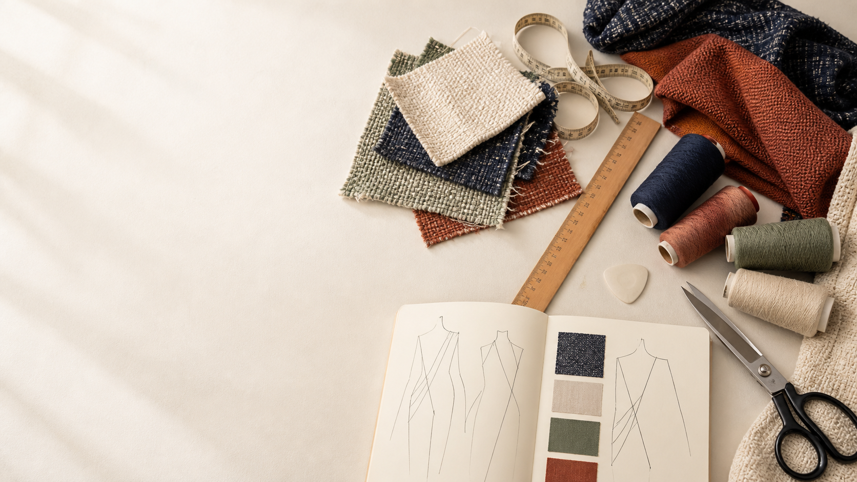
YEAR 11 TEXTILES AND DESIGN · MODULE 12 · WEEKS 23–24
Textile Project 2 evidence
Use three connected ideas to explain, apply and justify the learning in Module 12.
BEFORE YOU BEGIN
What do you already know about textile project 2 evidence, and what evidence would show it?
Notes:
Introduce Module 12 and ask the retrieval prompt before showing the learning map.
[Sources]
- SRC-NESA-SYL-2013: Year 11 Preliminary Textiles and Design syllabus.
- THEORY-QUESTION-MANIFEST-v1: Module 12 named sections.
- Course-owned image: textiles-design-workspace.png.

Slide 2
Module 12: three connected ideas
Connect the three ideas, then justify one decision with evidence.
01
02
03
Analysing experimental evidence
Experimental evidence can be used to compare textile materials and judge how well they meet relevant performance…
Fabric selection and design
Fabric selection begins by translating user and end-use needs into clear criteria .
Project evidence and evaluation
Strong project evidence forms a traceable chain from the original brief and research through experimentation,…
2
Notes:
Use the three ideas as a cumulative learning pathway rather than an agenda.
[Sources]
- SRC-NESA-SYL-2013.
- Theory files m12-s01 to s03.

Slide 3
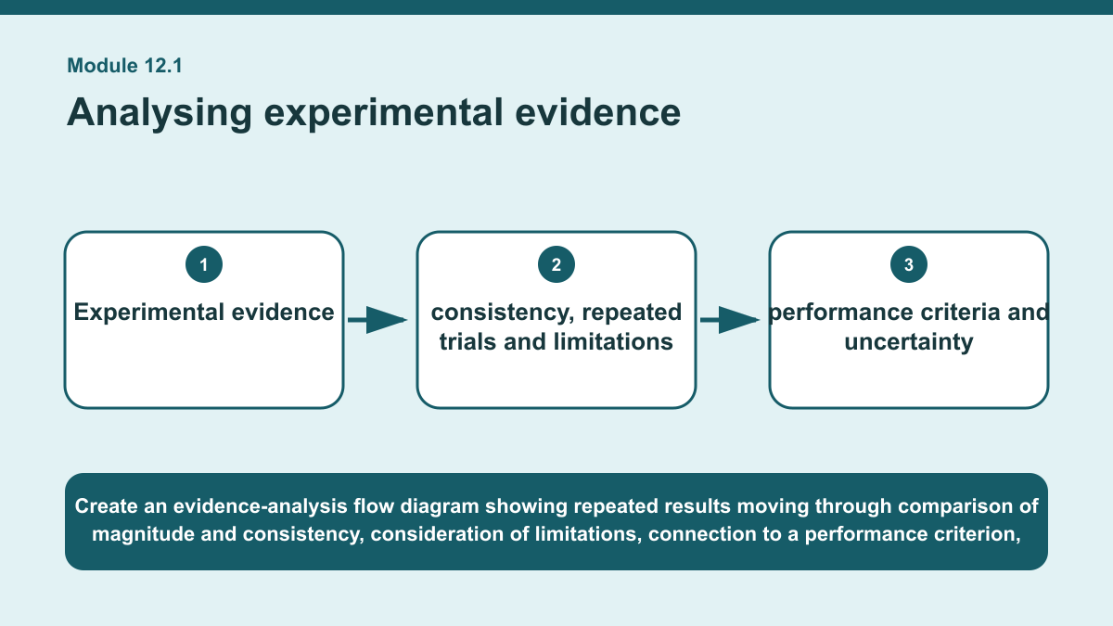
THEORY 1 OF 3
Analysing experimental evidence
01 Experimental evidence can be used to compare textile materials and judge how well they meet relevant performance criteria.
02 A useful comparison considers not only which material produced the higher or lower result, but also the magnitude of the difference.
03 A small difference may be less meaningful than a large, consistent difference, so results should be interpreted in relation to the…
EVIDENCE Make a comparative claim about two textile materials using supplied test evidence, then include one limitation and a cautious final judgement.
Create an evidence-analysis flow diagram showing repeated results moving through comparison of magnitude and consistency, consideration of limitations, connection…
3
Notes:
Teach the named section, then ask students to point to evidence in the diagram before attempting the prompt.
[Sources]
- SRC-NESA-SYL-2013.
- m12-s01.json.
- Generated course diagram: m12-s01.png; source-bound visual brief: Create an evidence-analysis flow diagram showing repeated results moving through comparison of magnitude and consistency, consideration of limitations, connection to a performance criterion, reporting of uncertainty and a cautious judgement with further evidence identified.

Slide 4
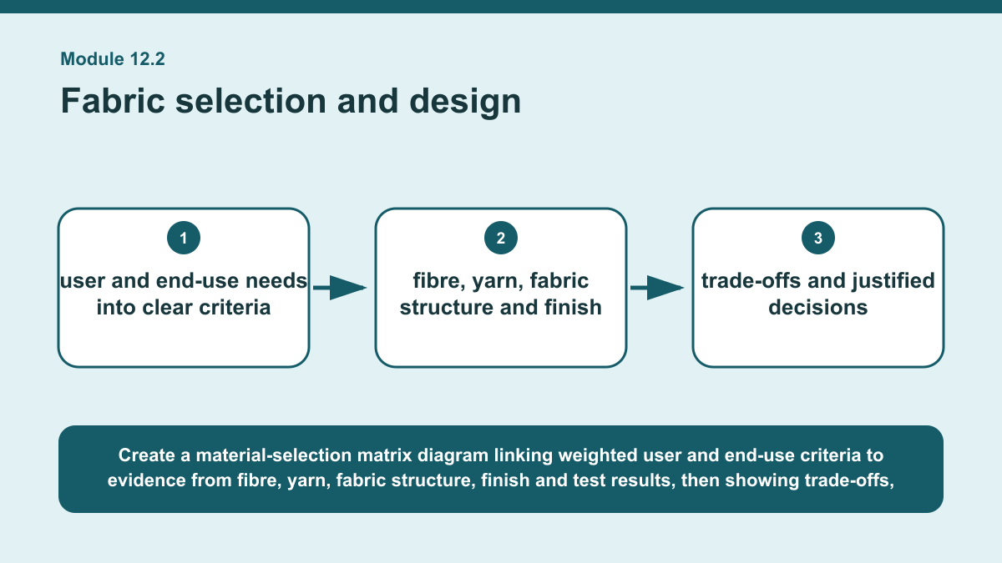
THEORY 2 OF 3
Fabric selection and design
01
01 Fabric selection begins by translating user and end-use needs into clear criteria .
02
02 Some criteria will matter more than others, so they can be weighted or prioritised according to the demands of the design.
03
03 Performance requirements may include characteristics such as durability, comfort, stability or care, while aesthetic requirements may…
EVIDENCE Explain a material-selection matrix comparing several fabric options and make an evidence-based recommendation for a stated user and end use.
4
Notes:
Teach the named section, then ask students to point to evidence in the diagram before attempting the prompt.
[Sources]
- SRC-NESA-SYL-2013.
- m12-s02.json.
- Generated course diagram: m12-s02.png; source-bound visual brief: Create a material-selection matrix diagram linking weighted user and end-use criteria to evidence from fibre, yarn, fabric structure, finish and test results, then showing trade-offs, rejected alternatives and a final justified fabric recommendation.

Slide 5
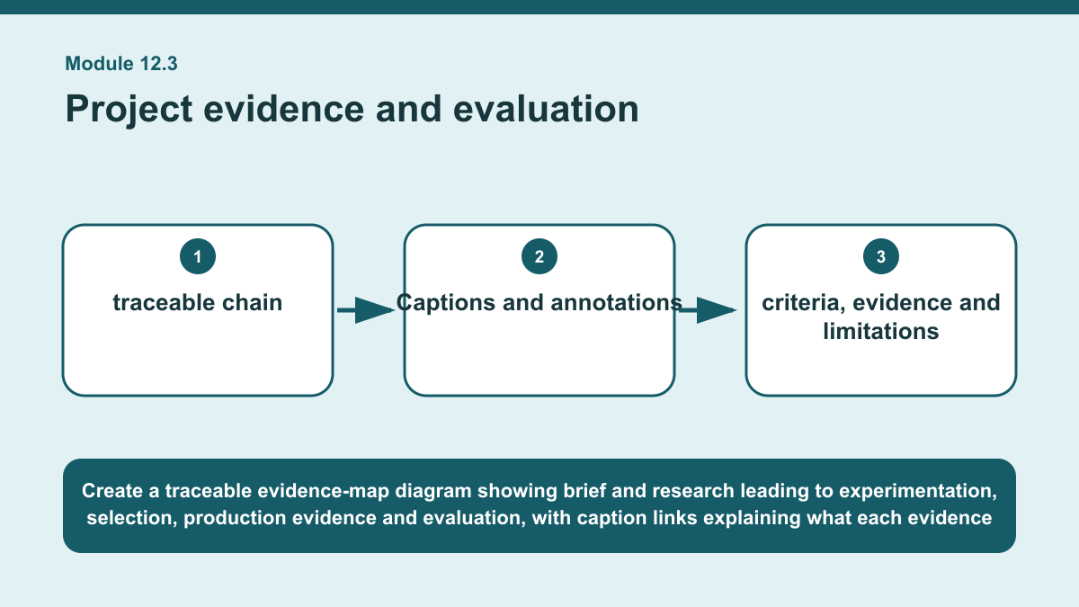
THEORY 3 OF 3
Project evidence and evaluation
01 Strong project evidence forms a traceable chain from the original brief and research through experimentation, selection, production…
02 Each stage should show how information influenced later decisions.
03 The aim is not to collect everything, but to keep evidence that helps explain what was considered, what changed and why particular…
EVIDENCE Create an evidence map for a textile project showing what evidence should be kept and how each item would support the final judgement.
Create a traceable evidence-map diagram showing brief and research leading to experimentation, selection, production evidence and evaluation, with caption links…
5
Notes:
Teach the named section, then ask students to point to evidence in the diagram before attempting the prompt.
[Sources]
- SRC-NESA-SYL-2013.
- m12-s03.json.
- Generated course diagram: m12-s03.png; source-bound visual brief: Create a traceable evidence-map diagram showing brief and research leading to experimentation, selection, production evidence and evaluation, with caption links explaining what each evidence item shows, why it matters and which final judgement it supports.

Slide 6
Retrieve the relationships—not isolated definitions
Answer aloud or write one precise sentence for each prompt.
01
02
03
ANALYSING EXPERIMENTAL EVIDENCE
What makes a comparative claim strong?
FABRIC SELECTION AND DESIGN
Why should rejected alternatives be recorded?
PROJECT EVIDENCE AND EVALUATION
What is the main difference between project evidence and a decorative scrapbook?
6
Notes:
Use these as formative retrieval prompts. Each is answerable from slides 3–5.
[Sources]
- Module 12 theory and knowledge checks.

Slide 7
Build a response that uses evidence
Prompt: Create an evidence map for a textile project showing what evidence should be kept and how each item…
READ
Identify one useful evidence item from each major stage of the…
SELECT
Explain what each item shows about the project's development.
EXPLAIN
Link each item to a decision, criterion or change.
CHECK
Explain how the collected evidence supports a balanced final…
Sentence starter: I would keep ___ from the research stage because it shows ___. From experimentation, I would keep ___ because it…
7
Notes:
Model the response process without supplying a finished student submission.
[Sources]
- Module 12 written-response scaffold.
- Read → Select → Explain → Check course routine.

Slide 8
YOUR NEXT MOVE
Exit ticket: carry Module 12 evidence forward
1. Name one relationship from Module 12 you can now explain.
2. Save one supported response in My folio.
3. Complete the Module 12 applied-practice activity.
Notes:
Direct students to the Module 12 activity and My folio. No formal submission condition is asserted.
[Sources]
- Course route busy-work/activity-12.html.
- Course route folio.html.
- Course-owned image: textiles-design-workspace.png.

