Slide 1
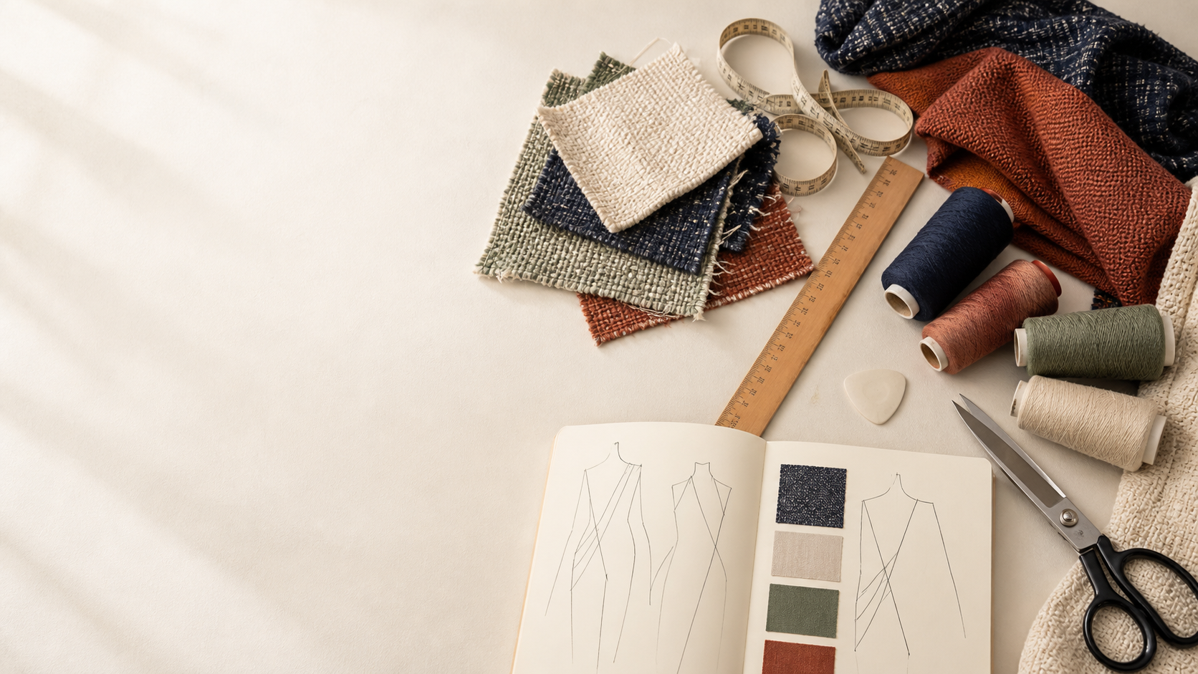
YEAR 11 TEXTILES AND DESIGN · MODULE 13 · WEEKS 25–26
Industry and careers
Use three connected ideas to explain, apply and justify the learning in Module 13.
BEFORE YOU BEGIN
What do you already know about industry and careers, and what evidence would show it?
Notes:
Introduce Module 13 and ask the retrieval prompt before showing the learning map.
[Sources]
- SRC-NESA-SYL-2013: Year 11 Preliminary Textiles and Design syllabus.
- THEORY-QUESTION-MANIFEST-v1: Module 13 named sections.
- Course-owned image: textiles-design-workspace.png.

Slide 2
Module 13: three connected ideas
Connect the three ideas, then justify one decision with evidence.
01
02
03
Industry development and sectors
The Australian textile, clothing, footwear and related products industry can be understood as an interconnected value…
Local and global context
Textile products can move through global supply networks that connect raw materials, processing, manufacture,…
Careers and training
The textiles, clothing, footwear and related products industry includes many different roles across design, pattern…
2
Notes:
Use the three ideas as a cumulative learning pathway rather than an agenda.
[Sources]
- SRC-NESA-SYL-2013.
- Theory files m13-s01 to s03.

Slide 3
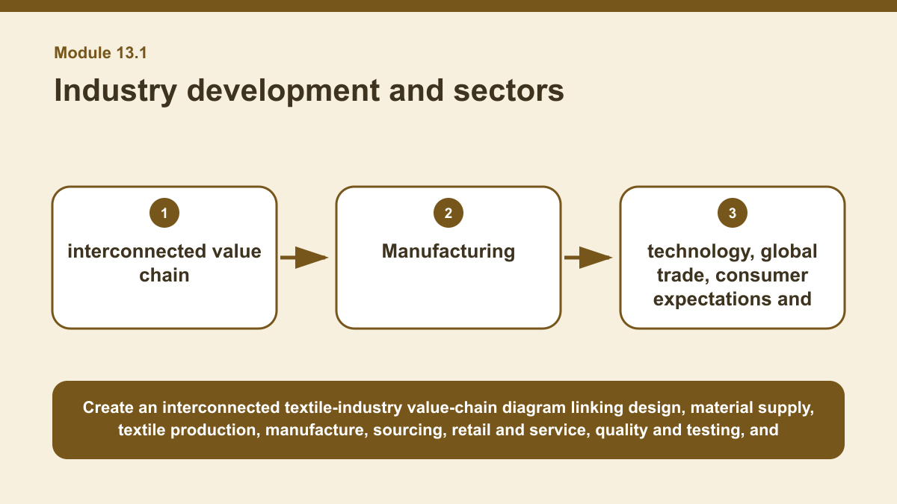
THEORY 1 OF 3
Industry development and sectors
01 The Australian textile, clothing, footwear and related products industry can be understood as an interconnected value chain .
02 Different sectors contribute at different stages, including design, fibre and material supply, textile production, product…
03 Decisions made in one part of the chain can affect requirements, costs, materials, timing and work in other parts.
EVIDENCE Analyse how one change in the textile industry could affect at least three connected parts of the value chain.
Create an interconnected textile-industry value-chain diagram linking design, material supply, textile production, manufacture, sourcing, retail and service,…
3
Notes:
Teach the named section, then ask students to point to evidence in the diagram before attempting the prompt.
[Sources]
- SRC-NESA-SYL-2013.
- m13-s01.json.
- Generated course diagram: m13-s01.png; source-bound visual brief: Create an interconnected textile-industry value-chain diagram linking design, material supply, textile production, manufacture, sourcing, retail and service, quality and testing, and recycling or circular activity, with technology, global trade, consumer expectations and sustainability shown as forces that can influence multiple sectors.

Slide 4
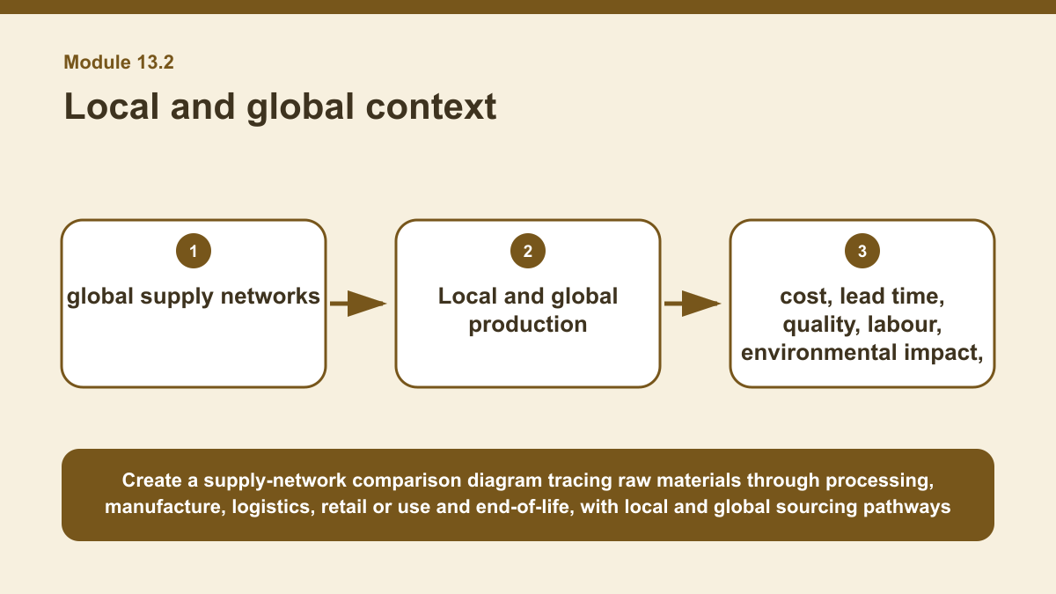
THEORY 2 OF 3
Local and global context
01
01 Textile products can move through global supply networks that connect raw materials, processing, manufacture, logistics, retail or…
02
02 These stages may occur in different locations and involve several organisations.
03
03 Understanding the supply network helps explain where materials come from, how products move between stages and where decisions about…
EVIDENCE Compare two sourcing approaches for a textile product and make a supported judgement about which would be more suitable.
4
Notes:
Teach the named section, then ask students to point to evidence in the diagram before attempting the prompt.
[Sources]
- SRC-NESA-SYL-2013.
- m13-s02.json.
- Generated course diagram: m13-s02.png; source-bound visual brief: Create a supply-network comparison diagram tracing raw materials through processing, manufacture, logistics, retail or use and end-of-life, with local and global sourcing pathways compared against cost, lead time, quality, labour, environmental impact, resilience and transparency.

Slide 5
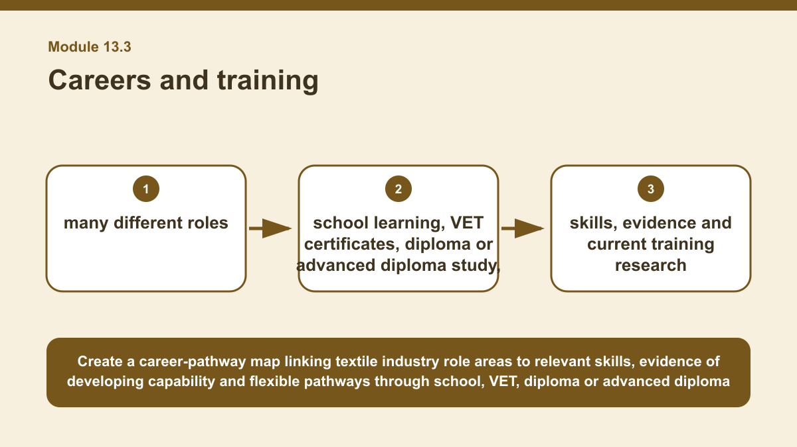
THEORY 3 OF 3
Careers and training
01 The textiles, clothing, footwear and related products industry includes many different roles across design, pattern and product…
02 These roles can require different combinations of creative, technical, communication, problem-solving and organisational skills.
03 Career planning therefore begins by understanding what a role involves and identifying the skills and knowledge that support that work.
EVIDENCE Create a realistic pathway map for one textile industry role, linking the role to relevant skills, evidence of developing capability and current…
Create a career-pathway map linking textile industry role areas to relevant skills, evidence of developing capability and flexible pathways through school, VET,…
5
Notes:
Teach the named section, then ask students to point to evidence in the diagram before attempting the prompt.
[Sources]
- SRC-NESA-SYL-2013.
- m13-s03.json.
- Generated course diagram: m13-s03.png; source-bound visual brief: Create a career-pathway map linking textile industry role areas to relevant skills, evidence of developing capability and flexible pathways through school, VET, diploma or advanced diploma study, university and workplace experience, ending with a checkpoint to verify current provider requirements.

Slide 6
Retrieve the relationships—not isolated definitions
Answer aloud or write one precise sentence for each prompt.
01
02
03
INDUSTRY DEVELOPMENT AND SECTORS
Why can a change in one industry sector affect several others?
LOCAL AND GLOBAL CONTEXT
Why is 'local is always better for the environment' a weak claim?
CAREERS AND TRAINING
Why should a career pathway remain flexible?
6
Notes:
Use these as formative retrieval prompts. Each is answerable from slides 3–5.
[Sources]
- Module 13 theory and knowledge checks.

Slide 7
Build a response that uses evidence
Prompt: Create a realistic pathway map for one textile industry role, linking the role to relevant skills,…
READ
Identify the role and the main skills it may require.
SELECT
Identify evidence that could demonstrate developing capability in…
EXPLAIN
Map possible learning stages such as school, VET, further study,…
CHECK
State which current training and provider requirements would need to…
Sentence starter: The role I am investigating is ___. Relevant skills may include ___. Evidence of developing capability could include…
7
Notes:
Model the response process without supplying a finished student submission.
[Sources]
- Module 13 written-response scaffold.
- Read → Select → Explain → Check course routine.

Slide 8
YOUR NEXT MOVE
Exit ticket: carry Module 13 evidence forward
1. Name one relationship from Module 13 you can now explain.
2. Save one supported response in My folio.
3. Complete the Module 13 applied-practice activity.
Notes:
Direct students to the Module 13 activity and My folio. No formal submission condition is asserted.
[Sources]
- Course route busy-work/activity-13.html.
- Course route folio.html.
- Course-owned image: textiles-design-workspace.png.

