Slide 1
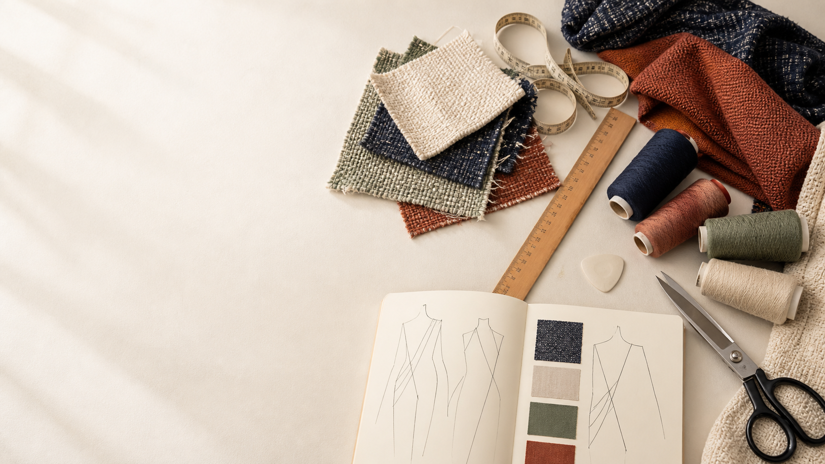
YEAR 11 TEXTILES AND DESIGN · MODULE 14 · WEEKS 27–28
Quality and value
Use three connected ideas to explain, apply and justify the learning in Module 14.
BEFORE YOU BEGIN
What do you already know about quality and value, and what evidence would show it?
Notes:
Introduce Module 14 and ask the retrieval prompt before showing the learning map.
[Sources]
- SRC-NESA-SYL-2013: Year 11 Preliminary Textiles and Design syllabus.
- THEORY-QUESTION-MANIFEST-v1: Module 14 named sections.
- Course-owned image: textiles-design-workspace.png.

Slide 2
Module 14: three connected ideas
Connect the three ideas, then justify one decision with evidence.
01
02
03
Quality assurance and control
Quality means fitness for purpose when a textile material, process or product is judged against relevant criteria.
Manufacturer and consumer roles
Manufacturers have responsibilities for defining product specifications, selecting suitable materials and production…
Perceived, cultural and economic value
Perceived value is the worth people believe a textile product has based on factors such as expectations, brand,…
2
Notes:
Use the three ideas as a cumulative learning pathway rather than an agenda.
[Sources]
- SRC-NESA-SYL-2013.
- Theory files m14-s01 to s03.

Slide 3
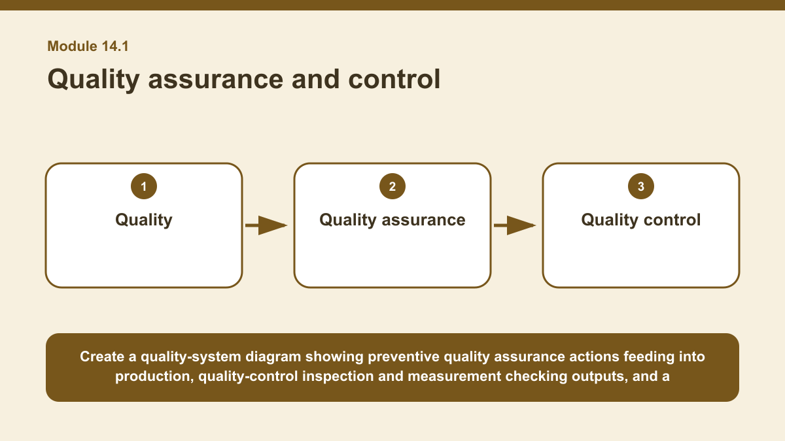
THEORY 1 OF 3
Quality assurance and control
01 Quality means fitness for purpose when a textile material, process or product is judged against relevant criteria.
02 Quality criteria describe what needs to be achieved, such as particular performance, consistency or design requirements.
03 Quality is therefore not simply a judgement that something looks good; it depends on whether the required criteria for the intended…
EVIDENCE Classify a set of quality actions as quality assurance or quality control, then develop a combined quality plan that uses both approaches.
Create a quality-system diagram showing preventive quality assurance actions feeding into production, quality-control inspection and measurement checking outputs,…
3
Notes:
Teach the named section, then ask students to point to evidence in the diagram before attempting the prompt.
[Sources]
- SRC-NESA-SYL-2013.
- m14-s01.json.
- Generated course diagram: m14-s01.png; source-bound visual brief: Create a quality-system diagram showing preventive quality assurance actions feeding into production, quality-control inspection and measurement checking outputs, and a corrective-action loop using records to trace causes back into the assurance system.

Slide 4
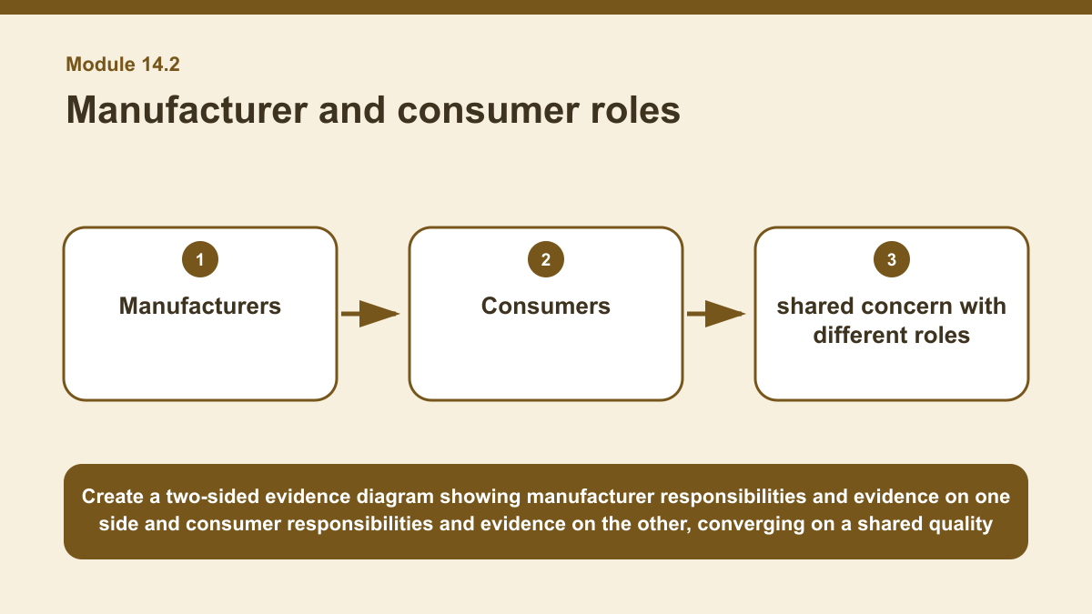
THEORY 2 OF 3
Manufacturer and consumer roles
01
01 Manufacturers have responsibilities for defining product specifications, selecting suitable materials and production processes,…
02
02 Labels and care information help communicate important details about the textile product, while records and quality systems can help…
03
03 When a problem is identified, the manufacturer may need to respond according to the responsibilities that apply to the product and…
EVIDENCE Evaluate the evidence available to both a manufacturer and a consumer when judging the quality of one textile product.
4
Notes:
Teach the named section, then ask students to point to evidence in the diagram before attempting the prompt.
[Sources]
- SRC-NESA-SYL-2013.
- m14-s02.json.
- Generated course diagram: m14-s02.png; source-bound visual brief: Create a two-sided evidence diagram showing manufacturer responsibilities and evidence on one side and consumer responsibilities and evidence on the other, converging on a shared quality judgement based on specifications, labels, construction, care information and observed performance rather than advertising alone.

Slide 5
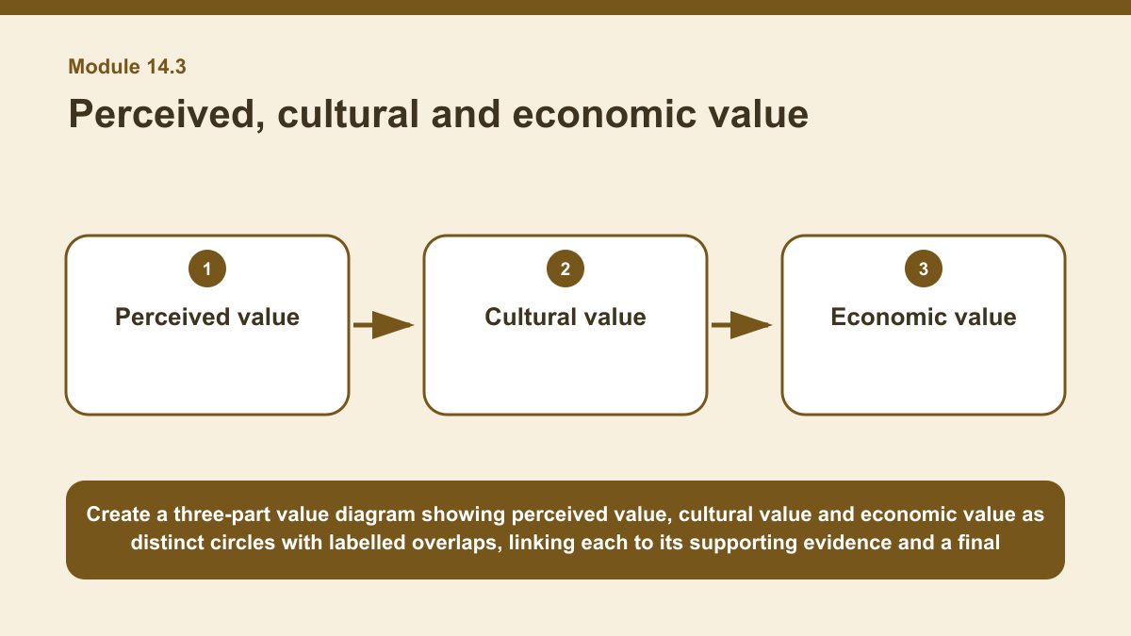
THEORY 3 OF 3
Perceived, cultural and economic value
01 Perceived value is the worth people believe a textile product has based on factors such as expectations, brand, presentation, rarity…
02 This value is not necessarily the same as production cost or measurable quality.
03 A product may be perceived as highly valuable because of how it is presented or understood, while another product with similar…
EVIDENCE Analyse how perceived, cultural and economic value interact in one textile example.
Create a three-part value diagram showing perceived value, cultural value and economic value as distinct circles with labelled overlaps, linking each to its…
5
Notes:
Teach the named section, then ask students to point to evidence in the diagram before attempting the prompt.
[Sources]
- SRC-NESA-SYL-2013.
- m14-s03.json.
- Generated course diagram: m14-s03.png; source-bound visual brief: Create a three-part value diagram showing perceived value, cultural value and economic value as distinct circles with labelled overlaps, linking each to its supporting evidence and a final supported judgement.

Slide 6
Retrieve the relationships—not isolated definitions
Answer aloud or write one precise sentence for each prompt.
01
02
03
QUALITY ASSURANCE AND CONTROL
Why are records important in a quality system?
MANUFACTURER AND CONSUMER ROLES
How are manufacturer and consumer roles best described?
PERCEIVED, CULTURAL AND ECONOMIC VALUE
What makes a judgement about cultural value stronger?
6
Notes:
Use these as formative retrieval prompts. Each is answerable from slides 3–5.
[Sources]
- Module 14 theory and knowledge checks.

Slide 7
Build a response that uses evidence
Prompt: Analyse how perceived, cultural and economic value interact in one textile example.
READ
Identify the textile example and evidence of its perceived value.
SELECT
Explain any cultural value using appropriate contextual evidence…
EXPLAIN
Analyse economic factors such as materials, labour, cost,…
CHECK
Explain how the three value types interact while keeping them…
Sentence starter: The textile has perceived value because ___. Its cultural value may relate to ___, supported by ___. Its economic…
7
Notes:
Model the response process without supplying a finished student submission.
[Sources]
- Module 14 written-response scaffold.
- Read → Select → Explain → Check course routine.

Slide 8
YOUR NEXT MOVE
Exit ticket: carry Module 14 evidence forward
1. Name one relationship from Module 14 you can now explain.
2. Save one supported response in My folio.
3. Complete the Module 14 applied-practice activity.
Notes:
Direct students to the Module 14 activity and My folio. No formal submission condition is asserted.
[Sources]
- Course route busy-work/activity-14.html.
- Course route folio.html.
- Course-owned image: textiles-design-workspace.png.

