Slide 1
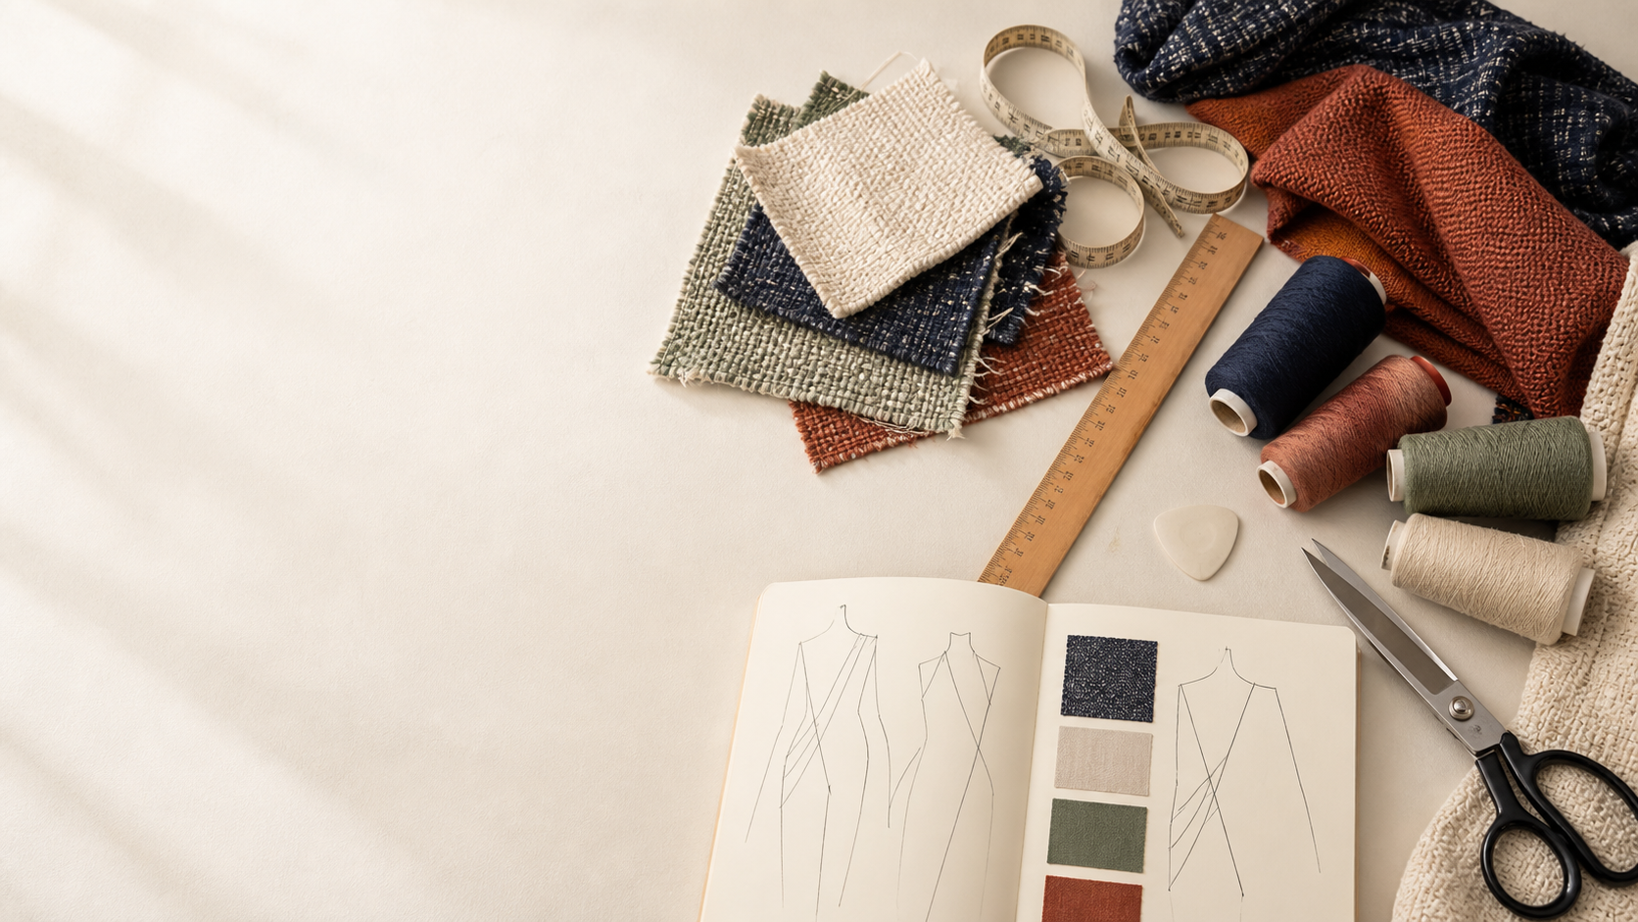
YEAR 11 TEXTILES AND DESIGN · MODULE 15 · WEEKS 29–30
Preliminary revision
Use three connected ideas to explain, apply and justify the learning in Module 15.
BEFORE YOU BEGIN
What do you already know about preliminary revision, and what evidence would show it?
Notes:
Introduce Module 15 and ask the retrieval prompt before showing the learning map.
[Sources]
- SRC-NESA-SYL-2013: Year 11 Preliminary Textiles and Design syllabus.
- THEORY-QUESTION-MANIFEST-v1: Module 15 named sections.
- Course-owned image: textiles-design-workspace.png.

Slide 2
Module 15: three connected ideas
Connect the three ideas, then justify one decision with evidence.
01
02
03
Knowledge retrieval
Retrieval practice strengthens recall by bringing information to mind before looking back at notes or theory.
Command terms and response planning
Command terms tell you what type of thinking and response is required.
Course synthesis
Course synthesis means connecting ideas across Design, Properties and Performance, and ATCFAI rather than treating…
2
Notes:
Use the three ideas as a cumulative learning pathway rather than an agenda.
[Sources]
- SRC-NESA-SYL-2013.
- Theory files m15-s01 to s03.

Slide 3
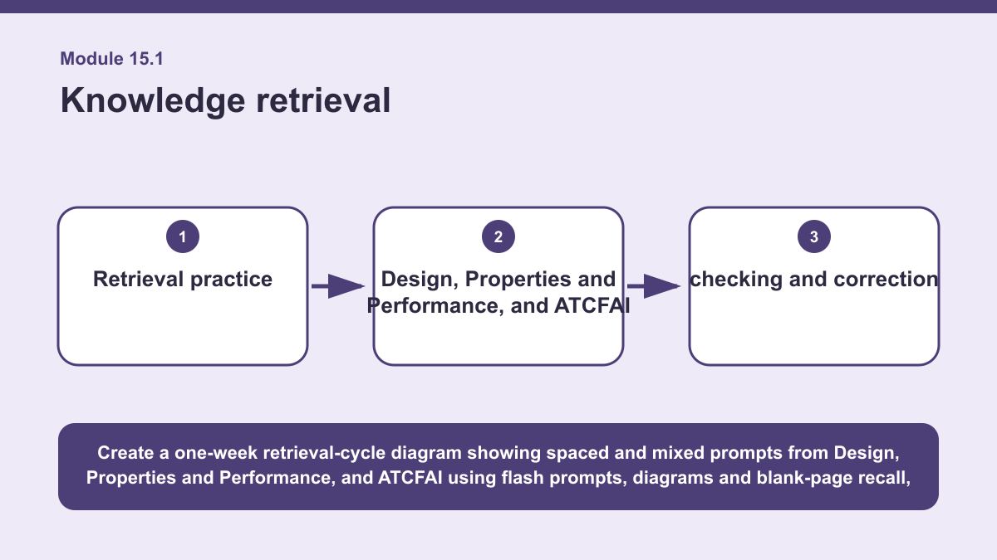
THEORY 1 OF 3
Knowledge retrieval
01 Retrieval practice strengthens recall by bringing information to mind before looking back at notes or theory.
02 Instead of beginning with rereading, students first attempt to remember, explain, classify or sketch what they know.
03 Retrieval can be spaced across several study sessions, mixed across different topics and kept low stakes so that mistakes become…
EVIDENCE Create a one-week retrieval plan that mixes Design, Properties and Performance, and ATCFAI and includes checking and correction of misunderstandings.
Create a one-week retrieval-cycle diagram showing spaced and mixed prompts from Design, Properties and Performance, and ATCFAI using flash prompts, diagrams and…
3
Notes:
Teach the named section, then ask students to point to evidence in the diagram before attempting the prompt.
[Sources]
- SRC-NESA-SYL-2013.
- m15-s01.json.
- Generated course diagram: m15-s01.png; source-bound visual brief: Create a one-week retrieval-cycle diagram showing spaced and mixed prompts from Design, Properties and Performance, and ATCFAI using flash prompts, diagrams and blank-page recall, with each session feeding into check, correct and return stages.

Slide 4
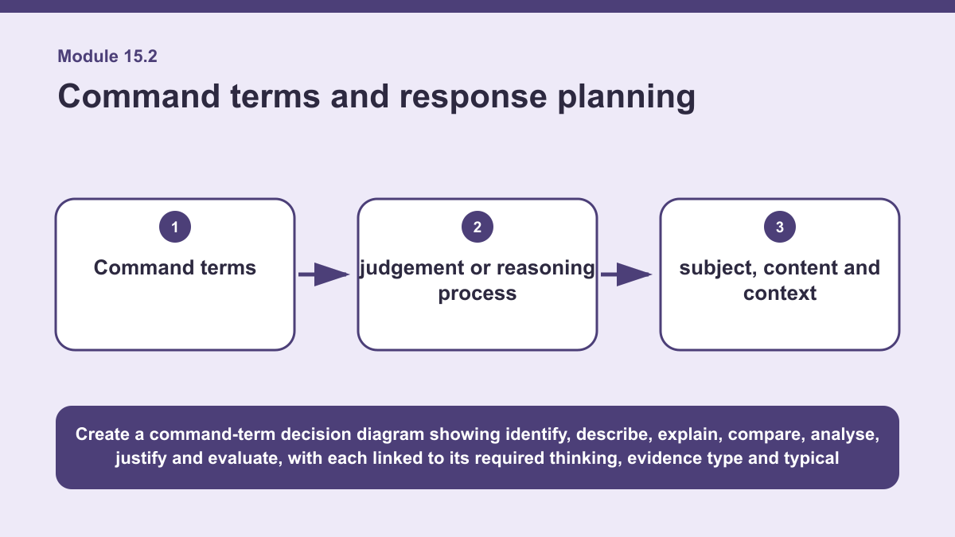
THEORY 2 OF 3
Command terms and response planning
01
01 Command terms tell you what type of thinking and response is required.
02
02 Identify means name or recognise relevant information.
03
03 Describe means give the main features or characteristics.
EVIDENCE Plan two responses to the same textile stimulus using two different command terms.
4
Notes:
Teach the named section, then ask students to point to evidence in the diagram before attempting the prompt.
[Sources]
- SRC-NESA-SYL-2013.
- m15-s02.json.
- Generated course diagram: m15-s02.png; source-bound visual brief: Create a command-term decision diagram showing identify, describe, explain, compare, analyse, justify and evaluate, with each linked to its required thinking, evidence type and typical response structure.

Slide 5
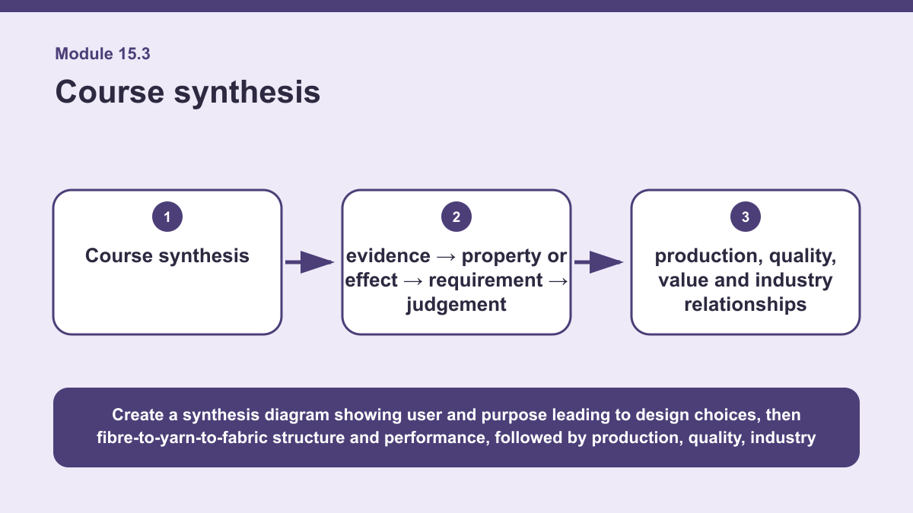
THEORY 3 OF 3
Course synthesis
01 Course synthesis means connecting ideas across Design, Properties and Performance, and ATCFAI rather than treating each area as…
02 A textile product begins with a user, purpose and set of requirements that influence design choices.
03 Those choices connect with fibre, yarn and fabric structure, which in turn influence properties and likely performance.
EVIDENCE Write a synthetic response about one unfamiliar textile product that links Design, Properties and Performance, and ATCFAI in a supported judgement.
Create a synthesis diagram showing user and purpose leading to design choices, then fibre-to-yarn-to-fabric structure and performance, followed by production,…
5
Notes:
Teach the named section, then ask students to point to evidence in the diagram before attempting the prompt.
[Sources]
- SRC-NESA-SYL-2013.
- m15-s03.json.
- Generated course diagram: m15-s03.png; source-bound visual brief: Create a synthesis diagram showing user and purpose leading to design choices, then fibre-to-yarn-to-fabric structure and performance, followed by production, quality, industry and value, all connected through an evidence-to-effect-to-requirement-to-judgement reasoning chain.

Slide 6
Retrieve the relationships—not isolated definitions
Answer aloud or write one precise sentence for each prompt.
01
02
03
KNOWLEDGE RETRIEVAL
Why should corrected ideas be retrieved again later?
COMMAND TERMS AND RESPONSE PLANNING
Why is planning before writing useful?
COURSE SYNTHESIS
What makes a synthetic judgement strong?
6
Notes:
Use these as formative retrieval prompts. Each is answerable from slides 3–5.
[Sources]
- Module 15 theory and knowledge checks.

Slide 7
Build a response that uses evidence
Prompt: Write a synthetic response about one unfamiliar textile product that links Design, Properties and…
READ
Identify the user, purpose and main design requirements of the…
SELECT
Use fibre, yarn, fabric or finish evidence to explain likely…
EXPLAIN
Connect the product to production, quality, industry or value…
CHECK
Bring the evidence together using an…
Sentence starter: The textile product is intended for ___, so the main requirements are ___. Evidence from its fibre, yarn or fabric…
7
Notes:
Model the response process without supplying a finished student submission.
[Sources]
- Module 15 written-response scaffold.
- Read → Select → Explain → Check course routine.

Slide 8
YOUR NEXT MOVE
Exit ticket: carry Module 15 evidence forward
1. Name one relationship from Module 15 you can now explain.
2. Save one supported response in My folio.
3. Complete the Module 15 applied-practice activity.
Notes:
Direct students to the Module 15 activity and My folio. No formal submission condition is asserted.
[Sources]
- Course route busy-work/activity-15.html.
- Course route folio.html.
- Course-owned image: textiles-design-workspace.png.

