Slide 1
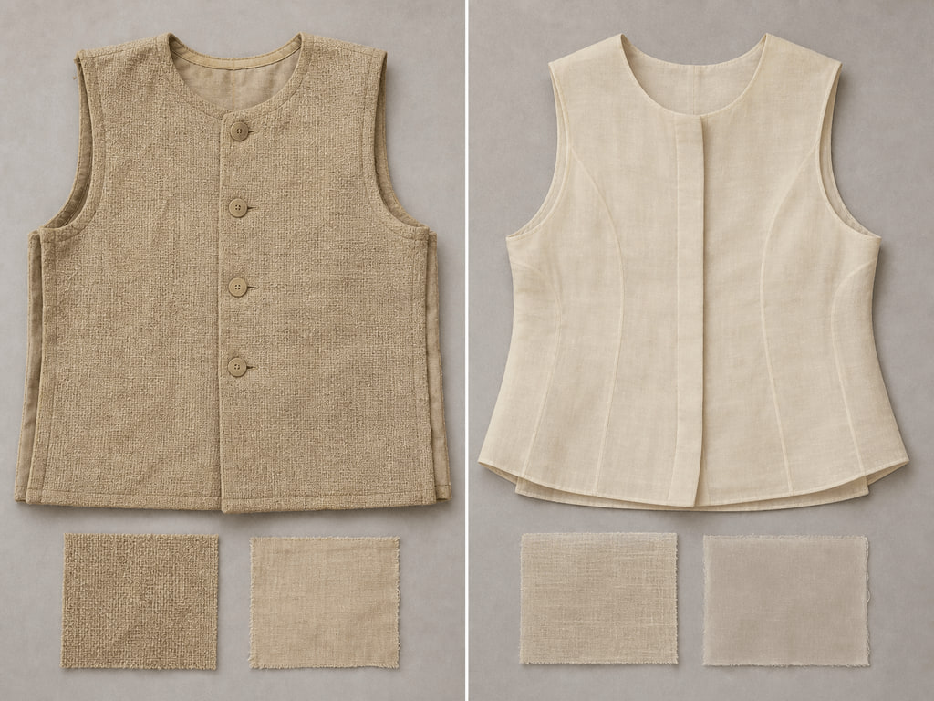
YEAR 12 TEXTILES AND DESIGN · MODULE 2 · TERM 4
Historical Design Development
Develops a disciplined method for tracing design change, explaining interacting factors and turning historical evidence…
BEFORE YOU BEGIN
What makes a historical trace stronger than a simple chronological list?
Notes:
Open with the retrieval question and give students quiet thinking time. Frame Module 2 as part of the concurrent Year 12 strands of theory, Major Textiles Project thinking and examination preparation.
[Sources]
- SRC-WWHS-SYL-2013: authorised course source.
- SRC-WWHS-SCOPE-2023-24: authorised course source.
- SRC-WWHS-HISTORICAL-DESIGN-PROGRAM: authorised course source.
- course-content.js: m02s01, local source-grounded learning package.
- Generated visual: assets/images/m02s01.png, image-generation tool, 30 August 2026.

Slide 2
Three sections build Historical Design Development
Move from source-grounded knowledge → visible evidence → a supported textile decision.
01
02
03
Tracing one focus area over time
Connect the key idea to visible evidence and a supported textile decision.
Factors that shape design change
Connect the key idea to visible evidence and a supported textile decision.
Turning historical evidence into analysis
Connect the key idea to visible evidence and a supported textile decision.
2
Notes:
Preview the three named sections as one reasoning sequence. Ask students to listen for the evidence relationship that carries from one section into the next.
[Sources]
- SRC-WWHS-SYL-2013: authorised course source.
- SRC-WWHS-SCOPE-2023-24: authorised course source.
- SRC-WWHS-HISTORICAL-DESIGN-PROGRAM: authorised course source.
- course-content.js: m02, local source-grounded learning package.

Slide 3
THEORY 1 OF 3
Trace a focus area through evidence
01 Trace a focus area through evidence
02 Use comparison lenses
03 Distinguish continuity from change
EVIDENCE Complete “Sequence, compare and annotate” and justify one decision.
Use the image as visual comparison evidence only.
3
Notes:
Explain the three relationships in plain language, then pause on the image. Ask students what they can observe directly and which conclusion still needs source evidence or a reasoned link.
[Sources]
- SRC-WWHS-SYL-2013: authorised course source.
- SRC-WWHS-SCOPE-2023-24: authorised course source.
- SRC-WWHS-HISTORICAL-DESIGN-PROGRAM: authorised course source.
- course-content.js: m02s01, local source-grounded learning package.
- Generated visual: assets/images/m02s01.png, image-generation tool, 30 August 2026.

Slide 4

THEORY 2 OF 3
Use factor lenses to investigate design change
01
01 Use factor lenses to investigate design change
02
02 Build a because-therefore causal chain
03
03 Explain how factors interact
EVIDENCE Complete “Build the strongest causal chain” and justify one decision.
4
Notes:
Explain the three relationships in plain language, then pause on the image. Ask students what they can observe directly and which conclusion still needs source evidence or a reasoned link.
[Sources]
- SRC-WWHS-SYL-2013: authorised course source.
- SRC-WWHS-SCOPE-2023-24: authorised course source.
- SRC-WWHS-HISTORICAL-DESIGN-PROGRAM: authorised course source.
- course-content.js: m02s02, local source-grounded learning package.
- Generated visual: assets/images/m02s02.png, image-generation tool, 30 August 2026.

Slide 5
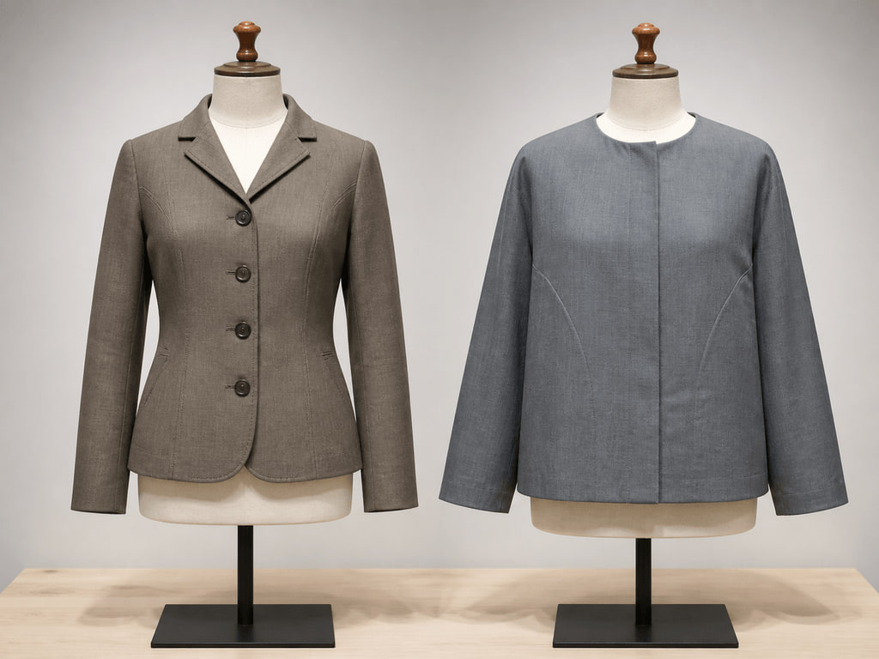
THEORY 3 OF 3
Separate observation from inference
01 Separate observation from inference
02 Consider source context and reliability
03 Build a claim-evidence-explanation-significance chain
EVIDENCE Complete “Annotation clinic: evidence or overclaim?” and justify one decision.
Notice one feature you can directly observe.
5
Notes:
Explain the three relationships in plain language, then pause on the image. Ask students what they can observe directly and which conclusion still needs source evidence or a reasoned link.
[Sources]
- SRC-WWHS-SYL-2013: authorised course source.
- SRC-WWHS-SCOPE-2023-24: authorised course source.
- SRC-WWHS-HISTORICAL-DESIGN-PROGRAM: authorised course source.
- course-content.js: m02s03, local source-grounded learning package.
- Generated visual: assets/images/m02s03.png, image-generation tool, 30 August 2026.

Slide 6
Retrieve the relationship—not just the definition
Answer aloud or write one precise evidence-based sentence for each prompt.
01
02
03
SECTION 1
Use evidence to explain: Tracing one focus area over time
SECTION 2
Use evidence to explain: Factors that shape design change
SECTION 3
Use evidence to explain: Turning historical evidence into analysis
6
Notes:
Use this as a formative pause. Invite one precise sentence for each prompt, then send students back to the matching theory when their explanation names a fact without showing the relationship.
[Sources]
- SRC-WWHS-SYL-2013: authorised course source.
- SRC-WWHS-SCOPE-2023-24: authorised course source.
- SRC-WWHS-HISTORICAL-DESIGN-PROGRAM: authorised course source.
- course-content.js: m02, local source-grounded learning package.

Slide 7
Build a response that shows your thinking
Prompt: explain how a student can turn visible differences between two historical textile sources into a defensible analysis of continuity and change without overclaiming.
READ
Identify the command term and exact relationship.
SELECT
Choose relevant course evidence.
EXPLAIN
Connect the evidence to the textile decision.
CHECK
Make a supported judgement and answer every part.
Sentence starter: The evidence shows ____. This matters because ____. Therefore ____.
7
Notes:
Model the response process without supplying a finished answer. Keep the talk track moving from the command term to relevant evidence, connected explanation and a final check against the prompt.
[Sources]
- SRC-WWHS-SYL-2013: authorised course source.
- SRC-WWHS-SCOPE-2023-24: authorised course source.
- SRC-WWHS-HISTORICAL-DESIGN-PROGRAM: authorised course source.
- course-content.js: m02s03, local source-grounded learning package.

Slide 8
YOUR NEXT MOVE
Exit ticket: carry one decision forward
1. Name one relationship you can now explain.
2. Record the evidence that makes your reasoning convincing.
3. Save one module response or activity, then carry useful evidence into My folio.
Notes:
Finish with one spoken or written exit response. Direct students to save one formative record in the module and carry only purposeful evidence into My folio; no formal submission condition is asserted here.
[Sources]
- SRC-WWHS-SYL-2013: authorised course source.
- SRC-WWHS-SCOPE-2023-24: authorised course source.
- SRC-WWHS-HISTORICAL-DESIGN-PROGRAM: authorised course source.
- course-content.js: m02s01, local source-grounded learning package.
- Generated visual: assets/images/m02s01.png, image-generation tool, 30 August 2026.

