Slide 1
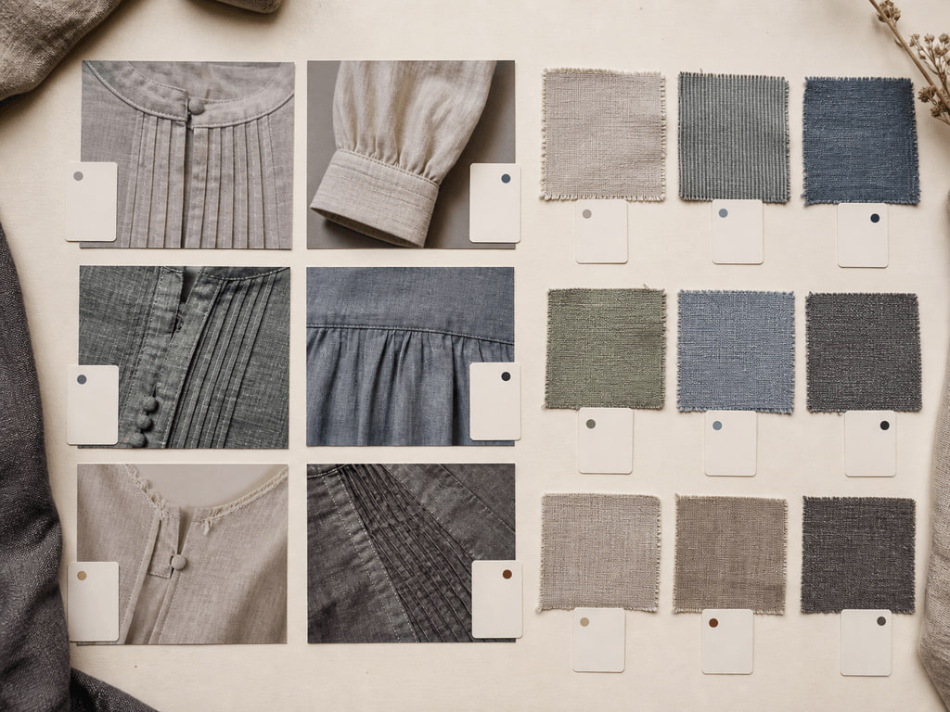
YEAR 12 TEXTILES AND DESIGN · MODULE 3 · TERM 4
Contemporary Designers and Trends
Builds evidence-based analysis of contemporary designer practice, interacting success factors and the two-way relationship…
BEFORE YOU BEGIN
Which statement best describes strong evidence of a contemporary designer's practice?
Notes:
Open with the retrieval question and give students quiet thinking time. Frame Module 3 as part of the concurrent Year 12 strands of theory, Major Textiles Project thinking and examination preparation.
[Sources]
- SRC-WWHS-SYL-2013: authorised course source.
- SRC-WWHS-DESIGNER-PROGRAM: authorised course source.
- SRC-WWHS-TASK2-HISTORICAL: authorised course source.
- course-content.js: m03s01, local source-grounded learning package.
- Generated visual: assets/images/m03s01.png, image-generation tool, 30 August 2026.

Slide 2
Three sections build Contemporary Designers and Trends
Move from source-grounded knowledge → visible evidence → a supported textile decision.
01
02
03
Designer practice, inspiration and signature
Connect the key idea to visible evidence and a supported textile decision.
Internal and external success factors
Connect the key idea to visible evidence and a supported textile decision.
The relationship between designers and trends
Connect the key idea to visible evidence and a supported textile decision.
2
Notes:
Preview the three named sections as one reasoning sequence. Ask students to listen for the evidence relationship that carries from one section into the next.
[Sources]
- SRC-WWHS-SYL-2013: authorised course source.
- SRC-WWHS-DESIGNER-PROGRAM: authorised course source.
- SRC-WWHS-TASK2-HISTORICAL: authorised course source.
- course-content.js: m03, local source-grounded learning package.

Slide 3
THEORY 1 OF 3
Designer practice: look for decisions, not just products
01 Designer practice: look for decisions, not just products
02 Inspiration: connect the claim to its source
03 Signature: establish a recurring pattern
EVIDENCE Complete “Evidence or assumption?” and justify one decision.
Notice which visible evidence supports the section’s key relationship.
3
Notes:
Explain the three relationships in plain language, then pause on the image. Ask students what they can observe directly and which conclusion still needs source evidence or a reasoned link.
[Sources]
- SRC-WWHS-SYL-2013: authorised course source.
- SRC-WWHS-DESIGNER-PROGRAM: authorised course source.
- SRC-WWHS-TASK2-HISTORICAL: authorised course source.
- course-content.js: m03s01, local source-grounded learning package.
- Generated visual: assets/images/m03s01.png, image-generation tool, 30 August 2026.

Slide 4
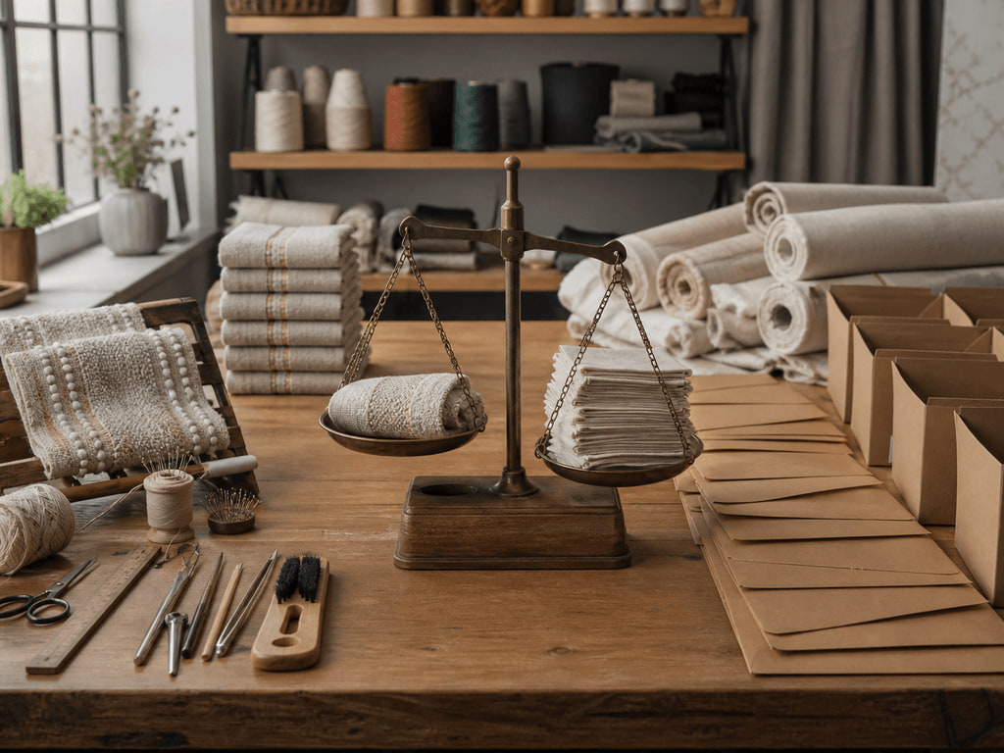
THEORY 2 OF 3
Internal factors: what the designer can influence
01
01 Internal factors: what the designer can influence
02
02 External factors: conditions beyond direct control
03
03 Interaction: explaining how factors combine
EVIDENCE Complete “Sort, connect and decide” and justify one decision.
4
Notes:
Explain the three relationships in plain language, then pause on the image. Ask students what they can observe directly and which conclusion still needs source evidence or a reasoned link.
[Sources]
- SRC-WWHS-SYL-2013: authorised course source.
- SRC-WWHS-DESIGNER-PROGRAM: authorised course source.
- SRC-WWHS-TASK2-HISTORICAL: authorised course source.
- course-content.js: m03s02, local source-grounded learning package.
- Generated visual: assets/images/m03s02.png, image-generation tool, 30 August 2026.

Slide 5
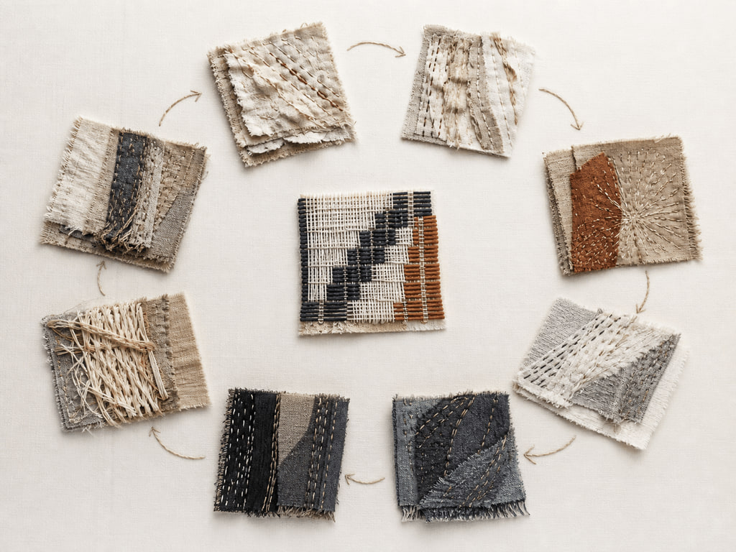
THEORY 3 OF 3
What makes something a trend?
01 What makes something a trend?
02 A two-way relationship
03 Making evidence-based claims about influence
EVIDENCE Complete “Build the trend-influence loop” and justify one decision.
Trace the visual loop.
5
Notes:
Explain the three relationships in plain language, then pause on the image. Ask students what they can observe directly and which conclusion still needs source evidence or a reasoned link.
[Sources]
- SRC-WWHS-SYL-2013: authorised course source.
- SRC-WWHS-DESIGNER-PROGRAM: authorised course source.
- SRC-WWHS-TASK2-HISTORICAL: authorised course source.
- course-content.js: m03s03, local source-grounded learning package.
- Generated visual: assets/images/m03s03.png, image-generation tool, 30 August 2026.

Slide 6
Retrieve the relationship—not just the definition
Answer aloud or write one precise evidence-based sentence for each prompt.
01
02
03
SECTION 1
Use evidence to explain: Designer practice, inspiration and signature
SECTION 2
Use evidence to explain: Internal and external success factors
SECTION 3
Use evidence to explain: The relationship between designers and trends
6
Notes:
Use this as a formative pause. Invite one precise sentence for each prompt, then send students back to the matching theory when their explanation names a fact without showing the relationship.
[Sources]
- SRC-WWHS-SYL-2013: authorised course source.
- SRC-WWHS-DESIGNER-PROGRAM: authorised course source.
- SRC-WWHS-TASK2-HISTORICAL: authorised course source.
- course-content.js: m03, local source-grounded learning package.

Slide 7
Build a response that shows your thinking
Prompt: explain the two-way relationship between designers and trends, showing how a designer may respond to an existing direction while also contributing ideas that influence what appears later.
READ
Identify the command term and exact relationship.
SELECT
Choose relevant course evidence.
EXPLAIN
Connect the evidence to the textile decision.
CHECK
Make a supported judgement and answer every part.
Sentence starter: The evidence shows ____. This matters because ____. Therefore ____.
7
Notes:
Model the response process without supplying a finished answer. Keep the talk track moving from the command term to relevant evidence, connected explanation and a final check against the prompt.
[Sources]
- SRC-WWHS-SYL-2013: authorised course source.
- SRC-WWHS-DESIGNER-PROGRAM: authorised course source.
- SRC-WWHS-TASK2-HISTORICAL: authorised course source.
- course-content.js: m03s03, local source-grounded learning package.

Slide 8
YOUR NEXT MOVE
Exit ticket: carry one decision forward
1. Name one relationship you can now explain.
2. Record the evidence that makes your reasoning convincing.
3. Save one module response or activity, then carry useful evidence into My folio.
Notes:
Finish with one spoken or written exit response. Direct students to save one formative record in the module and carry only purposeful evidence into My folio; no formal submission condition is asserted here.
[Sources]
- SRC-WWHS-SYL-2013: authorised course source.
- SRC-WWHS-DESIGNER-PROGRAM: authorised course source.
- SRC-WWHS-TASK2-HISTORICAL: authorised course source.
- course-content.js: m03s01, local source-grounded learning package.
- Generated visual: assets/images/m03s01.png, image-generation tool, 30 August 2026.

