Slide 1
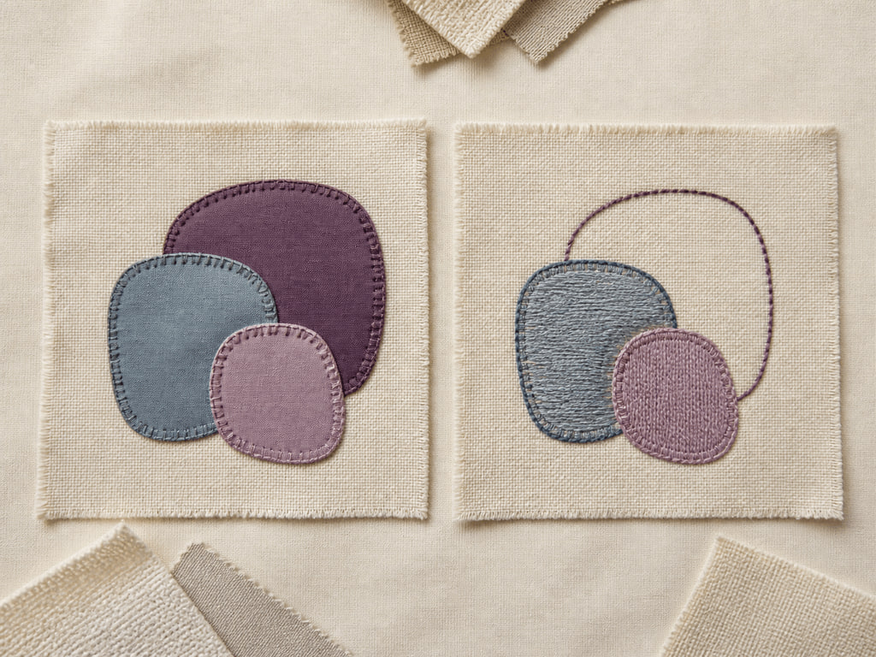
YEAR 12 TEXTILES AND DESIGN · MODULE 5 · TERM 1
Decoration Techniques and Sampling
Compares surface-decoration approaches, makes context-based hand, machine and hybrid decisions, and evaluates sample…
BEFORE YOU BEGIN
Which statement most accurately describes appliqué?
Notes:
Open with the retrieval question and give students quiet thinking time. Frame Module 5 as part of the concurrent Year 12 strands of theory, Major Textiles Project thinking and examination preparation.
[Sources]
- SRC-WWHS-SYL-2013: authorised course source.
- SRC-WWHS-COLOUR-PROGRAM: authorised course source.
- SRC-WWHS-TERM1-2024: authorised course source.
- SRC-WWHS-SCOPE-2023-24: authorised course source.
- SRC-WWHS-TASK3-HISTORICAL: authorised course source.
- course-content.js: m05s01, local source-grounded learning package.
- Generated visual: assets/images/m05s01.png, image-generation tool, 30 August 2026.

Slide 2
Three sections build Decoration Techniques and Sampling
Move from source-grounded knowledge → visible evidence → a supported textile decision.
01
02
03
Appliqué, embroidery and surface decoration
Connect the key idea to visible evidence and a supported textile decision.
Hand and machine technique decisions
Connect the key idea to visible evidence and a supported textile decision.
Comparing and evaluating samples
Connect the key idea to visible evidence and a supported textile decision.
2
Notes:
Preview the three named sections as one reasoning sequence. Ask students to listen for the evidence relationship that carries from one section into the next.
[Sources]
- SRC-WWHS-SYL-2013: authorised course source.
- SRC-WWHS-COLOUR-PROGRAM: authorised course source.
- SRC-WWHS-TERM1-2024: authorised course source.
- SRC-WWHS-SCOPE-2023-24: authorised course source.
- SRC-WWHS-TASK3-HISTORICAL: authorised course source.
- course-content.js: m05, local source-grounded learning package.

Slide 3
THEORY 1 OF 3
Appliqué: adding shaped textile pieces
01 Appliqué: adding shaped textile pieces
02 Embroidery: building designs with stitches
03 Connecting decoration effects to end use
EVIDENCE Complete “Technique–feature–effect match” and justify one decision.
Notice how added layers and stitched areas change the surface.
3
Notes:
Explain the three relationships in plain language, then pause on the image. Ask students what they can observe directly and which conclusion still needs source evidence or a reasoned link.
[Sources]
- SRC-WWHS-SYL-2013: authorised course source.
- SRC-WWHS-COLOUR-PROGRAM: authorised course source.
- SRC-WWHS-TERM1-2024: authorised course source.
- SRC-WWHS-SCOPE-2023-24: authorised course source.
- SRC-WWHS-TASK3-HISTORICAL: authorised course source.
- course-content.js: m05s01, local source-grounded learning package.
- Generated visual: assets/images/m05s01.png, image-generation tool, 30 August 2026.

Slide 4
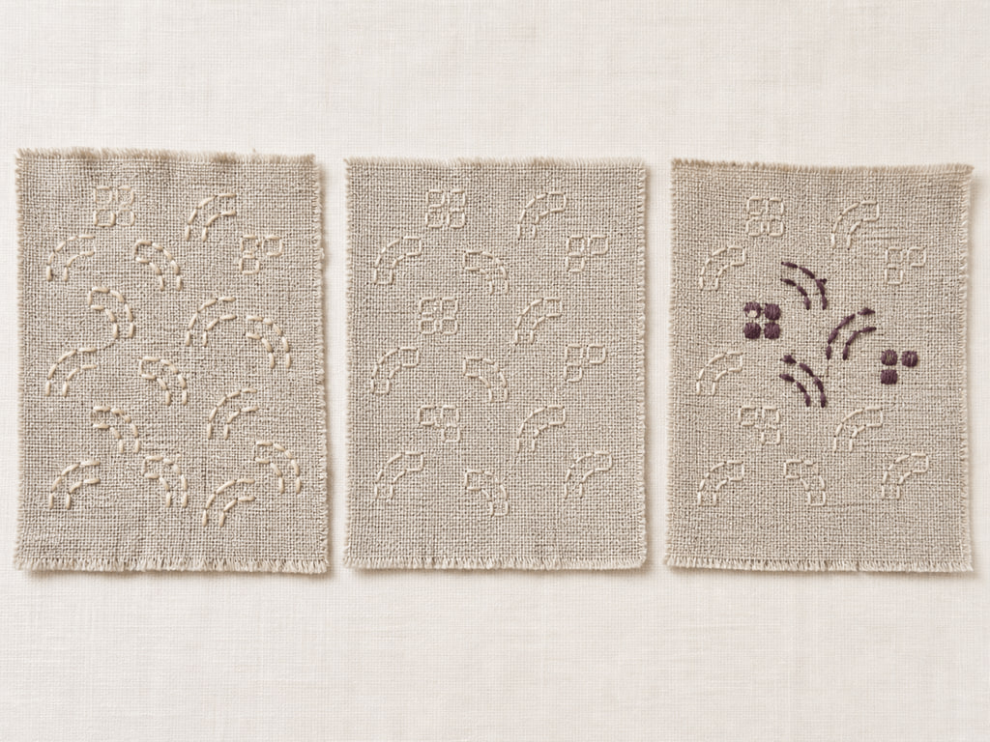
THEORY 2 OF 3
Decision criteria for choosing an approach
01
01 Decision criteria for choosing an approach
02
02 Comparing hand and machine-supported approaches
03
03 Hybrid decisions and a worked example
EVIDENCE Complete “Weighted decoration decision matrix” and justify one decision.
4
Notes:
Explain the three relationships in plain language, then pause on the image. Ask students what they can observe directly and which conclusion still needs source evidence or a reasoned link.
[Sources]
- SRC-WWHS-SYL-2013: authorised course source.
- SRC-WWHS-COLOUR-PROGRAM: authorised course source.
- SRC-WWHS-TERM1-2024: authorised course source.
- SRC-WWHS-SCOPE-2023-24: authorised course source.
- SRC-WWHS-TASK3-HISTORICAL: authorised course source.
- course-content.js: m05s02, local source-grounded learning package.
- Generated visual: assets/images/m05s02.png, image-generation tool, 30 August 2026.

Slide 5
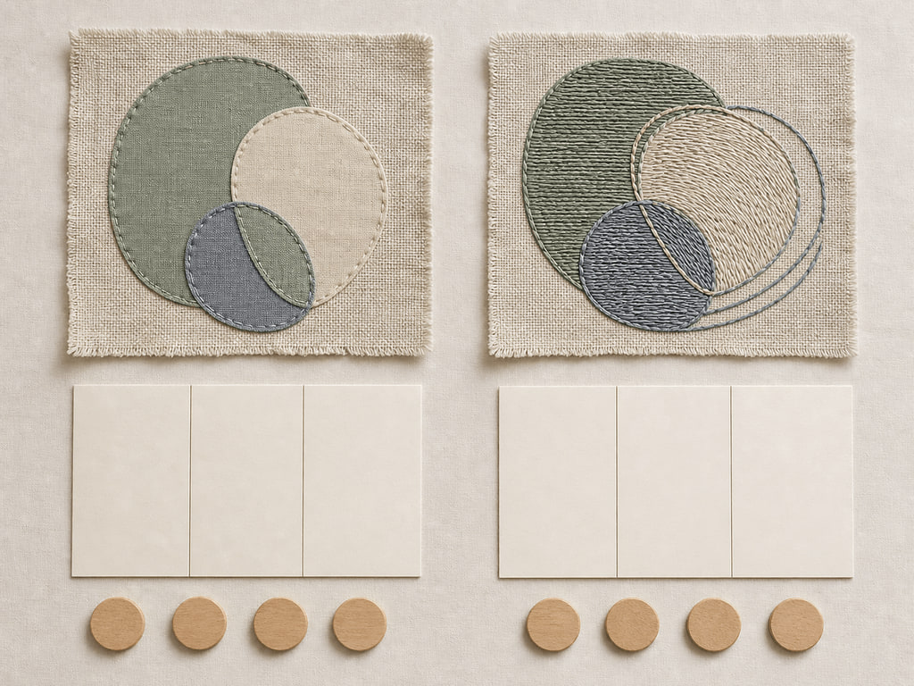
THEORY 3 OF 3
Fair comparison of samples
01 Fair comparison of samples
02 Evaluation using common criteria
03 Justifying selection and improvement
EVIDENCE Complete “Sample-evidence clinic” and justify one decision.
Notice which visible evidence supports the section’s key relationship.
5
Notes:
Explain the three relationships in plain language, then pause on the image. Ask students what they can observe directly and which conclusion still needs source evidence or a reasoned link.
[Sources]
- SRC-WWHS-SYL-2013: authorised course source.
- SRC-WWHS-COLOUR-PROGRAM: authorised course source.
- SRC-WWHS-TERM1-2024: authorised course source.
- SRC-WWHS-SCOPE-2023-24: authorised course source.
- SRC-WWHS-TASK3-HISTORICAL: authorised course source.
- course-content.js: m05s03, local source-grounded learning package.
- Generated visual: assets/images/m05s03.png, image-generation tool, 30 August 2026.

Slide 6
Retrieve the relationship—not just the definition
Answer aloud or write one precise evidence-based sentence for each prompt.
01
02
03
SECTION 1
Use evidence to explain: Appliqué, embroidery and surface decoration
SECTION 2
Use evidence to explain: Hand and machine technique decisions
SECTION 3
Use evidence to explain: Comparing and evaluating samples
6
Notes:
Use this as a formative pause. Invite one precise sentence for each prompt, then send students back to the matching theory when their explanation names a fact without showing the relationship.
[Sources]
- SRC-WWHS-SYL-2013: authorised course source.
- SRC-WWHS-COLOUR-PROGRAM: authorised course source.
- SRC-WWHS-TERM1-2024: authorised course source.
- SRC-WWHS-SCOPE-2023-24: authorised course source.
- SRC-WWHS-TASK3-HISTORICAL: authorised course source.
- course-content.js: m05, local source-grounded learning package.

Slide 7
Build a response that shows your thinking
Prompt: Evaluate two labelled decoration samples for a stated textile end use, using common criteria and evidence to justify which sample is more suitable while acknowledging a trade-off or limitation.
READ
Identify the command term and exact relationship.
SELECT
Choose relevant course evidence.
EXPLAIN
Connect the evidence to the textile decision.
CHECK
Make a supported judgement and answer every part.
Sentence starter: The evidence shows ____. This matters because ____. Therefore ____.
7
Notes:
Model the response process without supplying a finished answer. Keep the talk track moving from the command term to relevant evidence, connected explanation and a final check against the prompt.
[Sources]
- SRC-WWHS-SYL-2013: authorised course source.
- SRC-WWHS-COLOUR-PROGRAM: authorised course source.
- SRC-WWHS-TERM1-2024: authorised course source.
- SRC-WWHS-SCOPE-2023-24: authorised course source.
- SRC-WWHS-TASK3-HISTORICAL: authorised course source.
- course-content.js: m05s03, local source-grounded learning package.

Slide 8
YOUR NEXT MOVE
Exit ticket: carry one decision forward
1. Name one relationship you can now explain.
2. Record the evidence that makes your reasoning convincing.
3. Save one module response or activity, then carry useful evidence into My folio.
Notes:
Finish with one spoken or written exit response. Direct students to save one formative record in the module and carry only purposeful evidence into My folio; no formal submission condition is asserted here.
[Sources]
- SRC-WWHS-SYL-2013: authorised course source.
- SRC-WWHS-COLOUR-PROGRAM: authorised course source.
- SRC-WWHS-TERM1-2024: authorised course source.
- SRC-WWHS-SCOPE-2023-24: authorised course source.
- SRC-WWHS-TASK3-HISTORICAL: authorised course source.
- course-content.js: m05s01, local source-grounded learning package.
- Generated visual: assets/images/m05s01.png, image-generation tool, 30 August 2026.

