Slide 1
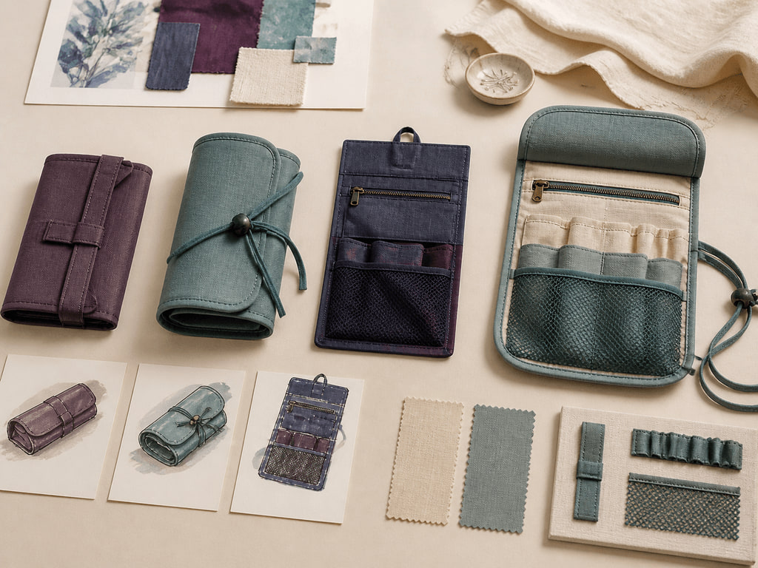
YEAR 12 TEXTILES AND DESIGN · MODULE 7 · TERM 1
MTP Design Development
Develop a defensible MTP direction through divergent ideas, functional and aesthetic analysis, and clear drawings…
BEFORE YOU BEGIN
What is the main purpose of divergent thinking during design development?
Notes:
Open with the retrieval question and give students quiet thinking time. Frame Module 7 as part of the concurrent Year 12 strands of theory, Major Textiles Project thinking and examination preparation.
[Sources]
- SRC-WWHS-SYL-2013: authorised course source.
- SRC-WWHS-SCOPE-2023-24: authorised course source.
- SRC-WWHS-TERM1-2024: authorised course source.
- SRC-WWHS-MTP-PROGRAM: authorised course source.
- course-content.js: m07s01, local source-grounded learning package.
- Generated visual: assets/images/m07s01.png, image-generation tool, 30 August 2026.

Slide 2
Three sections build MTP Design Development
Move from source-grounded knowledge → visible evidence → a supported textile decision.
01
02
03
Generating ideas and choosing a final direction
Connect the key idea to visible evidence and a supported textile decision.
Functional and aesthetic analysis
Connect the key idea to visible evidence and a supported textile decision.
Drawings, specifications and time planning
Connect the key idea to visible evidence and a supported textile decision.
2
Notes:
Preview the three named sections as one reasoning sequence. Ask students to listen for the evidence relationship that carries from one section into the next.
[Sources]
- SRC-WWHS-SYL-2013: authorised course source.
- SRC-WWHS-SCOPE-2023-24: authorised course source.
- SRC-WWHS-TERM1-2024: authorised course source.
- SRC-WWHS-MTP-PROGRAM: authorised course source.
- course-content.js: m07, local source-grounded learning package.

Slide 3
THEORY 1 OF 3
Generate a purposeful range of ideas
01 Generate a purposeful range of ideas
02 Use criteria to move from options to a direction
03 Worked choice: compare, select and record the decision
EVIDENCE Complete “Rank design directions using weighted.” and justify one decision.
Notice how the three concepts differ meaningfully rather than being minor variations.
3
Notes:
Explain the three relationships in plain language, then pause on the image. Ask students what they can observe directly and which conclusion still needs source evidence or a reasoned link.
[Sources]
- SRC-WWHS-SYL-2013: authorised course source.
- SRC-WWHS-SCOPE-2023-24: authorised course source.
- SRC-WWHS-TERM1-2024: authorised course source.
- SRC-WWHS-MTP-PROGRAM: authorised course source.
- course-content.js: m07s01, local source-grounded learning package.
- Generated visual: assets/images/m07s01.png, image-generation tool, 30 August 2026.

Slide 4
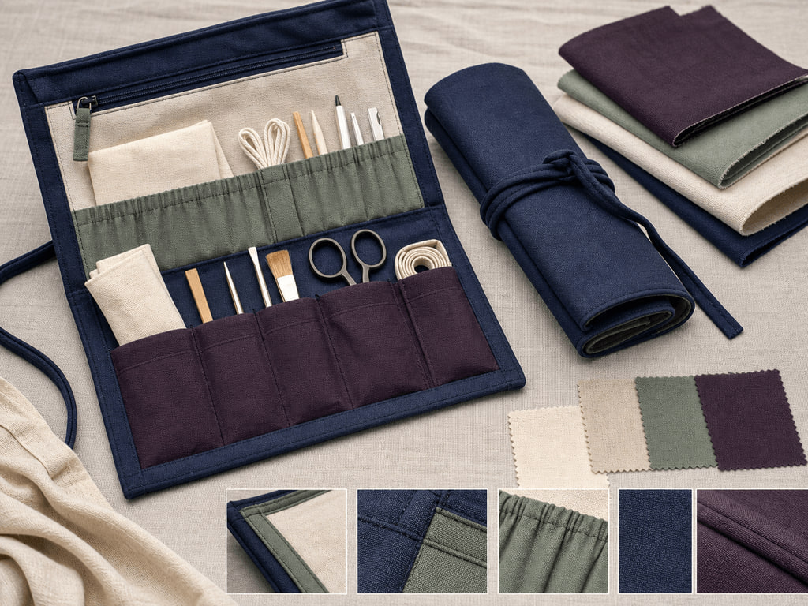
THEORY 2 OF 3
Analyse functional and aesthetic requirements together
01
01 Analyse functional and aesthetic requirements together
02
02 Turn preferences into observable or testable criteria
03
03 Worked analysis: a generic textile organiser or carry item
EVIDENCE Complete “Match requirements and resolve a trade-off” and justify one decision.
4
Notes:
Explain the three relationships in plain language, then pause on the image. Ask students what they can observe directly and which conclusion still needs source evidence or a reasoned link.
[Sources]
- SRC-WWHS-SYL-2013: authorised course source.
- SRC-WWHS-SCOPE-2023-24: authorised course source.
- SRC-WWHS-TERM1-2024: authorised course source.
- SRC-WWHS-MTP-PROGRAM: authorised course source.
- course-content.js: m07s02, local source-grounded learning package.
- Generated visual: assets/images/m07s02.png, image-generation tool, 30 August 2026.

Slide 5

THEORY 3 OF 3
Use drawings for different communication jobs
01 Use drawings for different communication jobs
02 Convert design intent into clear specifications
03 Plan tasks, dependencies, checks and contingency
EVIDENCE Complete “Sequence dependencies and respond to.” and justify one decision.
Notice how the appearance sketch, technical drawing and task sequence serve different purposes.
5
Notes:
Explain the three relationships in plain language, then pause on the image. Ask students what they can observe directly and which conclusion still needs source evidence or a reasoned link.
[Sources]
- SRC-WWHS-SYL-2013: authorised course source.
- SRC-WWHS-SCOPE-2023-24: authorised course source.
- SRC-WWHS-TERM1-2024: authorised course source.
- SRC-WWHS-MTP-PROGRAM: authorised course source.
- course-content.js: m07s03, local source-grounded learning package.
- Generated visual: assets/images/m07s03.png, image-generation tool, 30 August 2026.

Slide 6
Retrieve the relationship—not just the definition
Answer aloud or write one precise evidence-based sentence for each prompt.
01
02
03
SECTION 1
Use evidence to explain: Generating ideas and choosing a final direction
SECTION 2
Use evidence to explain: Functional and aesthetic analysis
SECTION 3
Use evidence to explain: Drawings, specifications and time planning
6
Notes:
Use this as a formative pause. Invite one precise sentence for each prompt, then send students back to the matching theory when their explanation names a fact without showing the relationship.
[Sources]
- SRC-WWHS-SYL-2013: authorised course source.
- SRC-WWHS-SCOPE-2023-24: authorised course source.
- SRC-WWHS-TERM1-2024: authorised course source.
- SRC-WWHS-MTP-PROGRAM: authorised course source.
- course-content.js: m07, local source-grounded learning package.

Slide 7
Build a response that shows your thinking
Prompt: Explain how drawings, specifications and a dependency-aware time plan can work together to communicate and manage the development of a generic textile design direction for both technical and non-technical audiences.
READ
Identify the command term and exact relationship.
SELECT
Choose relevant course evidence.
EXPLAIN
Connect the evidence to the textile decision.
CHECK
Make a supported judgement and answer every part.
Sentence starter: The evidence shows ____. This matters because ____. Therefore ____.
7
Notes:
Model the response process without supplying a finished answer. Keep the talk track moving from the command term to relevant evidence, connected explanation and a final check against the prompt.
[Sources]
- SRC-WWHS-SYL-2013: authorised course source.
- SRC-WWHS-SCOPE-2023-24: authorised course source.
- SRC-WWHS-TERM1-2024: authorised course source.
- SRC-WWHS-MTP-PROGRAM: authorised course source.
- course-content.js: m07s03, local source-grounded learning package.

Slide 8
YOUR NEXT MOVE
Exit ticket: carry one decision forward
1. Name one relationship you can now explain.
2. Record the evidence that makes your reasoning convincing.
3. Save one module response or activity, then carry useful evidence into My folio.
Notes:
Finish with one spoken or written exit response. Direct students to save one formative record in the module and carry only purposeful evidence into My folio; no formal submission condition is asserted here.
[Sources]
- SRC-WWHS-SYL-2013: authorised course source.
- SRC-WWHS-SCOPE-2023-24: authorised course source.
- SRC-WWHS-TERM1-2024: authorised course source.
- SRC-WWHS-MTP-PROGRAM: authorised course source.
- course-content.js: m07s01, local source-grounded learning package.
- Generated visual: assets/images/m07s01.png, image-generation tool, 30 August 2026.

