Slide 1

YEAR 12 TEXTILES AND DESIGN · MODULE 9 · TERM 2
Innovations and Emerging Textile Technologies
Distinguish invention and innovation, locate emerging developments at fibre, yarn and fabric levels, and evaluate product…
BEFORE YOU BEGIN
Which statement best distinguishes an invention from an innovation?
Notes:
Open with the retrieval question and give students quiet thinking time. Frame Module 9 as part of the concurrent Year 12 strands of theory, Major Textiles Project thinking and examination preparation.
[Sources]
- SRC-WWHS-SYL-2013: authorised course source.
- SRC-WWHS-SCOPE-2023-24: authorised course source.
- SRC-WWHS-TERM2-2024: authorised course source.
- SRC-WWHS-INNOVATIONS-PROGRAM: authorised course source.
- course-content.js: m09s01, local source-grounded learning package.
- Generated visual: assets/images/m09s01.png, image-generation tool, 30 August 2026.

Slide 2
Three sections build Innovations and Emerging Textile Technologies
Move from source-grounded knowledge → visible evidence → a supported textile decision.
01
02
03
Innovation definitions, needs and drivers
Connect the key idea to visible evidence and a supported textile decision.
Emerging fibres, yarns and fabrics
Connect the key idea to visible evidence and a supported textile decision.
Product, process and societal impacts
Connect the key idea to visible evidence and a supported textile decision.
2
Notes:
Preview the three named sections as one reasoning sequence. Ask students to listen for the evidence relationship that carries from one section into the next.
[Sources]
- SRC-WWHS-SYL-2013: authorised course source.
- SRC-WWHS-SCOPE-2023-24: authorised course source.
- SRC-WWHS-TERM2-2024: authorised course source.
- SRC-WWHS-INNOVATIONS-PROGRAM: authorised course source.
- course-content.js: m09, local source-grounded learning package.

Slide 3
THEORY 1 OF 3
A definition ladder for textile innovation
01 A definition ladder for textile innovation
02 From textile need to development and adoption
03 Worked example: a moisture-management textile
EVIDENCE Complete “Build the innovation chain” and justify one decision.
Notice which visible evidence supports the section’s key relationship.
3
Notes:
Explain the three relationships in plain language, then pause on the image. Ask students what they can observe directly and which conclusion still needs source evidence or a reasoned link.
[Sources]
- SRC-WWHS-SYL-2013: authorised course source.
- SRC-WWHS-SCOPE-2023-24: authorised course source.
- SRC-WWHS-TERM2-2024: authorised course source.
- SRC-WWHS-INNOVATIONS-PROGRAM: authorised course source.
- course-content.js: m09s01, local source-grounded learning package.
- Generated visual: assets/images/m09s01.png, image-generation tool, 30 August 2026.

Slide 4
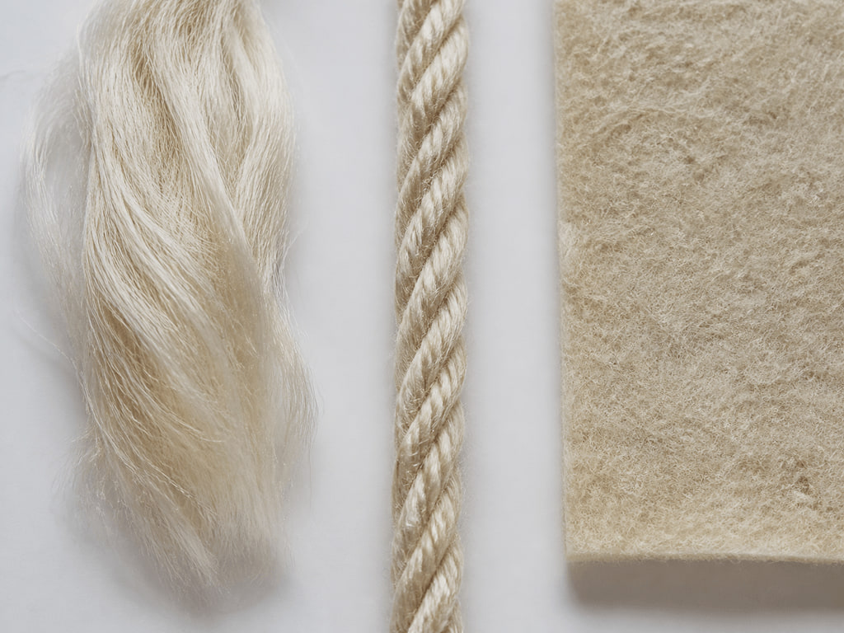
THEORY 2 OF 3
Locate the innovation: fibre, yarn or fabric
01
01 Locate the innovation: fibre, yarn or fabric
02
02 Reason from structure to property to performance
03
03 Build an evidence profile before making a judgement
EVIDENCE Complete “Classify the innovation pathway” and justify one decision.
4
Notes:
Explain the three relationships in plain language, then pause on the image. Ask students what they can observe directly and which conclusion still needs source evidence or a reasoned link.
[Sources]
- SRC-WWHS-SYL-2013: authorised course source.
- SRC-WWHS-SCOPE-2023-24: authorised course source.
- SRC-WWHS-TERM2-2024: authorised course source.
- SRC-WWHS-INNOVATIONS-PROGRAM: authorised course source.
- course-content.js: m09s02, local source-grounded learning package.
- Generated visual: assets/images/m09s02.png, image-generation tool, 30 August 2026.

Slide 5
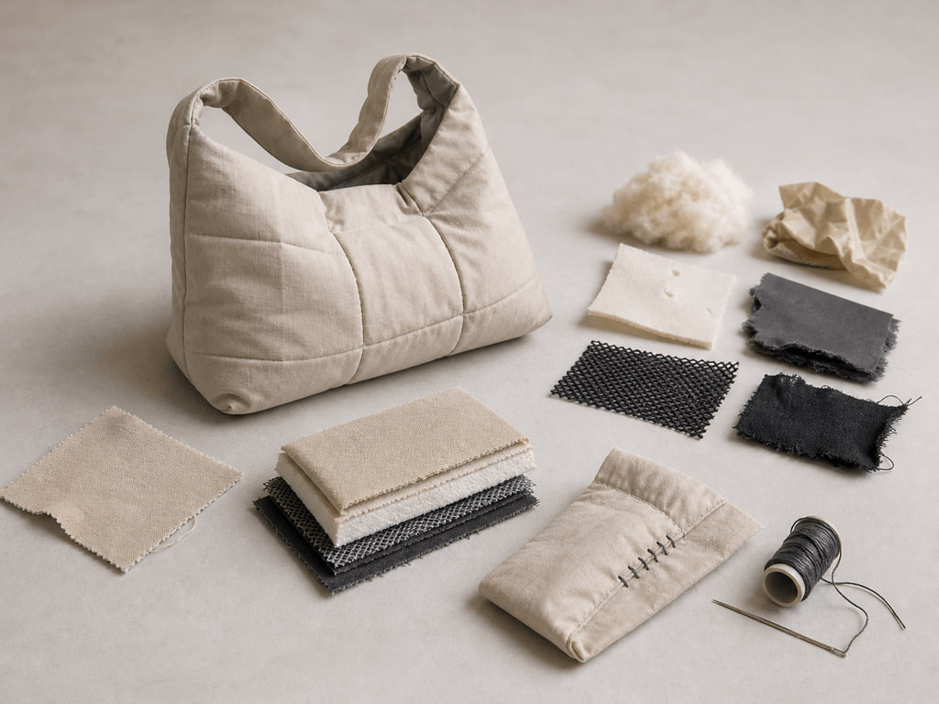
THEORY 3 OF 3
Use product, process, stakeholder and life-cycle lenses
01 Use product, process, stakeholder and life-cycle lenses
02 Trace trade-offs, evidence limits and reversibility
03 Worked impact analysis: temperature-managing textile
EVIDENCE Complete “Map the impacts and trade-offs” and justify one decision.
Notice which visible evidence supports the section’s key relationship.
5
Notes:
Explain the three relationships in plain language, then pause on the image. Ask students what they can observe directly and which conclusion still needs source evidence or a reasoned link.
[Sources]
- SRC-WWHS-SYL-2013: authorised course source.
- SRC-WWHS-SCOPE-2023-24: authorised course source.
- SRC-WWHS-TERM2-2024: authorised course source.
- SRC-WWHS-INNOVATIONS-PROGRAM: authorised course source.
- course-content.js: m09s03, local source-grounded learning package.
- Generated visual: assets/images/m09s03.png, image-generation tool, 30 August 2026.

Slide 6
Retrieve the relationship—not just the definition
Answer aloud or write one precise evidence-based sentence for each prompt.
01
02
03
SECTION 1
Use evidence to explain: Innovation definitions, needs and drivers
SECTION 2
Use evidence to explain: Emerging fibres, yarns and fabrics
SECTION 3
Use evidence to explain: Product, process and societal impacts
6
Notes:
Use this as a formative pause. Invite one precise sentence for each prompt, then send students back to the matching theory when their explanation names a fact without showing the relationship.
[Sources]
- SRC-WWHS-SYL-2013: authorised course source.
- SRC-WWHS-SCOPE-2023-24: authorised course source.
- SRC-WWHS-TERM2-2024: authorised course source.
- SRC-WWHS-INNOVATIONS-PROGRAM: authorised course source.
- course-content.js: m09, local source-grounded learning package.

Slide 7
Build a response that shows your thinking
Prompt: Evaluate a generic textile innovation as both a product and process change. Consider intended and unintended consequences for different stakeholders and life-cycle stages, then make a qualified judgement about its overall value.
READ
Identify the command term and exact relationship.
SELECT
Choose relevant course evidence.
EXPLAIN
Connect the evidence to the textile decision.
CHECK
Make a supported judgement and answer every part.
Sentence starter: The evidence shows ____. This matters because ____. Therefore ____.
7
Notes:
Model the response process without supplying a finished answer. Keep the talk track moving from the command term to relevant evidence, connected explanation and a final check against the prompt.
[Sources]
- SRC-WWHS-SYL-2013: authorised course source.
- SRC-WWHS-SCOPE-2023-24: authorised course source.
- SRC-WWHS-TERM2-2024: authorised course source.
- SRC-WWHS-INNOVATIONS-PROGRAM: authorised course source.
- course-content.js: m09s03, local source-grounded learning package.

Slide 8
YOUR NEXT MOVE
Exit ticket: carry one decision forward
1. Name one relationship you can now explain.
2. Record the evidence that makes your reasoning convincing.
3. Save one module response or activity, then carry useful evidence into My folio.
Notes:
Finish with one spoken or written exit response. Direct students to save one formative record in the module and carry only purposeful evidence into My folio; no formal submission condition is asserted here.
[Sources]
- SRC-WWHS-SYL-2013: authorised course source.
- SRC-WWHS-SCOPE-2023-24: authorised course source.
- SRC-WWHS-TERM2-2024: authorised course source.
- SRC-WWHS-INNOVATIONS-PROGRAM: authorised course source.
- course-content.js: m09s01, local source-grounded learning package.
- Generated visual: assets/images/m09s01.png, image-generation tool, 30 August 2026.

