Slide 1
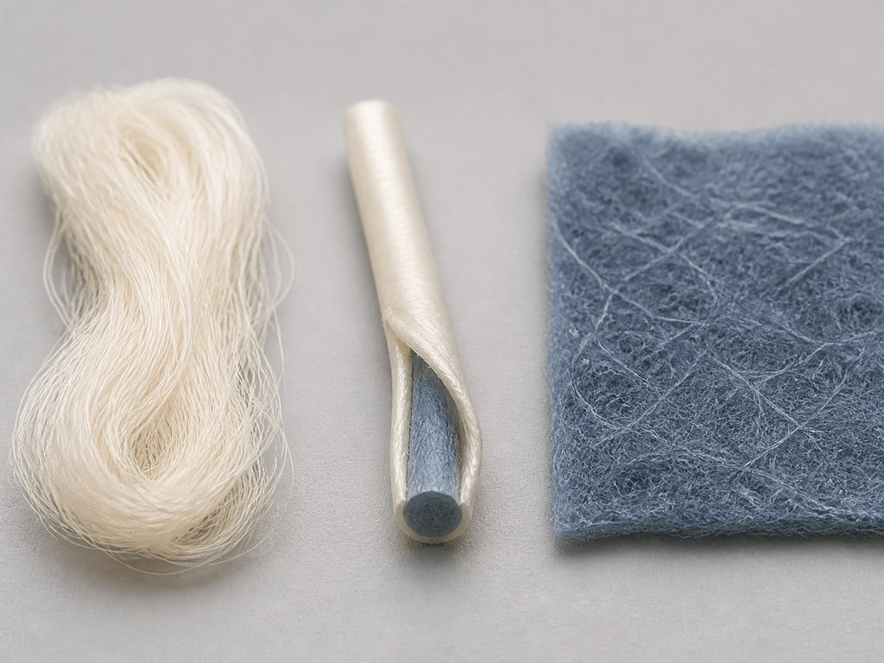
YEAR 12 TEXTILES AND DESIGN · MODULE 10 · TERM 2
Enhanced Performance
Retrieve Preliminary fibre, yarn and fabric structure–property knowledge, apply it to microfibres, bicomponent yarns and…
BEFORE YOU BEGIN
Which statement best describes microfibre?
Notes:
Open with the retrieval question and give students quiet thinking time. Frame Module 10 as part of the concurrent Year 12 strands of theory, Major Textiles Project thinking and examination preparation.
[Sources]
- SRC-WWHS-SYL-2013: authorised course source.
- SRC-WWHS-SCOPE-2023-24: authorised course source.
- SRC-WWHS-TERM2-2024: authorised course source.
- SRC-WWHS-INNOVATIONS-PROGRAM: authorised course source.
- accepted-year11-textiles-site: authorised course source.
- course-content.js: m10s01, local source-grounded learning package.
- Generated visual: assets/images/m10s01.png, image-generation tool, 30 August 2026.

Slide 2
Three sections build Enhanced Performance
Move from source-grounded knowledge → visible evidence → a supported textile decision.
01
02
03
Microfibres, bicomponent yarns and washable webs
Connect the key idea to visible evidence and a supported textile decision.
Revising structure–property relationships
Connect the key idea to visible evidence and a supported textile decision.
Selecting performance for end use
Connect the key idea to visible evidence and a supported textile decision.
2
Notes:
Preview the three named sections as one reasoning sequence. Ask students to listen for the evidence relationship that carries from one section into the next.
[Sources]
- SRC-WWHS-SYL-2013: authorised course source.
- SRC-WWHS-SCOPE-2023-24: authorised course source.
- SRC-WWHS-TERM2-2024: authorised course source.
- SRC-WWHS-INNOVATIONS-PROGRAM: authorised course source.
- accepted-year11-textiles-site: authorised course source.
- course-content.js: m10, local source-grounded learning package.

Slide 3
THEORY 1 OF 3
Preliminary retrieval and three technologies
01 Preliminary retrieval and three technologies
02 From structure to possible performance
03 Worked selection: no universal winner
EVIDENCE Complete “Match technology, structure, property and.” and justify one decision.
Notice which visible evidence supports the section’s key relationship.
3
Notes:
Explain the three relationships in plain language, then pause on the image. Ask students what they can observe directly and which conclusion still needs source evidence or a reasoned link.
[Sources]
- SRC-WWHS-SYL-2013: authorised course source.
- SRC-WWHS-SCOPE-2023-24: authorised course source.
- SRC-WWHS-TERM2-2024: authorised course source.
- SRC-WWHS-INNOVATIONS-PROGRAM: authorised course source.
- accepted-year11-textiles-site: authorised course source.
- course-content.js: m10s01, local source-grounded learning package.
- Generated visual: assets/images/m10s01.png, image-generation tool, 30 August 2026.

Slide 4
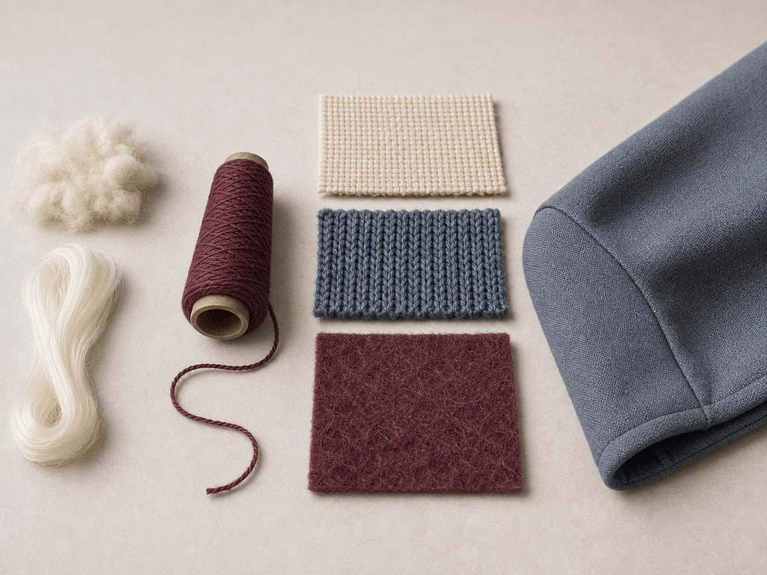
THEORY 2 OF 3
Preliminary retrieval: fibre, yarn and fabric
01
01 Preliminary retrieval: fibre, yarn and fabric
02
02 Building a layered causal explanation
03
03 Worked trace: moisture and comfort
EVIDENCE Complete “Repair a layered performance chain” and justify one decision.
4
Notes:
Explain the three relationships in plain language, then pause on the image. Ask students what they can observe directly and which conclusion still needs source evidence or a reasoned link.
[Sources]
- SRC-WWHS-SYL-2013: authorised course source.
- SRC-WWHS-SCOPE-2023-24: authorised course source.
- SRC-WWHS-TERM2-2024: authorised course source.
- SRC-WWHS-INNOVATIONS-PROGRAM: authorised course source.
- accepted-year11-textiles-site: authorised course source.
- course-content.js: m10s02, local source-grounded learning package.
- Generated visual: assets/images/m10s02.png, image-generation tool, 30 August 2026.

Slide 5
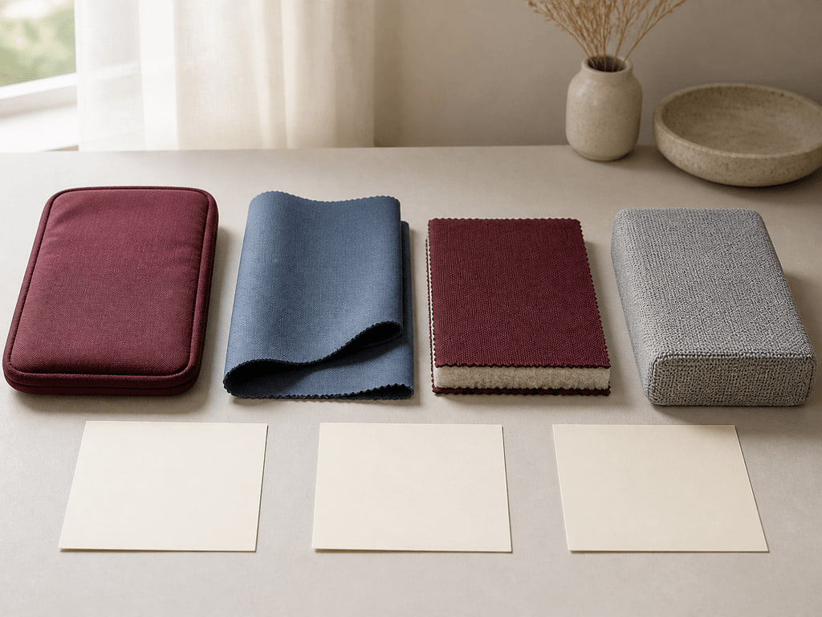
THEORY 3 OF 3
Building an end-use profile
01 Building an end-use profile
02 Comparing evidence and trade-offs
03 Worked justification: protective storage sleeve
EVIDENCE Complete “Prioritise end-use evidence and trade-offs” and justify one decision.
Notice which visible evidence supports the section’s key relationship.
5
Notes:
Explain the three relationships in plain language, then pause on the image. Ask students what they can observe directly and which conclusion still needs source evidence or a reasoned link.
[Sources]
- SRC-WWHS-SYL-2013: authorised course source.
- SRC-WWHS-SCOPE-2023-24: authorised course source.
- SRC-WWHS-TERM2-2024: authorised course source.
- SRC-WWHS-INNOVATIONS-PROGRAM: authorised course source.
- accepted-year11-textiles-site: authorised course source.
- course-content.js: m10s03, local source-grounded learning package.
- Generated visual: assets/images/m10s03.png, image-generation tool, 30 August 2026.

Slide 6
Retrieve the relationship—not just the definition
Answer aloud or write one precise evidence-based sentence for each prompt.
01
02
03
SECTION 1
Use evidence to explain: Microfibres, bicomponent yarns and washable webs
SECTION 2
Use evidence to explain: Revising structure–property relationships
SECTION 3
Use evidence to explain: Selecting performance for end use
6
Notes:
Use this as a formative pause. Invite one precise sentence for each prompt, then send students back to the matching theory when their explanation names a fact without showing the relationship.
[Sources]
- SRC-WWHS-SYL-2013: authorised course source.
- SRC-WWHS-SCOPE-2023-24: authorised course source.
- SRC-WWHS-TERM2-2024: authorised course source.
- SRC-WWHS-INNOVATIONS-PROGRAM: authorised course source.
- accepted-year11-textiles-site: authorised course source.
- course-content.js: m10, local source-grounded learning package.

Slide 7
Build a response that shows your thinking
Prompt: Justify the selection of one textile candidate for a stated end use using prioritised requirements, comparative evidence and trade-offs.
READ
Identify the command term and exact relationship.
SELECT
Choose relevant course evidence.
EXPLAIN
Connect the evidence to the textile decision.
CHECK
Make a supported judgement and answer every part.
Sentence starter: The evidence shows ____. This matters because ____. Therefore ____.
7
Notes:
Model the response process without supplying a finished answer. Keep the talk track moving from the command term to relevant evidence, connected explanation and a final check against the prompt.
[Sources]
- SRC-WWHS-SYL-2013: authorised course source.
- SRC-WWHS-SCOPE-2023-24: authorised course source.
- SRC-WWHS-TERM2-2024: authorised course source.
- SRC-WWHS-INNOVATIONS-PROGRAM: authorised course source.
- accepted-year11-textiles-site: authorised course source.
- course-content.js: m10s03, local source-grounded learning package.

Slide 8
YOUR NEXT MOVE
Exit ticket: carry one decision forward
1. Name one relationship you can now explain.
2. Record the evidence that makes your reasoning convincing.
3. Save one module response or activity, then carry useful evidence into My folio.
Notes:
Finish with one spoken or written exit response. Direct students to save one formative record in the module and carry only purposeful evidence into My folio; no formal submission condition is asserted here.
[Sources]
- SRC-WWHS-SYL-2013: authorised course source.
- SRC-WWHS-SCOPE-2023-24: authorised course source.
- SRC-WWHS-TERM2-2024: authorised course source.
- SRC-WWHS-INNOVATIONS-PROGRAM: authorised course source.
- accepted-year11-textiles-site: authorised course source.
- course-content.js: m10s01, local source-grounded learning package.
- Generated visual: assets/images/m10s01.png, image-generation tool, 30 August 2026.

