Slide 1
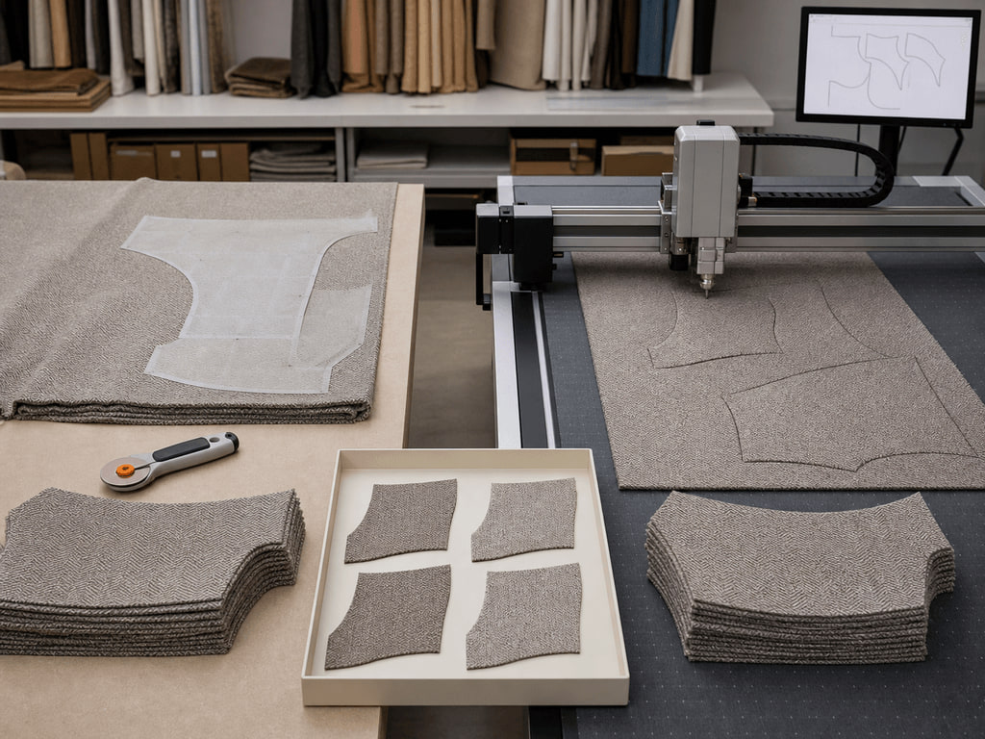
YEAR 12 TEXTILES AND DESIGN · MODULE 11 · TERM 2
Machinery, Seamless Technology and Enhancement
Explains how machinery, computer-supported production and seamless technology can change construction, performance…
BEFORE YOU BEGIN
Which statement best distinguishes a technology's function from a possible production consequence?
Notes:
Open with the retrieval question and give students quiet thinking time. Frame Module 11 as part of the concurrent Year 12 strands of theory, Major Textiles Project thinking and examination preparation.
[Sources]
- SRC-WWHS-SYL-2013: authorised course source.
- SRC-WWHS-INNOVATIONS-PROGRAM: authorised course source.
- SRC-WWHS-TERM2-2024: authorised course source.
- SRC-WWHS-SCOPE-2023-24: authorised course source.
- course-content.js: m11s01, local source-grounded learning package.
- Generated visual: assets/images/m11s01.png, image-generation tool, 30 August 2026.

Slide 2
Three sections build Machinery, Seamless Technology and Enhancement
Move from source-grounded knowledge → visible evidence → a supported textile decision.
01
02
03
Machinery and production technologies
Connect the key idea to visible evidence and a supported textile decision.
Seamless technology and construction change
Connect the key idea to visible evidence and a supported textile decision.
Decorative enhancement, efficiency and quality
Connect the key idea to visible evidence and a supported textile decision.
2
Notes:
Preview the three named sections as one reasoning sequence. Ask students to listen for the evidence relationship that carries from one section into the next.
[Sources]
- SRC-WWHS-SYL-2013: authorised course source.
- SRC-WWHS-INNOVATIONS-PROGRAM: authorised course source.
- SRC-WWHS-TERM2-2024: authorised course source.
- SRC-WWHS-SCOPE-2023-24: authorised course source.
- course-content.js: m11, local source-grounded learning package.

Slide 3
THEORY 1 OF 3
Technology function: what does the system do?
01 Technology function: what does the system do?
02 Production effects: what might change?
03 Trade-offs: choosing with evidence
EVIDENCE Complete “Build the consequence chain” and justify one decision.
Notice which visible evidence supports the section’s key relationship.
3
Notes:
Explain the three relationships in plain language, then pause on the image. Ask students what they can observe directly and which conclusion still needs source evidence or a reasoned link.
[Sources]
- SRC-WWHS-SYL-2013: authorised course source.
- SRC-WWHS-INNOVATIONS-PROGRAM: authorised course source.
- SRC-WWHS-TERM2-2024: authorised course source.
- SRC-WWHS-SCOPE-2023-24: authorised course source.
- course-content.js: m11s01, local source-grounded learning package.
- Generated visual: assets/images/m11s01.png, image-generation tool, 30 August 2026.

Slide 4

THEORY 2 OF 3
What seamless technology means
01
01 What seamless technology means
02
02 How construction can change
03
03 Performance effects and trade-offs
EVIDENCE Complete “Construction pathway sort and trade-off.” and justify one decision.
4
Notes:
Explain the three relationships in plain language, then pause on the image. Ask students what they can observe directly and which conclusion still needs source evidence or a reasoned link.
[Sources]
- SRC-WWHS-SYL-2013: authorised course source.
- SRC-WWHS-INNOVATIONS-PROGRAM: authorised course source.
- SRC-WWHS-TERM2-2024: authorised course source.
- SRC-WWHS-SCOPE-2023-24: authorised course source.
- course-content.js: m11s02, local source-grounded learning package.
- Generated visual: assets/images/m11s02.png, image-generation tool, 30 August 2026.

Slide 5
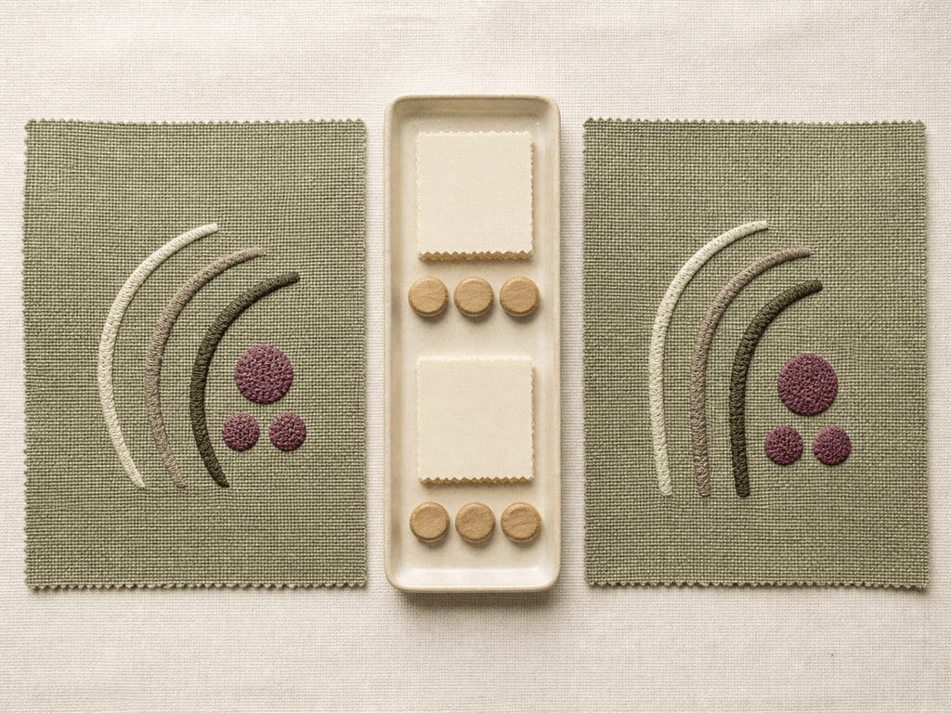
THEORY 3 OF 3
Enhancement purpose and surface effect
01 Enhancement purpose and surface effect
02 Efficiency and quality are broader judgements
03 Evidence-based comparison and qualified choice
EVIDENCE Complete “Anonymous quality-control sampling challenge” and justify one decision.
Notice which visible evidence supports the section’s key relationship.
5
Notes:
Explain the three relationships in plain language, then pause on the image. Ask students what they can observe directly and which conclusion still needs source evidence or a reasoned link.
[Sources]
- SRC-WWHS-SYL-2013: authorised course source.
- SRC-WWHS-INNOVATIONS-PROGRAM: authorised course source.
- SRC-WWHS-TERM2-2024: authorised course source.
- SRC-WWHS-SCOPE-2023-24: authorised course source.
- course-content.js: m11s03, local source-grounded learning package.
- Generated visual: assets/images/m11s03.png, image-generation tool, 30 August 2026.

Slide 6
Retrieve the relationship—not just the definition
Answer aloud or write one precise evidence-based sentence for each prompt.
01
02
03
SECTION 1
Use evidence to explain: Machinery and production technologies
SECTION 2
Use evidence to explain: Seamless technology and construction change
SECTION 3
Use evidence to explain: Decorative enhancement, efficiency and quality
6
Notes:
Use this as a formative pause. Invite one precise sentence for each prompt, then send students back to the matching theory when their explanation names a fact without showing the relationship.
[Sources]
- SRC-WWHS-SYL-2013: authorised course source.
- SRC-WWHS-INNOVATIONS-PROGRAM: authorised course source.
- SRC-WWHS-TERM2-2024: authorised course source.
- SRC-WWHS-SCOPE-2023-24: authorised course source.
- course-content.js: m11, local source-grounded learning package.

Slide 7
Build a response that shows your thinking
Prompt: Evaluate the suitability of conventional and technology-supported decorative enhancement for a fictional textile end use, using evidence about surface effect, accuracy, efficiency, quality and material response to make a qualified judgement.
READ
Identify the command term and exact relationship.
SELECT
Choose relevant course evidence.
EXPLAIN
Connect the evidence to the textile decision.
CHECK
Make a supported judgement and answer every part.
Sentence starter: The evidence shows ____. This matters because ____. Therefore ____.
7
Notes:
Model the response process without supplying a finished answer. Keep the talk track moving from the command term to relevant evidence, connected explanation and a final check against the prompt.
[Sources]
- SRC-WWHS-SYL-2013: authorised course source.
- SRC-WWHS-INNOVATIONS-PROGRAM: authorised course source.
- SRC-WWHS-TERM2-2024: authorised course source.
- SRC-WWHS-SCOPE-2023-24: authorised course source.
- course-content.js: m11s03, local source-grounded learning package.

Slide 8
YOUR NEXT MOVE
Exit ticket: carry one decision forward
1. Name one relationship you can now explain.
2. Record the evidence that makes your reasoning convincing.
3. Save one module response or activity, then carry useful evidence into My folio.
Notes:
Finish with one spoken or written exit response. Direct students to save one formative record in the module and carry only purposeful evidence into My folio; no formal submission condition is asserted here.
[Sources]
- SRC-WWHS-SYL-2013: authorised course source.
- SRC-WWHS-INNOVATIONS-PROGRAM: authorised course source.
- SRC-WWHS-TERM2-2024: authorised course source.
- SRC-WWHS-SCOPE-2023-24: authorised course source.
- course-content.js: m11s01, local source-grounded learning package.
- Generated visual: assets/images/m11s01.png, image-generation tool, 30 August 2026.

