Slide 1
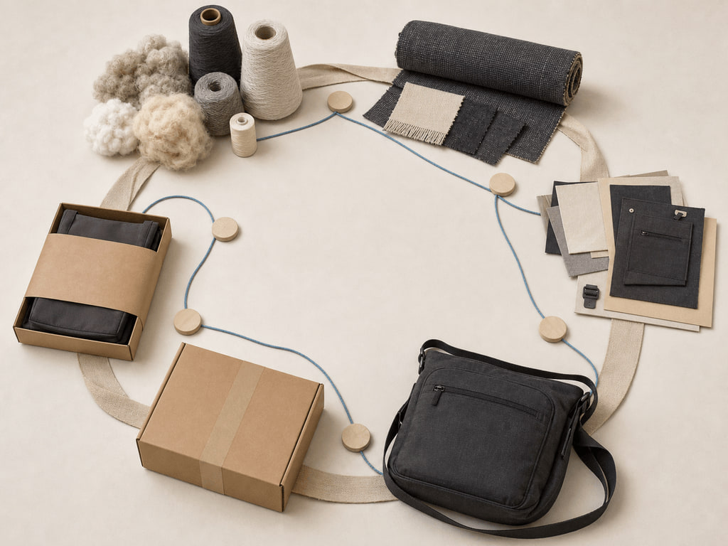
YEAR 12 TEXTILES AND DESIGN · MODULE 13 · TERM 3
The Australian Textiles Industry and Marketplace
Maps Australian textile-industry sectors and supply relationships, then connects product development, marketing and…
BEFORE YOU BEGIN
A student maps a fictional textile product as separate boxes for supplier, designer, manufacturer, distributor…
Notes:
Open with the retrieval question and give students quiet thinking time. Frame Module 13 as part of the concurrent Year 12 strands of theory, Major Textiles Project thinking and examination preparation.
[Sources]
- SRC-WWHS-SYL-2013: authorised course source.
- SRC-WWHS-INDUSTRY-PROGRAM: authorised course source.
- SRC-WWHS-TERM3-2024: authorised course source.
- SRC-WWHS-SCOPE-2023-24: authorised course source.
- course-content.js: m13s01, local source-grounded learning package.
- Generated visual: assets/images/m13s01.png, image-generation tool, 30 August 2026.

Slide 2
Three sections build The Australian Textiles Industry and Marketplace
Move from source-grounded knowledge → visible evidence → a supported textile decision.
01
02
03
Industry sectors and supply relationships
Connect the key idea to visible evidence and a supported textile decision.
Marketplace, product development and marketing
Connect the key idea to visible evidence and a supported textile decision.
Workplace, consumer and global links
Connect the key idea to visible evidence and a supported textile decision.
2
Notes:
Preview the three named sections as one reasoning sequence. Ask students to listen for the evidence relationship that carries from one section into the next.
[Sources]
- SRC-WWHS-SYL-2013: authorised course source.
- SRC-WWHS-INDUSTRY-PROGRAM: authorised course source.
- SRC-WWHS-TERM3-2024: authorised course source.
- SRC-WWHS-SCOPE-2023-24: authorised course source.
- course-content.js: m13, local source-grounded learning package.

Slide 3
THEORY 1 OF 3
Australian Textiles, Clothing.
01 Australian Textiles, Clothing, Footwear and Allied Industries
02 Sector relationships and flows
03 Using dated evidence for current claims
EVIDENCE Complete “Build the supply network” and justify one decision.
Notice which visible evidence supports the section’s key relationship.
3
Notes:
Explain the three relationships in plain language, then pause on the image. Ask students what they can observe directly and which conclusion still needs source evidence or a reasoned link.
[Sources]
- SRC-WWHS-SYL-2013: authorised course source.
- SRC-WWHS-INDUSTRY-PROGRAM: authorised course source.
- SRC-WWHS-TERM3-2024: authorised course source.
- SRC-WWHS-SCOPE-2023-24: authorised course source.
- course-content.js: m13s01, local source-grounded learning package.
- Generated visual: assets/images/m13s01.png, image-generation tool, 30 August 2026.

Slide 4

THEORY 2 OF 3
Target market and product development
01
01 Target market and product development
02
02 Connected marketing-mix decisions
03
03 Life-cycle position and evidence
EVIDENCE Complete “Marketing-mix constraint swap” and justify one decision.
4
Notes:
Explain the three relationships in plain language, then pause on the image. Ask students what they can observe directly and which conclusion still needs source evidence or a reasoned link.
[Sources]
- SRC-WWHS-SYL-2013: authorised course source.
- SRC-WWHS-INDUSTRY-PROGRAM: authorised course source.
- SRC-WWHS-TERM3-2024: authorised course source.
- SRC-WWHS-SCOPE-2023-24: authorised course source.
- course-content.js: m13s02, local source-grounded learning package.
- Generated visual: assets/images/m13s02.png, image-generation tool, 30 August 2026.

Slide 5

THEORY 3 OF 3
Connected influences across the industry
01 Connected influences across the industry
02 Tracing stakeholder effects and trade-offs
03 Product communication as a connected decision
EVIDENCE Complete “Stakeholder consequence carousel” and justify one decision.
Notice which visible evidence supports the section’s key relationship.
5
Notes:
Explain the three relationships in plain language, then pause on the image. Ask students what they can observe directly and which conclusion still needs source evidence or a reasoned link.
[Sources]
- SRC-WWHS-SYL-2013: authorised course source.
- SRC-WWHS-INDUSTRY-PROGRAM: authorised course source.
- SRC-WWHS-TERM3-2024: authorised course source.
- SRC-WWHS-SCOPE-2023-24: authorised course source.
- course-content.js: m13s03, local source-grounded learning package.
- Generated visual: assets/images/m13s03.png, image-generation tool, 30 August 2026.

Slide 6
Retrieve the relationship—not just the definition
Answer aloud or write one precise evidence-based sentence for each prompt.
01
02
03
SECTION 1
Use evidence to explain: Industry sectors and supply relationships
SECTION 2
Use evidence to explain: Marketplace, product development and marketing
SECTION 3
Use evidence to explain: Workplace, consumer and global links
6
Notes:
Use this as a formative pause. Invite one precise sentence for each prompt, then send students back to the matching theory when their explanation names a fact without showing the relationship.
[Sources]
- SRC-WWHS-SYL-2013: authorised course source.
- SRC-WWHS-INDUSTRY-PROGRAM: authorised course source.
- SRC-WWHS-TERM3-2024: authorised course source.
- SRC-WWHS-SCOPE-2023-24: authorised course source.
- course-content.js: m13, local source-grounded learning package.

Slide 7
Build a response that shows your thinking
Prompt: Explain how a change in consumer demand for a fictional unbranded textile product could interact with sourcing, skills and workplace decisions, and explain how these changes could influence lead time, quality expectations and product communication. Keep conclusions conditional and identify evidence that would still be required.
READ
Identify the command term and exact relationship.
SELECT
Choose relevant course evidence.
EXPLAIN
Connect the evidence to the textile decision.
CHECK
Make a supported judgement and answer every part.
Sentence starter: The evidence shows ____. This matters because ____. Therefore ____.
7
Notes:
Model the response process without supplying a finished answer. Keep the talk track moving from the command term to relevant evidence, connected explanation and a final check against the prompt.
[Sources]
- SRC-WWHS-SYL-2013: authorised course source.
- SRC-WWHS-INDUSTRY-PROGRAM: authorised course source.
- SRC-WWHS-TERM3-2024: authorised course source.
- SRC-WWHS-SCOPE-2023-24: authorised course source.
- course-content.js: m13s03, local source-grounded learning package.

Slide 8
YOUR NEXT MOVE
Exit ticket: carry one decision forward
1. Name one relationship you can now explain.
2. Record the evidence that makes your reasoning convincing.
3. Save one module response or activity, then carry useful evidence into My folio.
Notes:
Finish with one spoken or written exit response. Direct students to save one formative record in the module and carry only purposeful evidence into My folio; no formal submission condition is asserted here.
[Sources]
- SRC-WWHS-SYL-2013: authorised course source.
- SRC-WWHS-INDUSTRY-PROGRAM: authorised course source.
- SRC-WWHS-TERM3-2024: authorised course source.
- SRC-WWHS-SCOPE-2023-24: authorised course source.
- course-content.js: m13s01, local source-grounded learning package.
- Generated visual: assets/images/m13s01.png, image-generation tool, 30 August 2026.

