Slide 1
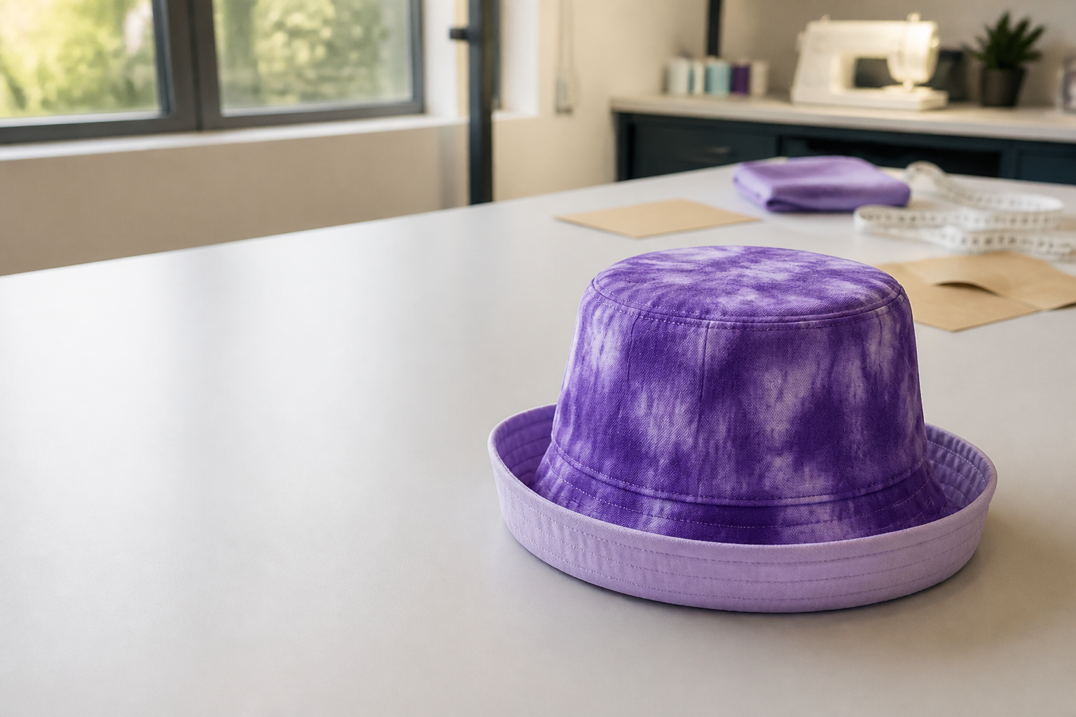
MODULE 01
Textiles with a purpose
Bucket Hat for a Cause
Year 7/8 Technology Mandatory • Textiles
Notes:
Introduce the lesson and ask students to predict how this topic will influence their own reversible hat.
[Sources]
- Bucket Hat for a Cause teacher program and 2026 class outline, Google Classroom/Drive, accessed 11 August 2026.
- Authorised Bucket Hat Teacher Edition images, Google Drive, accessed 11 August 2026.
[/Sources]

Slide 2
LEARNING MAP
Three ideas to take into the workshop
1
Textiles are engineered materials
2
Products communicate purpose
3
A cause needs evidence
BUCKET HAT FOR A CAUSE • MODULE 01
2
Notes:
Read the map aloud. Students choose the idea they already understand best and the one they need to watch closely.
[Sources]
- Bucket Hat for a Cause teacher program and 2026 class outline, Google Classroom/Drive, accessed 11 August 2026.
- Authorised Bucket Hat Teacher Edition images, Google Drive, accessed 11 August 2026.
[/Sources]

Slide 3
THEORY 1 OF 3
Textiles are engineered materials
NOTICE
What can you observe?
Write one evidence-backed sentence before moving on.
BUCKET HAT FOR A CAUSE • MODULE 01
3
Notes:
Teach: Textiles are engineered materials. Prompt students to move from observation to design consequence. The image is a discussion source, not decoration.
[Sources]
- Bucket Hat for a Cause teacher program and 2026 class outline, Google Classroom/Drive, accessed 11 August 2026.
- Authorised Bucket Hat Teacher Edition images, Google Drive, accessed 11 August 2026.
[/Sources]

Slide 4
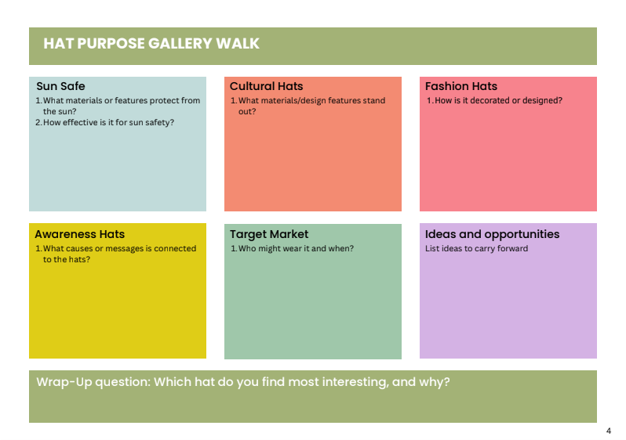
THEORY 2 OF 3
Products communicate purpose
CONNECT
How does it affect function, appearance or responsibility?
Write one evidence-backed sentence before moving on.
BUCKET HAT FOR A CAUSE • MODULE 01
4
Notes:
Teach: Products communicate purpose. Prompt students to move from observation to design consequence. The image is a discussion source, not decoration.
[Sources]
- Bucket Hat for a Cause teacher program and 2026 class outline, Google Classroom/Drive, accessed 11 August 2026.
- Authorised Bucket Hat Teacher Edition images, Google Drive, accessed 11 August 2026.
[/Sources]

Slide 5
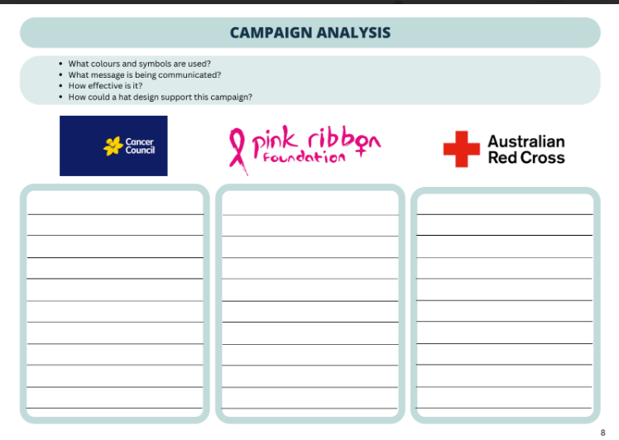
THEORY 3 OF 3
A cause needs evidence
DECIDE
What will you do in your own project?
Write one evidence-backed sentence before moving on.
BUCKET HAT FOR A CAUSE • MODULE 01
5
Notes:
Teach: A cause needs evidence. Prompt students to move from observation to design consequence. The image is a discussion source, not decoration.
[Sources]
- Bucket Hat for a Cause teacher program and 2026 class outline, Google Classroom/Drive, accessed 11 August 2026.
- Authorised Bucket Hat Teacher Edition images, Google Drive, accessed 11 August 2026.
[/Sources]

Slide 6
LEARNING CHECK
Can you apply the idea?
Which design decision would best demonstrate: “Products communicate purpose”?
Choose
Justify
Check evidence
BUCKET HAT FOR A CAUSE • MODULE 01
6
Notes:
Students answer independently, then compare justification with a partner. Accept different decisions when evidence is relevant and specific.
[Sources]
- Bucket Hat for a Cause teacher program and 2026 class outline, Google Classroom/Drive, accessed 11 August 2026.
- Authorised Bucket Hat Teacher Edition images, Google Drive, accessed 11 August 2026.
[/Sources]

Slide 7
WRITTEN RESPONSE
Use RSEC to build a strong paragraph
R
Respond
Answer the question directly
S
Support
Name a taught fact or observation
E
Explain
Show how it affects the design
C
Connect
Link back to purpose or criteria
BUCKET HAT FOR A CAUSE • MODULE 01
7
Notes:
Model an analogous response without answering the live question. Ask students to underline the factual support and circle the connection.
[Sources]
- Bucket Hat for a Cause teacher program and 2026 class outline, Google Classroom/Drive, accessed 11 August 2026.
- Authorised Bucket Hat Teacher Edition images, Google Drive, accessed 11 August 2026.
[/Sources]

Slide 8
EXIT TICKET
Leave with a decision
1
One new idea I can explain…
2
One action I will take in my folio or practical work…
Save your evidence before you leave
BUCKET HAT FOR A CAUSE • MODULE 01
8
Notes:
Use these two statements as a quick readiness check. Direct students back to the precise theory section if their answer is vague.
[Sources]
- Bucket Hat for a Cause teacher program and 2026 class outline, Google Classroom/Drive, accessed 11 August 2026.
- Authorised Bucket Hat Teacher Edition images, Google Drive, accessed 11 August 2026.
[/Sources]

