Slide 1
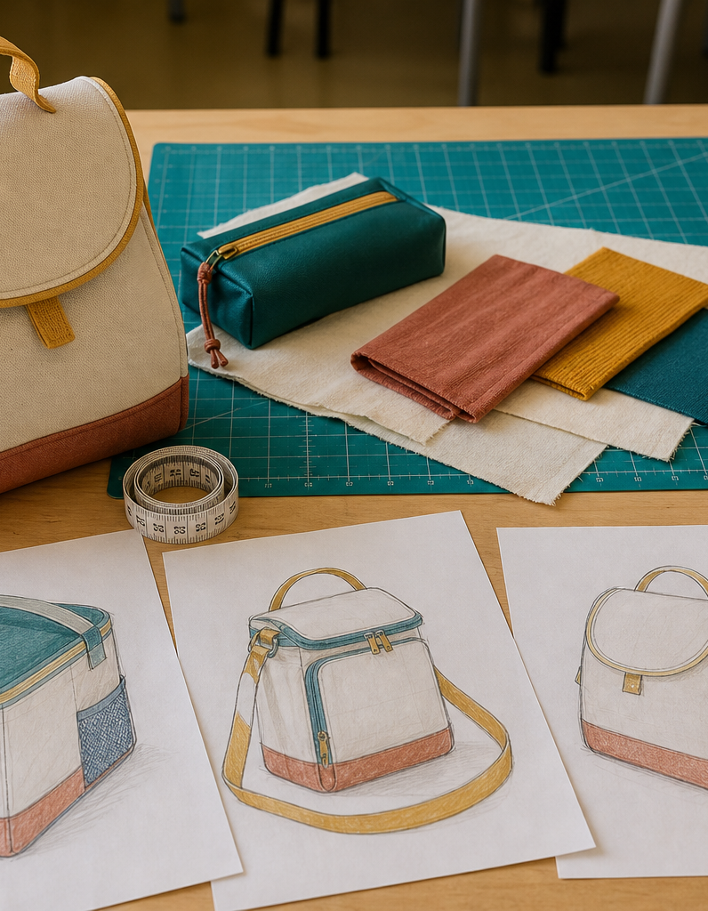
MODULE 1 OF 10
The design challenge
Understand the need, user and evidence before designing a lunch bag.
Year 7/8 Technology Mandatory · Student learning presentation
Notes:
Open by connecting this module to the student project and current teacher instructions.
[Sources]
- Lunch Is Packed authorised Classroom and Drive teaching sequence, inspected 11 August 2026.
- NSW Education Standards Authority, Technology 7–8 (2023): https://curriculum.nsw.edu.au/learning-areas/tas/technology-7-8-2023/overview

Slide 2
LUNCH IS PACKED
MODULE 1 · LEARNING PATH
Three ideas build one design decision
Read, notice, explain and apply each section in order.
1
1.1 Need statement and design brief
2
1.2 Users and real needs
3
1.3 Criteria, constraints and evidence
Notes:
[Sources]
- Lunch Is Packed authorised Classroom and Drive teaching sequence, inspected 11 August 2026.
- NSW Education Standards Authority, Technology 7–8 (2023): https://curriculum.nsw.edu.au/learning-areas/tas/technology-7-8-2023/overview

Slide 3
LUNCH IS PACKED
MODULE 1 · SECTION 1.1
1.1 Need statement and design brief
Key ideas to understand before you write.
1
A need statement explains the problem or opportunity.
2
It identifies the product, intended user and important qualities without locking the designer into one answer.
3
Ask: What must this solution achieve, and what is still mine to decide?
Notes:
[Sources]
- Lunch Is Packed authorised Classroom and Drive teaching sequence, inspected 11 August 2026.
- NSW Education Standards Authority, Technology 7–8 (2023): https://curriculum.nsw.edu.au/learning-areas/tas/technology-7-8-2023/overview

Slide 4
LUNCH IS PACKED
MODULE 1 · APPLY THE THEORY
Make the theory visible
Rewrite the Lunch Is Packed design brief in your own words.
WHAT THIS IS ASKING
Name the product, intended user and important qualities without inventing dimensions or materials.
STARTER
The task is to design a reusable lunch bag for… It needs to…
Return to the matching website section, complete the ten checks, then save your response.
Notes:
Students should write their own response. The website provides steps and an appropriate response example without revealing quiz answers.
[Sources]
- Lunch Is Packed authorised Classroom and Drive teaching sequence, inspected 11 August 2026.
- NSW Education Standards Authority, Technology 7–8 (2023): https://curriculum.nsw.edu.au/learning-areas/tas/technology-7-8-2023/overview

Slide 5
LUNCH IS PACKED
MODULE 1 · SECTION 1.2
1.2 Users and real needs
Key ideas to understand before you write.
1
Good design begins with people.
2
Before lunch, the bag must be packed and carried.
3
This prevents a design from becoming a collection of untested extras.
Notes:
[Sources]
- Lunch Is Packed authorised Classroom and Drive teaching sequence, inspected 11 August 2026.
- NSW Education Standards Authority, Technology 7–8 (2023): https://curriculum.nsw.edu.au/learning-areas/tas/technology-7-8-2023/overview

Slide 6
LUNCH IS PACKED
MODULE 1 · APPLY THE THEORY
Use evidence, not guesses
Explain four user needs and two maker needs for this project.
WHAT THIS IS ASKING
Name what the student using the bag requires and what the student making it requires.
STARTER
The intended user needs… The maker needs…
Return to the matching website section, complete the ten checks, then save your response.
Notes:
Students should write their own response. The website provides steps and an appropriate response example without revealing quiz answers.
[Sources]
- Lunch Is Packed authorised Classroom and Drive teaching sequence, inspected 11 August 2026.
- NSW Education Standards Authority, Technology 7–8 (2023): https://curriculum.nsw.edu.au/learning-areas/tas/technology-7-8-2023/overview

Slide 7
LUNCH IS PACKED
MODULE 1 · SECTION 1.3
1.3 Criteria, constraints and evidence
Key ideas to understand before you write.
1
Criteria describe how success will be judged.
2
Strong criteria name a feature, an expected performance and a way to observe it.
3
Constraints should describe actual boundaries, not excuses.
Notes:
[Sources]
- Lunch Is Packed authorised Classroom and Drive teaching sequence, inspected 11 August 2026.
- NSW Education Standards Authority, Technology 7–8 (2023): https://curriculum.nsw.edu.au/learning-areas/tas/technology-7-8-2023/overview

Slide 8
MODULE 1 REVIEW
Show what you understand.
1. Revisit all three theory sections.
2. Complete 30 knowledge checks and three guided responses.
3. Continue the Design brief evidence lab and keep authentic evidence.
Exact practical instructions and formal submission arrangements: Teacher to confirm.
Notes:
Use the website module and project activity for the interactive evidence tasks.
[Sources]
- Lunch Is Packed authorised Classroom and Drive teaching sequence, inspected 11 August 2026.
- NSW Education Standards Authority, Technology 7–8 (2023): https://curriculum.nsw.edu.au/learning-areas/tas/technology-7-8-2023/overview

