Slide 1
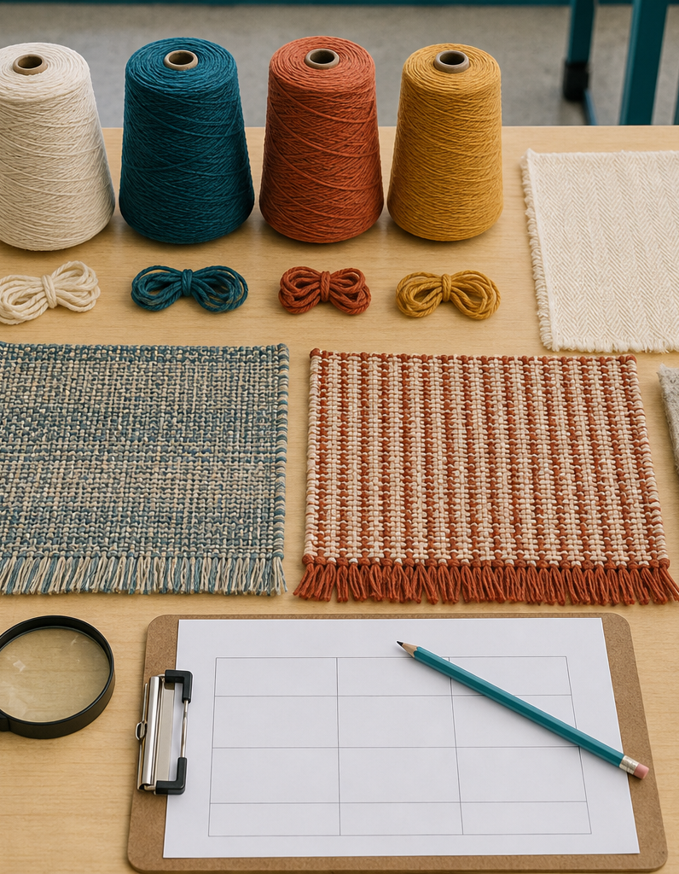
MODULE 2 OF 10
Textiles around us
Understand textile products, fibres, fabrics and useful properties.
Year 7/8 Technology Mandatory · Student learning presentation
Notes:
Open by connecting this module to the student project and current teacher instructions.
[Sources]
- Lunch Is Packed authorised Classroom and Drive teaching sequence, inspected 11 August 2026.
- NSW Education Standards Authority, Technology 7–8 (2023): https://curriculum.nsw.edu.au/learning-areas/tas/technology-7-8-2023/overview

Slide 2
LUNCH IS PACKED
MODULE 2 · LEARNING PATH
Three ideas build one design decision
Read, notice, explain and apply each section in order.
1
2.1 Textiles in everyday life
2
2.2 From fibre to fabric
3
2.3 Selecting by properties
Notes:
[Sources]
- Lunch Is Packed authorised Classroom and Drive teaching sequence, inspected 11 August 2026.
- NSW Education Standards Authority, Technology 7–8 (2023): https://curriculum.nsw.edu.au/learning-areas/tas/technology-7-8-2023/overview

Slide 3
LUNCH IS PACKED
MODULE 2 · SECTION 2.1
2.1 Textiles in everyday life
Key ideas to understand before you write.
1
Textiles are flexible materials made from fibres, yarns, fabrics or combinations of these.
2
Textile products are systems, not just pieces of fabric.
3
When investigating a product, move from name it to explain it : identify the component, state its function, name the property that supports that function and note a p…
Notes:
[Sources]
- Lunch Is Packed authorised Classroom and Drive teaching sequence, inspected 11 August 2026.
- NSW Education Standards Authority, Technology 7–8 (2023): https://curriculum.nsw.edu.au/learning-areas/tas/technology-7-8-2023/overview

Slide 4
LUNCH IS PACKED
MODULE 2 · APPLY THE THEORY
Make the theory visible
Identify six textile products and explain one property each product needs.
WHAT THIS IS ASKING
Choose products from more than one context and connect property to function.
STARTER
A… is a textile product used for… It needs… because…
Return to the matching website section, complete the ten checks, then save your response.
Notes:
Students should write their own response. The website provides steps and an appropriate response example without revealing quiz answers.
[Sources]
- Lunch Is Packed authorised Classroom and Drive teaching sequence, inspected 11 August 2026.
- NSW Education Standards Authority, Technology 7–8 (2023): https://curriculum.nsw.edu.au/learning-areas/tas/technology-7-8-2023/overview

Slide 5
LUNCH IS PACKED
MODULE 2 · SECTION 2.2
2.2 From fibre to fabric
Key ideas to understand before you write.
1
A fibre is the smallest hair-like unit.
2
Woven structures usually show two sets of yarns crossing at right angles.
3
Structure does not determine every property, but it gives useful clues.
Notes:
[Sources]
- Lunch Is Packed authorised Classroom and Drive teaching sequence, inspected 11 August 2026.
- NSW Education Standards Authority, Technology 7–8 (2023): https://curriculum.nsw.edu.au/learning-areas/tas/technology-7-8-2023/overview

Slide 6
LUNCH IS PACKED
MODULE 2 · APPLY THE THEORY
Use evidence, not guesses
Explain the difference between fibre, yarn and fabric.
WHAT THIS IS ASKING
Describe the sequence and give one woven, knitted or bonded example.
STARTER
A fibre is… Fibres can become… Fabric is formed when…
Return to the matching website section, complete the ten checks, then save your response.
Notes:
Students should write their own response. The website provides steps and an appropriate response example without revealing quiz answers.
[Sources]
- Lunch Is Packed authorised Classroom and Drive teaching sequence, inspected 11 August 2026.
- NSW Education Standards Authority, Technology 7–8 (2023): https://curriculum.nsw.edu.au/learning-areas/tas/technology-7-8-2023/overview

Slide 7
LUNCH IS PACKED
MODULE 2 · SECTION 2.3
2.3 Selecting by properties
Key ideas to understand before you write.
1
Designers compare properties such as strength, flexibility, thickness, absorbency, durability, handle, appearance and ease of care.
2
A thick material may offer body but be harder to fold accurately.
3
Give more importance to properties that directly affect function and safe construction, then explain why the chosen balance suits the brief.
Notes:
[Sources]
- Lunch Is Packed authorised Classroom and Drive teaching sequence, inspected 11 August 2026.
- NSW Education Standards Authority, Technology 7–8 (2023): https://curriculum.nsw.edu.au/learning-areas/tas/technology-7-8-2023/overview

Slide 8
MODULE 2 REVIEW
Show what you understand.
1. Revisit all three theory sections.
2. Complete 30 knowledge checks and three guided responses.
3. Continue the Textile sample investigation and keep authentic evidence.
Exact practical instructions and formal submission arrangements: Teacher to confirm.
Notes:
Use the website module and project activity for the interactive evidence tasks.
[Sources]
- Lunch Is Packed authorised Classroom and Drive teaching sequence, inspected 11 August 2026.
- NSW Education Standards Authority, Technology 7–8 (2023): https://curriculum.nsw.edu.au/learning-areas/tas/technology-7-8-2023/overview

